Slide 1
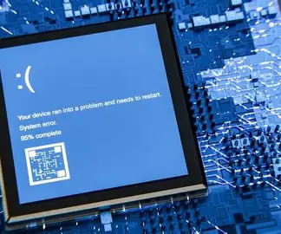
How One Software Update Crashed the World
SIMON
PPT
The CrowdStrike Global IT Outage
July 19, 2024
Presented by:
Howard
Aayou

Slide 2

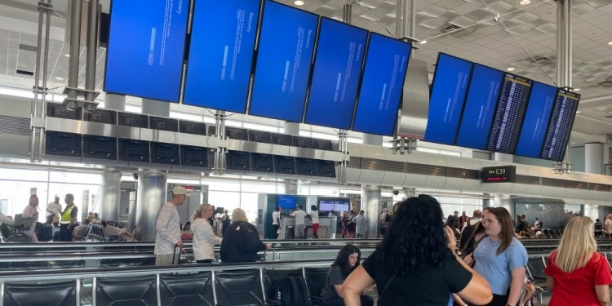
• CrowdStrike released a software update • The update contained an error • Millions of Windows computers crashed • Many systems showed the Blue Screen of Death (BSOD)
GLOBAL IMPACT
• CrowdStrike released a software update
• The update contained an error
• Millions of Windows computers crashed
• Many systems showed the Blue Screen of
Death (BSOD)

Slide 3


What should happen
What happended
Code Change
↓
Testing
↓
Code Review
↓
Staged Rollout
↓
Safe Release
Code Change
↓
Faulty Update
↓
Global Release
↓
System Crash
• The update contained a defect
• It was deployed globally
• Millions of systems received it immediately
• Windows computers crashed
• Test before deployment
• Review code changes
• Release gradually
• Monitor systems after updates
Notes:
6334ff4a-ca45-4394-b632-53e3e8128f2f.source.3.zh-Hans

