Slide 1
VĀYAS LIFE / CREATIVE RESEARCH
META ADS
COMPETITIVE CREATIVE RESEARCH
Calcium supplements for women
What competitors say, how they say it, and where Vāyas Life can differentiate.
PREPARED BY / KANISHK PRABHAT
01

Slide 2
EVALUATION FRAMEWORK
How to read this review
A structured creative assessment—not a claim about campaign performance.
01
HOOK & ATTENTION
02
AUDIENCE RELEVANCE
03
STORY + PRODUCT
Does the opening create a reason to stop and look?
Is the intended audience or need recognisable?
Does the product fit naturally into the creative?
04
MESSAGE CLARITY
05
STRUCTURE + ACTION
Is the main proposition focused and differentiated?
Does the ad progress logically and give a next step?
SCORING NOTE
Each ad receives up to 5 points per criterion (25 total). Scores are subjective creative-strategy judgements based on observable ad elements—not CTR, conversions, sales, ROAS, or proof that an ad performed well.
Research discipline: separate what is visibly present from interpretation; do not repeat medical or efficacy claims without substantiation.
VĀYAS LIFE / STATIC AD COMPETITIVE REVIEW
02

Slide 3
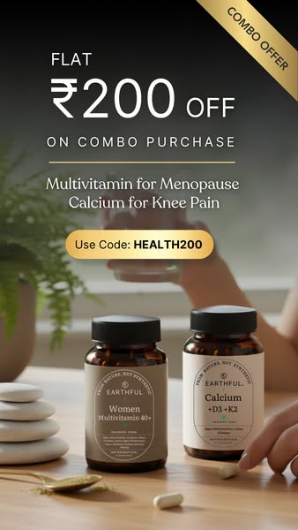
STATIC AD REVIEW / 01
EARTHFUL
LIFE-STAGE + COMBO OFFER • QUALITATIVE CREATIVE ASSESSMENT 19/25
“Multivitamin for Menopause + Calcium for Knee Pain”
WHY IT WORKS
WHERE IT FALLS SHORT
• Names a recognisable life stage instead of speaking to every supplement buyer.
• Combines two products into a contextual bundle and makes the ₹200 offer visible.
• The product and offer can be understood quickly in a feed.
• The menopause and knee-pain message risks implying a simple causal relationship.
• Two products and multiple concerns compete for one clear promise.
• The visual is conventional product-led ecommerce rather than a distinctive story.
TAKEAWAY FOR VĀYAS
Keep the life-stage specificity, but make the product role and one substantiated benefit unmistakable.
OPEN ORIGINAL META AD ↗
VĀYAS LIFE / STATIC AD COMPETITIVE REVIEW
03

Slide 4
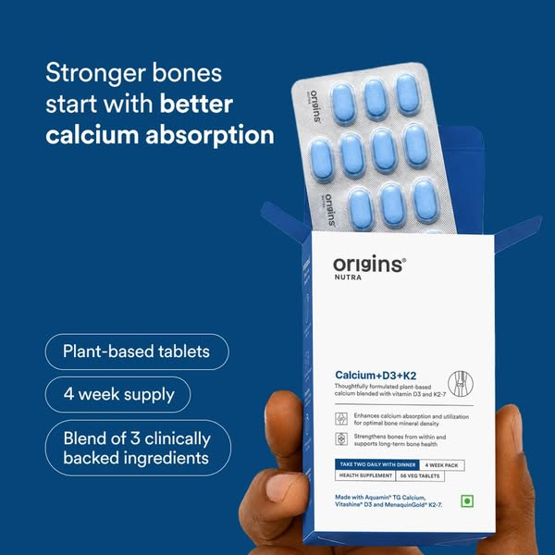
STATIC AD REVIEW / 02
ORIGINS NUTRA
ABSORPTION + FORMULATION • QUALITATIVE CREATIVE ASSESSMENT 18/25
“Stronger bones start with better calcium absorption.”
WHY IT WORKS
WHERE IT FALLS SHORT
• One dominant proposition gives the viewer a clear reason to look.
• Calcium + D3 + K2 and the three short supporting points create a simple information hierarchy.
• The hand-held pack makes the product tangible and legible.
• The audience is broad, not specifically women.
• “Clinically backed” and absorption-related claims need evidence and careful qualification.
• The rational layout offers limited emotional or life-stage relevance.
TAKEAWAY FOR VĀYAS
Use one clear formulation story—not a long ingredient list—and substantiate any superiority claim.
OPEN ORIGINAL META AD ↗
VĀYAS LIFE / STATIC AD COMPETITIVE REVIEW
04

Slide 5
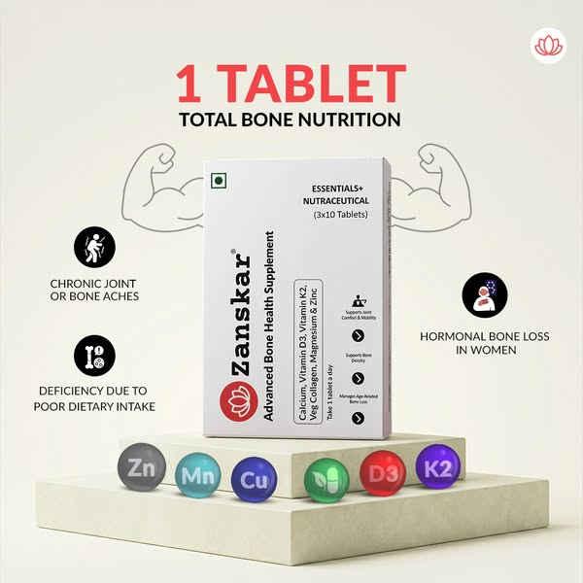
STATIC AD REVIEW / 03
ZANSKAR
COMPLETE BONE NUTRITION • QUALITATIVE CREATIVE ASSESSMENT 17/25
“1 tablet — total bone nutrition.”
WHY IT WORKS
WHERE IT FALLS SHORT
• The headline gives an immediate shorthand for the product proposition.
• The pack sits at the visual centre and the nutrient set supports the all-in-one idea.
• The creative gives several entry points into bone-health concerns.
• Ingredients, concerns and benefits compete for attention.
• The “70% Indians = Calcium Deficient” statistic needs independent verification.
• The message is not strongly tailored to women.
TAKEAWAY FOR VĀYAS
Completeness can differentiate, but simplify the hierarchy and avoid unverified statistics.
OPEN ORIGINAL META AD ↗
VĀYAS LIFE / STATIC AD COMPETITIVE REVIEW
05

Slide 6

STATIC AD REVIEW / 04
SWISSLIFE FOREVER
BONE HEALTH + BROADER WELLNESS • QUALITATIVE CREATIVE ASSESSMENT 17/25
“Strong bones. Stronger you.”
WHY IT WORKS
WHERE IT FALLS SHORT
• The line turns a functional benefit into a broader emotional promise.
• Bone imagery, botanical cues and an active-wellness aesthetic feel coherent.
• Pack size, price and delivery details make the offer concrete.
• Bone health, immunity, neural support, muscles, ingredients and price compete for attention.
• The creative is not women-specific.
• The breadth of benefit claims requires substantiation.
TAKEAWAY FOR VĀYAS
Keep one lead benefit; let supporting claims sit lower in the hierarchy instead of competing equally.
OPEN ORIGINAL META AD ↗
VĀYAS LIFE / STATIC AD COMPETITIVE REVIEW
06

Slide 7
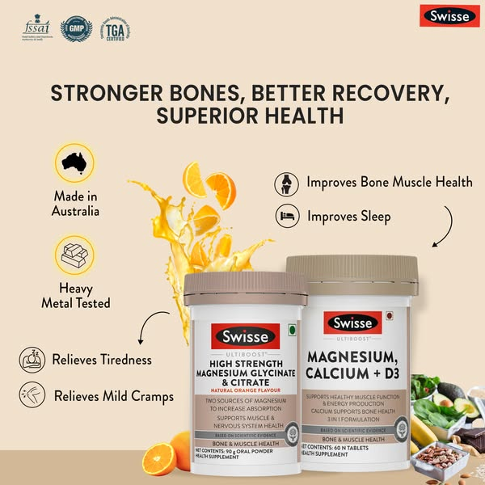
STATIC AD REVIEW / 05
SWISSE
PREMIUM BRAND TRUST • QUALITATIVE CREATIVE ASSESSMENT 16/25
“Stronger bones, better recovery, superior health.”
WHY IT WORKS
WHERE IT FALLS SHORT
• Established brand codes and Australian-origin cues can act as trust signals.
• Calcium + magnesium creates a broader formulation story.
• The packs are prominent and the presentation feels premium.
• The promise expands into recovery, sleep, tiredness and cramps.
• It is not built around a specific women’s need.
• Multiple functional claims dilute the main message and require substantiation.
TAKEAWAY FOR VĀYAS
Brand familiarity can support trust, but it cannot replace a focused, audience-relevant proposition.
OPEN ORIGINAL META AD ↗
VĀYAS LIFE / STATIC AD COMPETITIVE REVIEW
07

Slide 8
SYNTHESIS
Five ads, five different territories
This is a creative landscape—not a ranking of commercial performance.
BRAND
CREATIVE TERRITORY
WHAT IT USES
LEARNING FOR VĀYAS
EARTHFUL
Menopause / life stage
Personal relevance
One focused, substantiated need
ORIGINS NUTRA
Absorption / formulation
Clear rational proposition
Evidence-backed differentiation
ZANSKAR
Complete bone nutrition
All-in-one shorthand
Reduce claim and ingredient overload
SWISSLIFE FOREVER
Multi-benefit wellness
Emotional headline + offer
Choose a lead benefit
SWISSE
Premium brand trust
Brand cues + product visibility
Narrow the promise
EMERGING OPPORTUNITY
Move from “what is inside the bottle?” to “why does this matter to her?”—without claiming to treat symptoms or prevent disease.
VĀYAS LIFE / STATIC AD COMPETITIVE REVIEW
08

