Slide 1
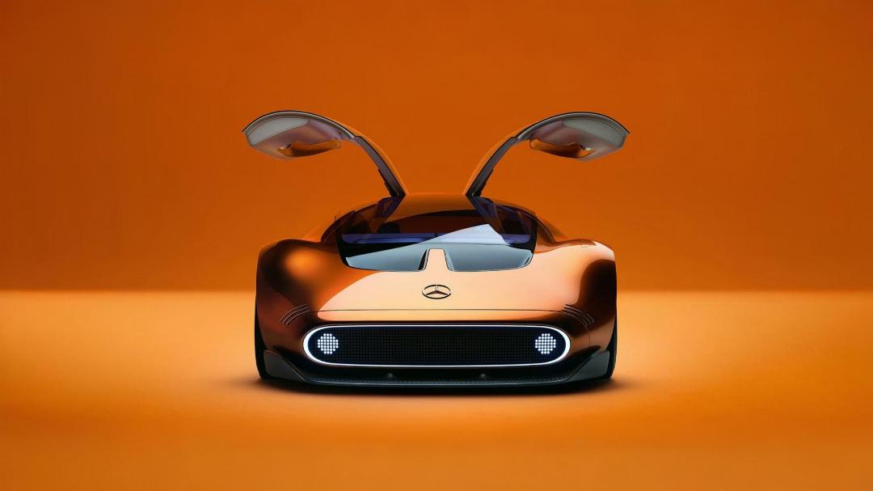

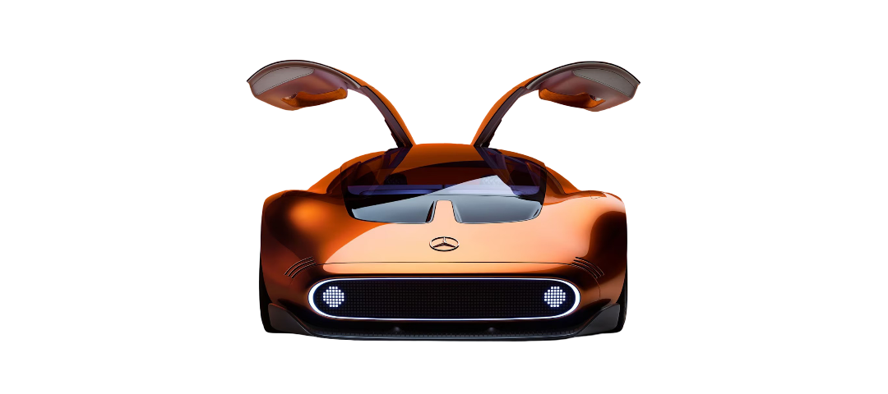


JAJS-Beans
Dhavala Venkata Aarush Avadhani (251333B)
Seth Su Junyi (250996K)
Javen Ho Jun Rui (251250D)
Koh Jun Kang(250963M)

Slide 2
Company Background
JAJS Beans, established in 1926
The company is named after its four founders(Javen, Aarush, Jun Kang and Seth)
JAJS Beans has pivoted and rebranded,
focusing on electric vehicles (EVs) and low-emission transport solutions for both private consumers and public-sector fleets
JAJS Beans is committed to improving public understanding and confidence through customer education.

Slide 3
Issue:
Consumers don’t realise the benefits of using EVs compared to petrol vehicles.
Don't understand the environmental impacts of their choice of vehicle.
users may be hesitant to purchase EVs.
Scratch:
Interactive pages with factual comparisons focused on key areas between EVs and petrol.
By: Javen

Slide 4

JAJS
background
by: Javen
next

Slide 5
JAJS
INFO
INFO
INFO
INFO
back
by: Javen

Slide 6
Quiz (Aarush)
Issue:
Users forget what they learn quickly
Users may forget what they learn about EVs
Scratch:
A quiz to reinforce learning and correct potential misconceptions

Slide 7
Quiz - Wireframe (Aarush)
By: Aarush
QUESTION
OPTION 1
OPTION 2
OPTION 3
OPTION 4
back
next

Slide 8
Game (Jun Kang)
Issue:
Users are avoiding electrical vehicles.
Assuming that there are not enough charging locations and electrical vehicles are not reliable in long distance driving
Scratch:
An electrical vehicle to travel and dodge obstacles and attempt to reach a high score

Slide 9
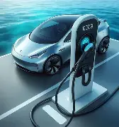

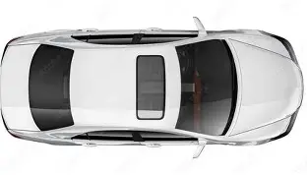
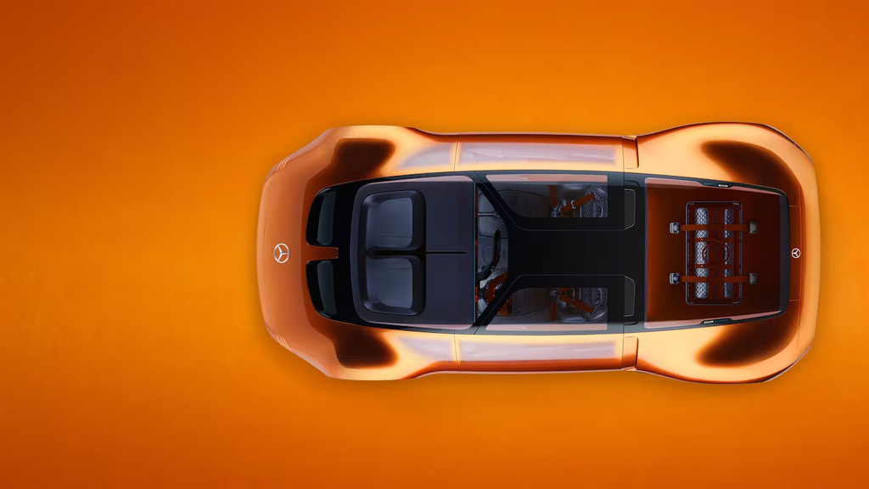
Game - Wireframe P1 (Jun Kang)
Petrol Car
Electrical Vehicle
Click your Favourite Car to start

Slide 10


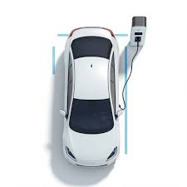

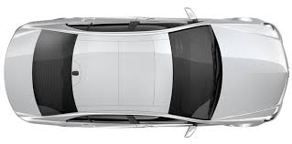
Game - Wireframe P2 (Jun Kang)
Score:10KM
Electric Vehicle Supply Equipment

Slide 11
Issue:
Lack of certainty from JAJS regarding effectiveness of game, introduction and quiz
Scratch:
A feedback form for users to give JAJS feedback on whether they understood the message presented to them, and where JAJS can improve on
By: Seth
By: Seth

Slide 12
Feedback
Question 1
Yes
No
Back
Next
By: Seth
By: Seth

Slide 13
Feedback
Question 2
1
10
Back
Next
By: Seth
By: Seth

Slide 14
Feedback
Question 3
1
Example 1
3
Example 2
2
Example 3
Back
Next
By: Seth
By: Seth

Slide 15
Feedback
Question 4
✔
Example 1
Example 2
✔
Example 3
Back
Next
By: Seth

