Slide 1




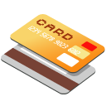

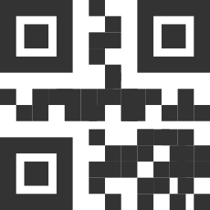
Payment receiver with a smartphone (PayPal user)
Payer with credit card
PayFive
Interaction
Flow
1. a. Scan payer’s credit card
1. b. Charge credit card (without saving the card info) to the receiver’s PayPal account
Payer (PayPal user, optionally)
2. a. Receiver creates QR with info
2. b. Payer scans QR
2. c. Payer pays using a credit card or PayPal

Slide 2


Charge credit card or send payment between PayPal accounts using PayPal Android library
PayFive
System Architecture
Scan credit card using card.io library
Generate and read QR code using Zxing and ZBar library
Android local storage (SQLite) stores menu items for street vendors

