Slide 1
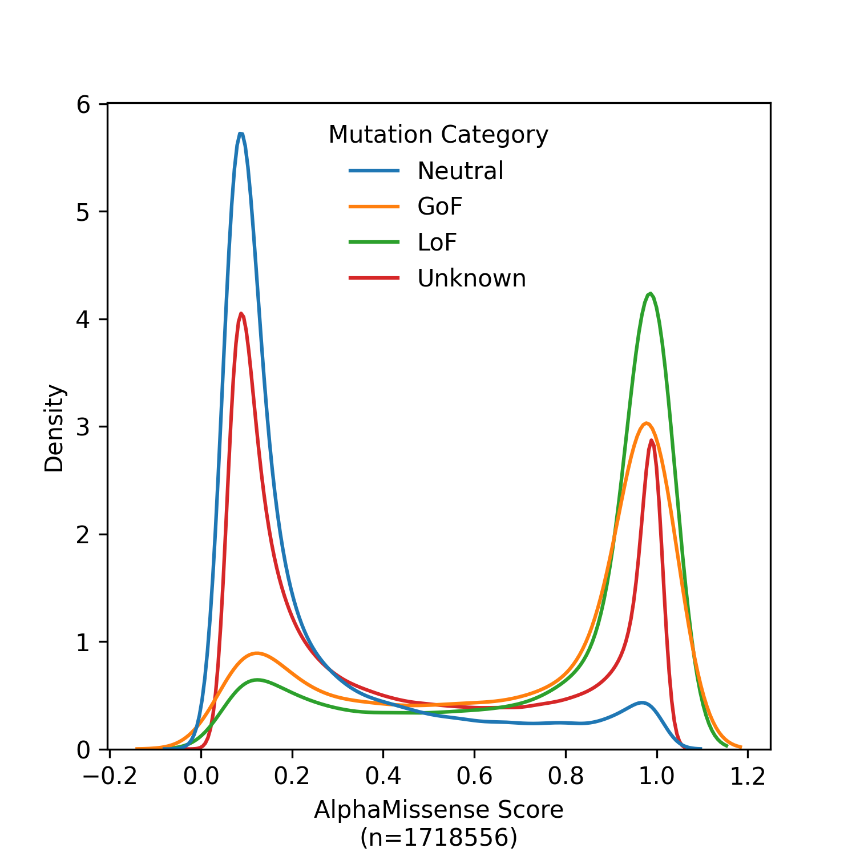
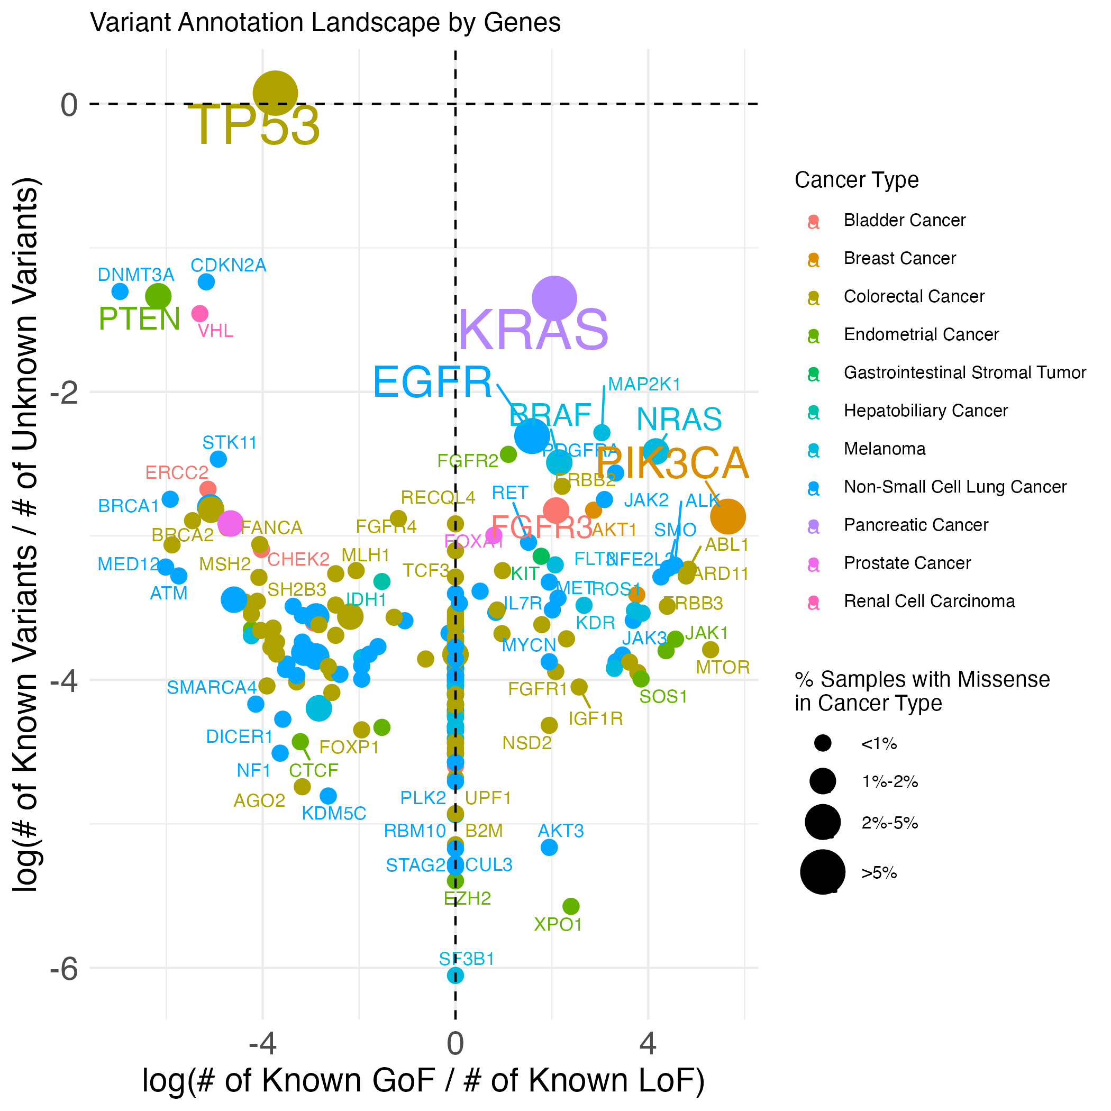
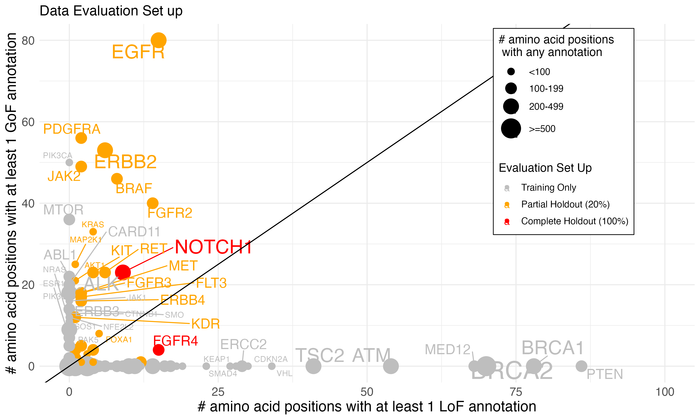
a)
b)
c)

Slide 2
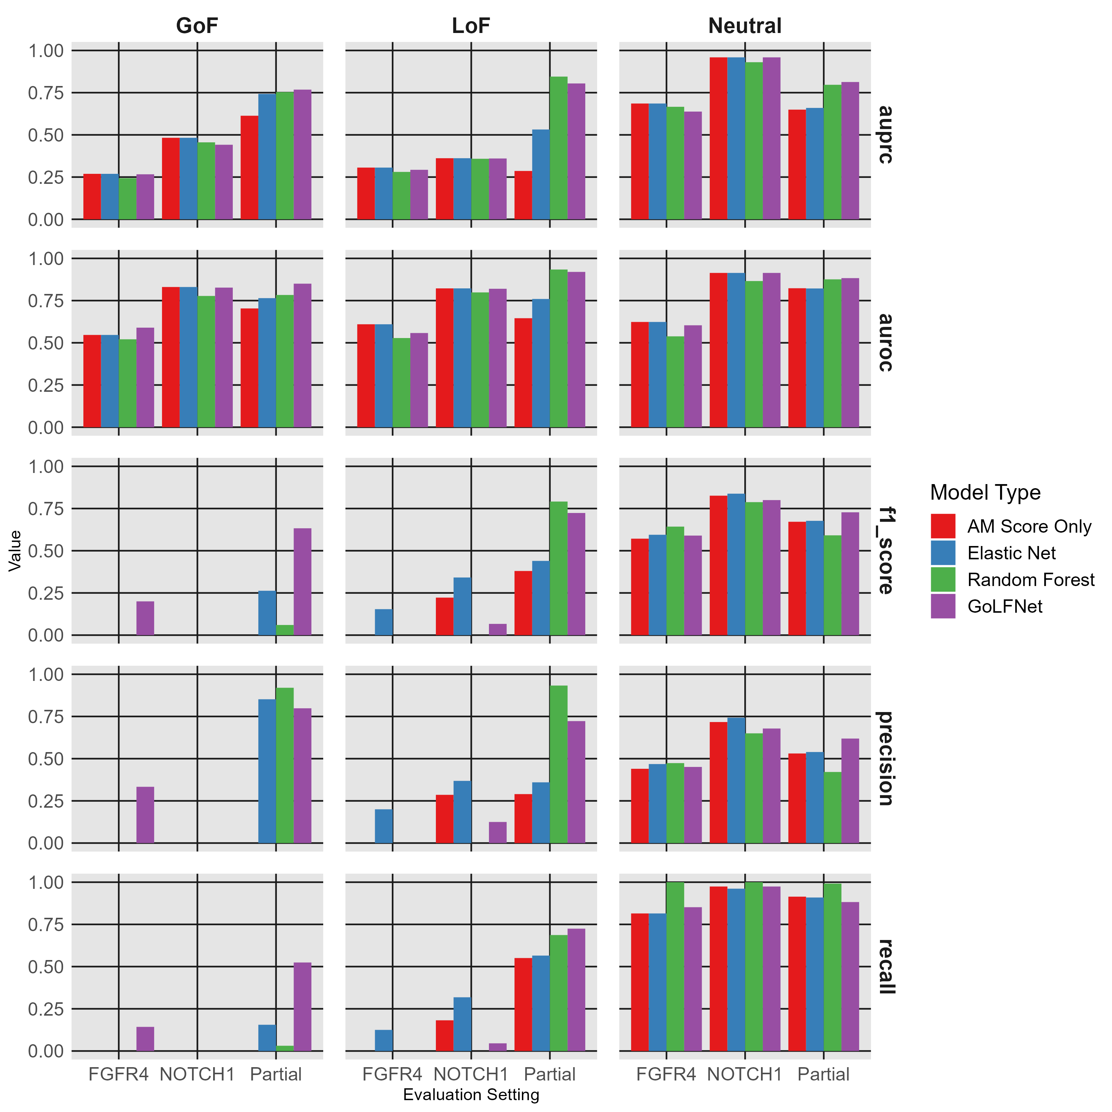
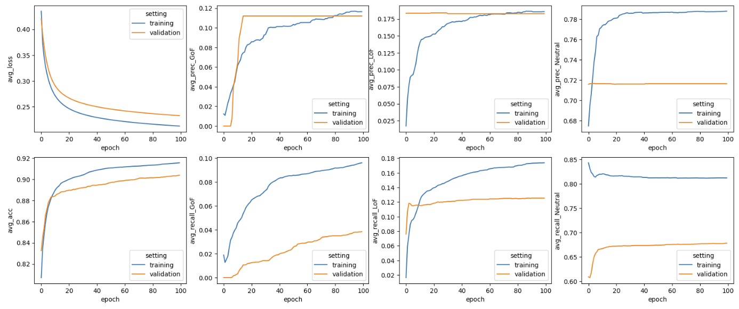
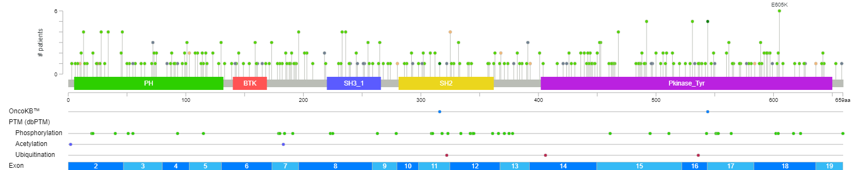
a)
c)
Mutated Amino Acid Sequence
Pretrained-ESM
(esm2_t36_3B_UR50D)
ESM Embedding
Dense
GoF
+
LoF
Other Mutation-specific Features
Neutral
b)
d)

