Slide 1
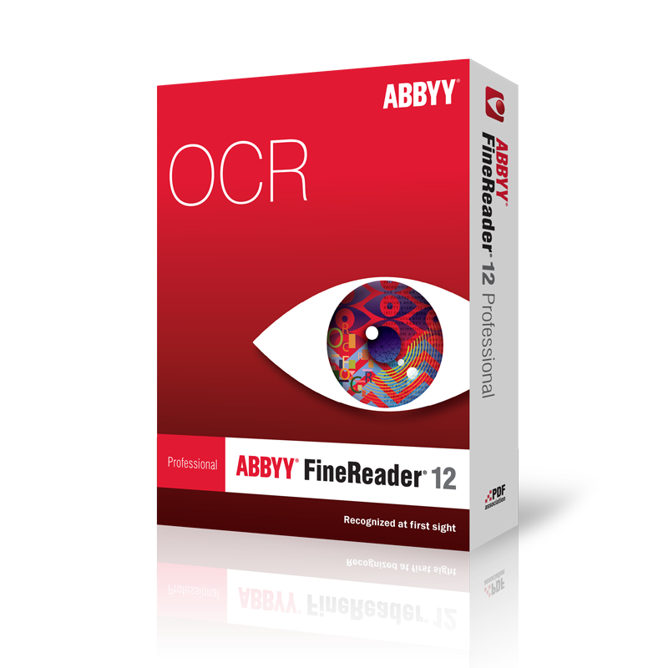
Introduction to ABBYY

Slide 2
Why do OCR?
OCR Quality on HathiTrust
Using ABBYY FineReader
- Loading a Document (pdf)
- Preparing the Pages
- Analyzing the Pages
- Recognizing the Pages
- Editing the Results
- Output to Text File

Slide 3
OCR Quality on HathiTrust
Some relatively good examples from 『早稲田文学』:
https://babel.hathitrust.org/cgi/pt?id=coo.31924095955450;view=1up;seq=7
https://babel.hathitrust.org/cgi/pt?id=coo.31924095955450;view=1up;seq=27;size=125
A bad example from the Keio Collection:
https://babel.hathitrust.org/cgi/pt?id=keio.10810269074;view=1up;seq=11

Slide 4
Steps for OCR in ABBYY
Open ABBYY FineReader
Select “Open in OCR Editor”
Select your pdf file (“ringo.pdf”)
- Files should ideally be scanned at 400dpi in black/white or grayscale
4) ABBYY will automatically try to recognize OCR areas in the document
- If the areas are acceptable, continue to step 5. Else, delete unwanted
areas by right-clicking on the area and selecting Delete.
- Also, be sure that your recognition language is set to “Japanese”
If there is an area not detected, choose Area → Draw Area → Text Area
from the file menu and draw a square over the section you want to scan.
If the page contains multiple areas to be recognized, it is important to set
the scan order. Click on Reorder in the menu and then click on all areas in
the order you want them to be scanned.
Click through each page on the left of the screen to make sure areas are
drawn properly. If you have a lot of pages, you may want to save an area
template (under Area) and the apply it to all pages (Load Area Template).

Slide 5
Steps for OCR in ABBYY (continued)
Explore the Tools → Options menu.
If the pages are not already recognized, select Recognize → Recognize All Pages. This will produce text output on the opposing page.
Edit the OCR results. Potentially mis-recognized items will be highlighted in blue. To correct a result, you can do one of the following:
- Manually input the correct result
- Right-click on the character and see if the correct solution appears
- For repeated mistakes, click on Ctrl-h to do a find and replace of the
whole document.
11) Select how you want the results to be output (generally a .txt file).
12) Save the results to a .txt file.
13) If you would like to continue editing the OCR file, save as an ABBYY OCR
project.

