Slide 1
News Classification NLP and Deep Learning
Hoyt Lui

Slide 2
Steps
Data Wrangling
Data preprocessing
Modeling – neural network
Testing
Predicting

Slide 3
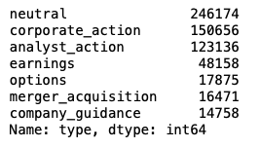
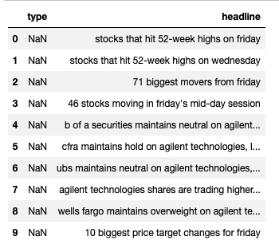
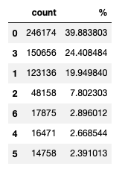
Data Wrangling
Classify news types in original dataset

Slide 4
Data Preprocessing
Train/test split
Tokenizer
Sequence padding

Slide 5
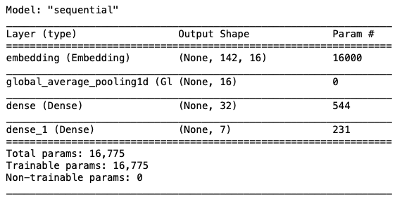
Modeling – Neural Network
Sequential
Global Average Pooling 1D

Slide 6
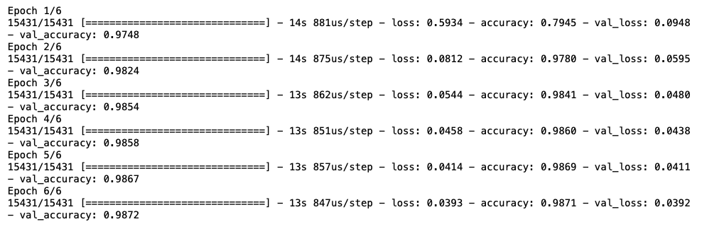
Modeling – Neural Network
Training and validating – 98.6-98.7% accuracy

Slide 7
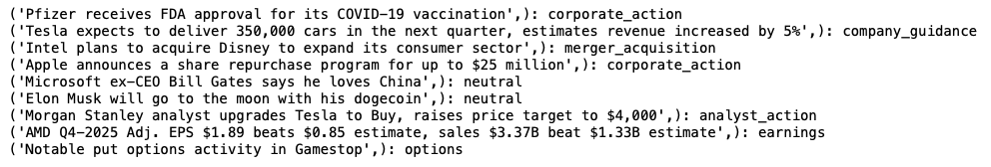
Testing
9/9 correct

Slide 8
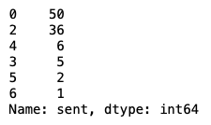
Predicting
Tesla (TSLA) – 100 recent news headlines

Slide 9
Takeaway
5th-6th time is the optimal for modeling building
A shy of 99% accuracy score
It correctly classifies the 9 sample headlines entered
It classifies 50 of 100 recent news headlines for Tesla as ‘neutral’

Slide 10
Further Work
Make the dataset more balanced by adding more news in the categories other than 'neutral', which has the key of 0 in sentiment dict.
Try other neural network models and add more layers to optimize the model.

