Slide 1

Real-Time Stock Recommendation System
Integrating Sentiment Analysis and Machine Learning
Group Members:
Hozefa Patel [N01686385]
Devkumar Ariwala [N01664568]
Jenil Pancholi [N01665133]

Slide 2
INTRODUCTION OF PROJECT
GOAL
IMPORTANCE
APPROACH
Develop a model to predict buy or sell signals for specific stocks, first analyzing movement averages and then considering real-time prices.
Helps traders make informed decisions by providing timely buy or sell recommendations based on historical trends and current market data
Models, trained on historical stock data and Twitter sentiment, first predicts using stock movement averages, then refines recommendations based on the current prices of specific stocks

Slide 3


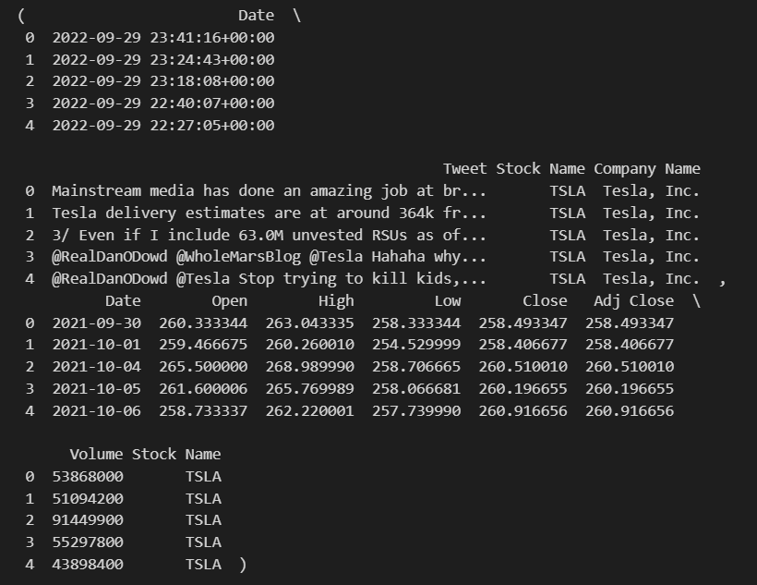
Data Collection and Preparation
stock_tweets.csv
stock_yfinance_data.csv

Slide 4
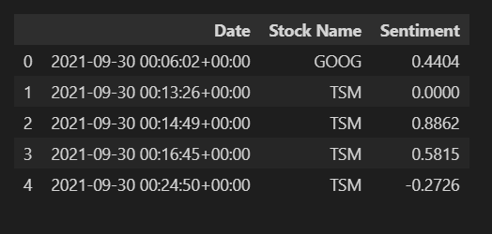
Sentiment Analysis using NLP Techniques

Slide 5
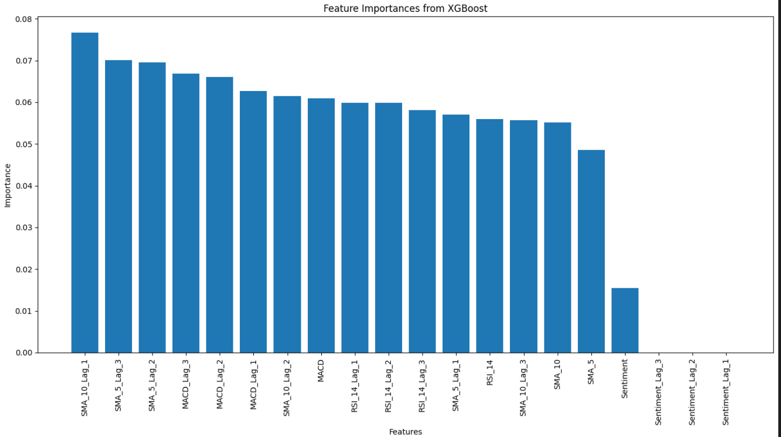
Feature Importances from XGBoost

Slide 6
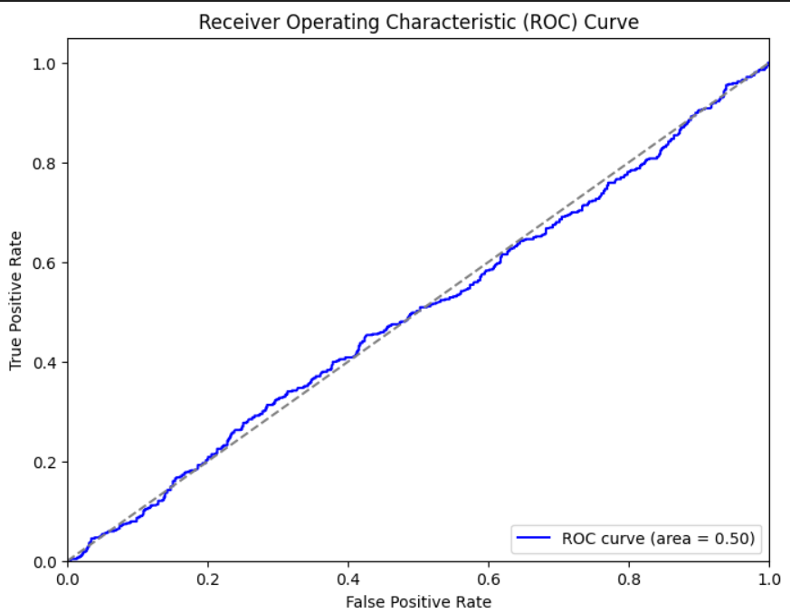
ROC CURVE

Slide 7
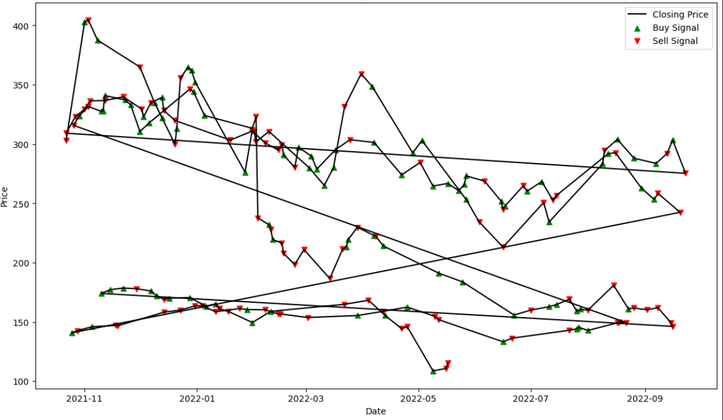
STOCK PRICE WITH BUY/SELL RECOMMENDATIONS

Slide 8
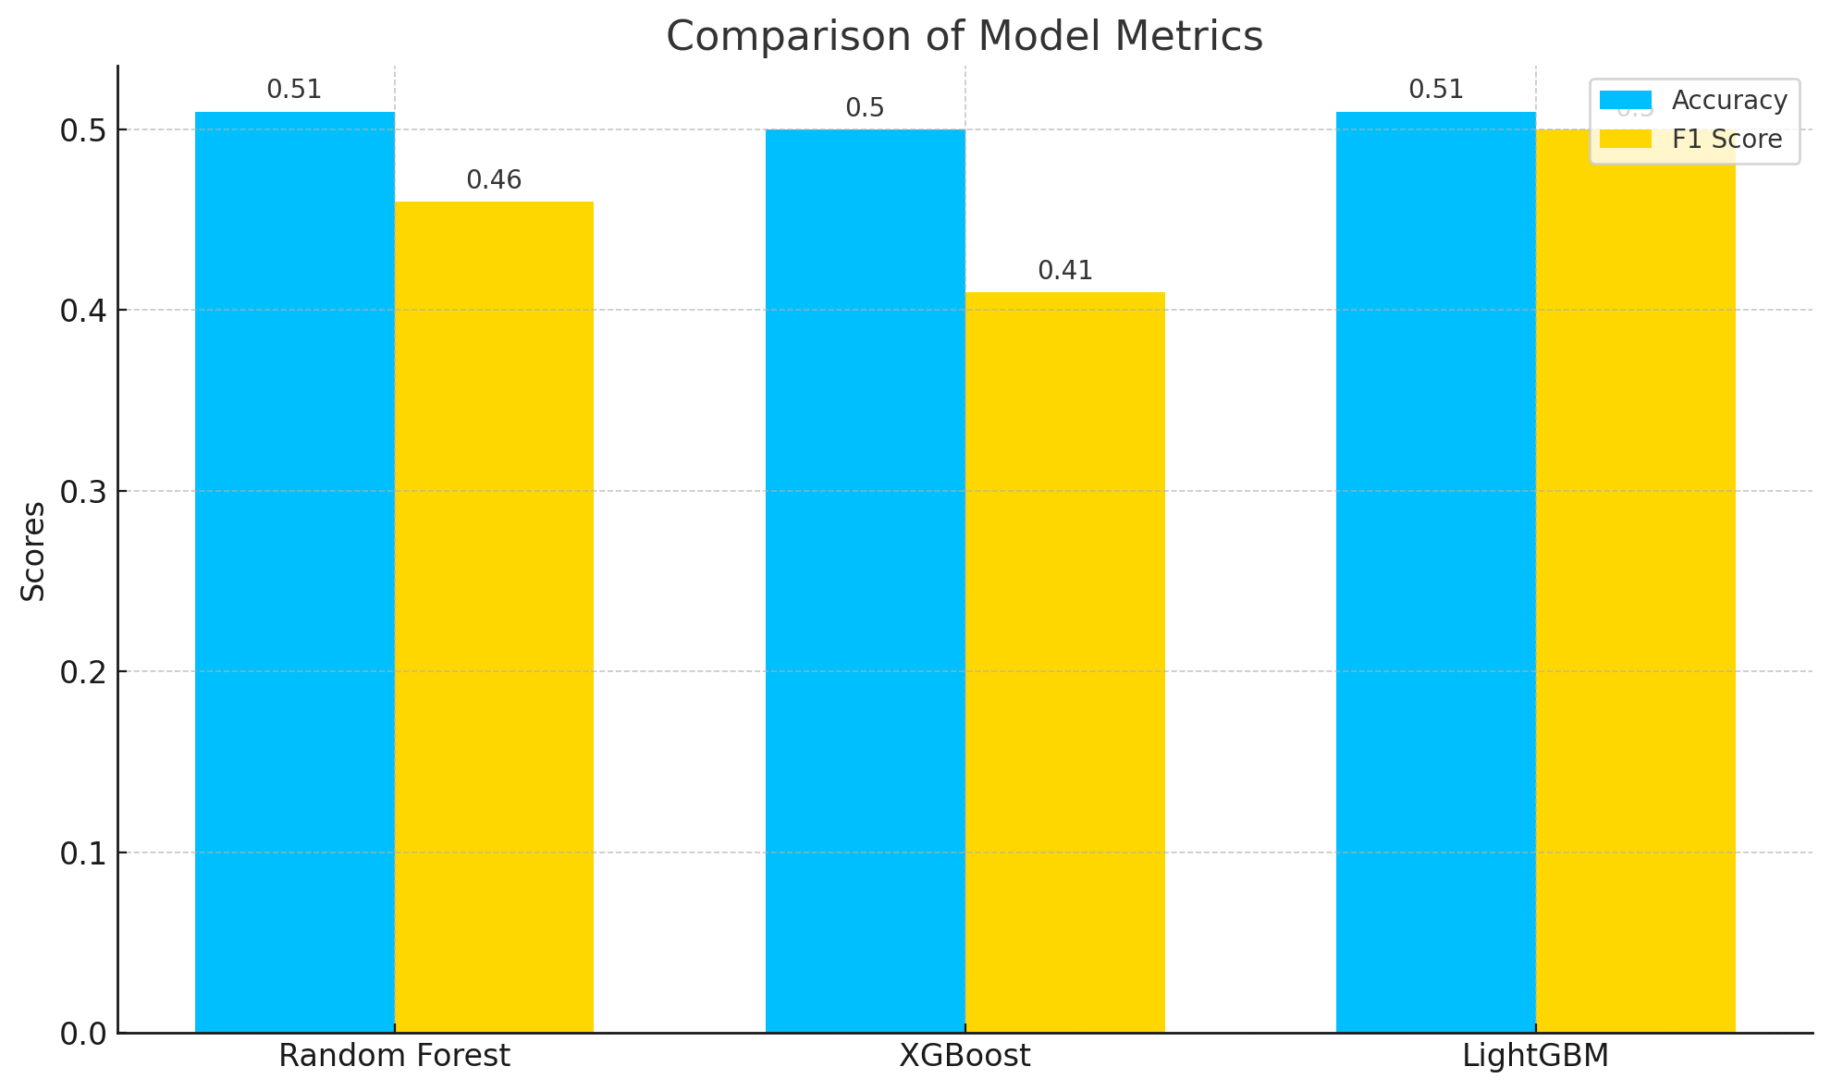
MODEL COMPARISONS

Slide 9
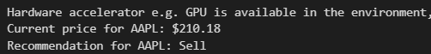
Real-Time Stock Recommendations: Predictive Results

Slide 10
THANKS!
ANY QUESTIONS?

