Slide 1

COLLEGE oF SCIENCE
PhaSE #1
Done by: 404 TEAM

Slide 2
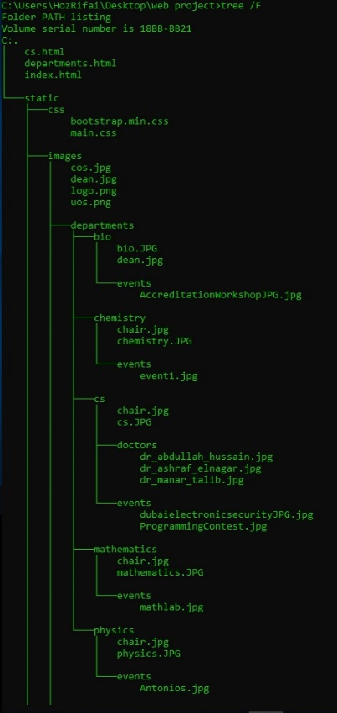
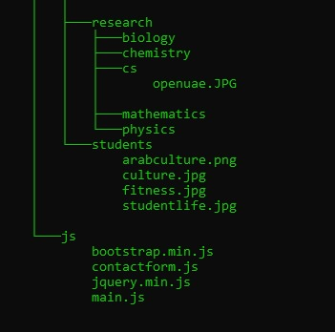
Our files Structure

Slide 3
OUR 20 pages plan
We are using hierarchical structure!
We will have multiple links in the home page that will link us to other pages in the website. Ex department, Event, Student and Research page
We will have 5 pages inside the department main page
Multiple pages inside the events main page
Multiple pages inside the students main page
Multiple pages inside the research page

Slide 4
Our audience
Students who are willing to make a difference in the world
Faculty
Staff
Researchers
Parents
Donors
Alumni

Slide 5
Home page
Nav-bar
Dean’s welcoming message
Events and activities
Students
Research
Contact us
Footer

Slide 6
Departments
Applied biology
Applied Physics & Astronomy
Chemistry
Computer Science
Mathematics

Slide 7
Computer Science
Programs and Degrees
Bachelor of Science in Computer Science
Master Of Science In Computer Science
Bachelor of Science in Information Technology
Our people
Contact us

