Slide 1
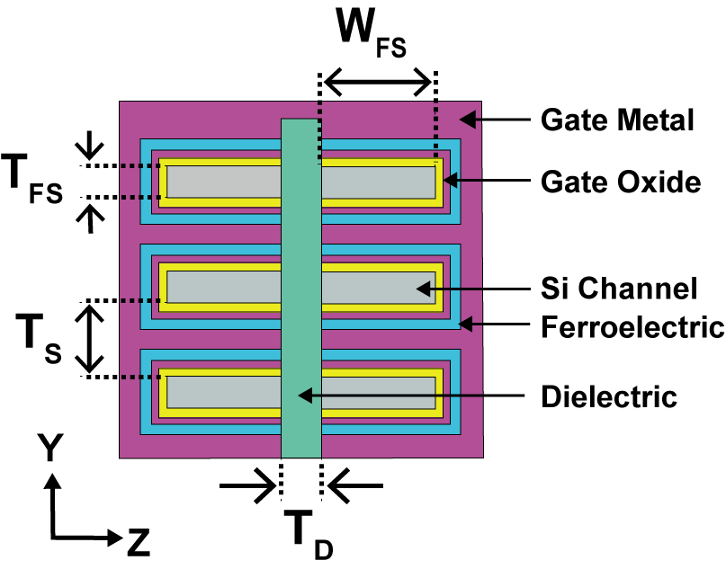
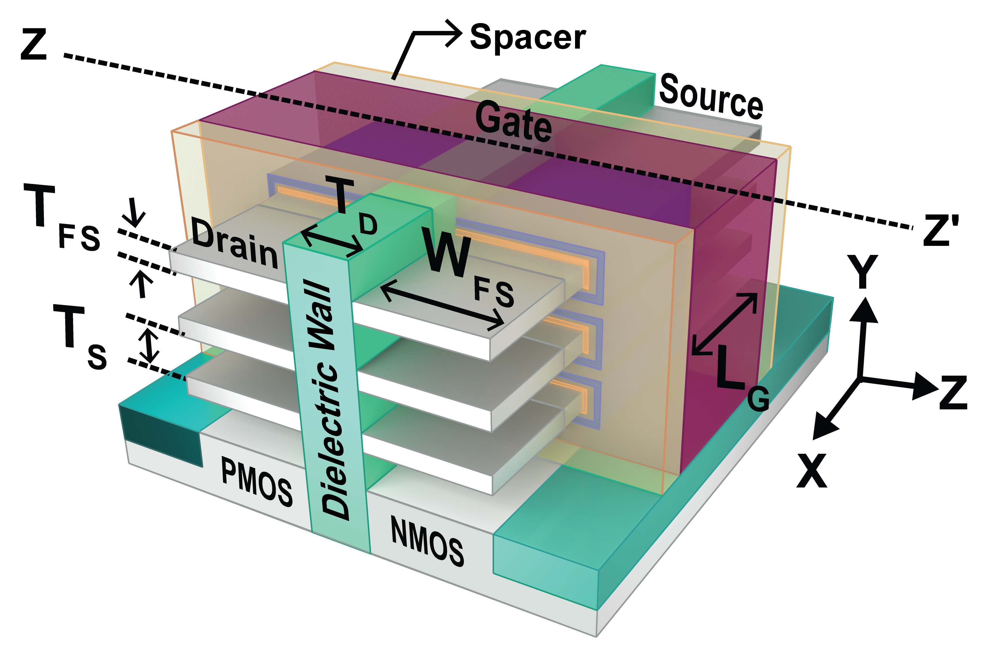
(a)
(b)
Figure 1

Slide 2
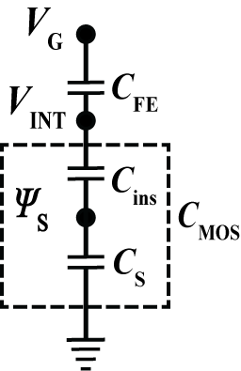
(a)
(b)
Q_{G} (V_{INT}, V_{D})
V_{G}
Landau-Khalatnikov (L-K)
Ferroelectric Model
V_{INT} = V_{G}-V_{FE}
ATLAS TCAD Model
I_{D} (V_{INT} , V_{D})
Q_{G} (V_{INT} , V_{D})
I_{D} (V_{G} , V_{D})
Q_{G} (V_{G}, V_{D})
Figure 2

Slide 3
(a)
(b)
E_{C} = 1.15 MV/cm
P_{r} = 5 µC/cm²
T_{FE} = 16 nm
α = -3×10⁹ m/F
β = 6×10¹¹ m⁵/C²F
γ = 0 m⁹/FC⁴
Figure 3

Slide 4
(a)
(b)
(c)
(d)
X
X
Y
Y
C_{MOS}
|C_{FE}|
|C_{FE}|
|C_{FE}|
C_{MOS}
|C_{FE}|
|C_{FE}|
|C_{FE}|
Figure 4

Slide 5
(a)
(b)
T_{FE} (critical) =
5.92 nm NMOS
T_{FE} (critical) =
6.37 nm
PMOS
FSH FET: T_{FE} = 0 nm (NMOS and PMOS); NC-FSH FET: T_{FE} (critical) = 6.37 nm (PMOS) and 5.92 nm (NMOS)
(c)
(d)
(e)
T_{FE} (critical) =
5.92 nm NMOS
T_{FE} (critical) =
6.37 nm
PMOS

Slide 6
(a)
(b)
(c)
(d)
Figure 6

Slide 7
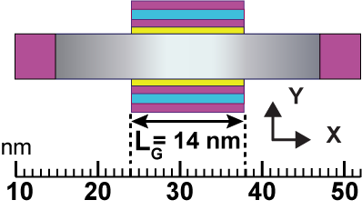
(a)
(b)
(c)
(d)
V_{D} =
0.1 V
V_{D} =
0.1 V
V_{D} =
0.2 V
V_{D} =
0.2 V
V_{D} =
0.3 V
V_{D} =
0.3 V
Figure 7

Slide 8
(a)
(b)
Figure 8

Slide 9
(a)
(b)
(c)
(d)
Figure 9

Slide 10
(a)
(b)
# of stacked sheets: 3 (FSH FET and NC-FSH FET); 4 (NSH FET and NC-NSH FET)
Width of stacked sheet: 21 nm (FSH FET and NC-FSH FET); 12 nm (NSH FET and NC-NSH FET)
(c)
(d)
(e)
Figure 10

