Slide 1
Daily Market Report
Trade Date: 2026-05-25
JPX Derivative & Commodity Analytics
DataServer In-House

Slide 2
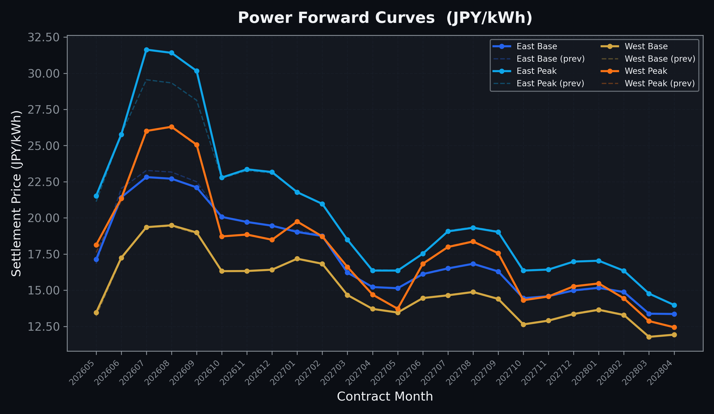
Power Forward Curves
East/West Base & Peak monthly contracts (2026-05-25)

Slide 3
Commodity Snapshot
Front-month settlement prices as of 2026-05-25
Category | Asset | Contract | Settlement | Unit | Change | % Chg
Energy | Barge Gas Oil | 202606 | 109,700.00 | JPY/kl | +0.00 | +0.00%
Energy | Barge Gasoline | 202606 | 100,000.00 | JPY/kl | +0.00 | +0.00%
Energy | Barge Kerosene | 202606 | 105,000.00 | JPY/kl | +0.00 | +0.00%
Energy | Chukyo Gasoline | 202606 | 94,100.00 | JPY/kl | -5900.00 | -5.90%
Energy | Chukyo Kerosene | 202606 | 105,000.00 | JPY/kl | +0.00 | +0.00%
Energy | Dubai Crude Oil | 202605 | 102,000.00 | JPY/kl | -390.00 | -0.38%
Energy | LNG (Platts JKM) | 202607 | 2,921.00 | USD/MMBtu | -34.00 | -1.15%
Metals | Gold | - | 23,154.00 | JPY/g | +161.00 | +0.70%
Metals | Palladium | 202606 | 7,000.00 | JPY/g | +0.00 | +0.00%
Metals | Platinum | - | 9,664.00 | JPY/g | -202.00 | -2.05%
Metals | Silver | 202606 | 390.00 | JPY/10g | +0.00 | +0.00%
Industrial | Rubber (RSS3) | 202605 | 394.00 | JPY/kg | -3.00 | -0.76%
Industrial | Rubber (TSR20) | 202606 | 350.00 | JPY/kg | +0.00 | +0.00%
Industrial | Shanghai Natural Rubber | 202609 | 17,575.00 | JPY/kg | +90.00 | +0.51%
Agriculture | Azuki Beans | 202605 | 12,300.00 | JPY/bag | +0.00 | +0.00%
Agriculture | Corn | 202607 | 39,000.00 | JPY/t | +0.00 | +0.00%
Agriculture | Soybeans | 202606 | 64,000.00 | JPY/t | +0.00 | +0.00%

Slide 4
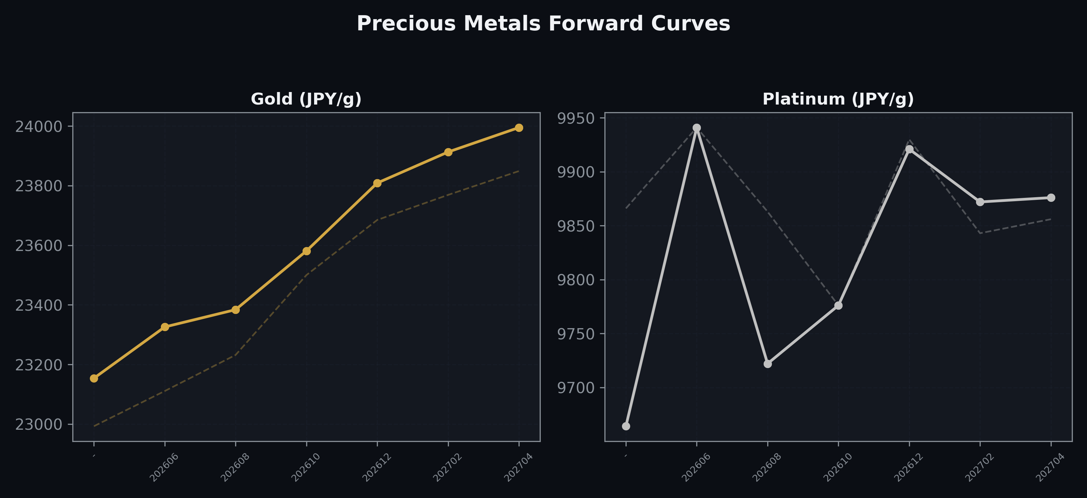
Precious Metals Forward Curves
Gold & Platinum (2026-05-25)

Slide 5
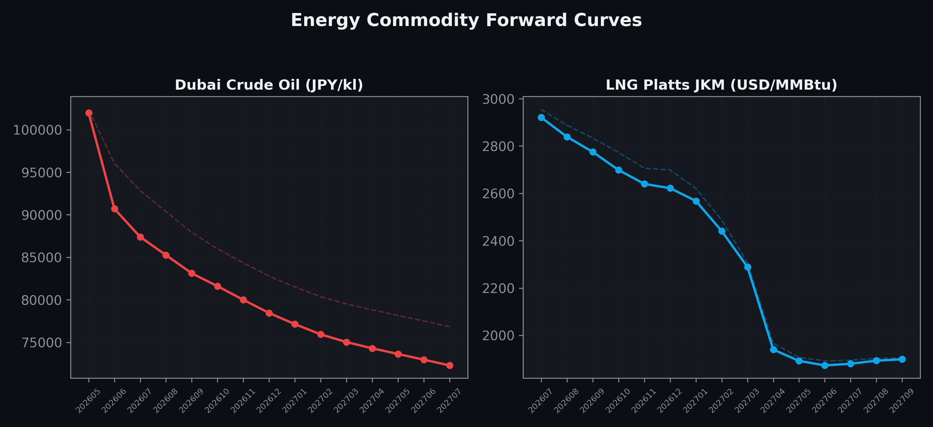
Energy Commodity Forward Curves
Dubai Crude Oil & LNG Platts JKM (2026-05-25)

Slide 6
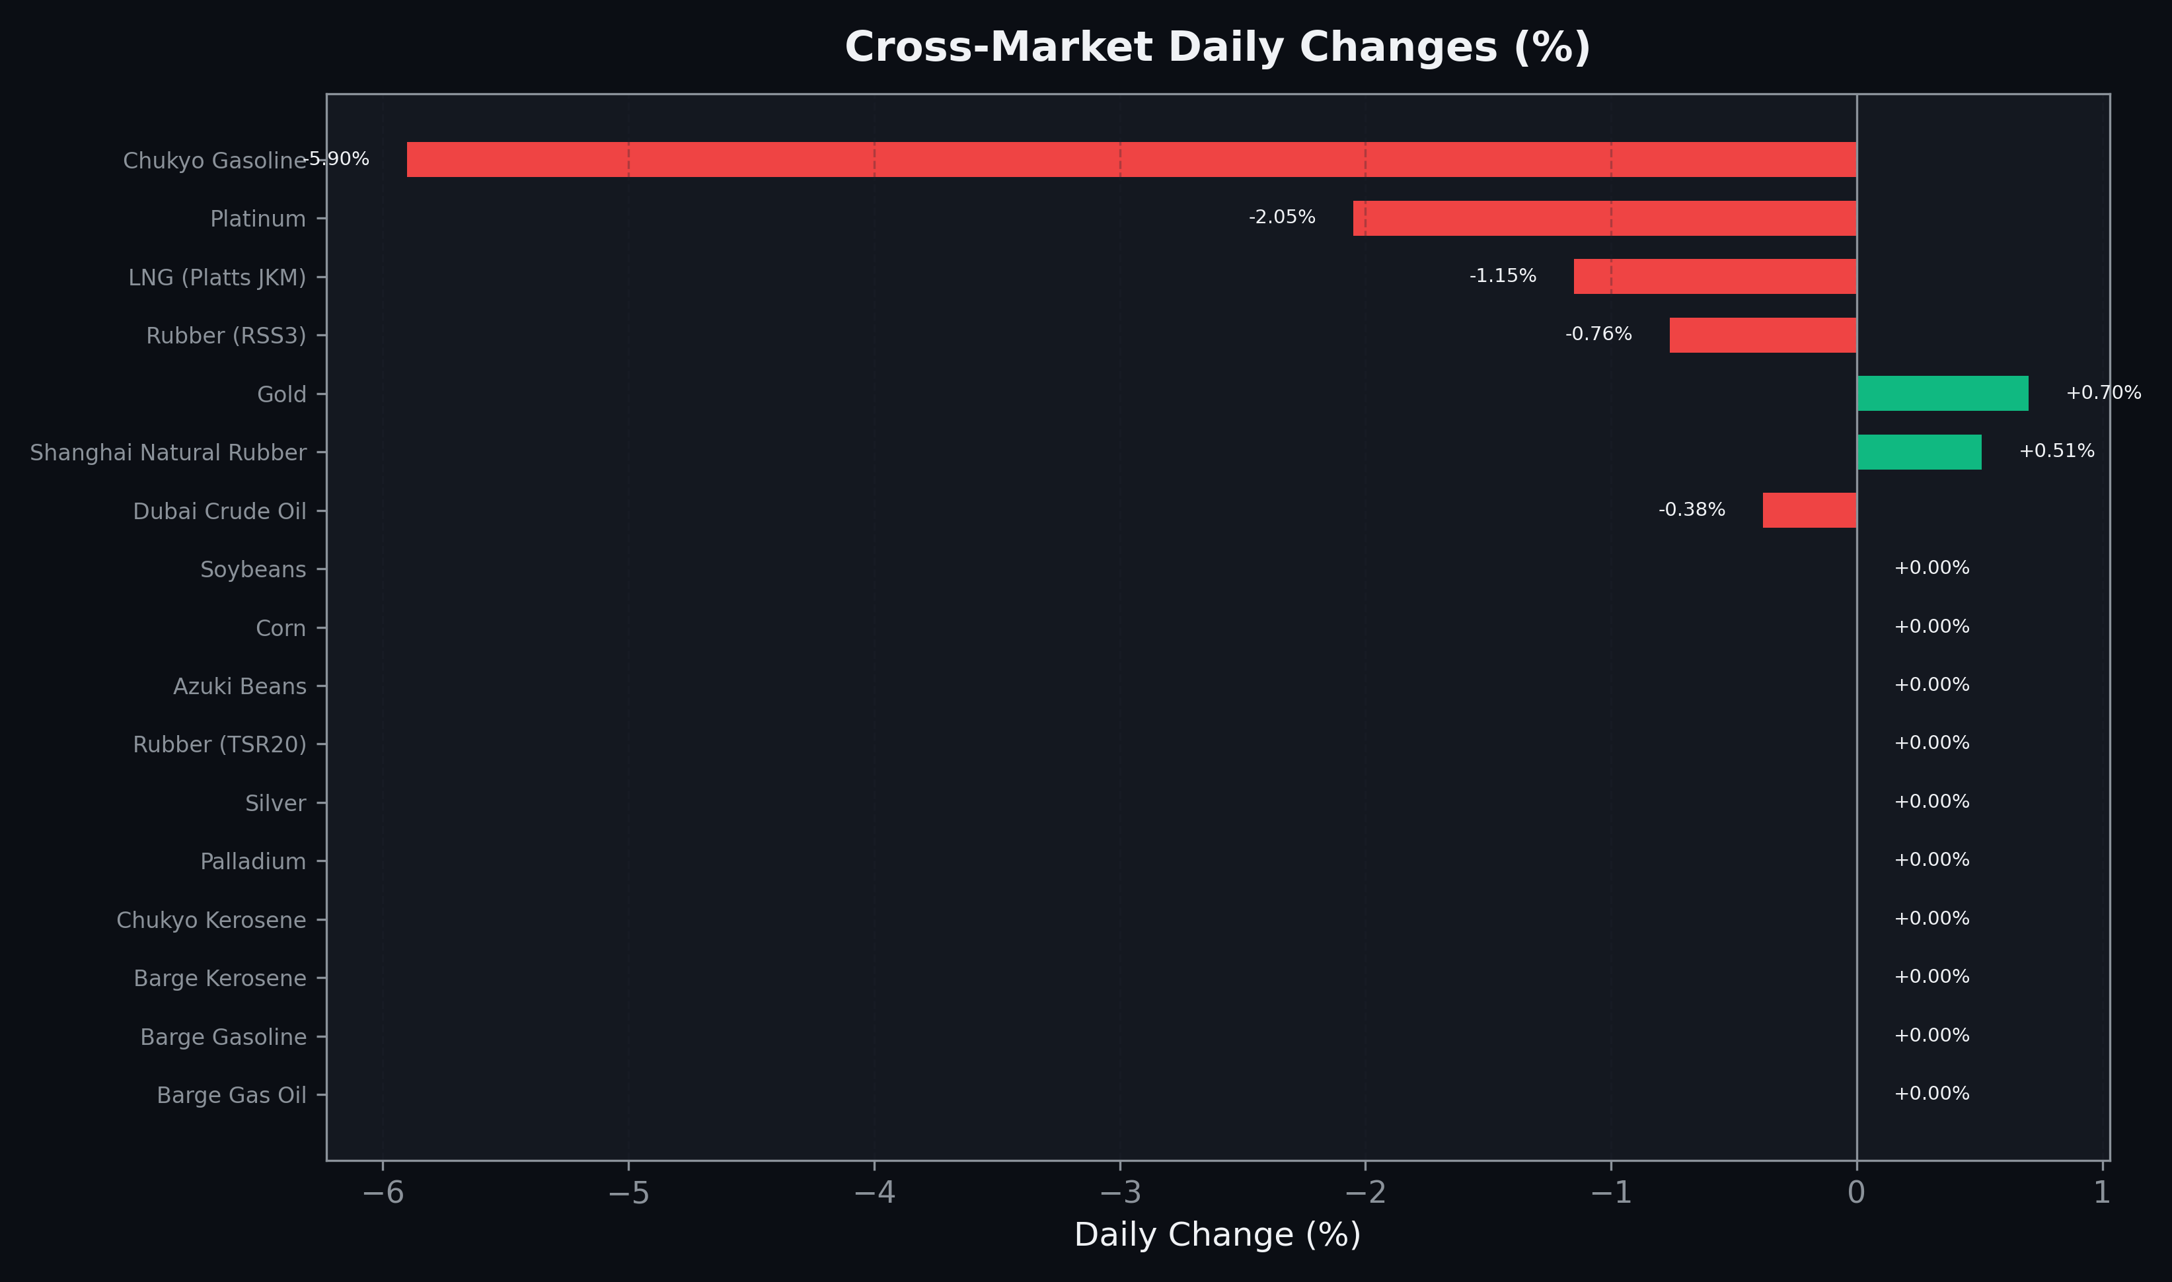
Cross-Market Daily Changes
All commodities sorted by absolute % change

Slide 7
Top Power Futures Movers
Largest absolute settlement price changes vs previous day (2026-05-25)
Instrument | Underlying | Month | Price | Prev | Change | % Chg
FUT_EWPW_260528 | Power West Peak (Weekly) | 20260529 | 17.19 | 14.79 | +2.40 | +16.23%
FUT_EEP_260730 | Power East Peak (Monthly) | 202607 | 31.63 | 29.55 | +2.08 | +7.04%
FUT_EEP_260828 | Power East Peak (Monthly) | 202608 | 31.41 | 29.33 | +2.08 | +7.09%
FUT_EEP_260929 | Power East Peak (Monthly) | 202609 | 30.16 | 28.13 | +2.03 | +7.22%
FUT_EEPW_260528 | Power East Peak (Weekly) | 20260529 | 22.23 | 20.99 | +1.24 | +5.91%
FUT_ECB_260629 | 電力(中部・ベース) | 202606 | 19.85 | 20.86 | -1.01 | -4.84%
FUT_ECB_260730 | 電力(中部・ベース) | 202607 | 21.85 | 22.84 | -0.99 | -4.33%
FUT_ECB_260828 | 電力(中部・ベース) | 202608 | 21.87 | 22.84 | -0.97 | -4.25%
FUT_ECB_260929 | 電力(中部・ベース) | 202609 | 21.49 | 22.40 | -0.91 | -4.06%
FUT_EEB_260629 | Power East Base (Monthly) | 202606 | 21.42 | 22.03 | -0.61 | -2.77%
FUT_EWP_260528 | Power West Peak (Monthly) | 202605 | 18.13 | 17.61 | +0.52 | +2.95%
FUT_ECP_260528 | 電力(中部・日中) | 202605 | 19.64 | 19.14 | +0.50 | +2.61%
FUT_EWBW_260528 | Power West Base (Weekly) | 20260529 | 15.90 | 15.40 | +0.50 | +3.25%
FUT_EEB_260730 | Power East Base (Monthly) | 202607 | 22.82 | 23.28 | -0.46 | -1.98%
FUT_EEB_260828 | Power East Base (Monthly) | 202608 | 22.71 | 23.17 | -0.46 | -1.99%

