Slide 1
Daily Market Report
Trade Date: 2026-04-10
JPX Derivative & Commodity Analytics
DataServer In-House

Slide 2
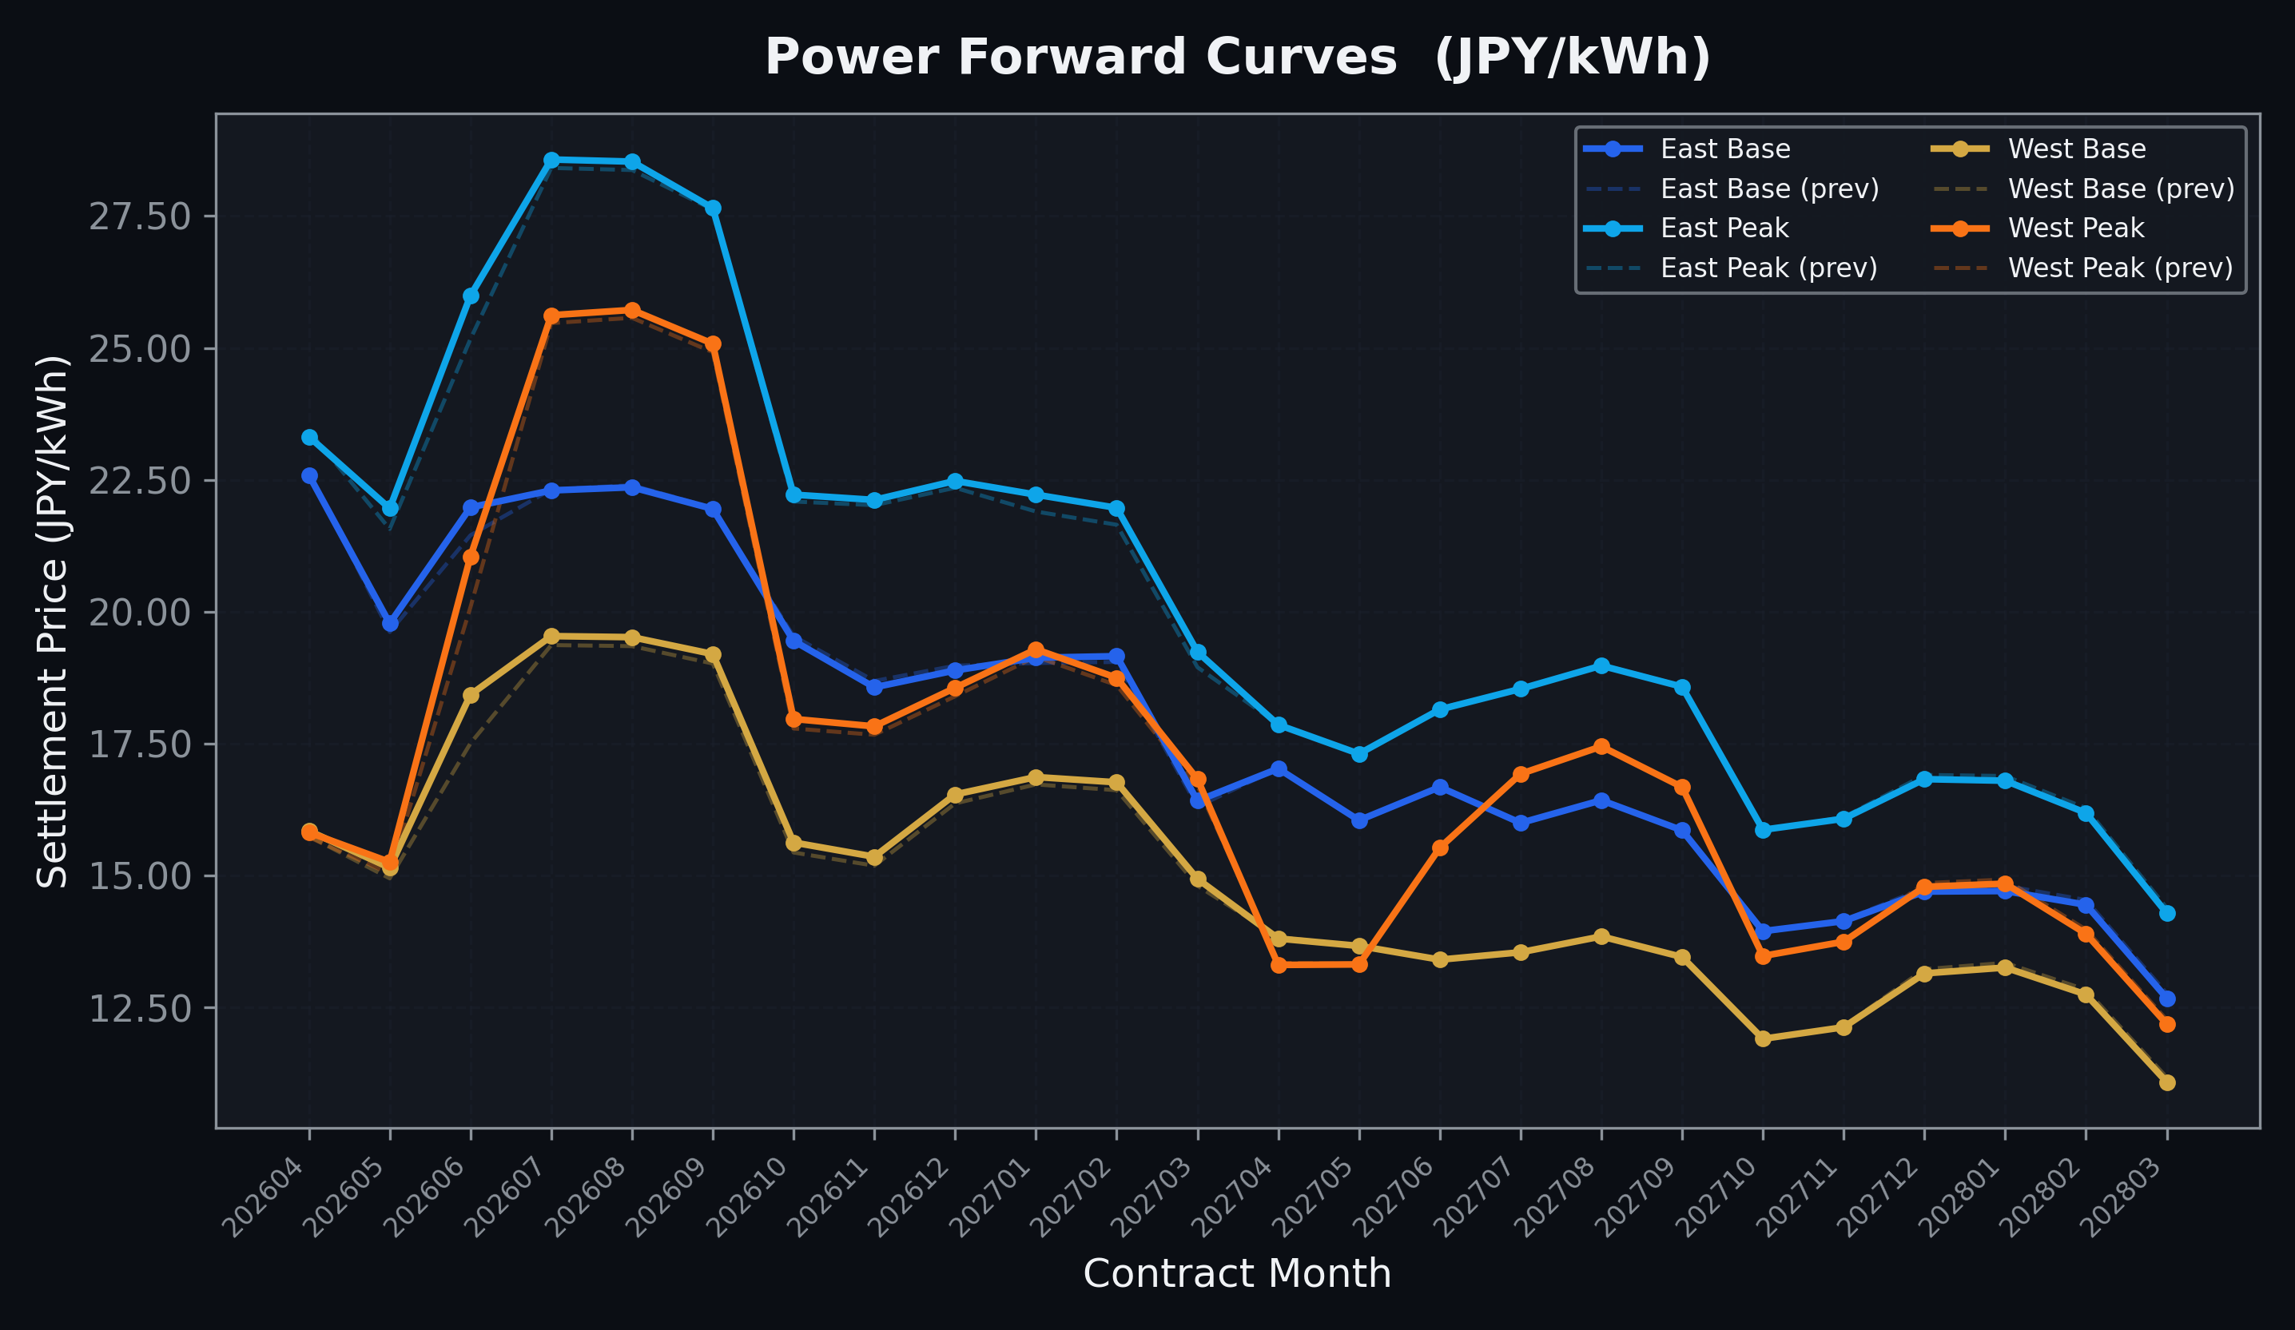
Power Forward Curves
East/West Base & Peak monthly contracts (2026-04-10)

Slide 3
Commodity Snapshot
Front-month settlement prices as of 2026-04-10
Category | Asset | Contract | Settlement | Unit | Change | % Chg
Energy | Barge Gas Oil | 202605 | 113,100.00 | JPY/kl | +200.00 | +0.18%
Energy | Barge Gasoline | 202605 | 115,000.00 | JPY/kl | +0.00 | +0.00%
Energy | Barge Kerosene | 202605 | 105,000.00 | JPY/kl | +0.00 | +0.00%
Energy | Chukyo Gasoline | 202605 | 110,000.00 | JPY/kl | +0.00 | +0.00%
Energy | Chukyo Kerosene | 202605 | 105,000.00 | JPY/kl | +0.00 | +0.00%
Energy | Dubai Crude Oil | 202604 | 103,230.00 | JPY/kl | +2250.00 | +2.23%
Energy | LNG (Platts JKM) | 202605 | 2,910.00 | USD/MMBtu | +27.00 | +0.94%
Metals | Gold | - | 24,209.00 | JPY/g | +214.00 | +0.89%
Metals | Palladium | 202604 | 7,500.00 | JPY/g | +0.00 | +0.00%
Metals | Platinum | - | 10,334.00 | JPY/g | +115.00 | +1.13%
Metals | Silver | 202604 | 365.00 | JPY/10g | +0.00 | +0.00%
Industrial | Rubber (RSS3) | 202604 | 379.40 | JPY/kg | -3.50 | -0.91%
Industrial | Rubber (TSR20) | 202605 | 320.00 | JPY/kg | +0.00 | +0.00%
Industrial | Shanghai Natural Rubber | 202605 | 16,710.00 | JPY/kg | -320.00 | -1.88%
Agriculture | Azuki Beans | 202604 | 12,300.00 | JPY/bag | +0.00 | +0.00%
Agriculture | Corn | 202605 | 39,000.00 | JPY/t | +0.00 | +0.00%
Agriculture | Soybeans | 202604 | 64,000.00 | JPY/t | +0.00 | +0.00%

Slide 4
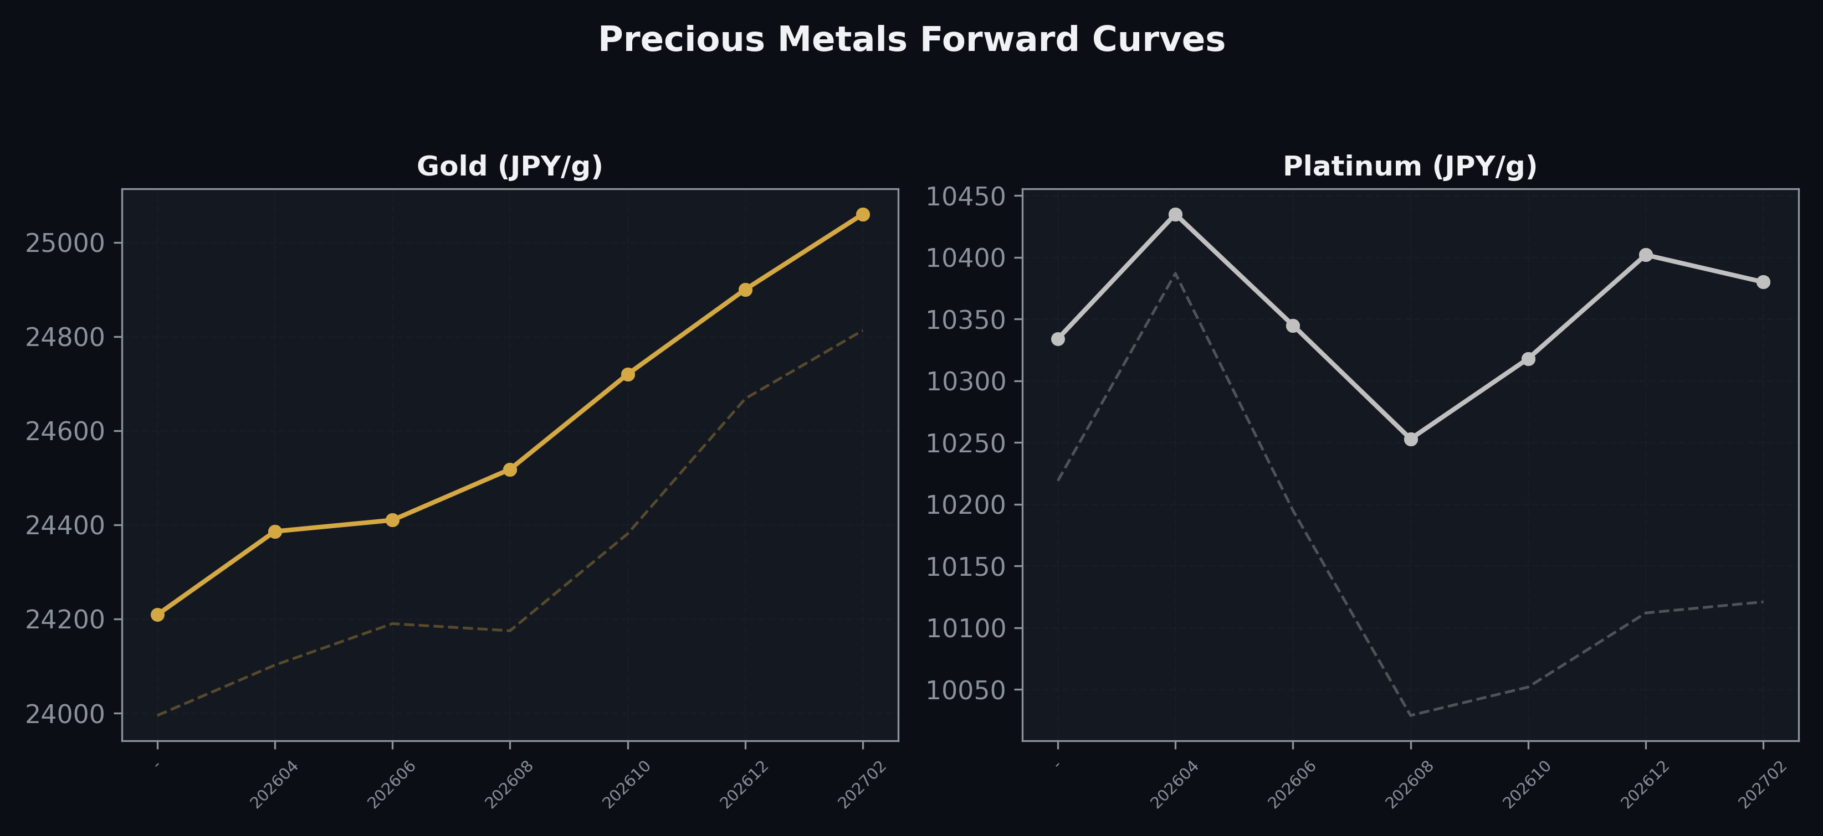
Precious Metals Forward Curves
Gold & Platinum (2026-04-10)

Slide 5
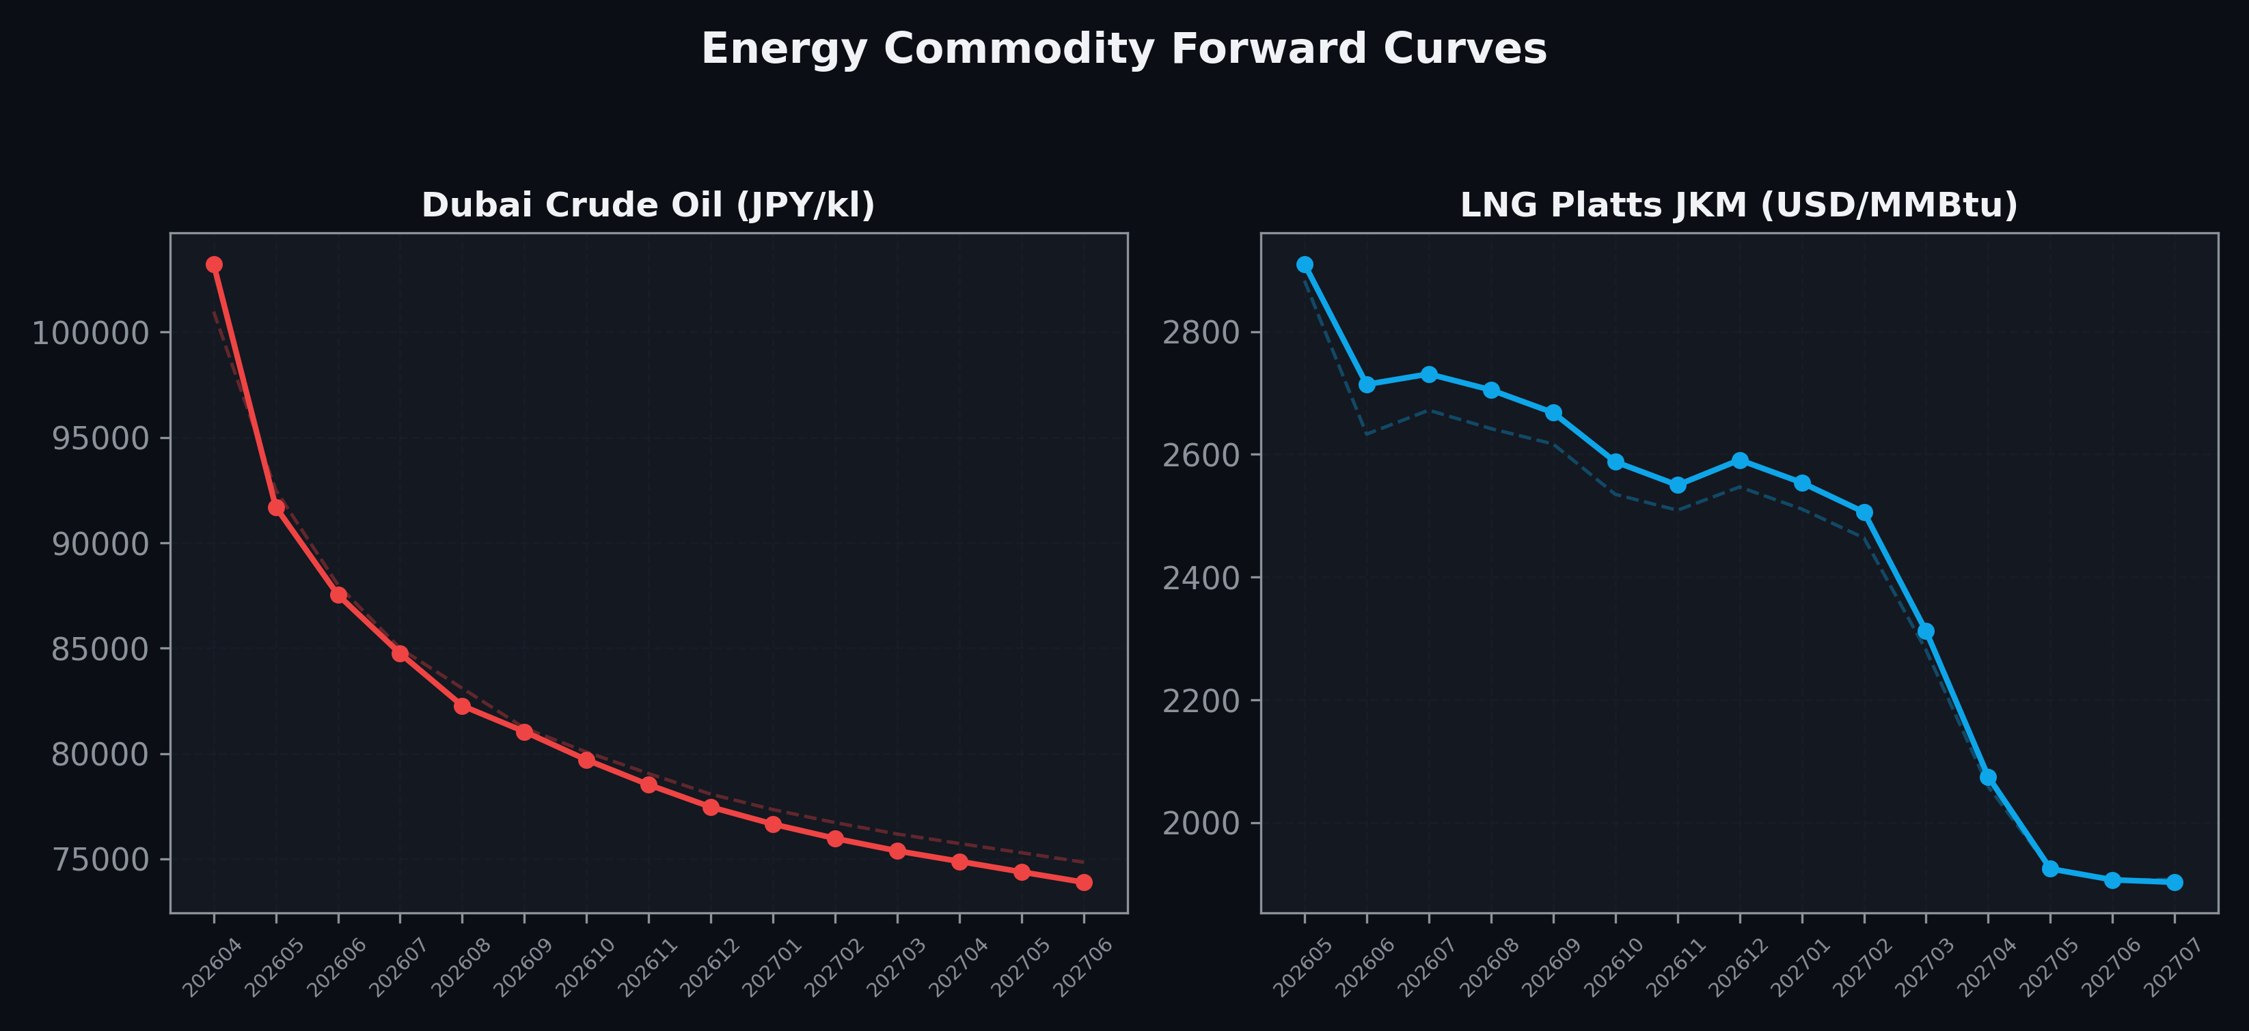
Energy Commodity Forward Curves
Dubai Crude Oil & LNG Platts JKM (2026-04-10)

Slide 6
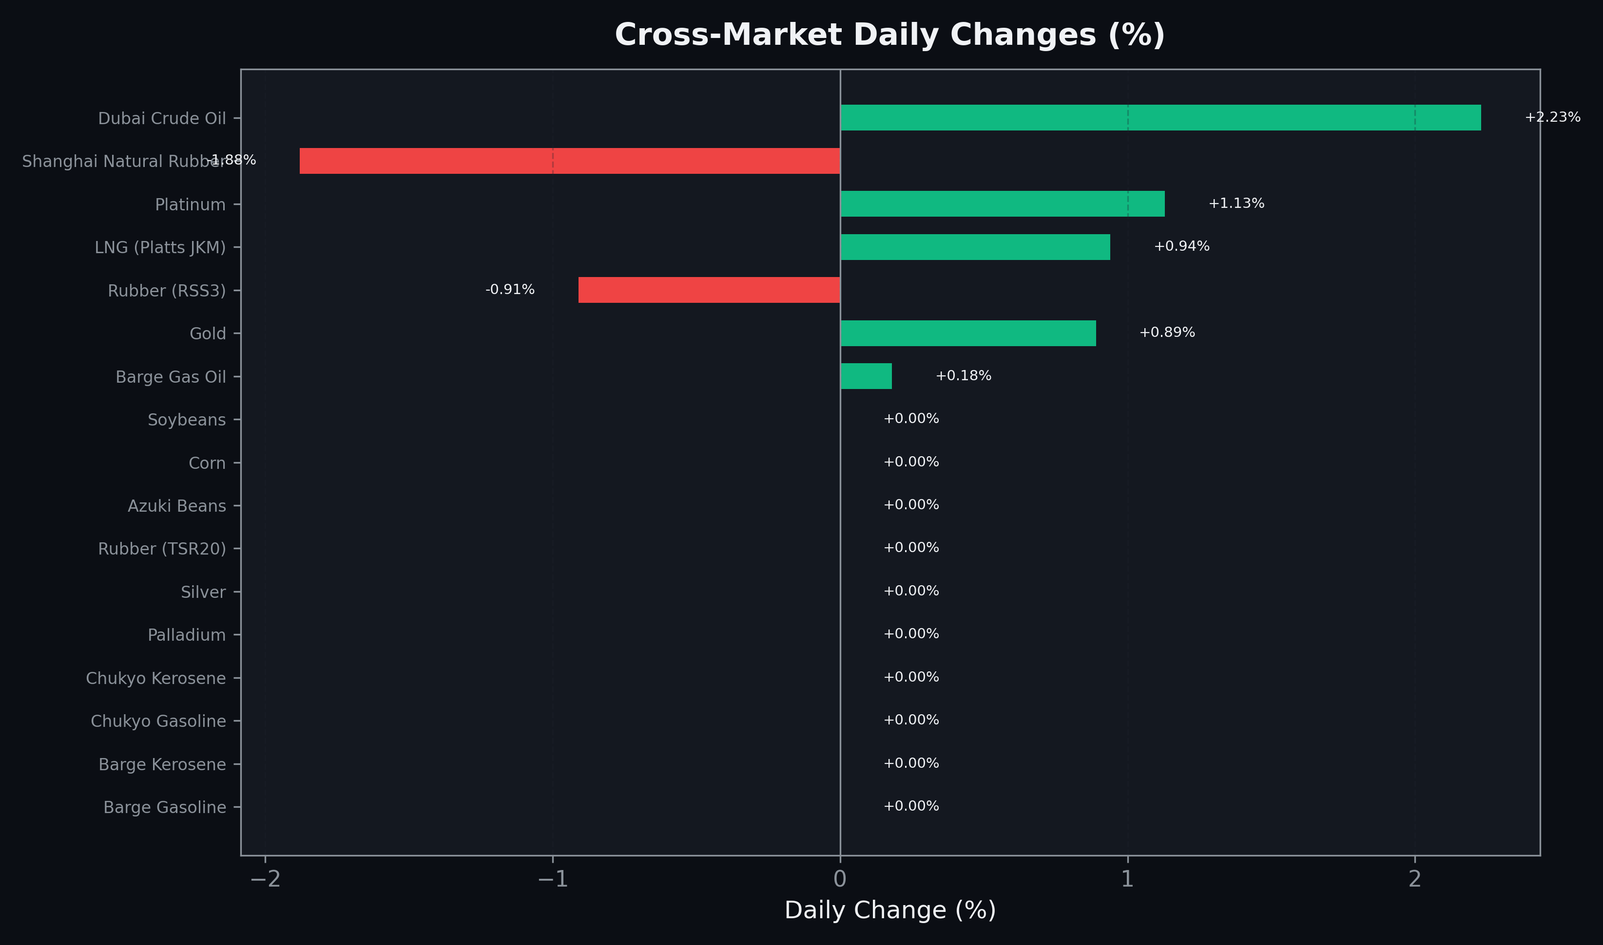
Cross-Market Daily Changes
All commodities sorted by absolute % change

Slide 7
Top Power Futures Movers
Largest absolute settlement price changes vs previous day (2026-04-10)
Instrument | Underlying | Month | Price | Prev | Change | % Chg
FUT_EWP_260629 | Power West Peak (Monthly) | 202606 | 21.05 | 20.09 | +0.96 | +4.78%
FUT_EWB_260629 | Power West Base (Monthly) | 202606 | 18.43 | 17.51 | +0.92 | +5.25%
FUT_EEP_260629 | Power East Peak (Monthly) | 202606 | 25.99 | 25.17 | +0.82 | +3.26%
FUT_EWPW_260416 | Power West Peak (Weekly) | 20260417 | 15.68 | 14.86 | +0.82 | +5.52%
FUT_EEPW_260428 | Power East Peak (Weekly) | 20260501 | 20.32 | 19.53 | +0.79 | +4.05%
FUT_EEBW_260507 | Power East Base (Weekly) | 20260508 | 18.46 | 17.87 | +0.59 | +3.30%
FUT_EEBW_260416 | Power East Base (Weekly) | 20260417 | 22.64 | 23.20 | -0.56 | -2.41%
FUT_EEB_260629 | Power East Base (Monthly) | 202606 | 21.98 | 21.45 | +0.53 | +2.47%
FUT_EEBW_260430 | Power East Base (Weekly) | 20260501 | 20.49 | 20.01 | +0.48 | +2.40%
FUT_EEPW_260416 | Power East Peak (Weekly) | 20260417 | 22.54 | 23.00 | -0.46 | -2.00%
FUT_EEP_260528 | Power East Peak (Monthly) | 202605 | 21.96 | 21.57 | +0.39 | +1.81%
FUT_EEPW_260423 | Power East Peak (Weekly) | 20260424 | 23.96 | 24.35 | -0.39 | -1.60%
FUT_EEBW_260423 | Power East Base (Weekly) | 20260424 | 22.88 | 23.23 | -0.35 | -1.51%
FUT_EWBW_260430 | Power West Base (Weekly) | 20260501 | 14.34 | 14.01 | +0.33 | +2.36%
FUT_EEP_270128 | Power East Peak (Monthly) | 202701 | 22.22 | 21.90 | +0.32 | +1.46%

