Slide 1
Daily Market Report
Trade Date: 2026-05-13
JPX Derivative & Commodity Analytics
DataServer In-House

Slide 2
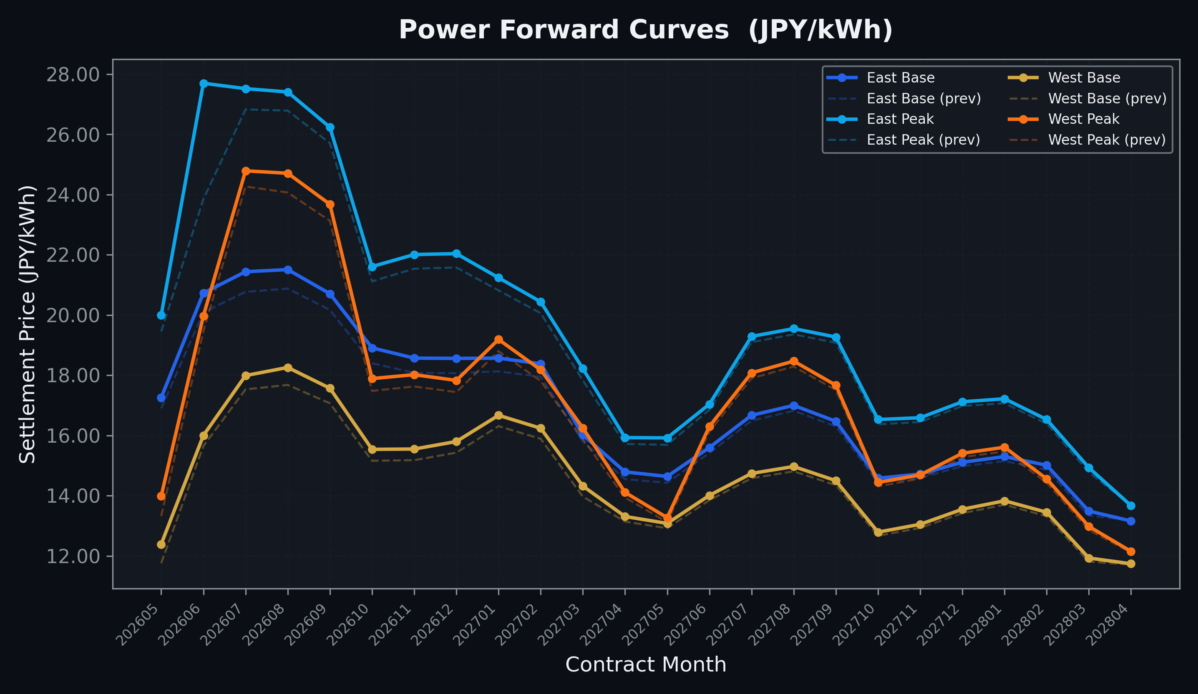
Power Forward Curves
East/West Base & Peak monthly contracts (2026-05-13)

Slide 3
Commodity Snapshot
Front-month settlement prices as of 2026-05-13
Category | Asset | Contract | Settlement | Unit | Change | % Chg
Energy | Barge Gas Oil | 202606 | 110,700.00 | JPY/kl | +100.00 | +0.09%
Energy | Barge Gasoline | 202606 | 100,000.00 | JPY/kl | +0.00 | +0.00%
Energy | Barge Kerosene | 202606 | 105,000.00 | JPY/kl | +0.00 | +0.00%
Energy | Chukyo Gasoline | 202606 | 100,000.00 | JPY/kl | +0.00 | +0.00%
Energy | Chukyo Kerosene | 202606 | 105,000.00 | JPY/kl | +0.00 | +0.00%
Energy | Dubai Crude Oil | 202605 | 102,050.00 | JPY/kl | +2310.00 | +2.32%
Energy | LNG (Platts JKM) | 202606 | 2,700.00 | USD/MMBtu | +4.00 | +0.15%
Metals | Gold | - | 23,656.00 | JPY/g | +11.00 | +0.05%
Metals | Palladium | 202606 | 7,500.00 | JPY/g | +0.00 | +0.00%
Metals | Platinum | - | 10,557.00 | JPY/g | -108.00 | -1.01%
Metals | Silver | 202606 | 420.00 | JPY/10g | +0.00 | +0.00%
Industrial | Rubber (RSS3) | 202605 | 408.00 | JPY/kg | +7.20 | +1.80%
Industrial | Rubber (TSR20) | 202606 | 350.00 | JPY/kg | +10.00 | +2.94%
Industrial | Shanghai Natural Rubber | 202605 | 17,905.00 | JPY/kg | +275.00 | +1.56%
Agriculture | Azuki Beans | 202605 | 12,300.00 | JPY/bag | +0.00 | +0.00%
Agriculture | Corn | 202607 | 39,000.00 | JPY/t | +0.00 | +0.00%
Agriculture | Soybeans | 202606 | 64,000.00 | JPY/t | +0.00 | +0.00%

Slide 4
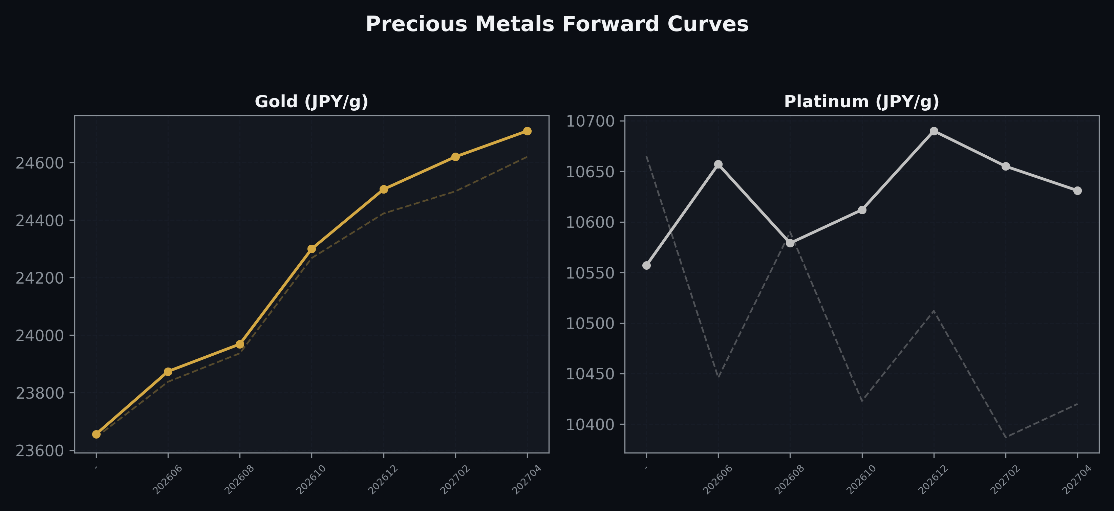
Precious Metals Forward Curves
Gold & Platinum (2026-05-13)

Slide 5
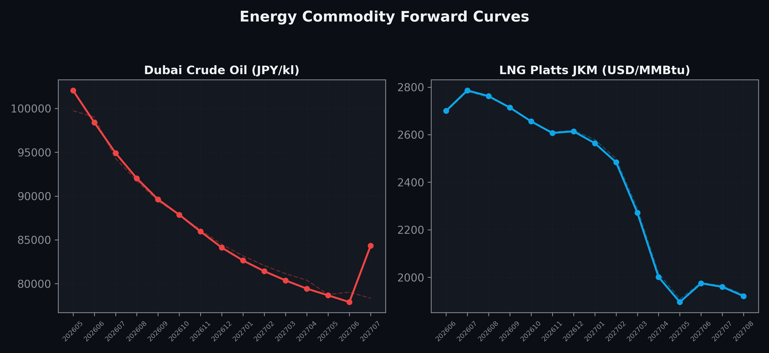
Energy Commodity Forward Curves
Dubai Crude Oil & LNG Platts JKM (2026-05-13)

Slide 6
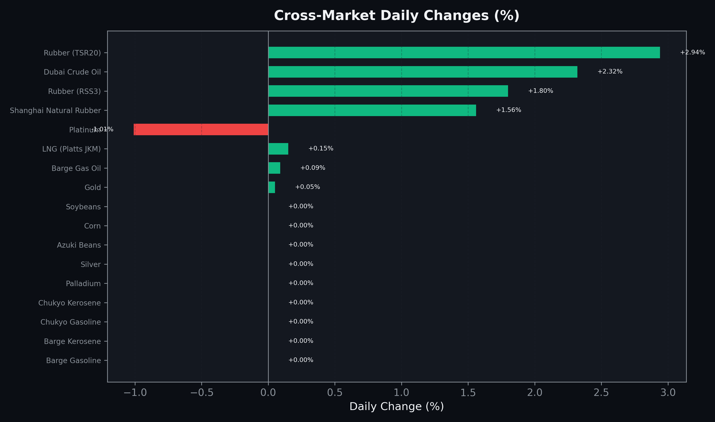
Cross-Market Daily Changes
All commodities sorted by absolute % change

Slide 7
Top Power Futures Movers
Largest absolute settlement price changes vs previous day (2026-05-13)
Instrument | Underlying | Month | Price | Prev | Change | % Chg
FUT_EEP_260629 | Power East Peak (Monthly) | 202606 | 27.70 | 23.85 | +3.85 | +16.14%
FUT_EEBW_260521 | Power East Base (Weekly) | 20260522 | 19.80 | 17.87 | +1.93 | +10.80%
FUT_EEPW_260604 | Power East Peak (Weekly) | 20260605 | 23.93 | 22.21 | +1.72 | +7.74%
FUT_EWPW_260514 | Power West Peak (Weekly) | 20260515 | 14.63 | 13.20 | +1.43 | +10.83%
FUT_EWBW_260514 | Power West Base (Weekly) | 20260515 | 12.65 | 11.60 | +1.05 | +9.05%
FUT_EWPW_260521 | Power West Peak (Weekly) | 20260522 | 12.27 | 11.48 | +0.79 | +6.88%
FUT_EEBW_260514 | Power East Base (Weekly) | 20260515 | 16.90 | 16.13 | +0.77 | +4.77%
FUT_EWBW_260521 | Power West Base (Weekly) | 20260522 | 12.96 | 12.24 | +0.72 | +5.88%
FUT_EEPW_260521 | Power East Peak (Weekly) | 20260522 | 19.60 | 18.89 | +0.71 | +3.76%
FUT_EEP_260730 | Power East Peak (Monthly) | 202607 | 27.52 | 26.83 | +0.69 | +2.57%
FUT_EWBW_260528 | Power West Base (Weekly) | 20260529 | 12.81 | 12.13 | +0.68 | +5.61%
FUT_ECP_260730 | 電力(中部・日中) | 202607 | 25.36 | 24.69 | +0.67 | +2.71%
FUT_EEB_260730 | Power East Base (Monthly) | 202607 | 21.44 | 20.77 | +0.67 | +3.23%
FUT_EWP_260528 | Power West Peak (Monthly) | 202605 | 13.99 | 13.32 | +0.67 | +5.03%
FUT_ECB_260730 | 電力(中部・ベース) | 202607 | 19.98 | 19.32 | +0.66 | +3.42%

