Slide 1
Daily Market Report
Trade Date: 2026-06-24
JPX Derivative & Commodity Analytics
DataServer In-House

Slide 2
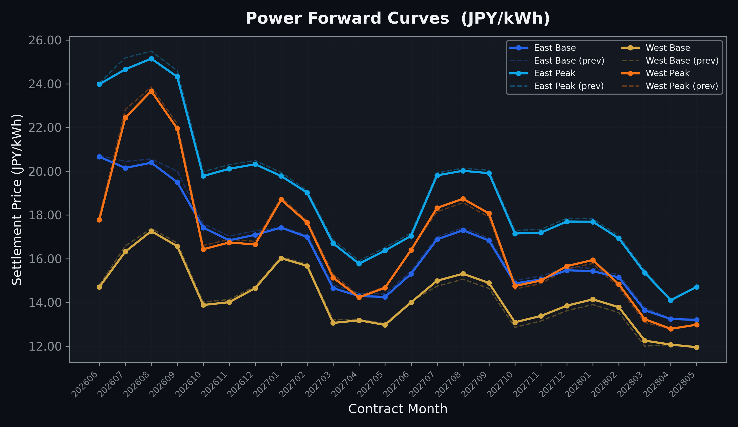
Power Forward Curves
East/West Base & Peak monthly contracts (2026-06-24)

Slide 3
Commodity Snapshot
Front-month settlement prices as of 2026-06-24
Category | Asset | Contract | Settlement | Unit | Change | % Chg
Energy | Barge Gas Oil | 202607 | 105,200.00 | JPY/kl | +100.00 | +0.10%
Energy | Barge Gasoline | 202607 | 97,000.00 | JPY/kl | -1000.00 | -1.02%
Energy | Barge Kerosene | 202607 | 108,000.00 | JPY/kl | -1000.00 | -0.92%
Energy | Chukyo Gasoline | 202607 | 94,000.00 | JPY/kl | +0.00 | +0.00%
Energy | Chukyo Kerosene | 202607 | 105,000.00 | JPY/kl | +0.00 | +0.00%
Energy | Dubai Crude Oil | 202606 | 81,060.00 | JPY/kl | -140.00 | -0.17%
Energy | LNG (Platts JKM) | 202608 | 2,528.00 | USD/MMBtu | -30.00 | -1.17%
Metals | Gold | - | 21,086.00 | JPY/g | -348.00 | -1.62%
Metals | Palladium | 202606 | 6,400.00 | JPY/g | -200.00 | -3.03%
Metals | Platinum | - | 8,452.00 | JPY/g | -75.00 | -0.88%
Metals | Silver | 202606 | 325.00 | JPY/10g | -15.00 | -4.41%
Industrial | Rubber (RSS3) | 202606 | 429.70 | JPY/kg | +1.90 | +0.44%
Industrial | Rubber (TSR20) | 202607 | 365.00 | JPY/kg | +0.00 | +0.00%
Industrial | Shanghai Natural Rubber | 202609 | 17,710.00 | JPY/kg | +210.00 | +1.20%
Agriculture | Azuki Beans | 202606 | 12,300.00 | JPY/bag | +0.00 | +0.00%
Agriculture | Corn | 202609 | 39,000.00 | JPY/t | +0.00 | +0.00%
Agriculture | Soybeans | 202608 | 64,000.00 | JPY/t | +0.00 | +0.00%

Slide 4
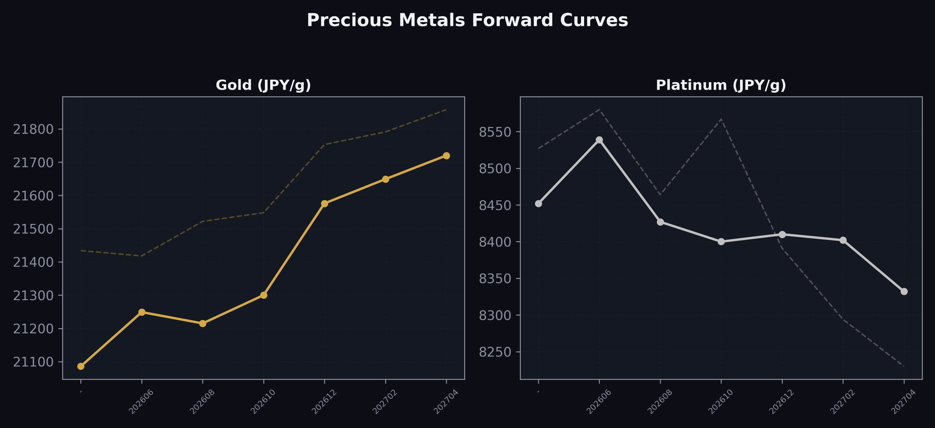
Precious Metals Forward Curves
Gold & Platinum (2026-06-24)

Slide 5
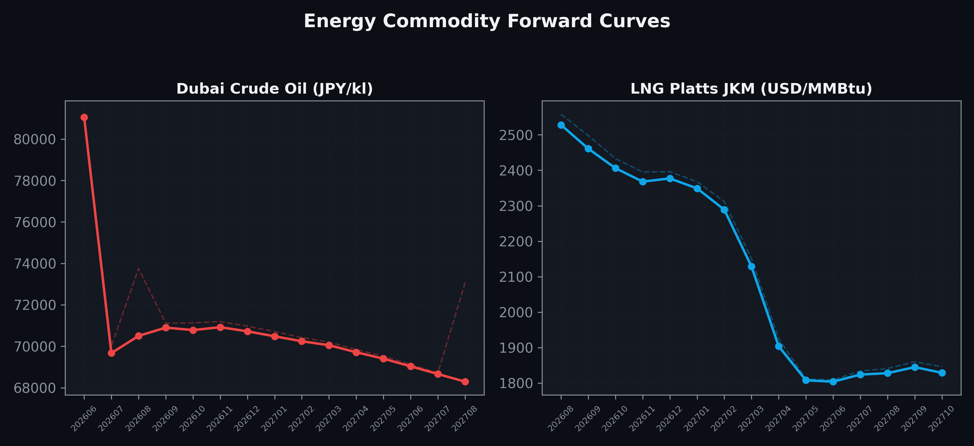
Energy Commodity Forward Curves
Dubai Crude Oil & LNG Platts JKM (2026-06-24)

Slide 6
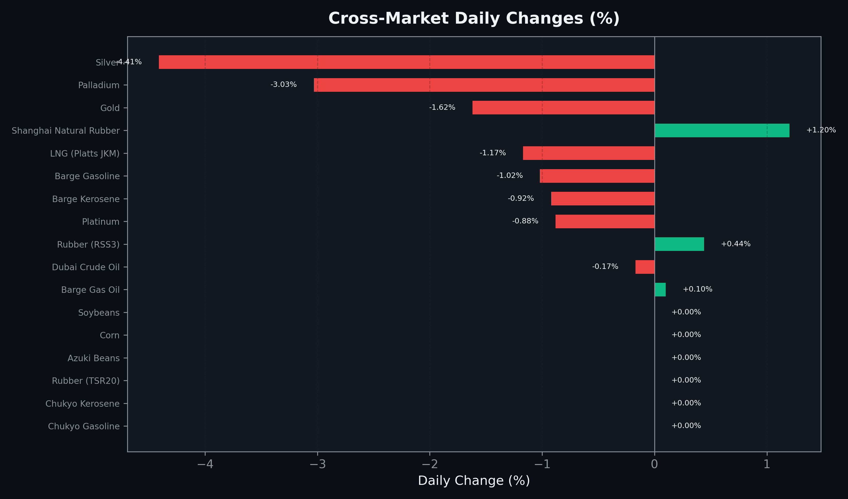
Cross-Market Daily Changes
All commodities sorted by absolute % change

Slide 7
Top Power Futures Movers
Largest absolute settlement price changes vs previous day (2026-06-24)
Instrument | Underlying | Month | Price | Prev | Change | % Chg
FUT_ECP_260730 | 電力(中部・日中) | 202607 | 23.67 | 24.35 | -0.68 | -2.79%
FUT_ECP_260929 | 電力(中部・日中) | 202609 | 23.62 | 24.17 | -0.55 | -2.28%
FUT_EWPW_260702 | Power West Peak (Weekly) | 20260703 | 18.90 | 19.44 | -0.54 | -2.78%
FUT_EEP_260730 | Power East Peak (Monthly) | 202607 | 24.66 | 25.19 | -0.53 | -2.10%
FUT_EWPW_260723 | Power West Peak (Weekly) | 20260724 | 22.88 | 22.35 | +0.53 | +2.37%
FUT_EEB_260929 | Power East Base (Monthly) | 202609 | 19.50 | 20.00 | -0.50 | -2.50%
FUT_EWBW_260723 | Power West Base (Weekly) | 20260724 | 16.94 | 16.52 | +0.42 | +2.54%
FUT_EWP_260730 | Power West Peak (Monthly) | 202607 | 22.45 | 22.82 | -0.37 | -1.62%
FUT_ECP_260828 | 電力(中部・日中) | 202608 | 24.68 | 25.03 | -0.35 | -1.40%
FUT_EEBW_260702 | Power East Base (Weekly) | 20260703 | 19.44 | 19.79 | -0.35 | -1.77%
FUT_EEP_260828 | Power East Peak (Monthly) | 202608 | 25.15 | 25.49 | -0.34 | -1.33%
FUT_EEPW_260625 | Power East Peak (Weekly) | 20260626 | 20.89 | 20.55 | +0.34 | +1.65%
FUT_EEPW_260702 | Power East Peak (Weekly) | 20260703 | 22.90 | 23.24 | -0.34 | -1.46%
FUT_EEPW_260716 | Power East Peak (Weekly) | 20260717 | 24.87 | 25.20 | -0.33 | -1.31%
FUT_EEB_260730 | Power East Base (Monthly) | 202607 | 20.15 | 20.45 | -0.30 | -1.47%

