Slide 1
Daily Market Report
Trade Date: 2026-05-22
JPX Derivative & Commodity Analytics
DataServer In-House

Slide 2
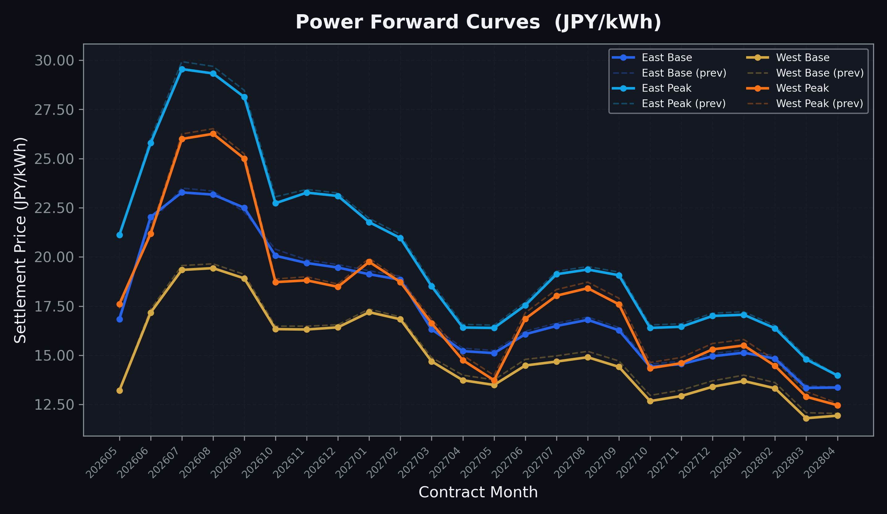
Power Forward Curves
East/West Base & Peak monthly contracts (2026-05-22)

Slide 3
Commodity Snapshot
Front-month settlement prices as of 2026-05-22
Category | Asset | Contract | Settlement | Unit | Change | % Chg
Energy | Barge Gas Oil | 202606 | 109,700.00 | JPY/kl | +0.00 | +0.00%
Energy | Barge Gasoline | 202606 | 100,000.00 | JPY/kl | +0.00 | +0.00%
Energy | Barge Kerosene | 202606 | 105,000.00 | JPY/kl | +0.00 | +0.00%
Energy | Chukyo Gasoline | 202606 | 100,000.00 | JPY/kl | +0.00 | +0.00%
Energy | Chukyo Kerosene | 202606 | 105,000.00 | JPY/kl | +0.00 | +0.00%
Energy | Dubai Crude Oil | 202605 | 102,390.00 | JPY/kl | -370.00 | -0.36%
Energy | LNG (Platts JKM) | 202607 | 2,955.00 | USD/MMBtu | -46.00 | -1.53%
Metals | Gold | - | 22,993.00 | JPY/g | -11.00 | -0.05%
Metals | Palladium | 202606 | 7,000.00 | JPY/g | +0.00 | +0.00%
Metals | Platinum | - | 9,866.00 | JPY/g | +113.00 | +1.16%
Metals | Silver | 202606 | 390.00 | JPY/10g | +0.00 | +0.00%
Industrial | Rubber (RSS3) | 202605 | 397.00 | JPY/kg | +0.00 | +0.00%
Industrial | Rubber (TSR20) | 202606 | 350.00 | JPY/kg | +0.00 | +0.00%
Industrial | Shanghai Natural Rubber | 202609 | 17,485.00 | JPY/kg | +15.00 | +0.09%
Agriculture | Azuki Beans | 202605 | 12,300.00 | JPY/bag | +0.00 | +0.00%
Agriculture | Corn | 202607 | 39,000.00 | JPY/t | +0.00 | +0.00%
Agriculture | Soybeans | 202606 | 64,000.00 | JPY/t | +0.00 | +0.00%

Slide 4
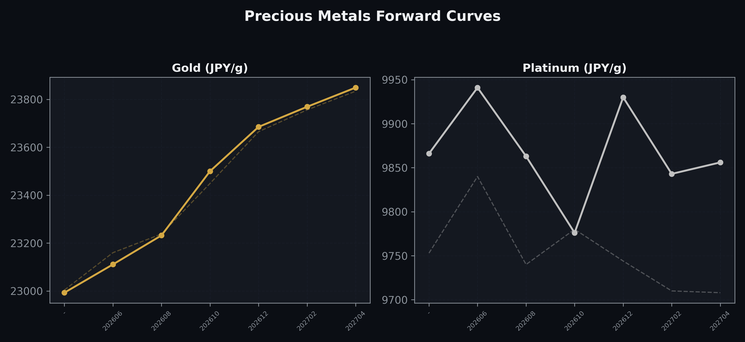
Precious Metals Forward Curves
Gold & Platinum (2026-05-22)

Slide 5
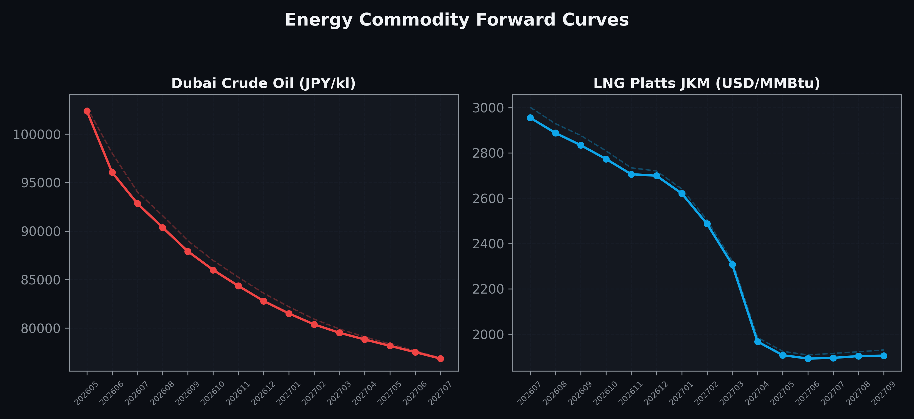
Energy Commodity Forward Curves
Dubai Crude Oil & LNG Platts JKM (2026-05-22)

Slide 6
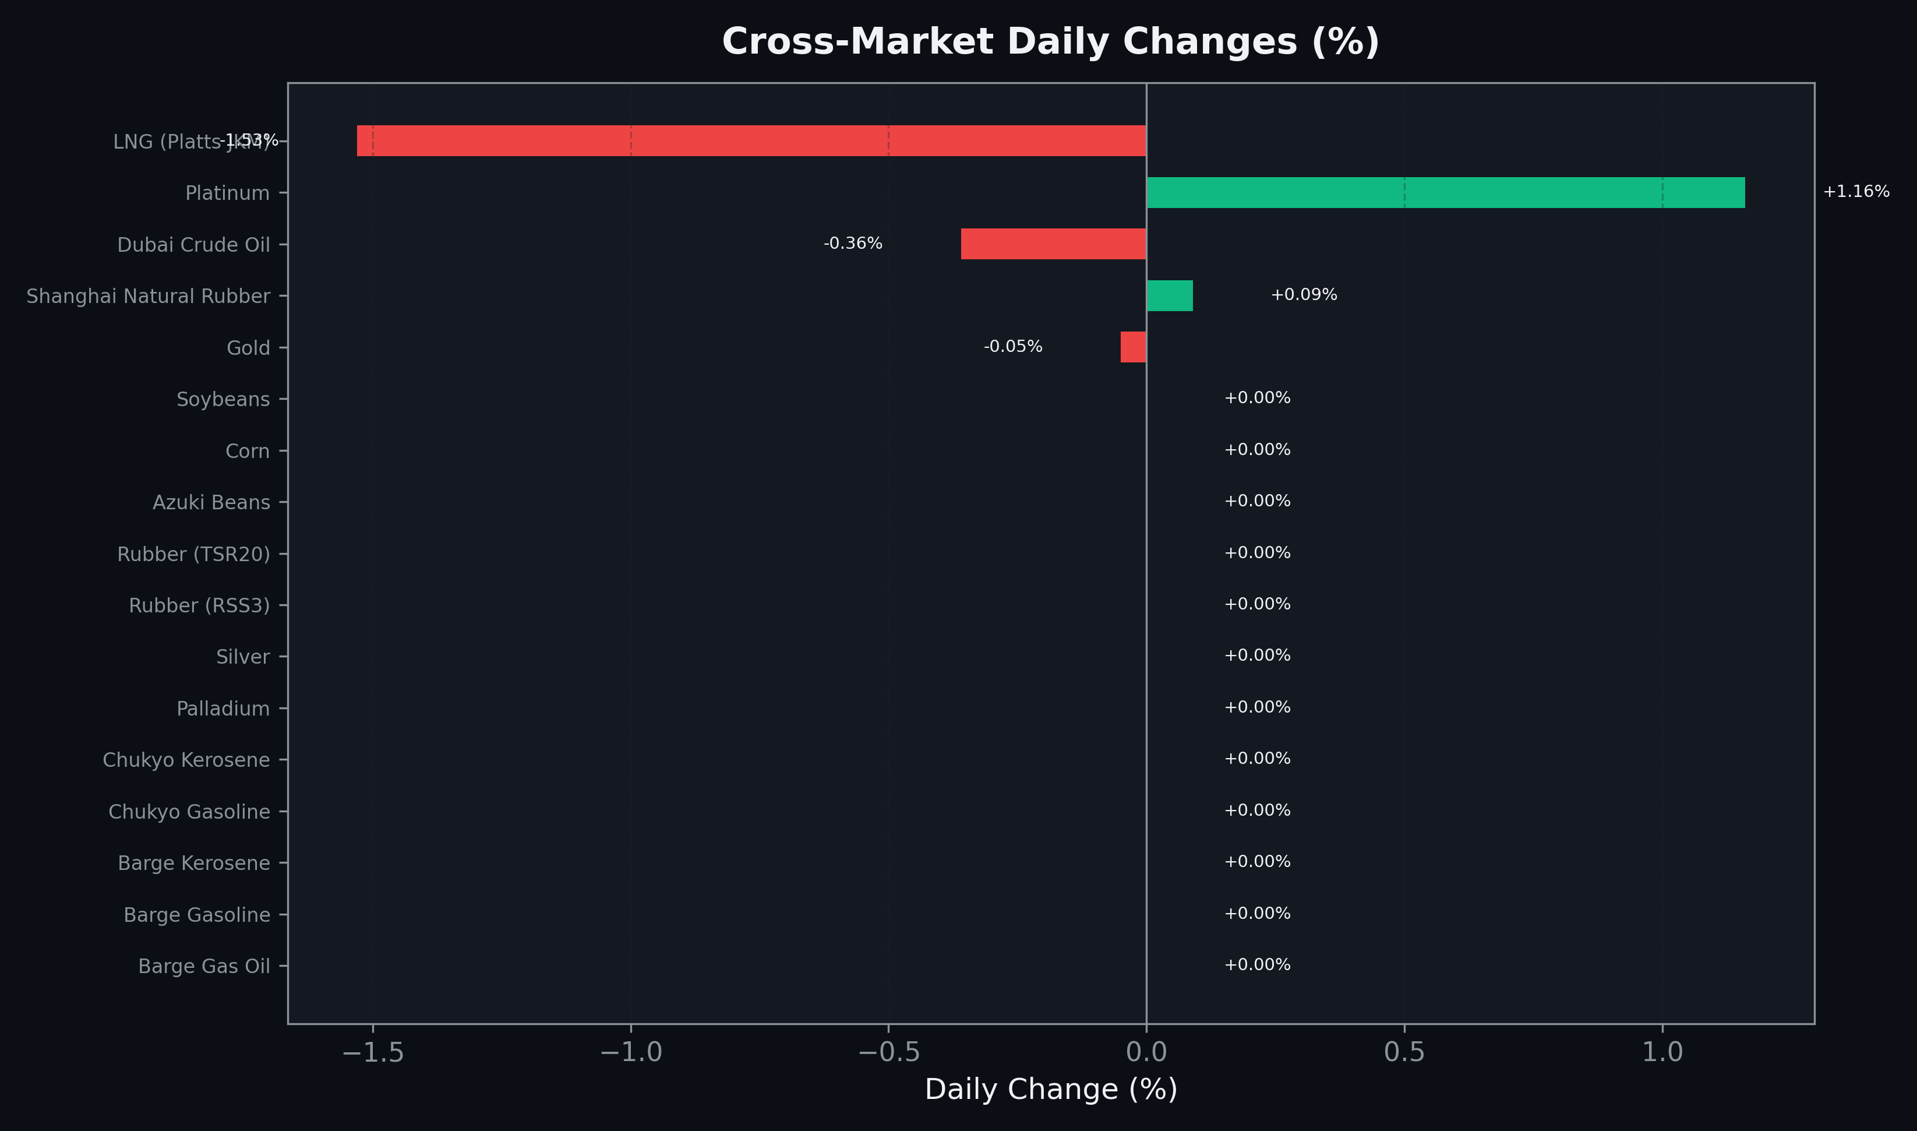
Cross-Market Daily Changes
All commodities sorted by absolute % change

Slide 7
Top Power Futures Movers
Largest absolute settlement price changes vs previous day (2026-05-22)
Instrument | Underlying | Month | Price | Prev | Change | % Chg
FUT_ECB_260629 | 電力(中部・ベース) | 202606 | 20.86 | 20.03 | +0.83 | +4.14%
FUT_ECB_260828 | 電力(中部・ベース) | 202608 | 22.84 | 22.05 | +0.79 | +3.58%
FUT_ECB_260730 | 電力(中部・ベース) | 202607 | 22.84 | 22.07 | +0.77 | +3.49%
FUT_ECB_260929 | 電力(中部・ベース) | 202609 | 22.40 | 21.66 | +0.74 | +3.42%
FUT_EEP_260730 | Power East Peak (Monthly) | 202607 | 29.55 | 29.93 | -0.38 | -1.27%
FUT_EEP_260828 | Power East Peak (Monthly) | 202608 | 29.33 | 29.69 | -0.36 | -1.21%
FUT_EEP_260929 | Power East Peak (Monthly) | 202609 | 28.13 | 28.47 | -0.34 | -1.19%
FUT_EEB_261030 | Power East Base (Monthly) | 202610 | 20.06 | 20.39 | -0.33 | -1.62%
FUT_EEP_261029 | Power East Peak (Monthly) | 202610 | 22.73 | 23.06 | -0.33 | -1.43%
FUT_EWPW_260604 | Power West Peak (Weekly) | 20260605 | 19.81 | 20.14 | -0.33 | -1.64%
FUT_ECP_260730 | 電力(中部・日中) | 202607 | 27.27 | 27.58 | -0.31 | -1.12%
FUT_EEB_260629 | Power East Base (Monthly) | 202606 | 22.03 | 21.72 | +0.31 | +1.43%
FUT_EWB_270629 | Power West Base (Monthly) | 202706 | 14.48 | 14.79 | -0.31 | -2.10%
FUT_EWP_270629 | Power West Peak (Monthly) | 202706 | 16.85 | 17.16 | -0.31 | -1.81%
FUT_EWP_270729 | Power West Peak (Monthly) | 202707 | 18.03 | 18.34 | -0.31 | -1.69%

