Slide 1
Daily Market Report
Trade Date: 2026-03-11
JPX Derivative & Commodity Analytics
DataServer In-House

Slide 2
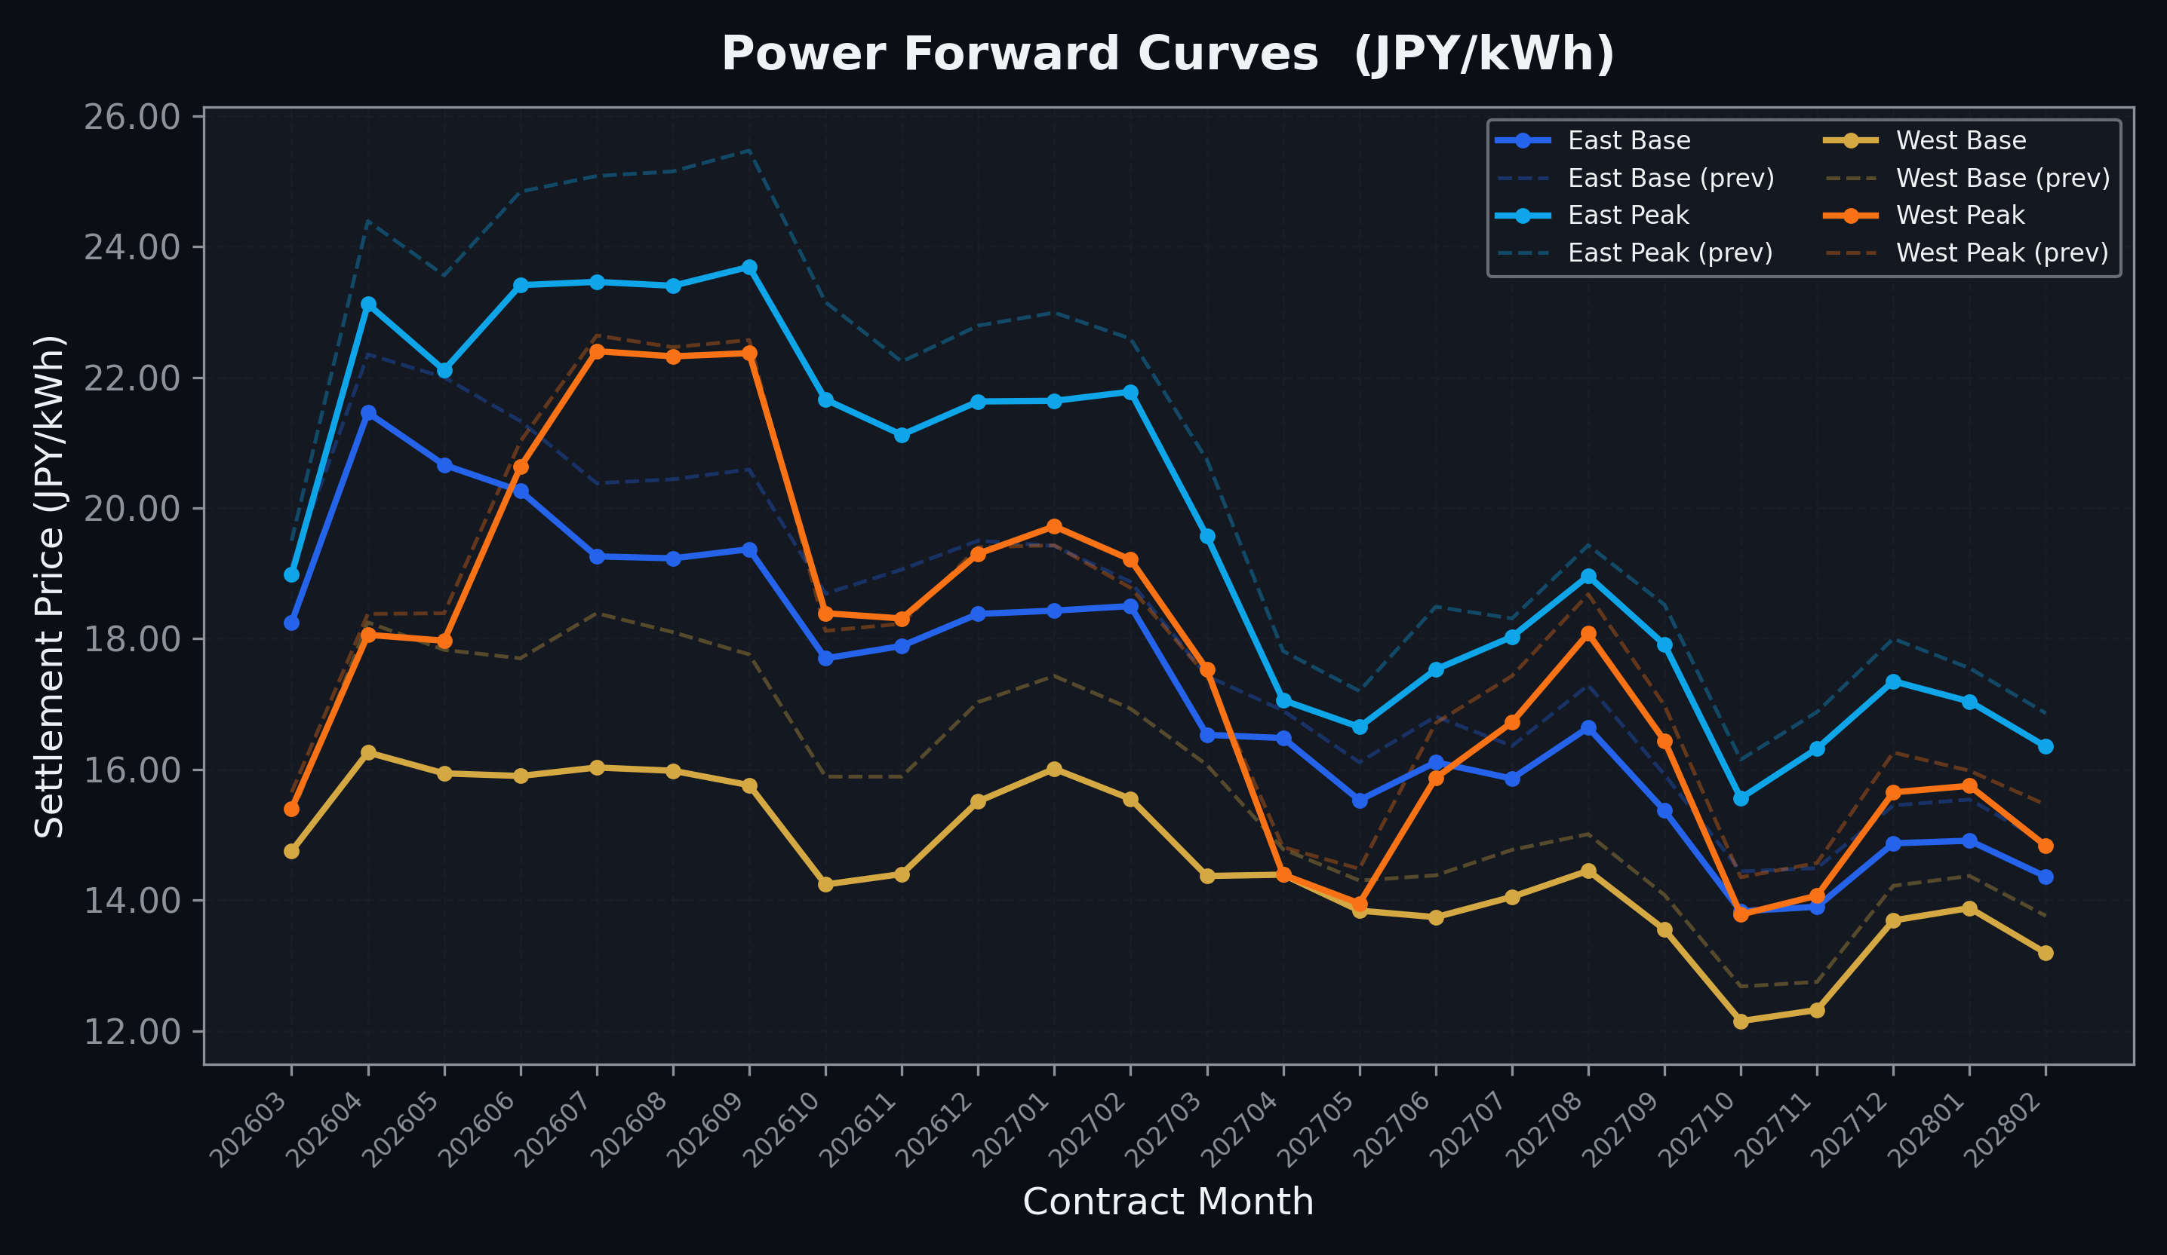
Power Forward Curves
East/West Base & Peak monthly contracts (2026-03-11)

Slide 3
Commodity Snapshot
Front-month settlement prices as of 2026-03-11
Category | Asset | Contract | Settlement | Unit | Change | % Chg
Energy | Barge Gas Oil | 202604 | 95,600.00 | JPY/kl | +1600.00 | +1.70%
Energy | Barge Gasoline | 202604 | 110,000.00 | JPY/kl | +0.00 | +0.00%
Energy | Barge Kerosene | 202604 | 108,000.00 | JPY/kl | +0.00 | +0.00%
Energy | Chukyo Gasoline | 202604 | 100,000.00 | JPY/kl | +0.00 | +0.00%
Energy | Chukyo Kerosene | 202604 | 94,000.00 | JPY/kl | +0.00 | +0.00%
Energy | Dubai Crude Oil | 202603 | 104,930.00 | JPY/kl | +4930.00 | +4.93%
Energy | LNG (Platts JKM) | 202604 | 2,756.00 | USD/MMBtu | -261.00 | -8.65%
Metals | Gold | - | 26,099.00 | JPY/g | +154.00 | +0.59%
Metals | Palladium | 202604 | 8,500.00 | JPY/g | +0.00 | +0.00%
Metals | Platinum | - | 10,966.00 | JPY/g | -19.00 | -0.17%
Metals | Silver | 202604 | 420.00 | JPY/10g | +0.00 | +0.00%
Industrial | Rubber (RSS3) | 202603 | 374.50 | JPY/kg | +1.50 | +0.40%
Industrial | Rubber (TSR20) | 202604 | 310.00 | JPY/kg | +0.00 | +0.00%
Industrial | Shanghai Natural Rubber | 202605 | 17,125.00 | JPY/kg | +40.00 | +0.23%
Agriculture | Azuki Beans | 202603 | 12,300.00 | JPY/bag | +0.00 | +0.00%
Agriculture | Corn | 202605 | 39,000.00 | JPY/t | +0.00 | +0.00%
Agriculture | Soybeans | 202604 | 64,000.00 | JPY/t | +0.00 | +0.00%

Slide 4
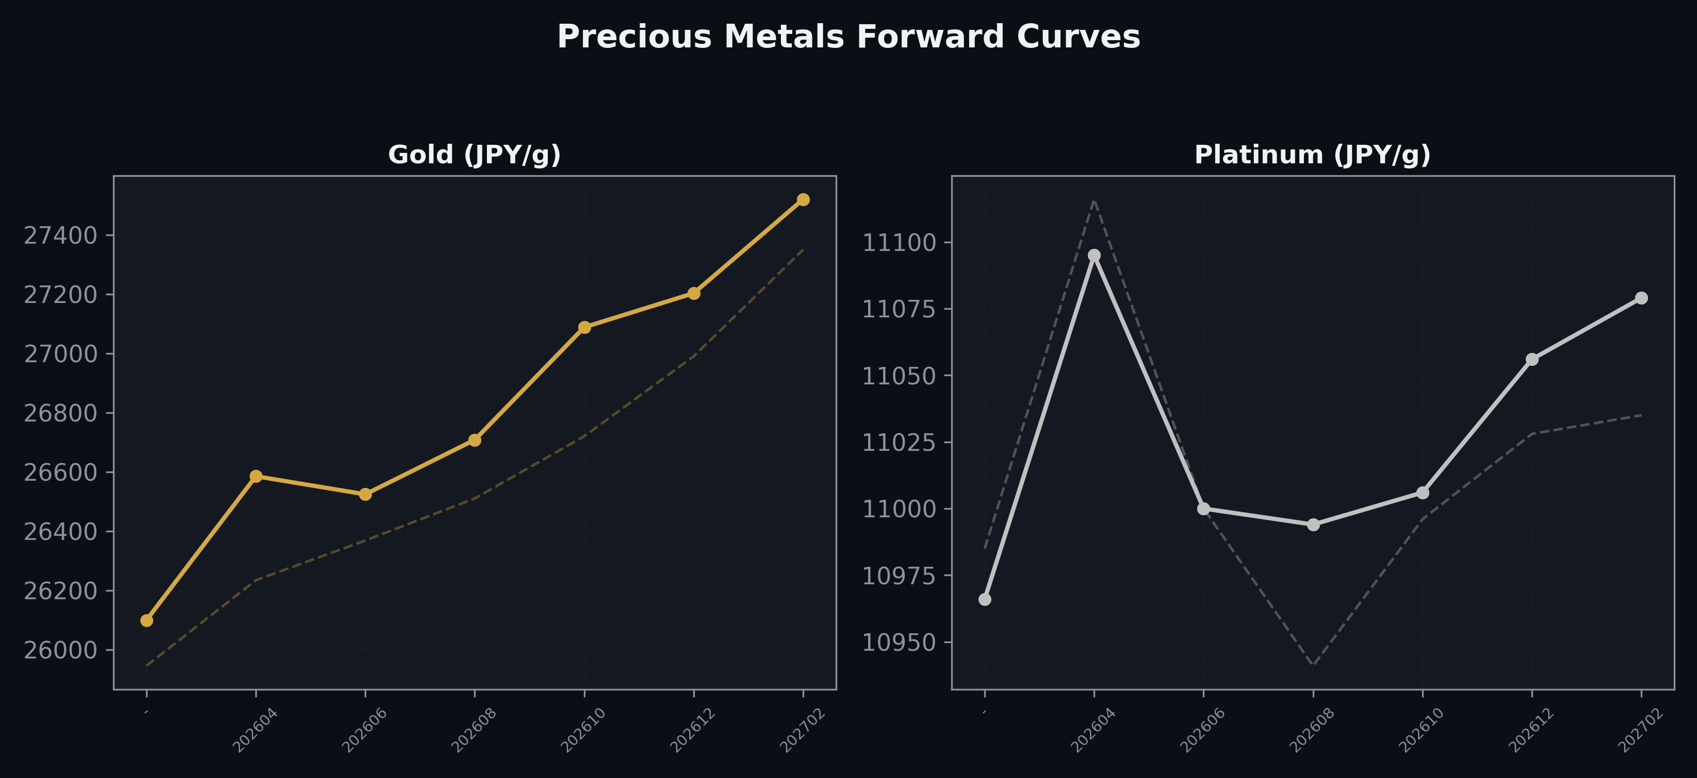
Precious Metals Forward Curves
Gold & Platinum (2026-03-11)

Slide 5
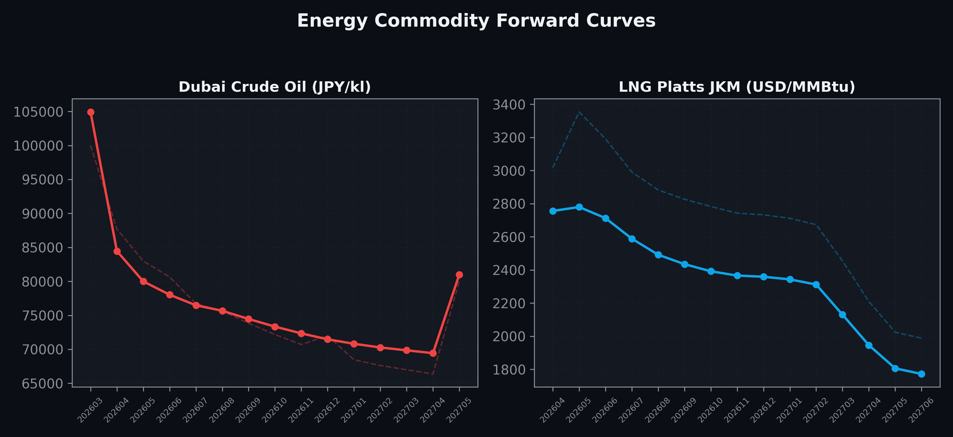
Energy Commodity Forward Curves
Dubai Crude Oil & LNG Platts JKM (2026-03-11)

Slide 6
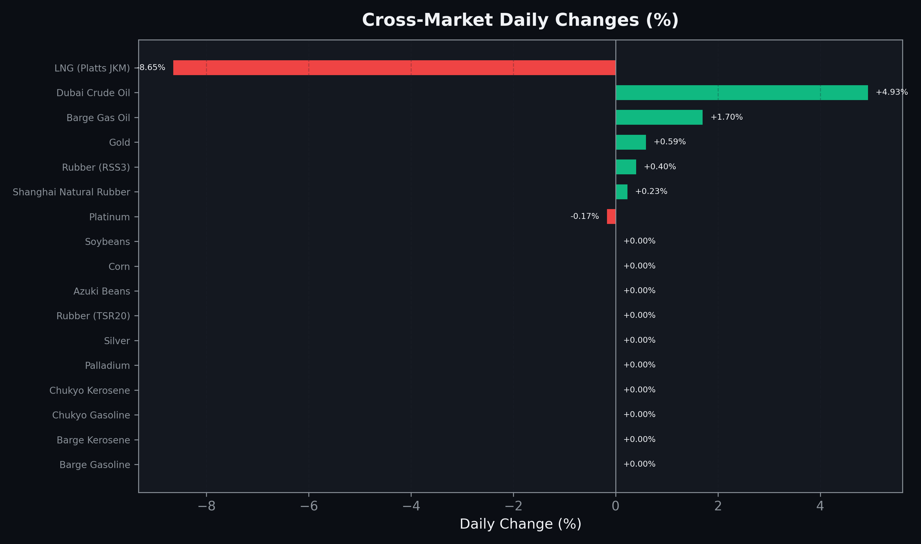
Cross-Market Daily Changes
All commodities sorted by absolute % change

Slide 7
Top Power Futures Movers
Largest absolute settlement price changes vs previous day (2026-03-11)
Instrument | Underlying | Month | Price | Prev | Change | % Chg
FUT_EWB_260730 | Power West Base (Monthly) | 202607 | 16.03 | 18.39 | -2.36 | -12.83%
FUT_EWB_260828 | Power West Base (Monthly) | 202608 | 15.98 | 18.10 | -2.12 | -11.71%
FUT_EEPW_260312 | Power East Peak (Weekly) | 20260313 | 13.96 | 15.96 | -2.00 | -12.53%
FUT_EWB_260929 | Power West Base (Monthly) | 202609 | 15.76 | 17.76 | -2.00 | -11.26%
FUT_EWB_260428 | Power West Base (Monthly) | 202604 | 16.26 | 18.25 | -1.99 | -10.90%
FUT_EWB_260529 | Power West Base (Monthly) | 202605 | 15.94 | 17.83 | -1.89 | -10.60%
FUT_EWB_260629 | Power West Base (Monthly) | 202606 | 15.90 | 17.70 | -1.80 | -10.17%
FUT_EEP_260929 | Power East Peak (Monthly) | 202609 | 23.69 | 25.47 | -1.78 | -6.99%
FUT_EWBY_260326 | Power West Base (Yearly) | 202604 | 15.49 | 17.27 | -1.78 | -10.31%
FUT_EEP_260828 | Power East Peak (Monthly) | 202608 | 23.40 | 25.15 | -1.75 | -6.96%
FUT_EWB_270330 | Power West Base (Monthly) | 202703 | 14.37 | 16.07 | -1.70 | -10.58%
FUT_EWB_261030 | Power West Base (Monthly) | 202610 | 14.24 | 15.89 | -1.65 | -10.38%
FUT_EEP_260730 | Power East Peak (Monthly) | 202607 | 23.46 | 25.08 | -1.62 | -6.46%
FUT_EWB_261230 | Power West Base (Monthly) | 202612 | 15.51 | 17.03 | -1.52 | -8.93%
FUT_EEP_261029 | Power East Peak (Monthly) | 202610 | 21.66 | 23.15 | -1.49 | -6.44%

