Slide 1
Daily Market Report
Trade Date: 2026-06-25
JPX Derivative & Commodity Analytics
DataServer In-House

Slide 2
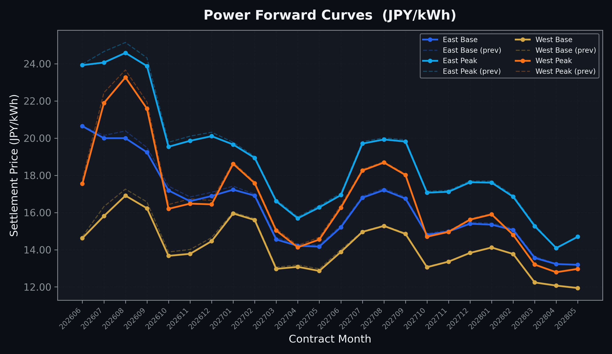
Power Forward Curves
East/West Base & Peak monthly contracts (2026-06-25)

Slide 3
Commodity Snapshot
Front-month settlement prices as of 2026-06-25
Category | Asset | Contract | Settlement | Unit | Change | % Chg
Energy | Barge Gas Oil | 202607 | 105,200.00 | JPY/kl | +0.00 | +0.00%
Energy | Barge Gasoline | 202607 | 97,000.00 | JPY/kl | +0.00 | +0.00%
Energy | Barge Kerosene | 202607 | 108,000.00 | JPY/kl | +0.00 | +0.00%
Energy | Chukyo Gasoline | 202607 | 94,000.00 | JPY/kl | +0.00 | +0.00%
Energy | Chukyo Kerosene | 202607 | 105,500.00 | JPY/kl | +500.00 | +0.48%
Energy | Dubai Crude Oil | 202606 | 80,300.00 | JPY/kl | -760.00 | -0.94%
Energy | LNG (Platts JKM) | 202608 | 2,485.00 | USD/MMBtu | -43.00 | -1.70%
Metals | Gold | - | 20,629.00 | JPY/g | -457.00 | -2.17%
Metals | Palladium | 202606 | 6,400.00 | JPY/g | +0.00 | +0.00%
Metals | Platinum | - | 8,044.00 | JPY/g | -408.00 | -4.83%
Metals | Silver | 202606 | 325.00 | JPY/10g | +0.00 | +0.00%
Industrial | Rubber (RSS3) | 202607 | 413.40 | JPY/kg | -16.30 | -3.79%
Industrial | Rubber (TSR20) | 202607 | 350.00 | JPY/kg | -15.00 | -4.11%
Industrial | Shanghai Natural Rubber | 202609 | 16,750.00 | JPY/kg | -960.00 | -5.42%
Agriculture | Azuki Beans | 202606 | 12,300.00 | JPY/bag | +0.00 | +0.00%
Agriculture | Corn | 202609 | 39,000.00 | JPY/t | +0.00 | +0.00%
Agriculture | Soybeans | 202608 | 64,000.00 | JPY/t | +0.00 | +0.00%

Slide 4
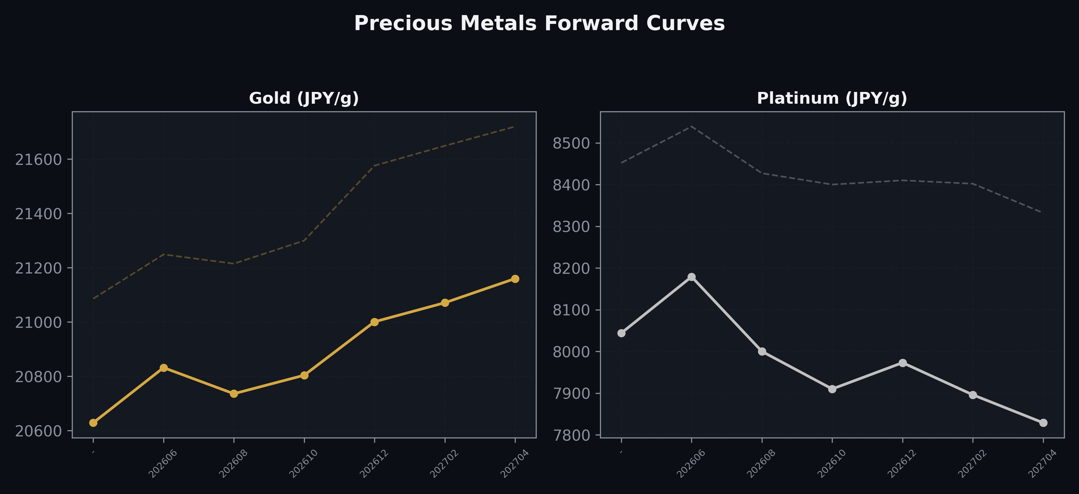
Precious Metals Forward Curves
Gold & Platinum (2026-06-25)

Slide 5
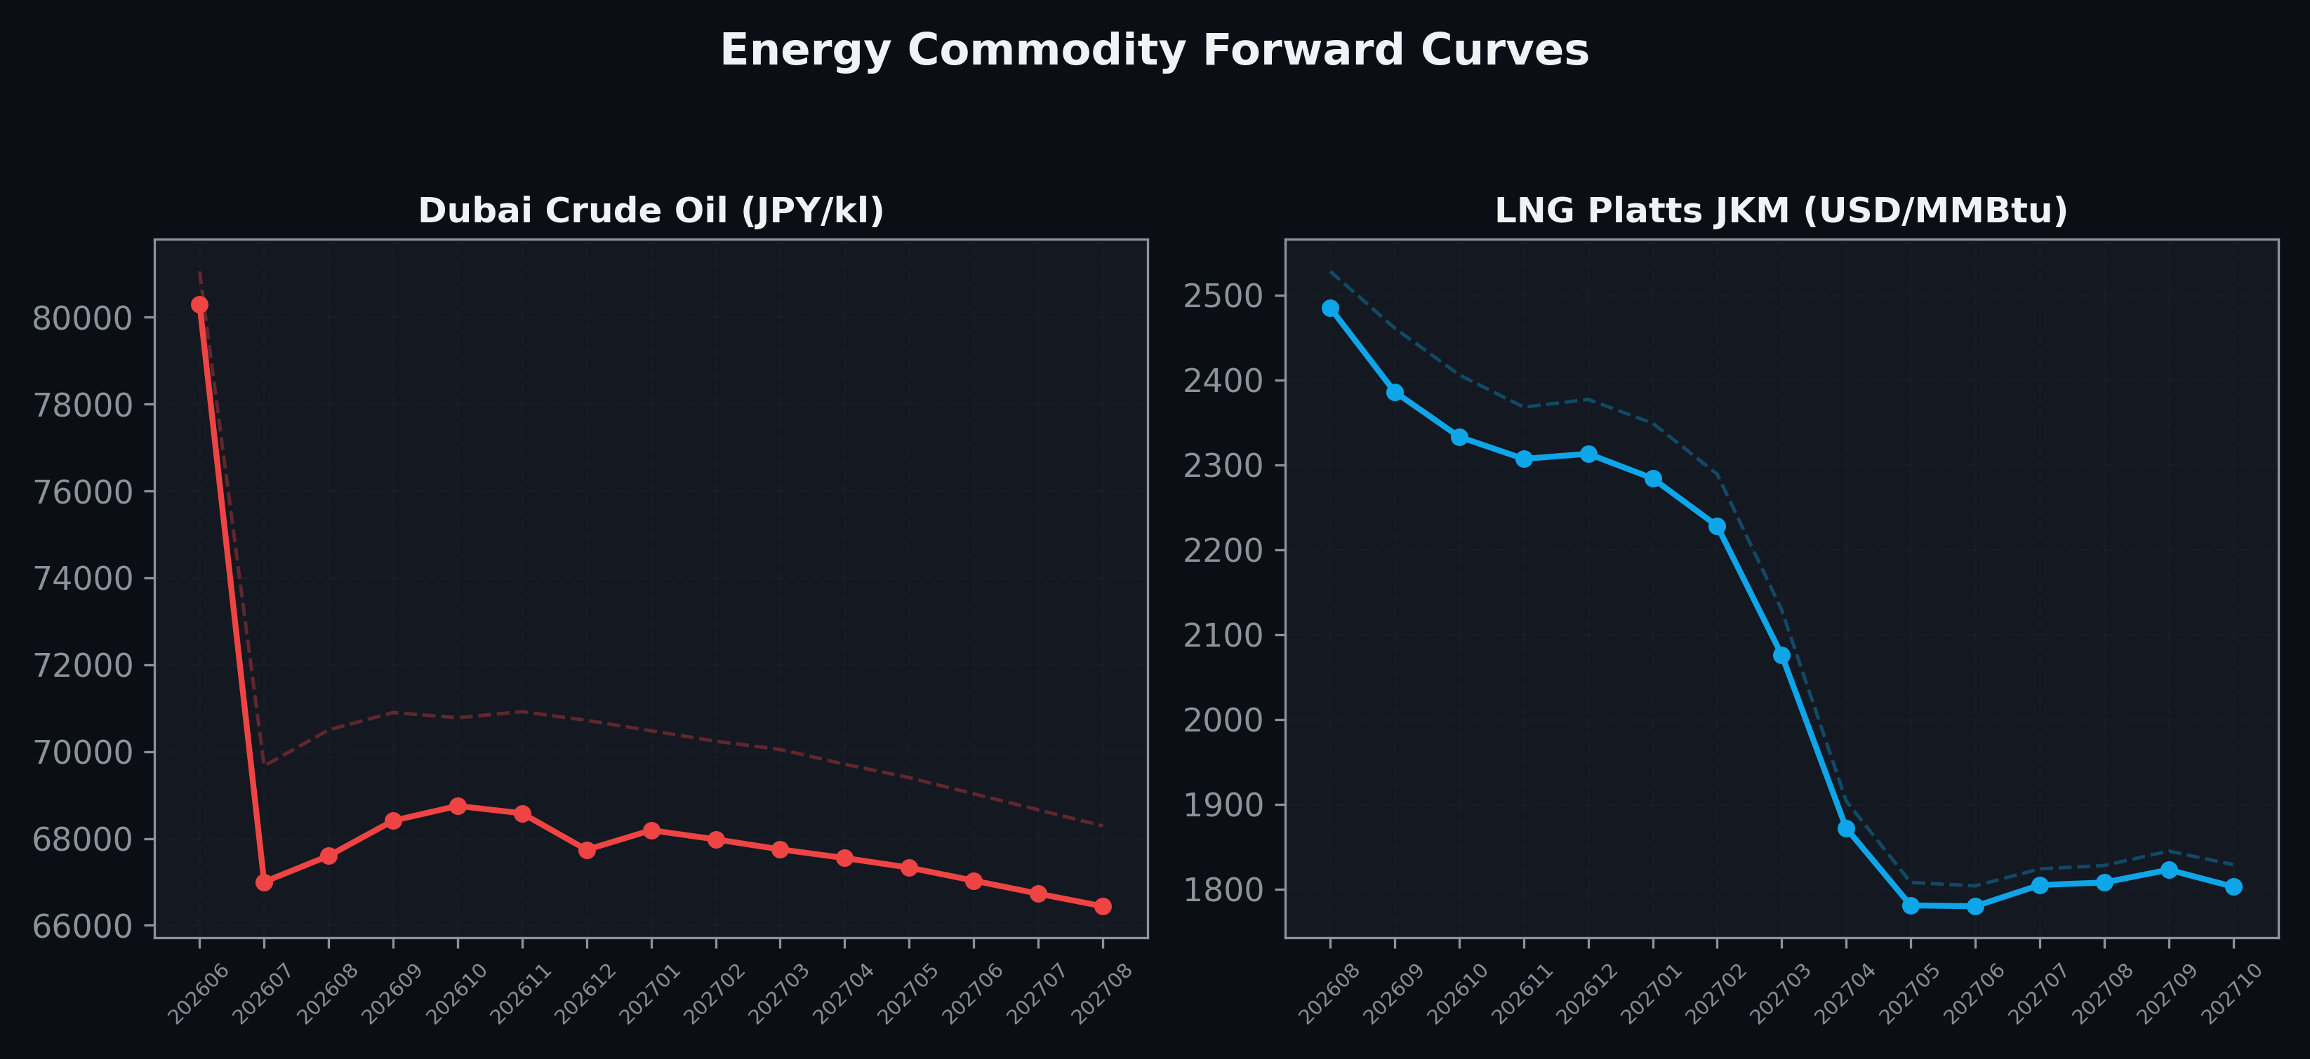
Energy Commodity Forward Curves
Dubai Crude Oil & LNG Platts JKM (2026-06-25)

Slide 6
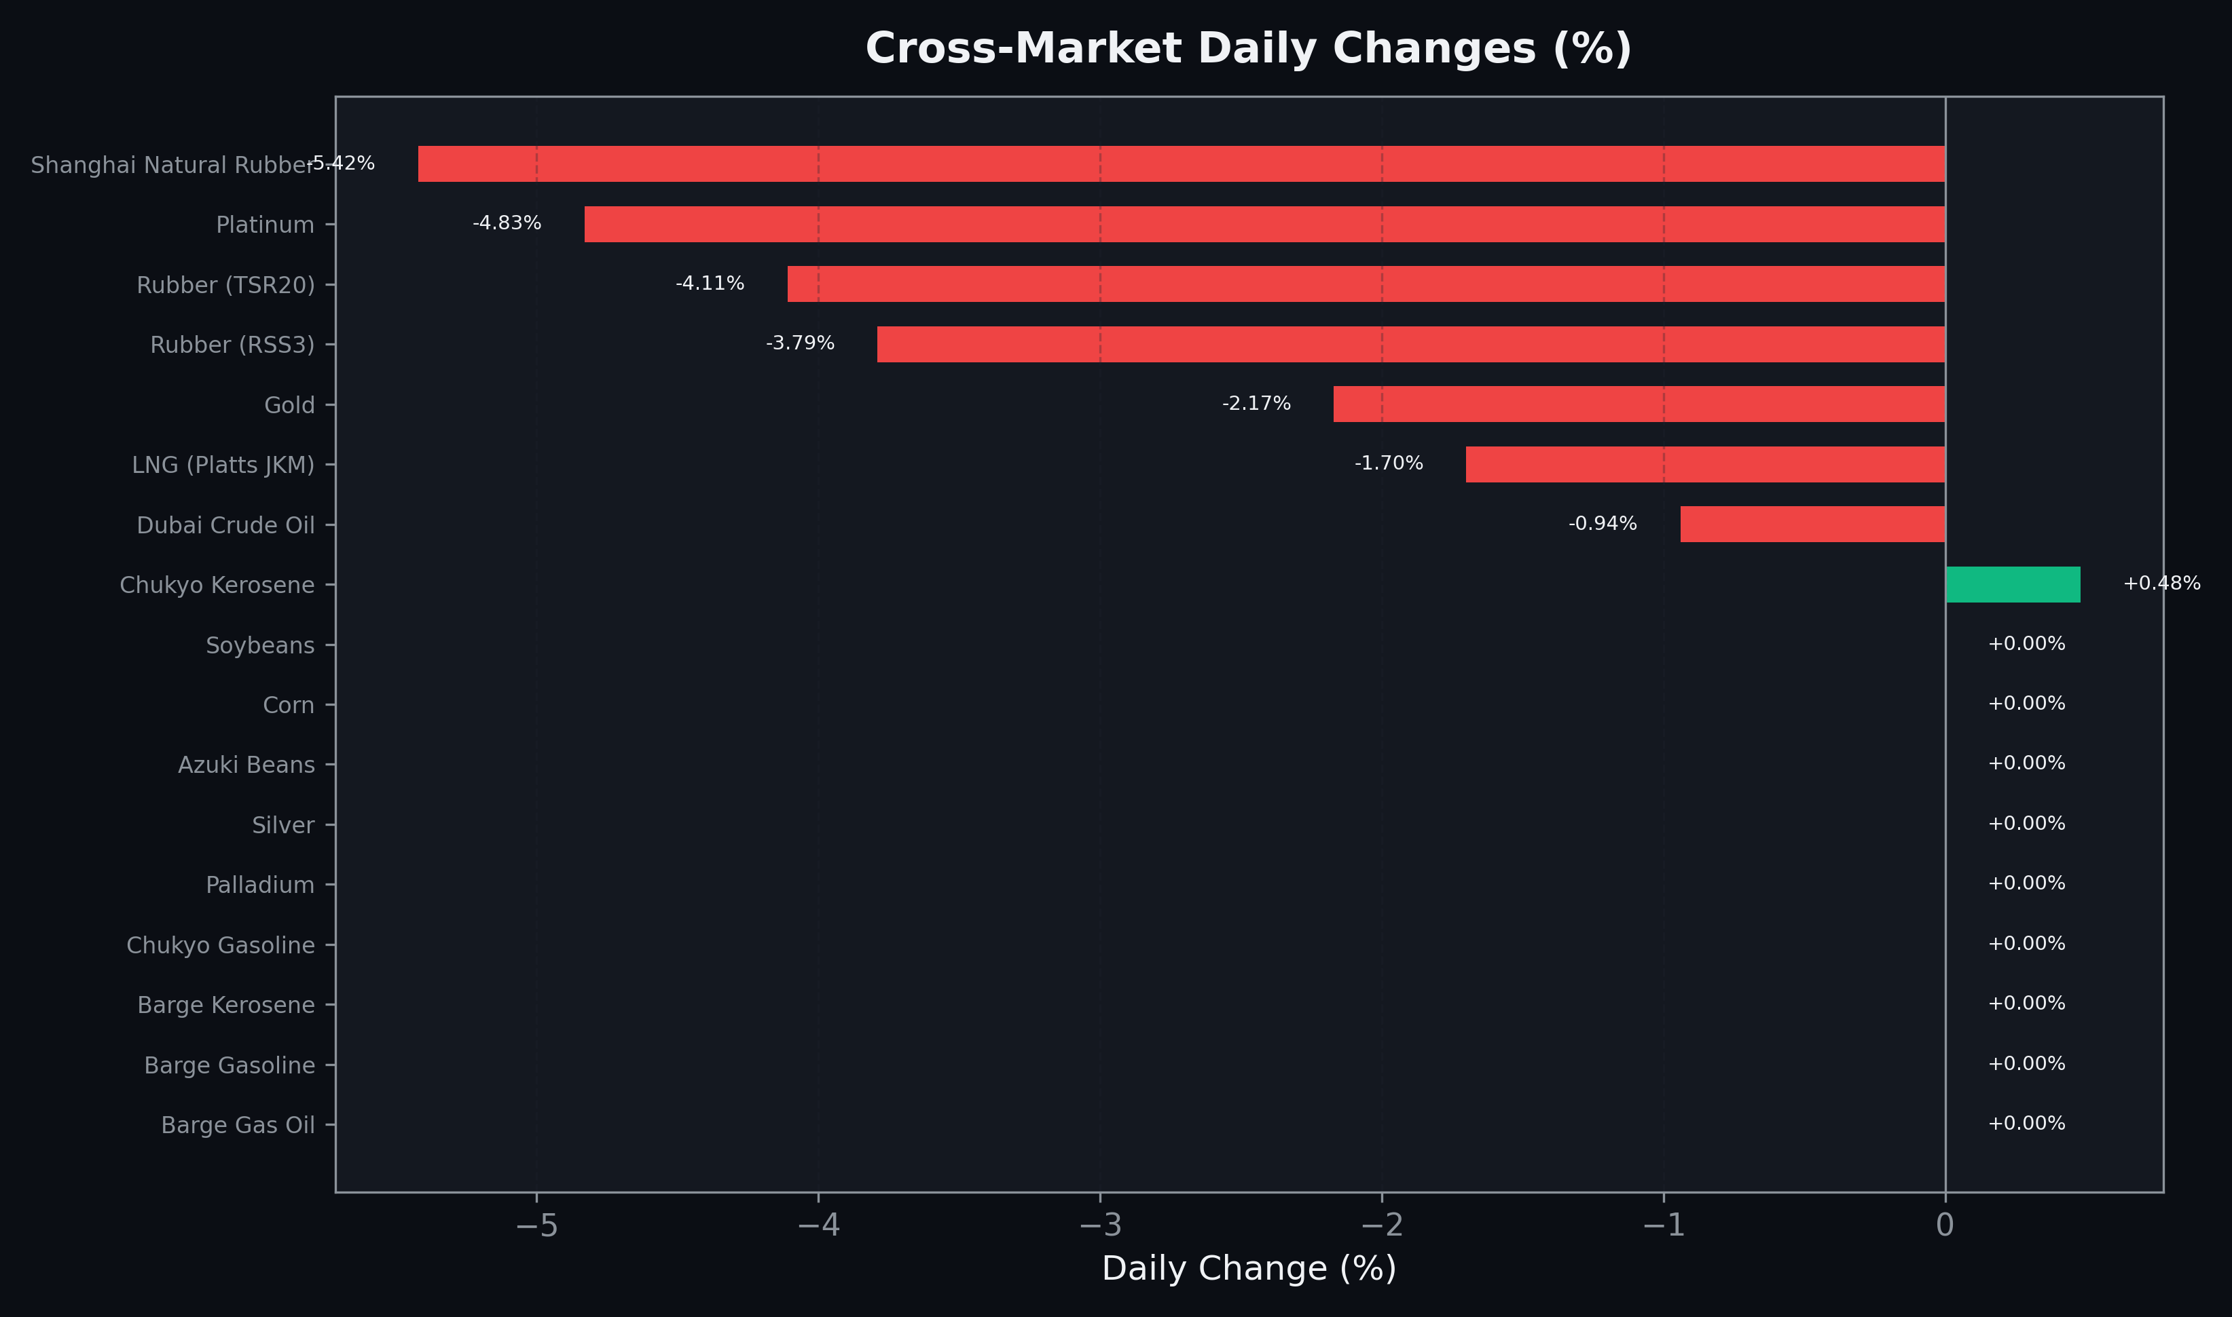
Cross-Market Daily Changes
All commodities sorted by absolute % change

Slide 7
Top Power Futures Movers
Largest absolute settlement price changes vs previous day (2026-06-25)
Instrument | Underlying | Month | Price | Prev | Change | % Chg
FUT_EEP_260730 | Power East Peak (Monthly) | 202607 | 24.07 | 24.66 | -0.59 | -2.39%
FUT_EEP_260828 | Power East Peak (Monthly) | 202608 | 24.59 | 25.15 | -0.56 | -2.23%
FUT_EWP_260730 | Power West Peak (Monthly) | 202607 | 21.89 | 22.45 | -0.56 | -2.49%
FUT_EWBW_260709 | Power West Base (Weekly) | 20260710 | 15.38 | 15.92 | -0.54 | -3.39%
FUT_EWPW_260702 | Power West Peak (Weekly) | 20260703 | 18.36 | 18.90 | -0.54 | -2.86%
FUT_EWB_260730 | Power West Base (Monthly) | 202607 | 15.81 | 16.32 | -0.51 | -3.12%
FUT_EWPW_260709 | Power West Peak (Weekly) | 20260710 | 20.95 | 21.40 | -0.45 | -2.10%
FUT_EWPW_260723 | Power West Peak (Weekly) | 20260724 | 22.43 | 22.88 | -0.45 | -1.97%
FUT_ECB_260730 | 電力(中部・ベース) | 202607 | 18.24 | 18.68 | -0.44 | -2.36%
FUT_EEP_260929 | Power East Peak (Monthly) | 202609 | 23.88 | 24.32 | -0.44 | -1.81%
FUT_EEPW_260709 | Power East Peak (Weekly) | 20260710 | 24.10 | 24.54 | -0.44 | -1.79%
FUT_EEPW_260723 | Power East Peak (Weekly) | 20260724 | 24.75 | 25.19 | -0.44 | -1.75%
FUT_EEPW_260716 | Power East Peak (Weekly) | 20260717 | 24.44 | 24.87 | -0.43 | -1.73%
FUT_ECP_260730 | 電力(中部・日中) | 202607 | 23.25 | 23.67 | -0.42 | -1.77%
FUT_EEBW_260723 | Power East Base (Weekly) | 20260724 | 19.52 | 19.93 | -0.41 | -2.06%

