Slide 1
Daily Market Report
Trade Date: 2026-04-27
JPX Derivative & Commodity Analytics
DataServer In-House

Slide 2
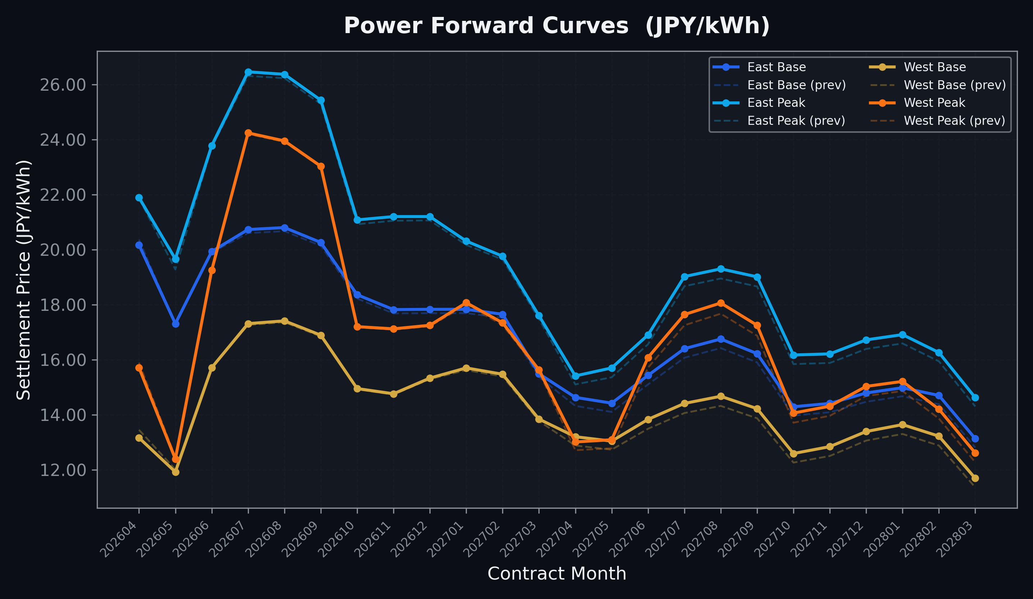
Power Forward Curves
East/West Base & Peak monthly contracts (2026-04-27)

Slide 3
Commodity Snapshot
Front-month settlement prices as of 2026-04-27
Category | Asset | Contract | Settlement | Unit | Change | % Chg
Energy | Barge Gas Oil | 202606 | 114,900.00 | JPY/kl | -200.00 | -0.17%
Energy | Barge Gasoline | 202606 | 100,000.00 | JPY/kl | -5000.00 | -4.76%
Energy | Barge Kerosene | 202606 | 105,000.00 | JPY/kl | +0.00 | +0.00%
Energy | Chukyo Gasoline | 202606 | 100,000.00 | JPY/kl | -5000.00 | -4.76%
Energy | Chukyo Kerosene | 202606 | 105,000.00 | JPY/kl | +0.00 | +0.00%
Energy | Dubai Crude Oil | 202604 | 105,800.00 | JPY/kl | +30.00 | +0.03%
Energy | LNG (Platts JKM) | 202606 | 2,669.00 | USD/MMBtu | +3.00 | +0.11%
Metals | Gold | - | 24,034.00 | JPY/g | +177.00 | +0.74%
Metals | Palladium | 202606 | 7,900.00 | JPY/g | +0.00 | +0.00%
Metals | Platinum | - | 10,116.00 | JPY/g | +35.00 | +0.35%
Metals | Silver | 202606 | 390.00 | JPY/10g | +6.90 | +1.80%
Industrial | Rubber (RSS3) | 202605 | 383.80 | JPY/kg | -2.80 | -0.72%
Industrial | Rubber (TSR20) | 202605 | 330.00 | JPY/kg | +0.00 | +0.00%
Industrial | Shanghai Natural Rubber | 202605 | 17,100.00 | JPY/kg | +165.00 | +0.97%
Agriculture | Azuki Beans | 202605 | 12,300.00 | JPY/bag | +0.00 | +0.00%
Agriculture | Corn | 202607 | 39,000.00 | JPY/t | +0.00 | +0.00%
Agriculture | Soybeans | 202606 | 64,000.00 | JPY/t | +0.00 | +0.00%

Slide 4
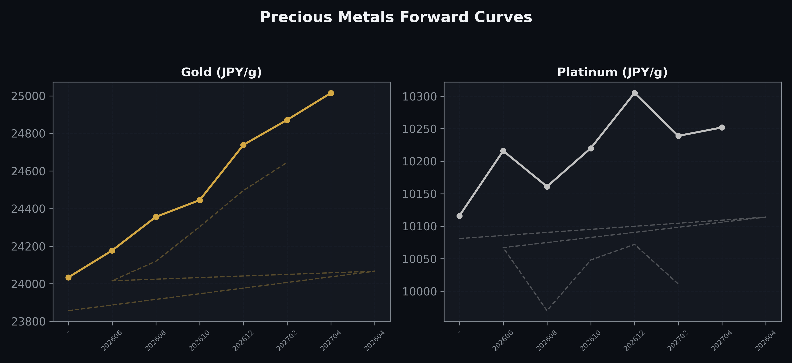
Precious Metals Forward Curves
Gold & Platinum (2026-04-27)

Slide 5
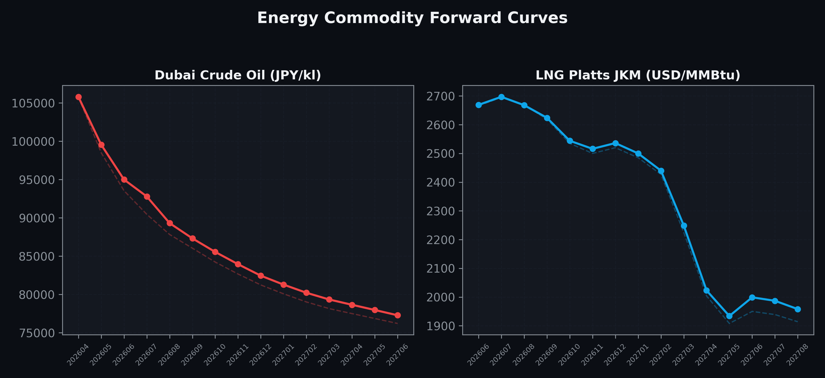
Energy Commodity Forward Curves
Dubai Crude Oil & LNG Platts JKM (2026-04-27)

Slide 6
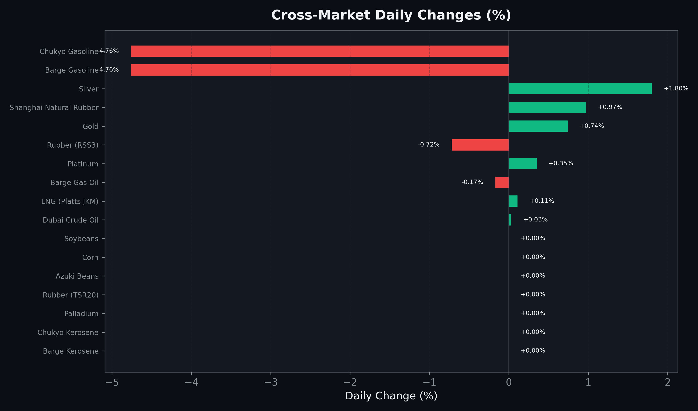
Cross-Market Daily Changes
All commodities sorted by absolute % change

Slide 7
Top Power Futures Movers
Largest absolute settlement price changes vs previous day (2026-04-27)
Instrument | Underlying | Month | Price | Prev | Change | % Chg
FUT_EEPW_260428 | Power East Peak (Weekly) | 20260501 | 20.51 | 18.53 | +1.98 | +10.69%
FUT_EWBW_260430 | Power West Base (Weekly) | 20260501 | 10.72 | 12.42 | -1.70 | -13.69%
FUT_EWP_270729 | Power West Peak (Monthly) | 202707 | 17.64 | 17.25 | +0.39 | +2.26%
FUT_EWP_270830 | Power West Peak (Monthly) | 202708 | 18.06 | 17.67 | +0.39 | +2.21%
FUT_EWPW_260428 | Power West Peak (Weekly) | 20260501 | 12.39 | 12.00 | +0.39 | +3.25%
FUT_EEP_260528 | Power East Peak (Monthly) | 202605 | 19.66 | 19.28 | +0.38 | +1.97%
FUT_EWP_270929 | Power West Peak (Monthly) | 202709 | 17.25 | 16.87 | +0.38 | +2.25%
FUT_EWP_270629 | Power West Peak (Monthly) | 202706 | 16.08 | 15.71 | +0.37 | +2.36%
FUT_ECP_270729 | 電力(中部・日中) | 202707 | 17.71 | 17.36 | +0.35 | +2.02%
FUT_ECP_270929 | 電力(中部・日中) | 202709 | 17.83 | 17.48 | +0.35 | +2.00%
FUT_EEP_270729 | Power East Peak (Monthly) | 202707 | 19.02 | 18.67 | +0.35 | +1.87%
FUT_EEP_270830 | Power East Peak (Monthly) | 202708 | 19.30 | 18.95 | +0.35 | +1.85%
FUT_EEP_270929 | Power East Peak (Monthly) | 202709 | 19.01 | 18.66 | +0.35 | +1.88%
FUT_EWB_270730 | Power West Base (Monthly) | 202707 | 14.41 | 14.06 | +0.35 | +2.49%
FUT_EWB_270830 | Power West Base (Monthly) | 202708 | 14.67 | 14.32 | +0.35 | +2.44%

