Slide 1
Daily Market Report
Trade Date: 2026-04-07
JPX Derivative & Commodity Analytics
DataServer In-House

Slide 2
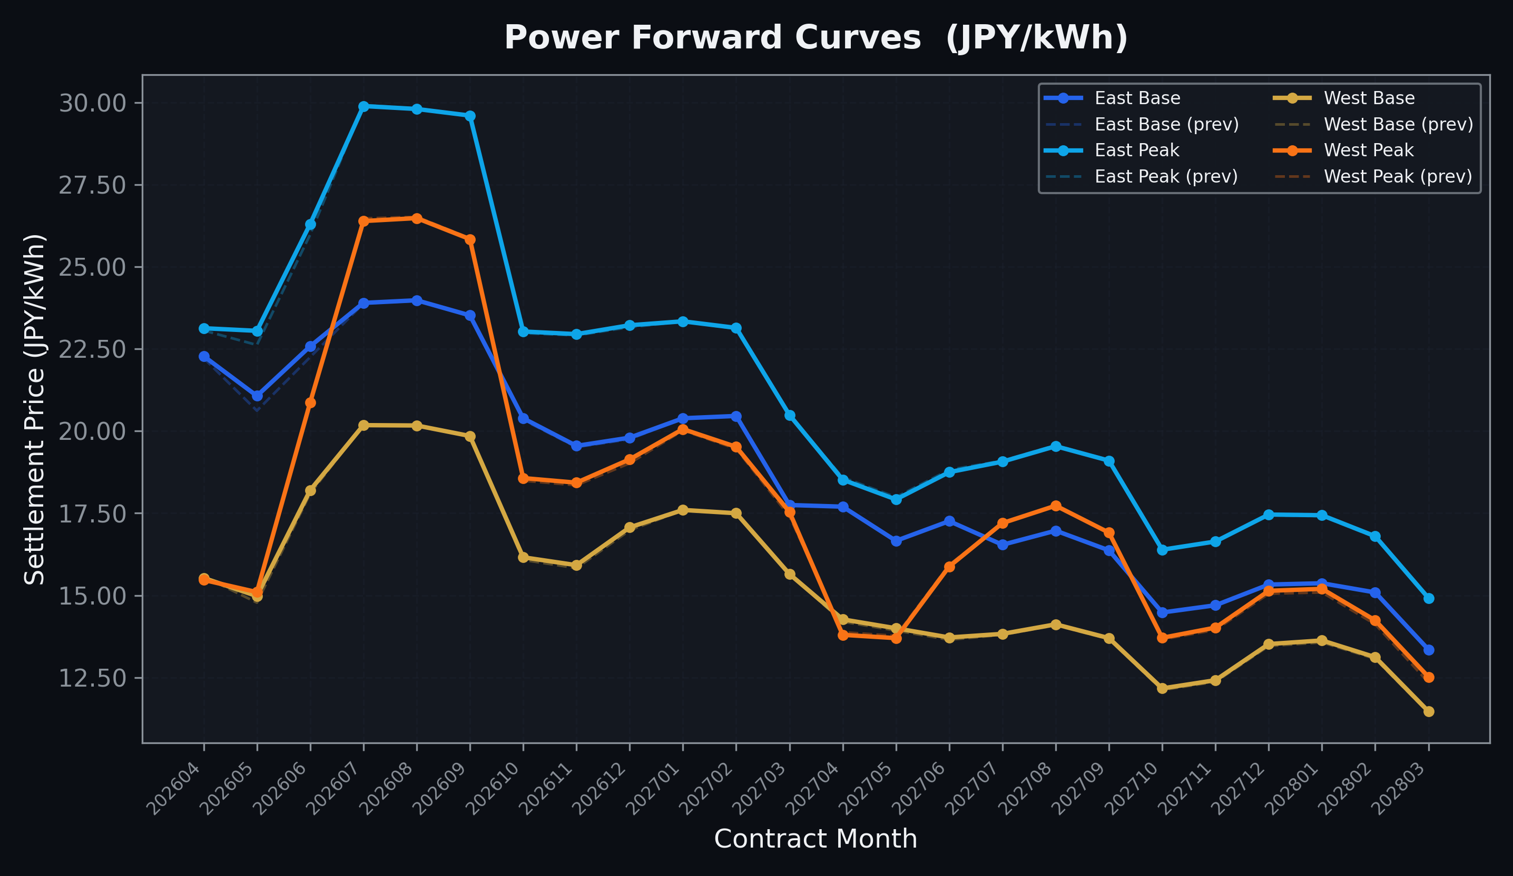
Power Forward Curves
East/West Base & Peak monthly contracts (2026-04-07)

Slide 3
Commodity Snapshot
Front-month settlement prices as of 2026-04-07
Category | Asset | Contract | Settlement | Unit | Change | % Chg
Energy | Barge Gas Oil | 202605 | 111,300.00 | JPY/kl | +500.00 | +0.45%
Energy | Barge Gasoline | 202605 | 120,000.00 | JPY/kl | -5000.00 | -4.00%
Energy | Barge Kerosene | 202605 | 110,000.00 | JPY/kl | -5000.00 | -4.35%
Energy | Chukyo Gasoline | 202605 | 110,000.00 | JPY/kl | -5000.00 | -4.35%
Energy | Chukyo Kerosene | 202605 | 105,000.00 | JPY/kl | +0.00 | +0.00%
Energy | Dubai Crude Oil | 202604 | 119,320.00 | JPY/kl | -1620.00 | -1.34%
Energy | LNG (Platts JKM) | 202605 | 3,132.00 | USD/MMBtu | +3.00 | +0.10%
Metals | Gold | - | 23,714.00 | JPY/g | -81.00 | -0.34%
Metals | Palladium | 202604 | 7,500.00 | JPY/g | +0.00 | +0.00%
Metals | Platinum | - | 10,010.00 | JPY/g | +78.00 | +0.79%
Metals | Silver | 202604 | 365.00 | JPY/10g | +0.00 | +0.00%
Industrial | Rubber (RSS3) | 202604 | 386.70 | JPY/kg | +6.70 | +1.76%
Industrial | Rubber (TSR20) | 202605 | 320.00 | JPY/kg | +0.00 | +0.00%
Industrial | Shanghai Natural Rubber | 202605 | 16,925.00 | JPY/kg | +65.00 | +0.39%
Agriculture | Azuki Beans | 202604 | 12,300.00 | JPY/bag | +0.00 | +0.00%
Agriculture | Corn | 202605 | 39,000.00 | JPY/t | +0.00 | +0.00%
Agriculture | Soybeans | 202604 | 64,000.00 | JPY/t | +0.00 | +0.00%

Slide 4
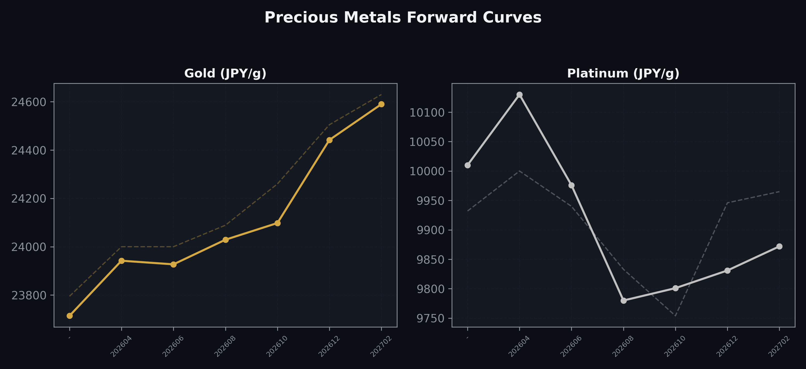
Precious Metals Forward Curves
Gold & Platinum (2026-04-07)

Slide 5
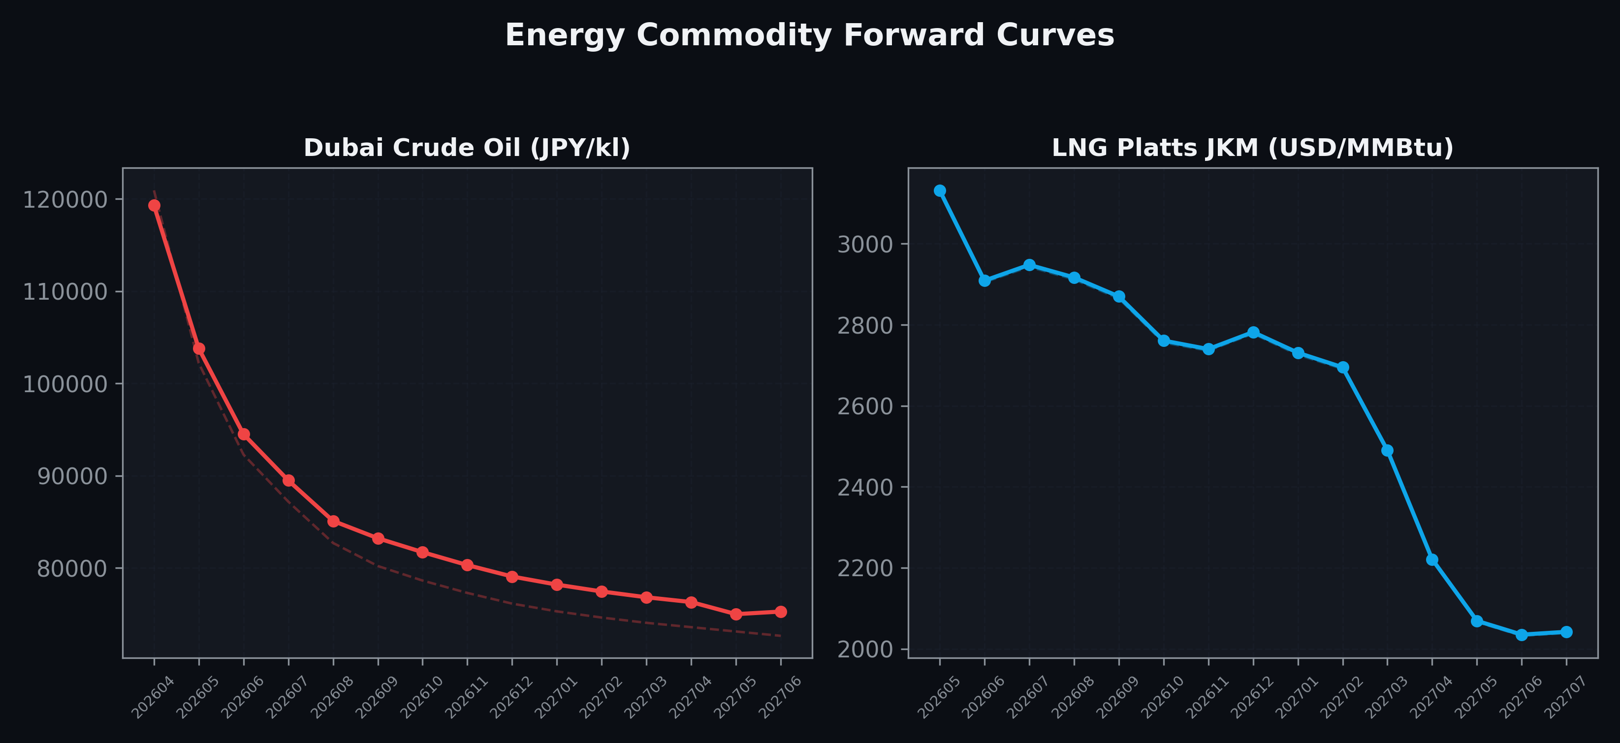
Energy Commodity Forward Curves
Dubai Crude Oil & LNG Platts JKM (2026-04-07)

Slide 6
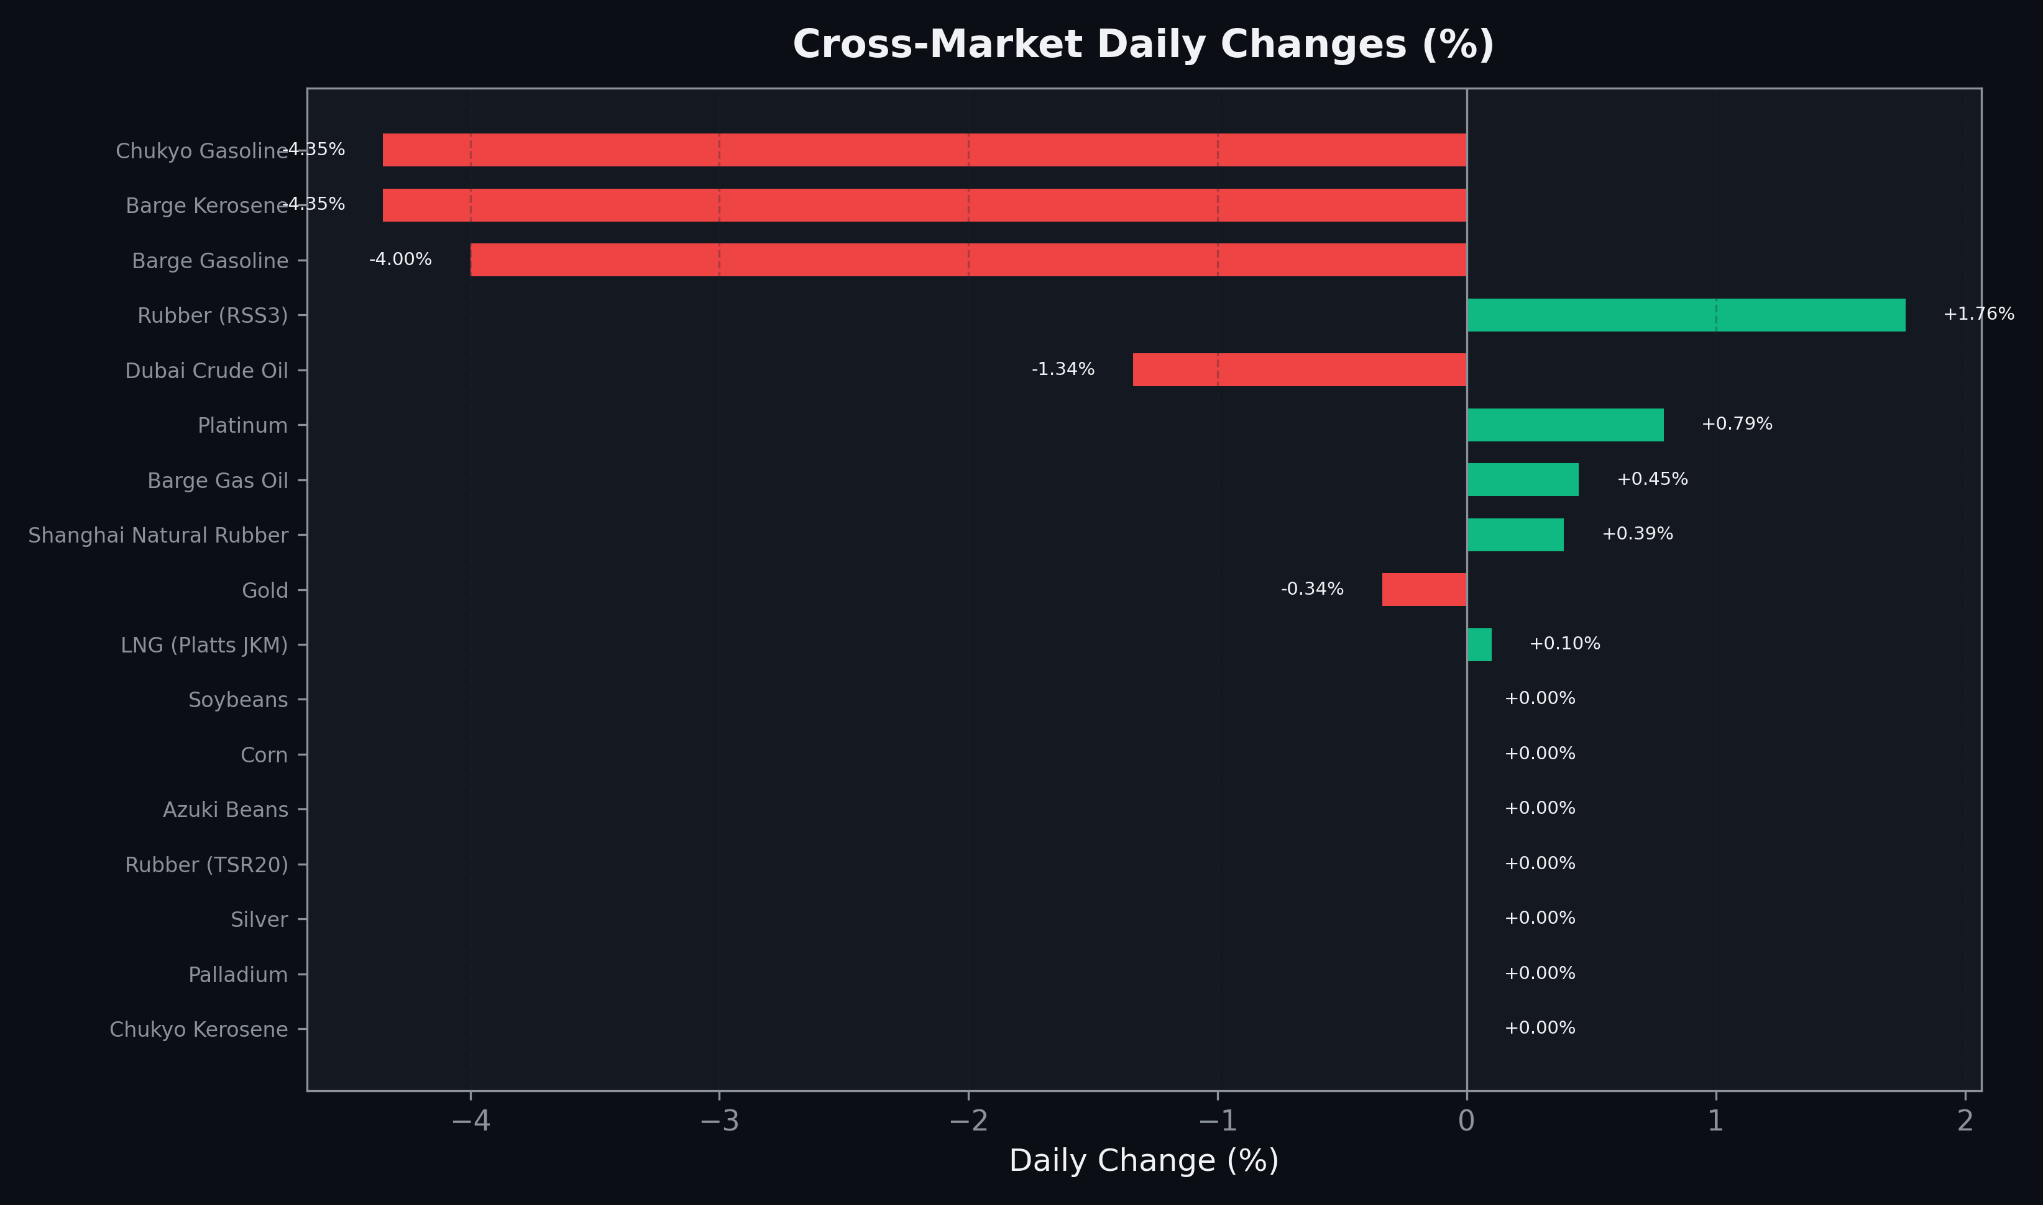
Cross-Market Daily Changes
All commodities sorted by absolute % change

Slide 7
Top Power Futures Movers
Largest absolute settlement price changes vs previous day (2026-04-07)
Instrument | Underlying | Month | Price | Prev | Change | % Chg
FUT_EEPW_260409 | Power East Peak (Weekly) | 20260410 | 21.62 | 22.89 | -1.27 | -5.55%
FUT_EEBW_260507 | Power East Base (Weekly) | 20260508 | 19.40 | 18.62 | +0.78 | +4.19%
FUT_EEPW_260507 | Power East Peak (Weekly) | 20260508 | 21.97 | 21.21 | +0.76 | +3.58%
FUT_EEB_260529 | Power East Base (Monthly) | 202605 | 21.07 | 20.62 | +0.45 | +2.18%
FUT_EWBW_260507 | Power West Base (Weekly) | 20260508 | 13.93 | 13.48 | +0.45 | +3.34%
FUT_EEBW_260409 | Power East Base (Weekly) | 20260410 | 21.45 | 21.89 | -0.44 | -2.01%
FUT_EEP_260528 | Power East Peak (Monthly) | 202605 | 23.05 | 22.62 | +0.43 | +1.90%
FUT_EEB_260629 | Power East Base (Monthly) | 202606 | 22.58 | 22.25 | +0.33 | +1.48%
FUT_EEP_260629 | Power East Peak (Monthly) | 202606 | 26.30 | 25.98 | +0.32 | +1.23%
FUT_EWB_260529 | Power West Base (Monthly) | 202605 | 14.98 | 14.78 | +0.20 | +1.35%
FUT_EWPW_260507 | Power West Peak (Weekly) | 20260508 | 13.46 | 13.26 | +0.20 | +1.51%
FUT_EWP_280330 | Power West Peak (Monthly) | 202803 | 12.52 | 12.35 | +0.17 | +1.38%
FUT_EWPW_260409 | Power West Peak (Weekly) | 20260410 | 16.83 | 16.68 | +0.15 | +0.90%
FUT_EWP_270330 | Power West Peak (Monthly) | 202703 | 17.54 | 17.41 | +0.13 | +0.75%
FUT_EWP_261228 | Power West Peak (Monthly) | 202612 | 19.14 | 19.02 | +0.12 | +0.63%

