Slide 1
Daily Market Report
Trade Date: 2026-04-06
JPX Derivative & Commodity Analytics
DataServer In-House

Slide 2
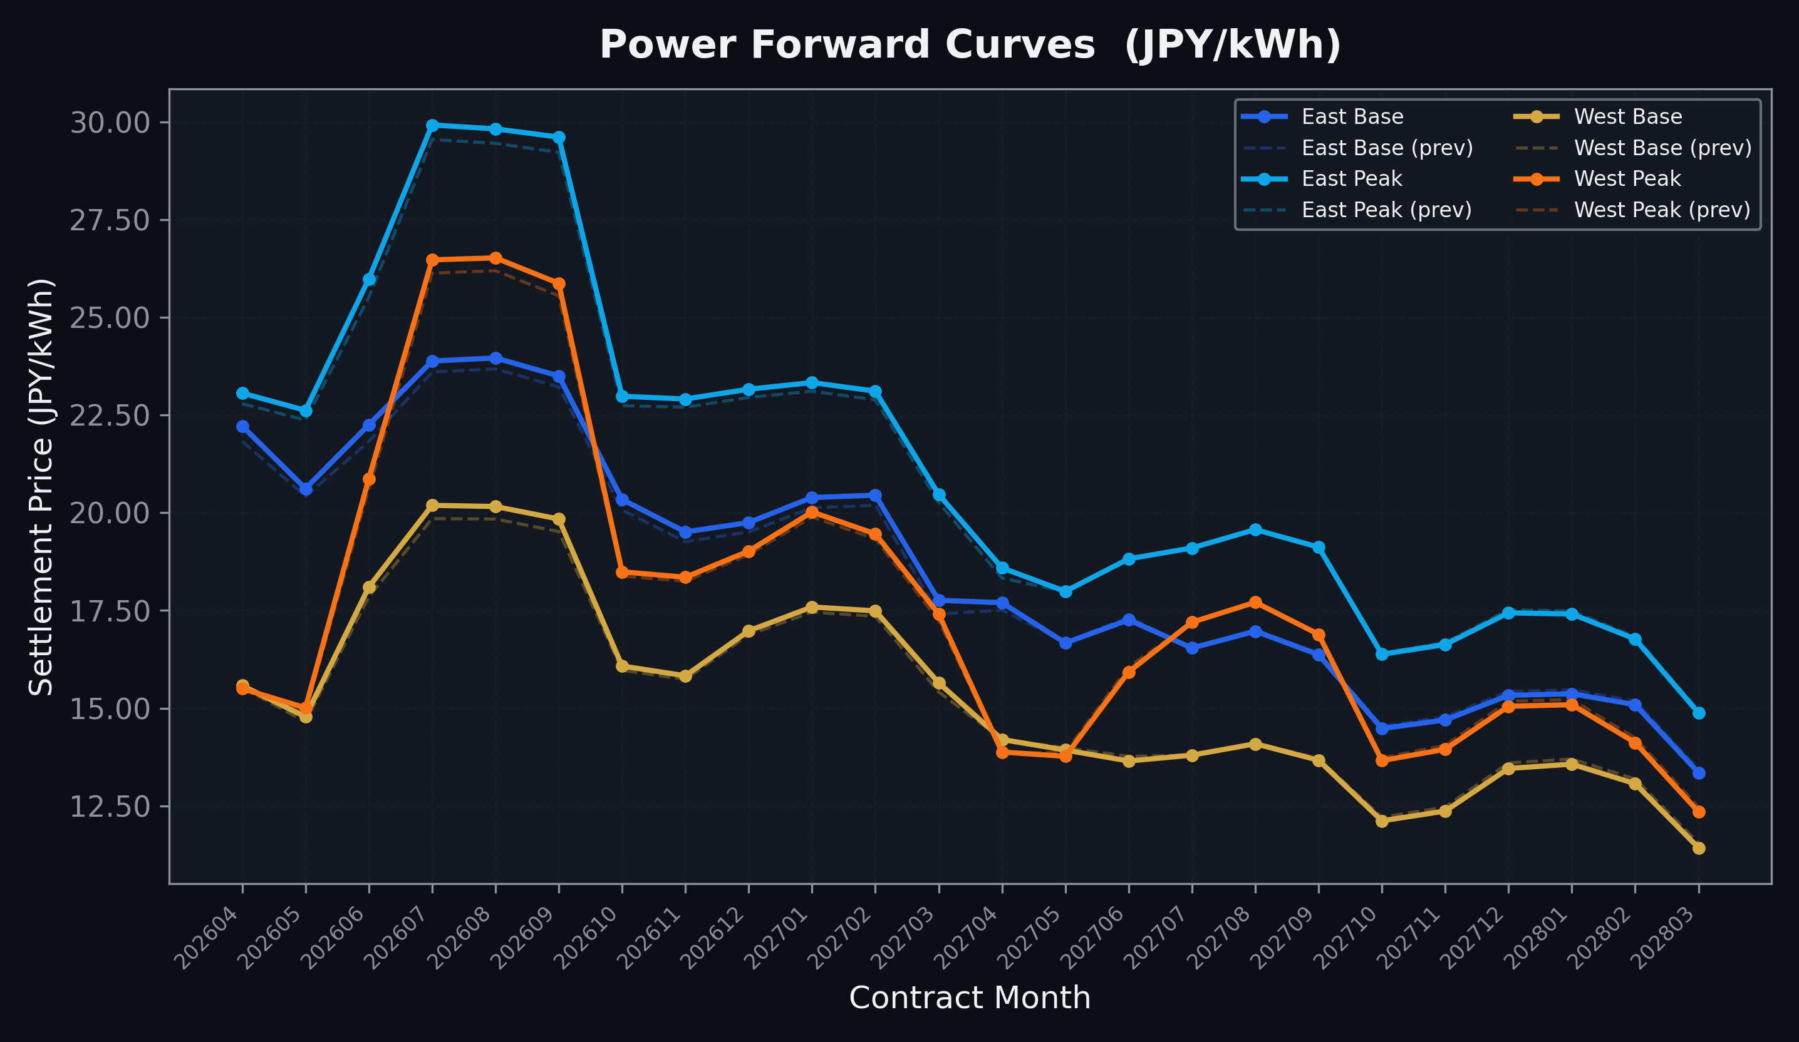
Power Forward Curves
East/West Base & Peak monthly contracts (2026-04-06)

Slide 3
Commodity Snapshot
Front-month settlement prices as of 2026-04-06
Category | Asset | Contract | Settlement | Unit | Change | % Chg
Energy | Barge Gas Oil | 202605 | 110,800.00 | JPY/kl | +400.00 | +0.36%
Energy | Barge Gasoline | 202605 | 125,000.00 | JPY/kl | -5000.00 | -3.85%
Energy | Barge Kerosene | 202605 | 115,000.00 | JPY/kl | -5000.00 | -4.17%
Energy | Chukyo Gasoline | 202605 | 115,000.00 | JPY/kl | -5000.00 | -4.17%
Energy | Chukyo Kerosene | 202605 | 105,000.00 | JPY/kl | -5000.00 | -4.55%
Energy | Dubai Crude Oil | 202604 | 120,940.00 | JPY/kl | +130.00 | +0.11%
Energy | LNG (Platts JKM) | 202605 | 3,129.00 | USD/MMBtu | -1.00 | -0.03%
Metals | Gold | - | 23,795.00 | JPY/g | -6.00 | -0.03%
Metals | Palladium | 202604 | 7,500.00 | JPY/g | +200.00 | +2.74%
Metals | Platinum | - | 9,932.00 | JPY/g | +225.00 | +2.32%
Metals | Silver | 202604 | 365.00 | JPY/10g | +5.00 | +1.39%
Industrial | Rubber (RSS3) | 202604 | 380.00 | JPY/kg | +1.40 | +0.37%
Industrial | Rubber (TSR20) | 202605 | 320.00 | JPY/kg | +8.00 | +2.56%
Industrial | Shanghai Natural Rubber | 202605 | 16,860.00 | JPY/kg | -45.00 | -0.27%
Agriculture | Azuki Beans | 202604 | 12,300.00 | JPY/bag | +0.00 | +0.00%
Agriculture | Corn | 202605 | 39,000.00 | JPY/t | +0.00 | +0.00%
Agriculture | Soybeans | 202604 | 64,000.00 | JPY/t | +0.00 | +0.00%

Slide 4
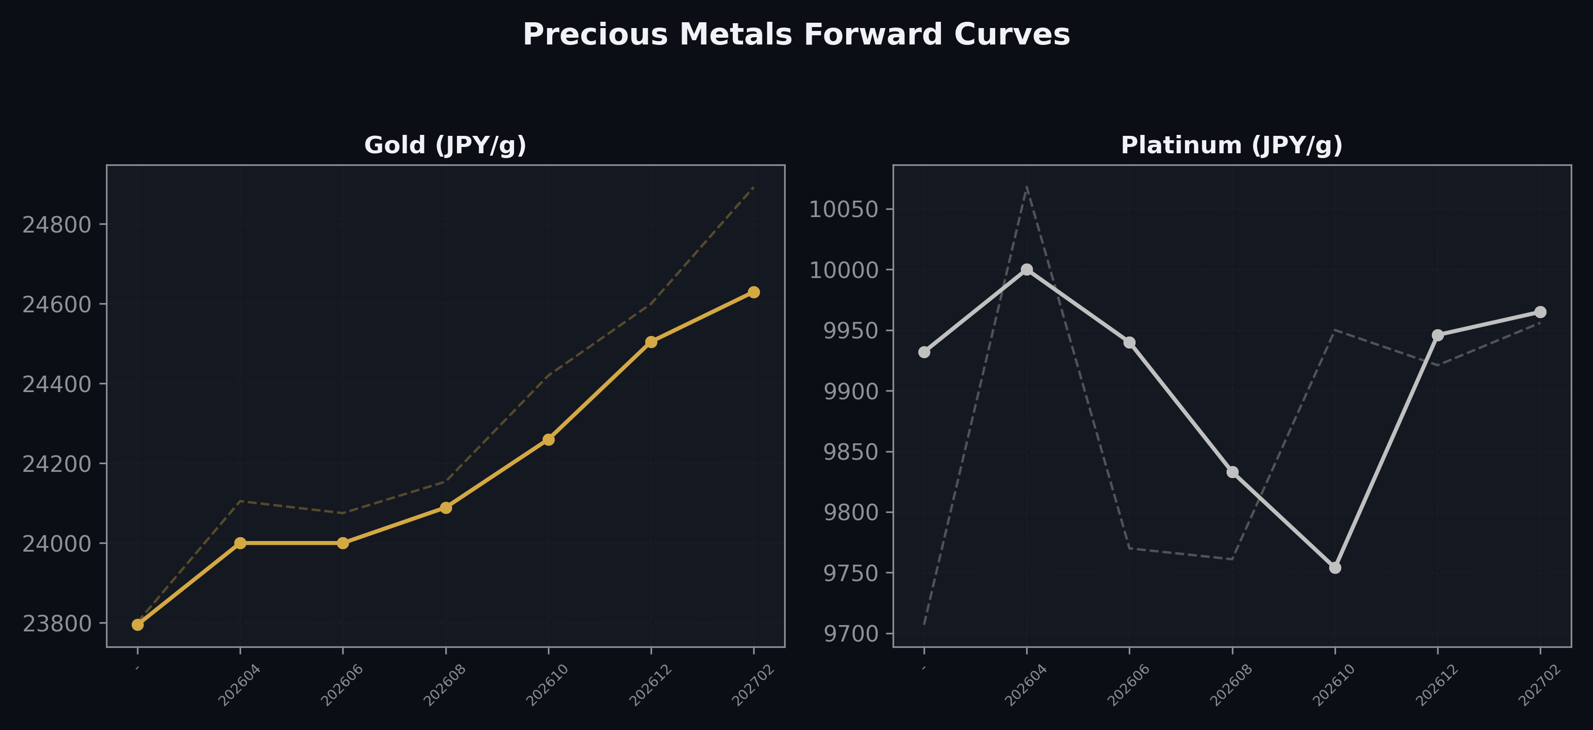
Precious Metals Forward Curves
Gold & Platinum (2026-04-06)

Slide 5
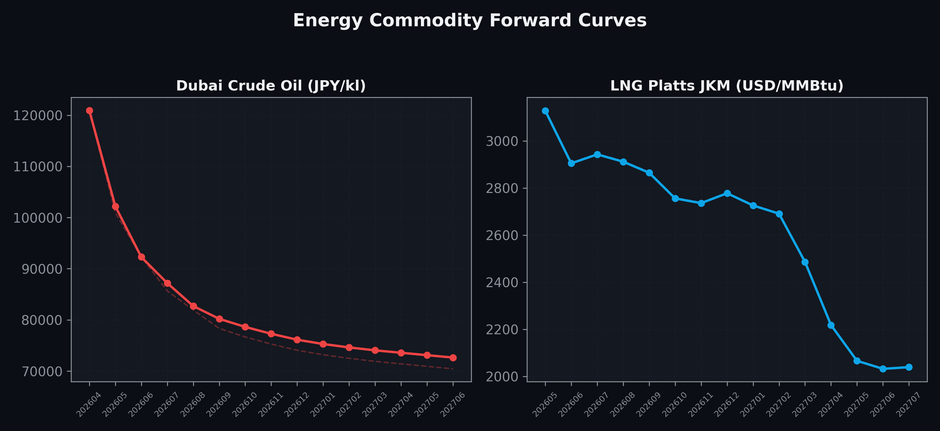
Energy Commodity Forward Curves
Dubai Crude Oil & LNG Platts JKM (2026-04-06)

Slide 6
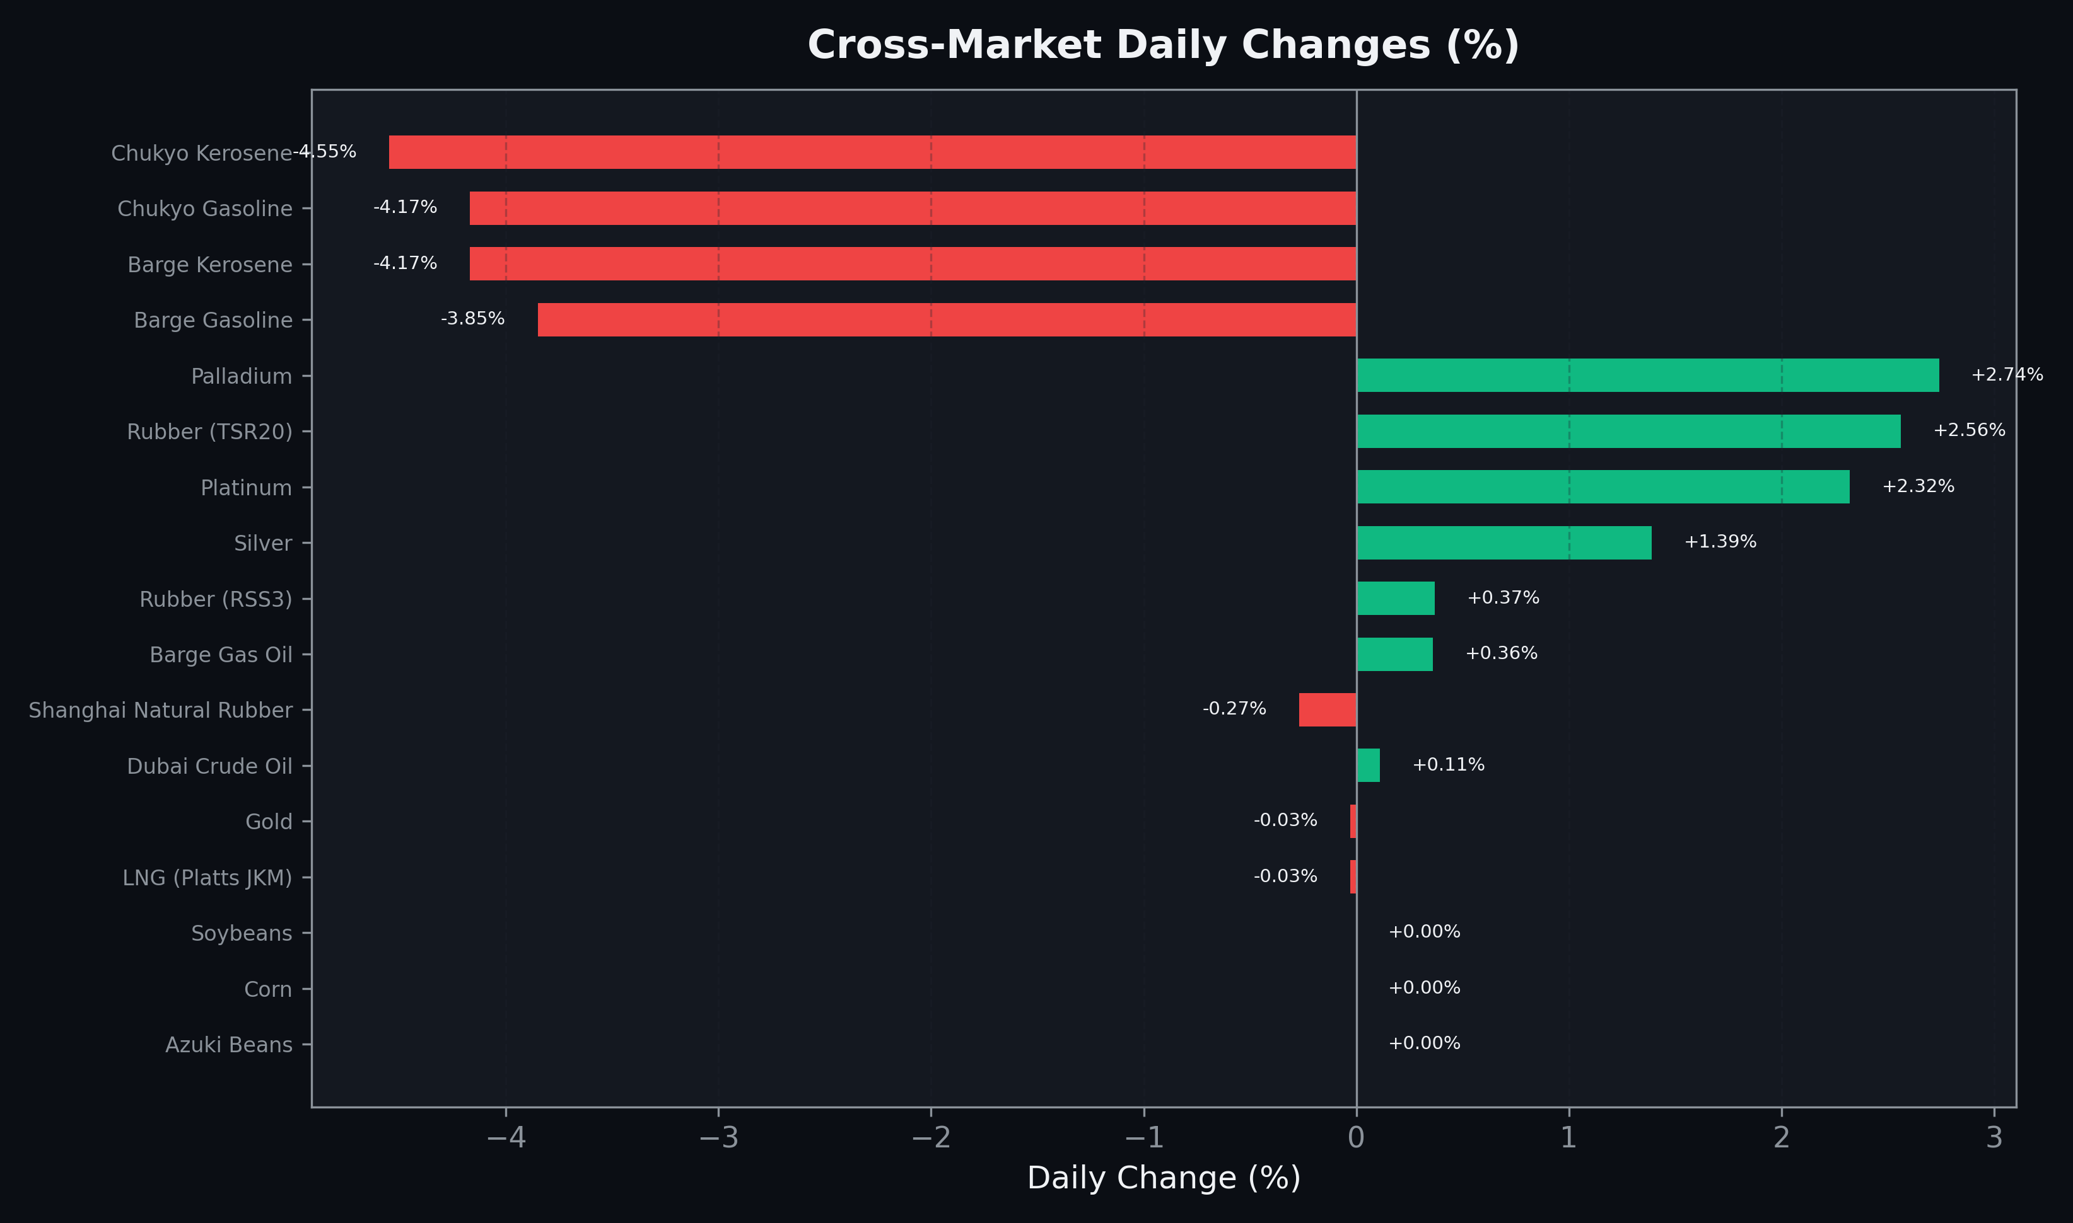
Cross-Market Daily Changes
All commodities sorted by absolute % change

Slide 7
Top Power Futures Movers
Largest absolute settlement price changes vs previous day (2026-04-06)
Instrument | Underlying | Month | Price | Prev | Change | % Chg
FUT_EWPW_260409 | Power West Peak (Weekly) | 20260410 | 16.68 | 14.92 | +1.76 | +11.80%
FUT_EWBW_260409 | Power West Base (Weekly) | 20260410 | 14.35 | 15.87 | -1.52 | -9.58%
FUT_EEPW_260507 | Power East Peak (Weekly) | 20260508 | 21.21 | 20.43 | +0.78 | +3.82%
FUT_EEPW_260409 | Power East Peak (Weekly) | 20260410 | 22.89 | 22.15 | +0.74 | +3.34%
FUT_EEP_260629 | Power East Peak (Monthly) | 202606 | 25.98 | 25.51 | +0.47 | +1.84%
FUT_EEB_260629 | Power East Base (Monthly) | 202606 | 22.25 | 21.82 | +0.43 | +1.97%
FUT_EEBW_260409 | Power East Base (Weekly) | 20260410 | 21.89 | 22.30 | -0.41 | -1.84%
FUT_EEBW_260416 | Power East Base (Weekly) | 20260417 | 22.26 | 21.85 | +0.41 | +1.88%
FUT_EEB_260428 | Power East Base (Monthly) | 202604 | 22.22 | 21.83 | +0.39 | +1.79%
FUT_EEBY_280328 | Power East Base (Yearly) | 202804 | 14.06 | 14.45 | -0.39 | -2.70%
FUT_EEP_260929 | Power East Peak (Monthly) | 202609 | 29.61 | 29.22 | +0.39 | +1.33%
FUT_EEP_260730 | Power East Peak (Monthly) | 202607 | 29.92 | 29.55 | +0.37 | +1.25%
FUT_EEP_260828 | Power East Peak (Monthly) | 202608 | 29.82 | 29.45 | +0.37 | +1.26%
FUT_EWBY_280328 | Power West Base (Yearly) | 202804 | 11.61 | 11.97 | -0.36 | -3.01%
FUT_EEB_270330 | Power East Base (Monthly) | 202703 | 17.76 | 17.41 | +0.35 | +2.01%

