Slide 1
Daily Market Report
Trade Date: 2026-06-02
JPX Derivative & Commodity Analytics
DataServer In-House

Slide 2
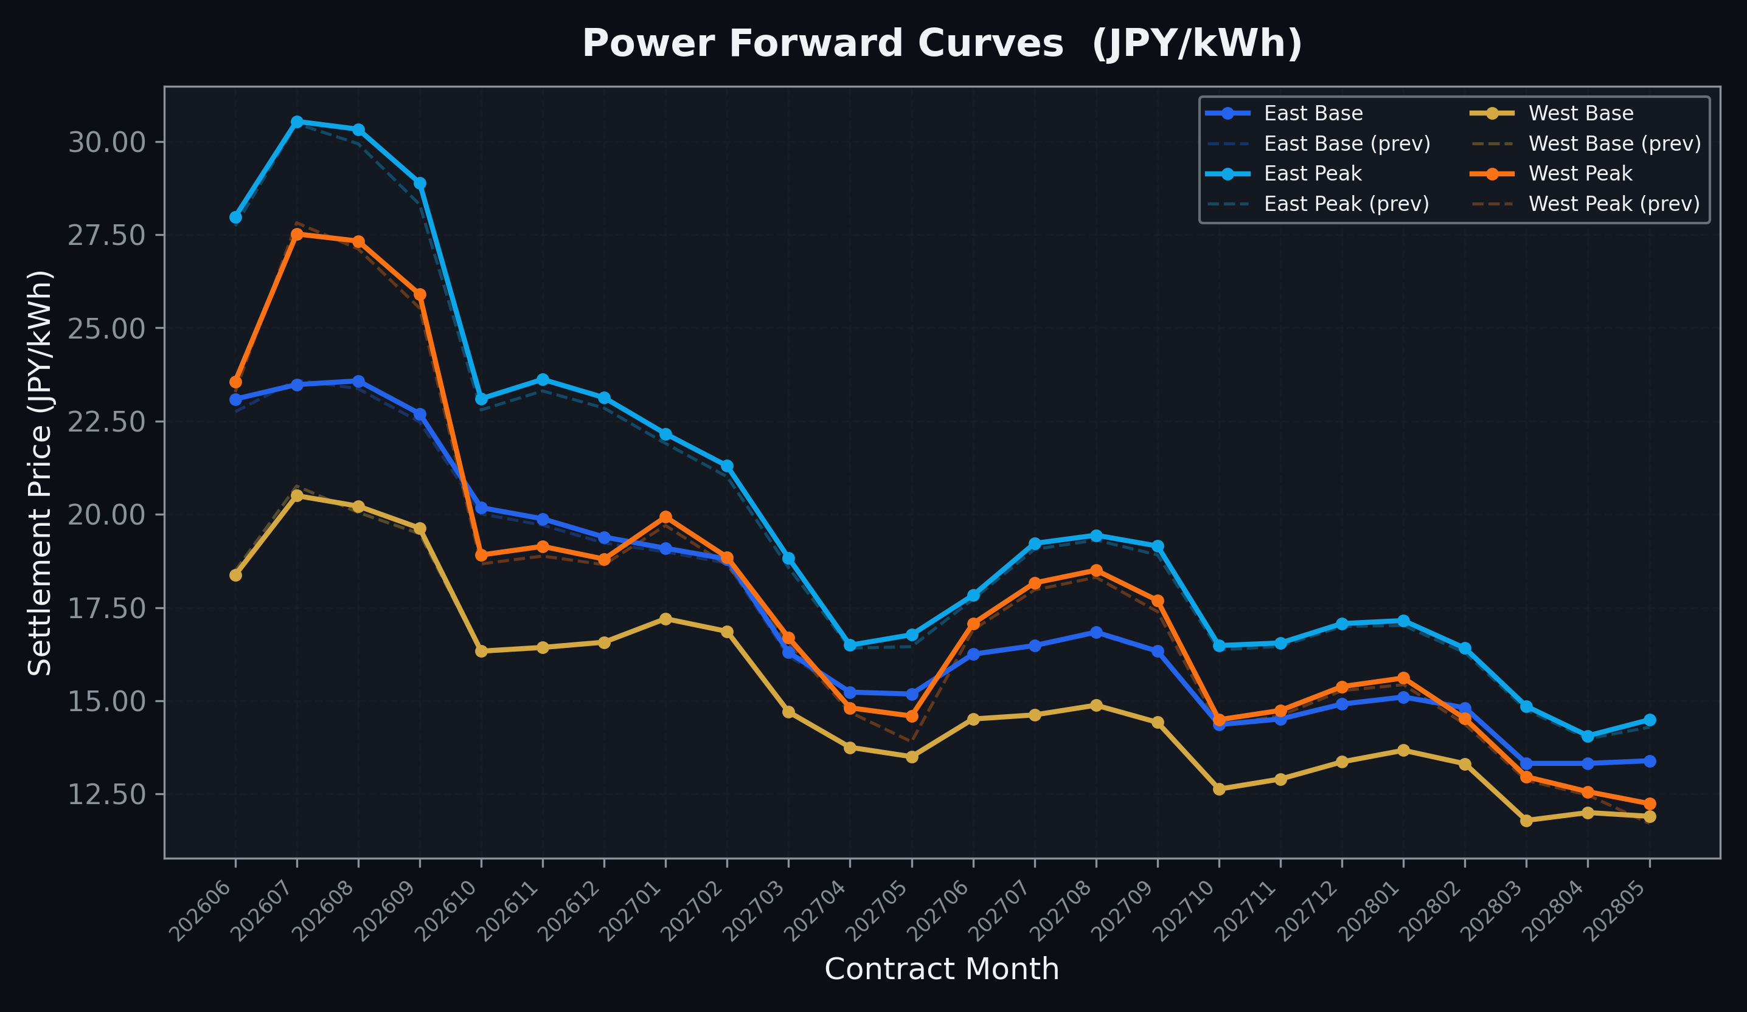
Power Forward Curves
East/West Base & Peak monthly contracts (2026-06-02)

Slide 3
Commodity Snapshot
Front-month settlement prices as of 2026-06-02
Category | Asset | Contract | Settlement | Unit | Change | % Chg
Energy | Barge Gas Oil | 202607 | 108,400.00 | JPY/kl | -1900.00 | -1.72%
Energy | Barge Gasoline | 202607 | 100,000.00 | JPY/kl | +0.00 | +0.00%
Energy | Barge Kerosene | 202607 | 105,000.00 | JPY/kl | +0.00 | +0.00%
Energy | Chukyo Gasoline | 202607 | 95,000.00 | JPY/kl | +0.00 | +0.00%
Energy | Chukyo Kerosene | 202607 | 105,000.00 | JPY/kl | +0.00 | +0.00%
Energy | Dubai Crude Oil | 202606 | 92,590.00 | JPY/kl | +1590.00 | +1.75%
Energy | LNG (Platts JKM) | 202607 | 2,958.00 | USD/MMBtu | +62.00 | +2.14%
Metals | Gold | - | 23,383.00 | JPY/g | -78.00 | -0.33%
Metals | Palladium | 202606 | 7,000.00 | JPY/g | +0.00 | +0.00%
Metals | Platinum | - | 9,814.00 | JPY/g | +222.00 | +2.31%
Metals | Silver | 202606 | 390.00 | JPY/10g | +0.00 | +0.00%
Industrial | Rubber (RSS3) | 202606 | 413.50 | JPY/kg | +6.80 | +1.67%
Industrial | Rubber (TSR20) | 202607 | 360.00 | JPY/kg | +10.00 | +2.86%
Industrial | Shanghai Natural Rubber | 202609 | 18,635.00 | JPY/kg | +70.00 | +0.38%
Agriculture | Azuki Beans | 202606 | 12,300.00 | JPY/bag | +0.00 | +0.00%
Agriculture | Corn | 202607 | 39,000.00 | JPY/t | +0.00 | +0.00%
Agriculture | Soybeans | 202606 | 64,000.00 | JPY/t | +0.00 | +0.00%

Slide 4
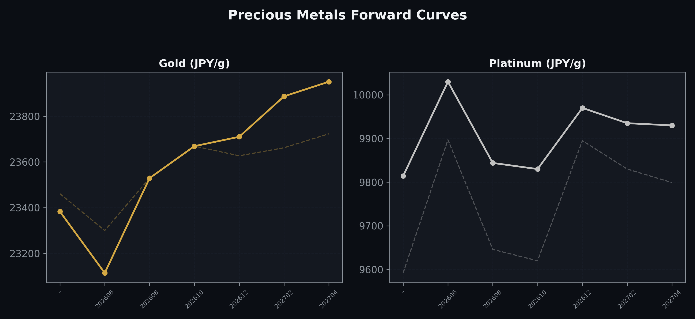
Precious Metals Forward Curves
Gold & Platinum (2026-06-02)

Slide 5
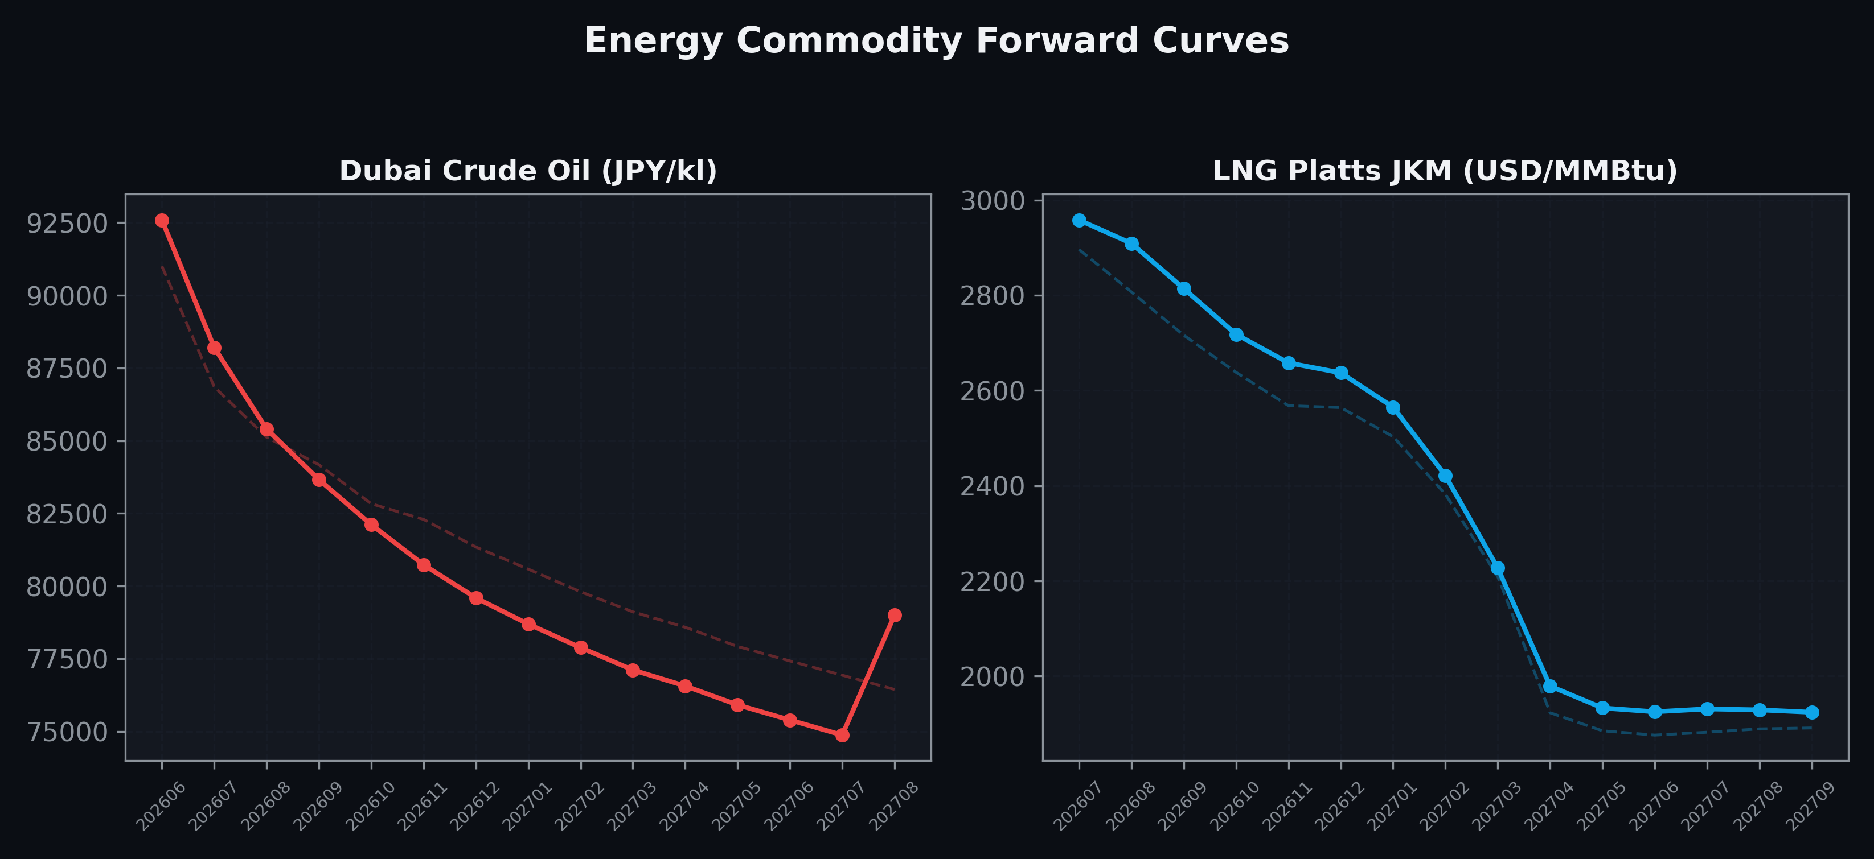
Energy Commodity Forward Curves
Dubai Crude Oil & LNG Platts JKM (2026-06-02)

Slide 6
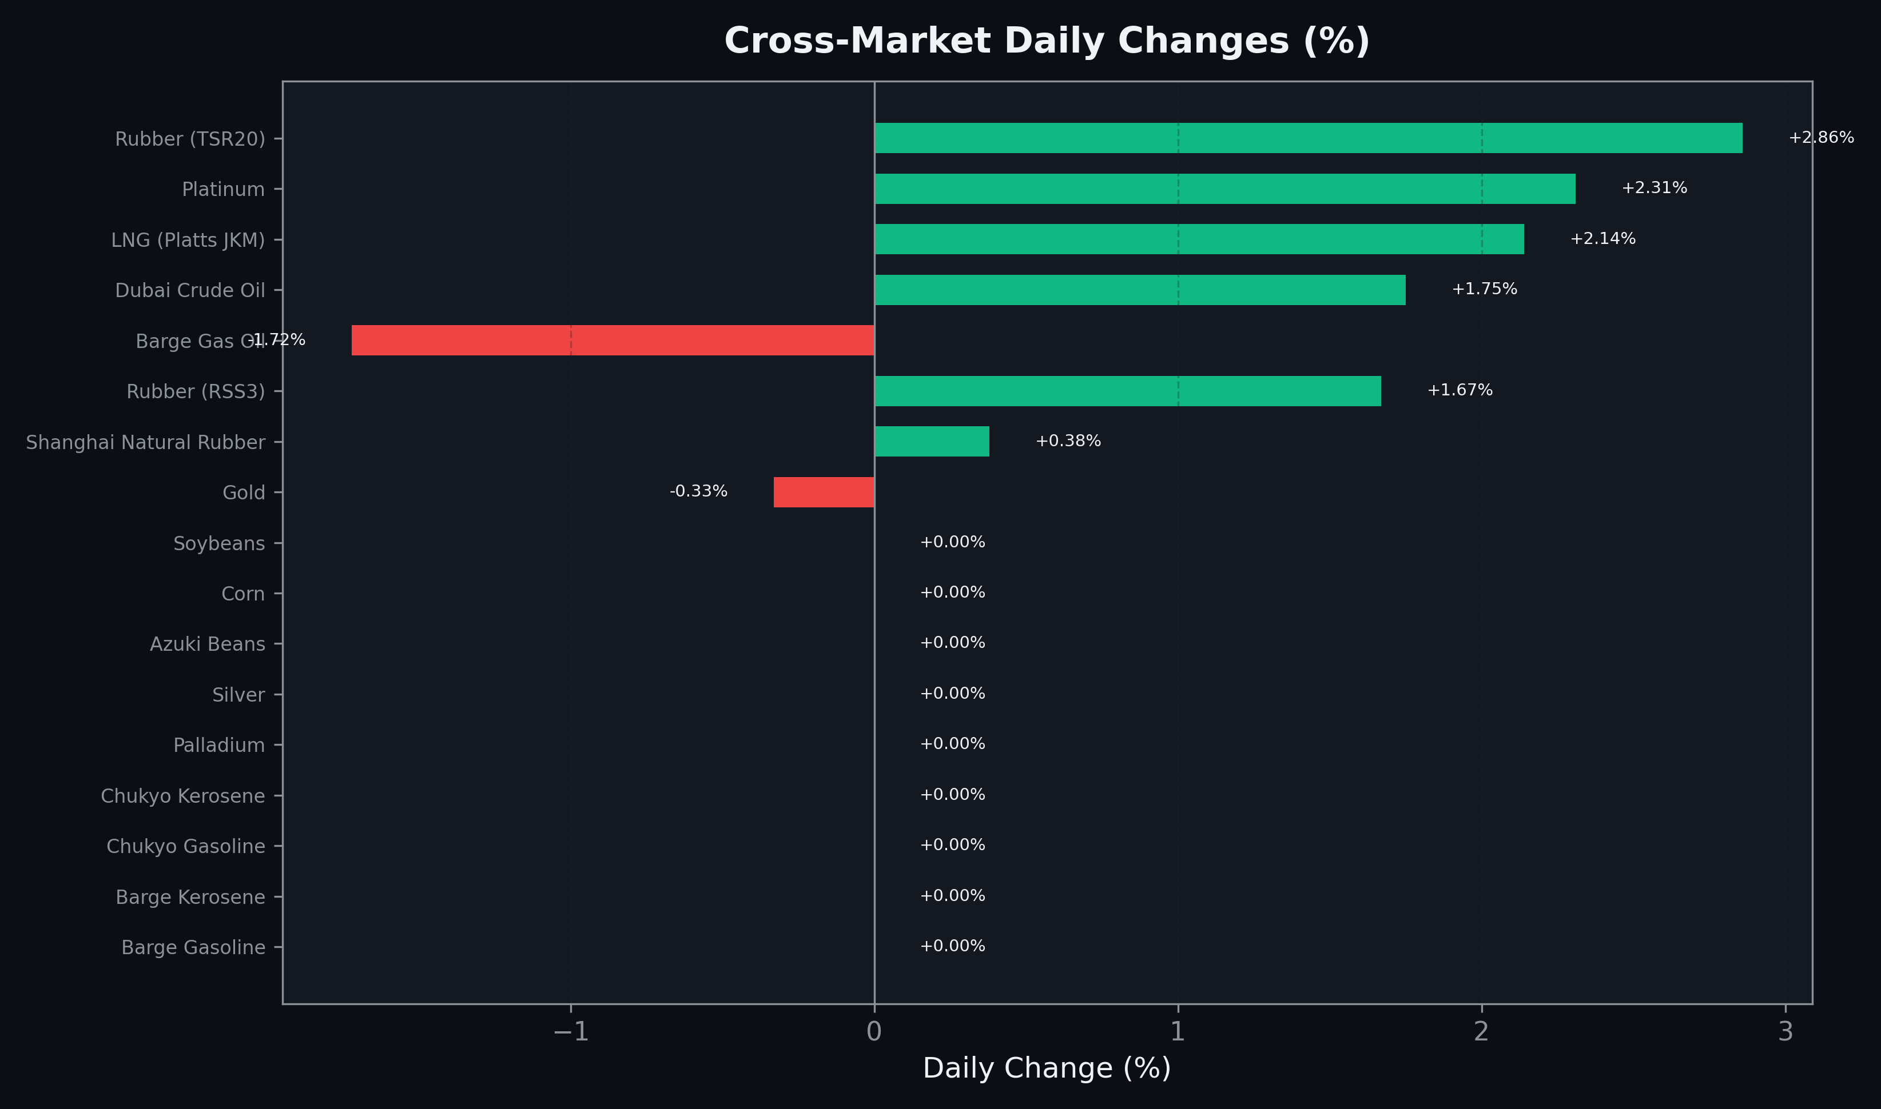
Cross-Market Daily Changes
All commodities sorted by absolute % change

Slide 7
Top Power Futures Movers
Largest absolute settlement price changes vs previous day (2026-06-02)
Instrument | Underlying | Month | Price | Prev | Change | % Chg
FUT_EEPW_260604 | Power East Peak (Weekly) | 20260605 | 28.36 | 26.95 | +1.41 | +5.23%
FUT_EWBW_260702 | Power West Base (Weekly) | 20260703 | 18.84 | 19.70 | -0.86 | -4.37%
FUT_EEPW_260611 | Power East Peak (Weekly) | 20260612 | 26.57 | 25.76 | +0.81 | +3.14%
FUT_EWBW_260625 | Power West Base (Weekly) | 20260626 | 18.83 | 19.60 | -0.77 | -3.93%
FUT_EWPW_260611 | Power West Peak (Weekly) | 20260612 | 22.57 | 21.87 | +0.70 | +3.20%
FUT_EWP_270528 | Power West Peak (Monthly) | 202705 | 14.59 | 13.90 | +0.69 | +4.96%
FUT_EEP_260929 | Power East Peak (Monthly) | 202609 | 28.89 | 28.31 | +0.58 | +2.05%
FUT_ECP_270528 | 電力(中部・日中) | 202705 | 14.83 | 14.30 | +0.53 | +3.71%
FUT_EWP_280530 | Power West Peak (Monthly) | 202805 | 12.24 | 11.71 | +0.53 | +4.53%
FUT_ECP_260929 | 電力(中部・日中) | 202609 | 27.65 | 27.16 | +0.49 | +1.80%
FUT_EWBW_260618 | Power West Base (Weekly) | 20260619 | 18.89 | 19.36 | -0.47 | -2.43%
FUT_ECP_260828 | 電力(中部・日中) | 202608 | 28.59 | 28.14 | +0.45 | +1.60%
FUT_EWBW_260604 | Power West Base (Weekly) | 20260605 | 16.30 | 16.74 | -0.44 | -2.63%
FUT_EEP_260828 | Power East Peak (Monthly) | 202608 | 30.33 | 29.94 | +0.39 | +1.30%
FUT_EEPW_260618 | Power East Peak (Weekly) | 20260619 | 26.44 | 26.06 | +0.38 | +1.46%

