Slide 1
Daily Market Report
Trade Date: 2026-04-16
JPX Derivative & Commodity Analytics
DataServer In-House

Slide 2
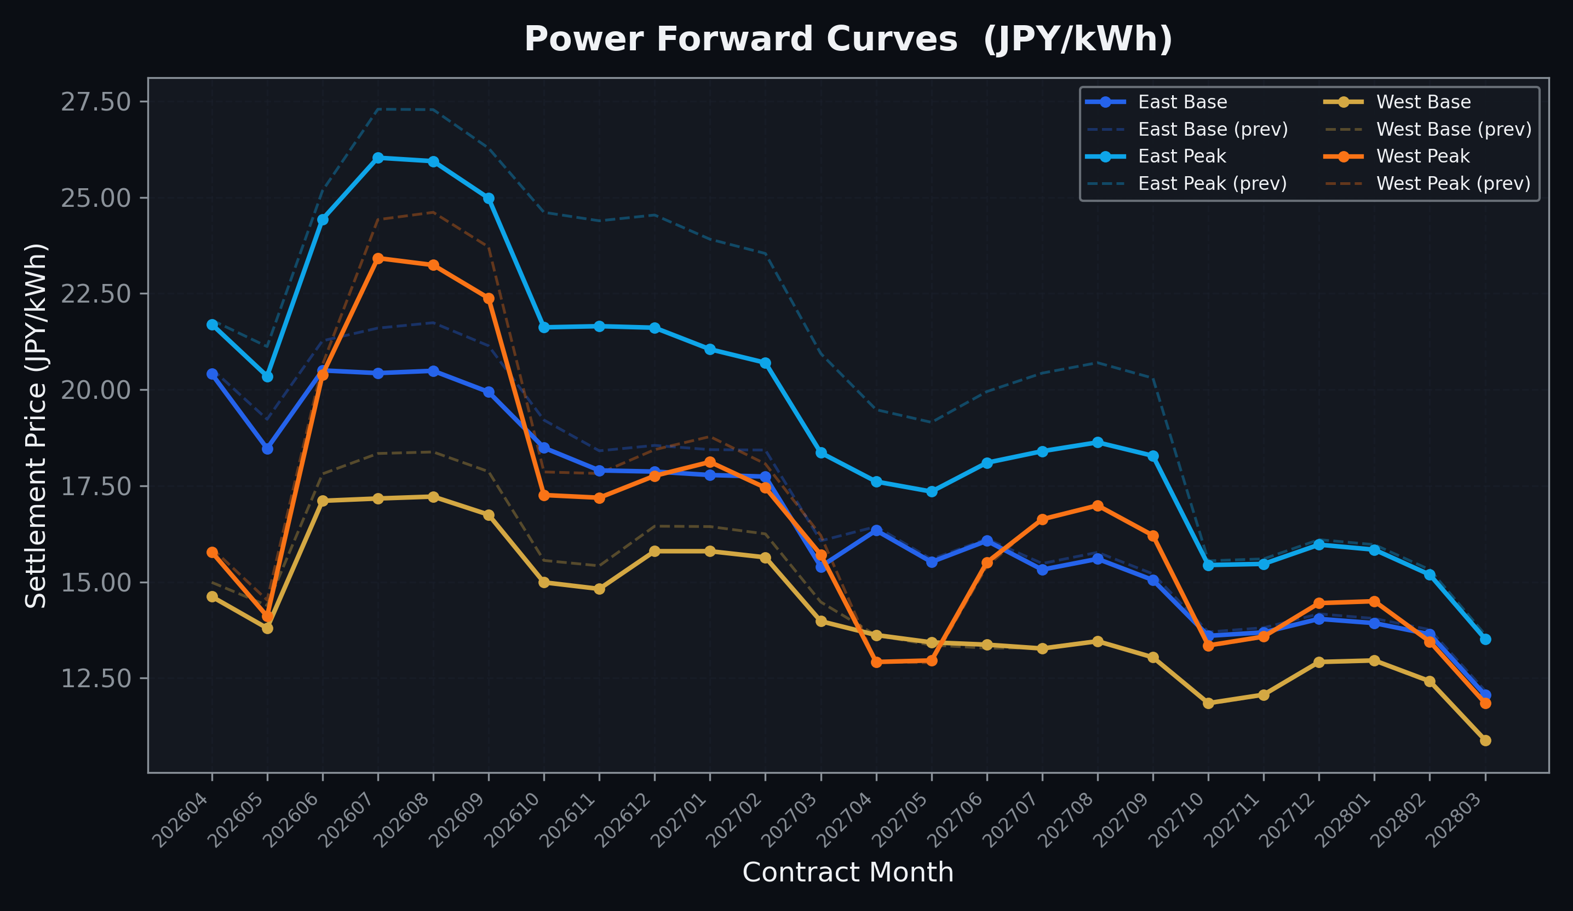
Power Forward Curves
East/West Base & Peak monthly contracts (2026-04-16)

Slide 3
Commodity Snapshot
Front-month settlement prices as of 2026-04-16
Category | Asset | Contract | Settlement | Unit | Change | % Chg
Energy | Barge Gas Oil | 202605 | 115,800.00 | JPY/kl | +1200.00 | +1.05%
Energy | Barge Gasoline | 202605 | 105,000.00 | JPY/kl | -5000.00 | -4.55%
Energy | Barge Kerosene | 202605 | 105,000.00 | JPY/kl | +0.00 | +0.00%
Energy | Chukyo Gasoline | 202605 | 105,000.00 | JPY/kl | +0.00 | +0.00%
Energy | Chukyo Kerosene | 202605 | 105,000.00 | JPY/kl | +0.00 | +0.00%
Energy | Dubai Crude Oil | 202604 | 104,060.00 | JPY/kl | +20.00 | +0.02%
Energy | LNG (Platts JKM) | 202606 | 2,500.00 | USD/MMBtu | -587.00 | -19.02%
Metals | Gold | - | 24,525.00 | JPY/g | -15.00 | -0.06%
Metals | Palladium | 202604 | 8,000.00 | JPY/g | +0.00 | +0.00%
Metals | Platinum | - | 10,686.00 | JPY/g | -42.00 | -0.39%
Metals | Silver | 202604 | 383.10 | JPY/10g | -6.90 | -1.77%
Industrial | Rubber (RSS3) | 202604 | 379.00 | JPY/kg | +2.00 | +0.53%
Industrial | Rubber (TSR20) | 202605 | 325.00 | JPY/kg | +0.00 | +0.00%
Industrial | Shanghai Natural Rubber | 202605 | 16,695.00 | JPY/kg | +15.00 | +0.09%
Agriculture | Azuki Beans | 202604 | 12,300.00 | JPY/bag | +0.00 | +0.00%
Agriculture | Corn | 202607 | 39,000.00 | JPY/t | +0.00 | +0.00%
Agriculture | Soybeans | 202606 | 64,000.00 | JPY/t | +0.00 | +0.00%

Slide 4
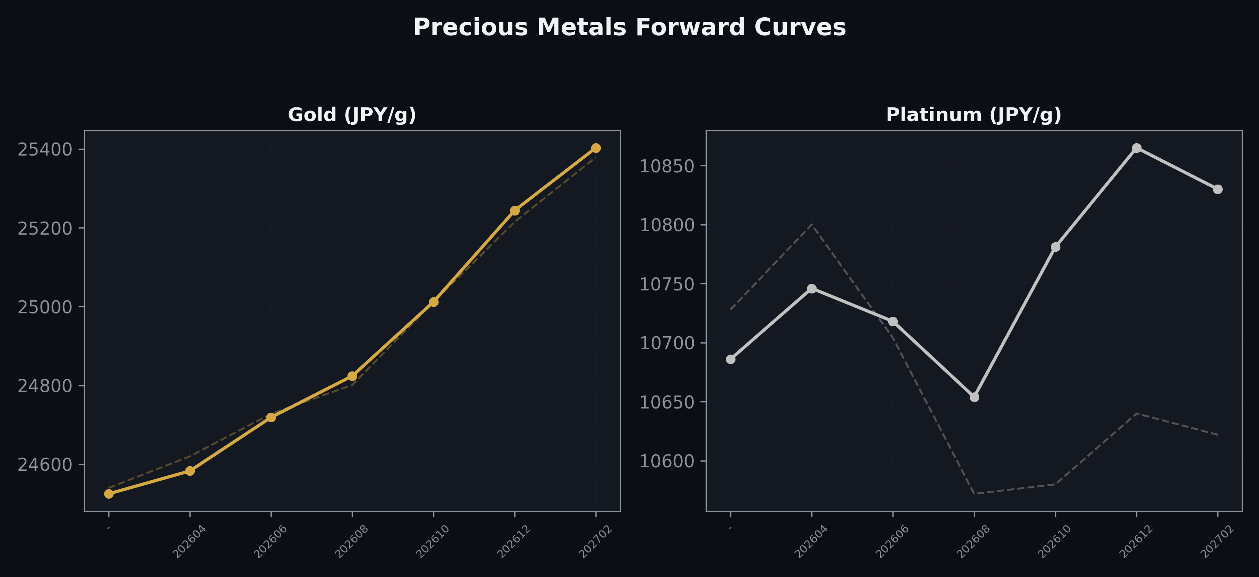
Precious Metals Forward Curves
Gold & Platinum (2026-04-16)

Slide 5
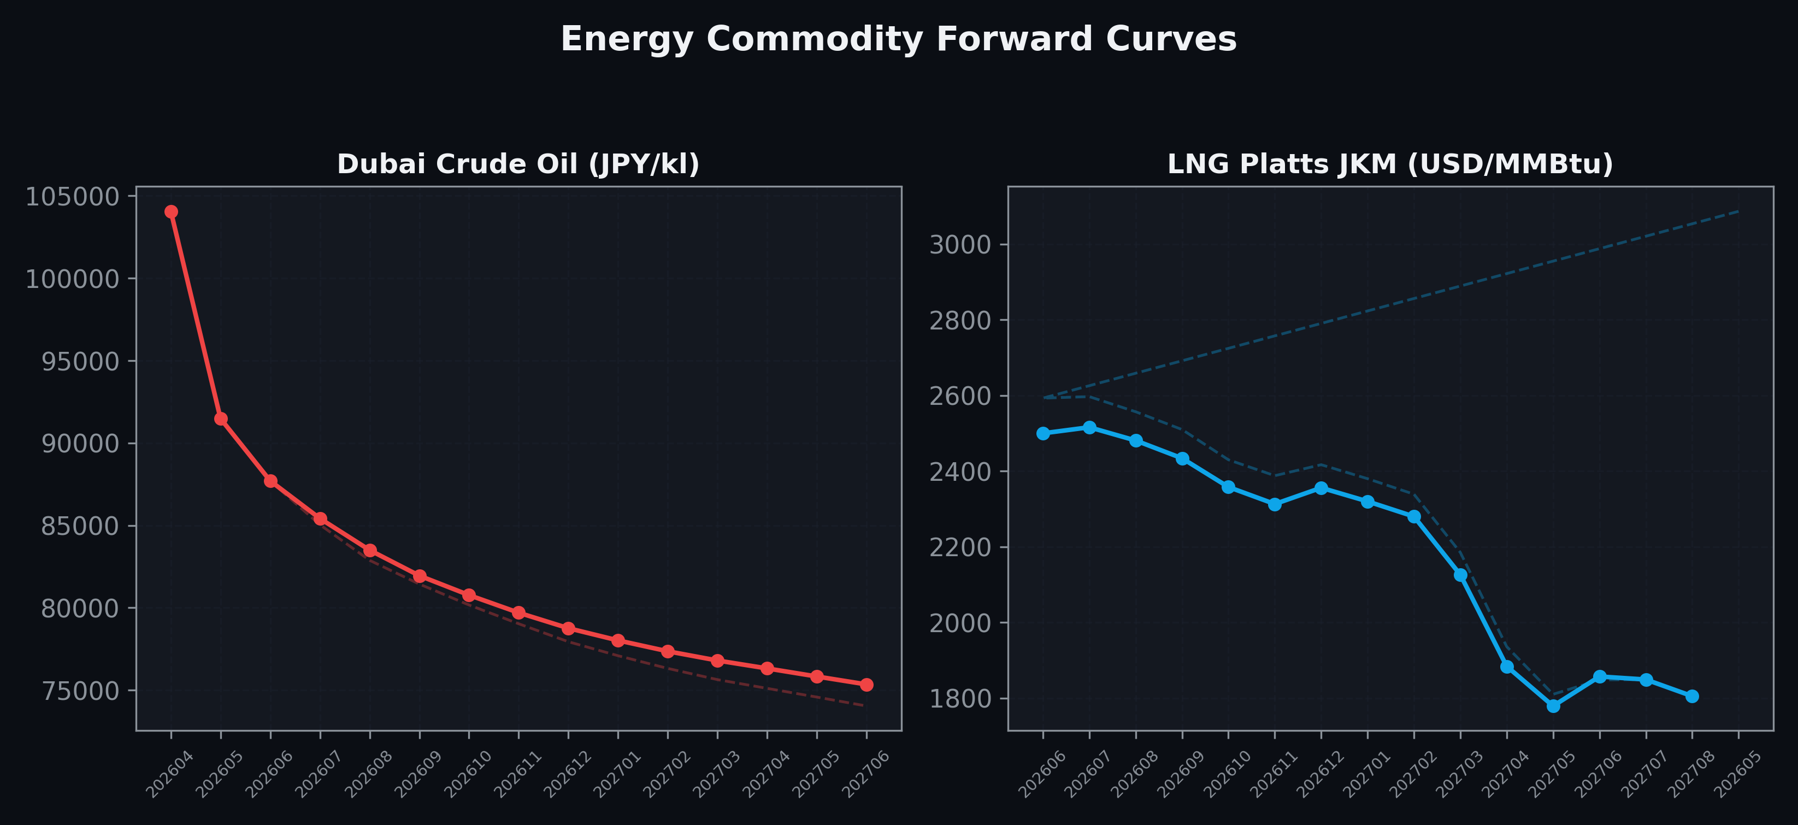
Energy Commodity Forward Curves
Dubai Crude Oil & LNG Platts JKM (2026-04-16)

Slide 6
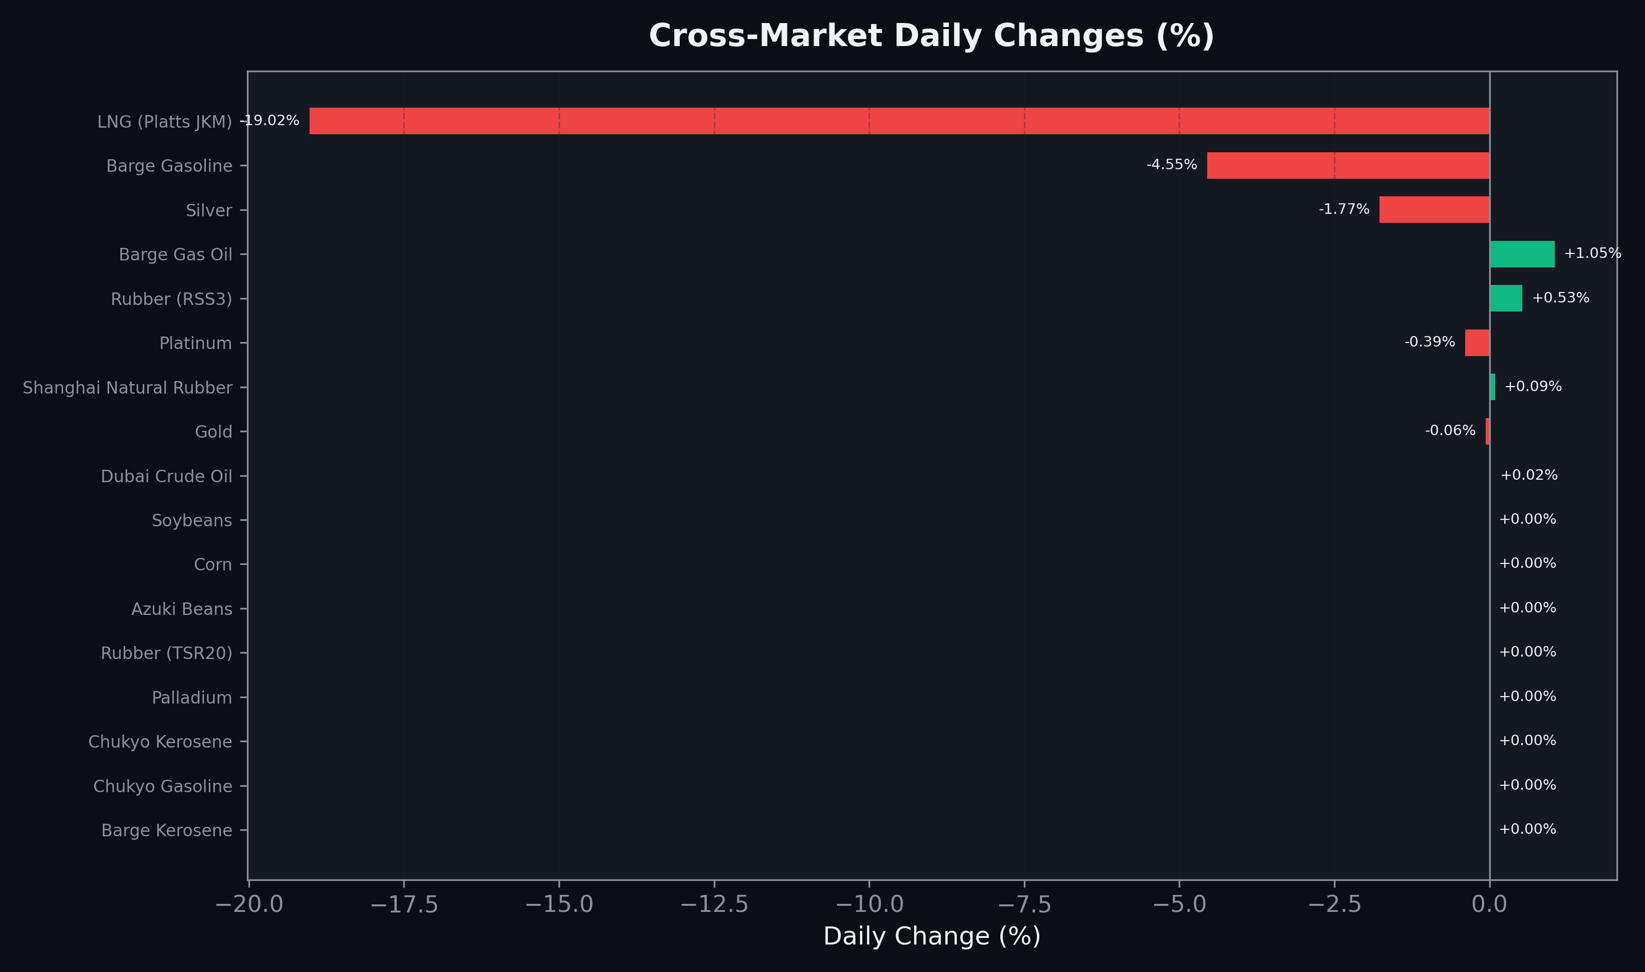
Cross-Market Daily Changes
All commodities sorted by absolute % change

Slide 7
Top Power Futures Movers
Largest absolute settlement price changes vs previous day (2026-04-16)
Instrument | Underlying | Month | Price | Prev | Change | % Chg
FUT_EEP_261029 | Power East Peak (Monthly) | 202610 | 21.62 | 24.61 | -2.99 | -12.15%
FUT_EEP_261228 | Power East Peak (Monthly) | 202612 | 21.61 | 24.54 | -2.93 | -11.94%
FUT_EEP_270128 | Power East Peak (Monthly) | 202701 | 21.05 | 23.91 | -2.86 | -11.96%
FUT_EEP_270225 | Power East Peak (Monthly) | 202702 | 20.70 | 23.54 | -2.84 | -12.06%
FUT_EEP_261127 | Power East Peak (Monthly) | 202611 | 21.65 | 24.39 | -2.74 | -11.23%
FUT_EEP_270330 | Power East Peak (Monthly) | 202703 | 18.36 | 20.94 | -2.58 | -12.32%
FUT_EEP_270830 | Power East Peak (Monthly) | 202708 | 18.63 | 20.70 | -2.07 | -10.00%
FUT_EEP_270729 | Power East Peak (Monthly) | 202707 | 18.40 | 20.43 | -2.03 | -9.94%
FUT_EEP_270929 | Power East Peak (Monthly) | 202709 | 18.28 | 20.30 | -2.02 | -9.95%
FUT_EEP_270428 | Power East Peak (Monthly) | 202704 | 17.61 | 19.48 | -1.87 | -9.60%
FUT_EEP_270629 | Power East Peak (Monthly) | 202706 | 18.10 | 19.95 | -1.85 | -9.27%
FUT_EEP_270528 | Power East Peak (Monthly) | 202705 | 17.35 | 19.15 | -1.80 | -9.40%
FUT_EWP_260828 | Power West Peak (Monthly) | 202608 | 23.24 | 24.61 | -1.37 | -5.57%
FUT_ECP_260828 | 電力(中部・日中) | 202608 | 24.60 | 25.95 | -1.35 | -5.20%
FUT_EEP_260828 | Power East Peak (Monthly) | 202608 | 25.94 | 27.28 | -1.34 | -4.91%

