Slide 1
Daily Market Report
Trade Date: 2026-05-12
JPX Derivative & Commodity Analytics
DataServer In-House

Slide 2
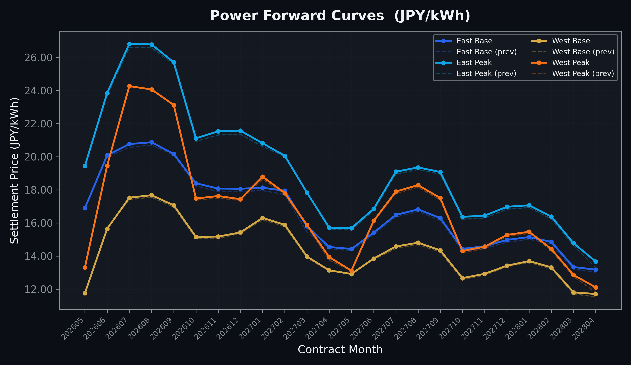
Power Forward Curves
East/West Base & Peak monthly contracts (2026-05-12)

Slide 3
Commodity Snapshot
Front-month settlement prices as of 2026-05-12
Category | Asset | Contract | Settlement | Unit | Change | % Chg
Energy | Barge Gas Oil | 202606 | 110,600.00 | JPY/kl | -600.00 | -0.54%
Energy | Barge Gasoline | 202606 | 100,000.00 | JPY/kl | +0.00 | +0.00%
Energy | Barge Kerosene | 202606 | 105,000.00 | JPY/kl | +0.00 | +0.00%
Energy | Chukyo Gasoline | 202606 | 100,000.00 | JPY/kl | +0.00 | +0.00%
Energy | Chukyo Kerosene | 202606 | 105,000.00 | JPY/kl | +0.00 | +0.00%
Energy | Dubai Crude Oil | 202605 | 99,740.00 | JPY/kl | -60.00 | -0.06%
Energy | LNG (Platts JKM) | 202606 | 2,696.00 | USD/MMBtu | -4.00 | -0.15%
Metals | Gold | - | 23,645.00 | JPY/g | +182.00 | +0.78%
Metals | Palladium | 202606 | 7,500.00 | JPY/g | +0.00 | +0.00%
Metals | Platinum | - | 10,665.00 | JPY/g | +501.00 | +4.93%
Metals | Silver | 202606 | 420.00 | JPY/10g | +30.00 | +7.69%
Industrial | Rubber (RSS3) | 202605 | 400.80 | JPY/kg | +4.30 | +1.08%
Industrial | Rubber (TSR20) | 202606 | 340.00 | JPY/kg | +0.00 | +0.00%
Industrial | Shanghai Natural Rubber | 202605 | 17,630.00 | JPY/kg | -120.00 | -0.68%
Agriculture | Azuki Beans | 202605 | 12,300.00 | JPY/bag | +0.00 | +0.00%
Agriculture | Corn | 202607 | 39,000.00 | JPY/t | +0.00 | +0.00%
Agriculture | Soybeans | 202606 | 64,000.00 | JPY/t | +0.00 | +0.00%

Slide 4
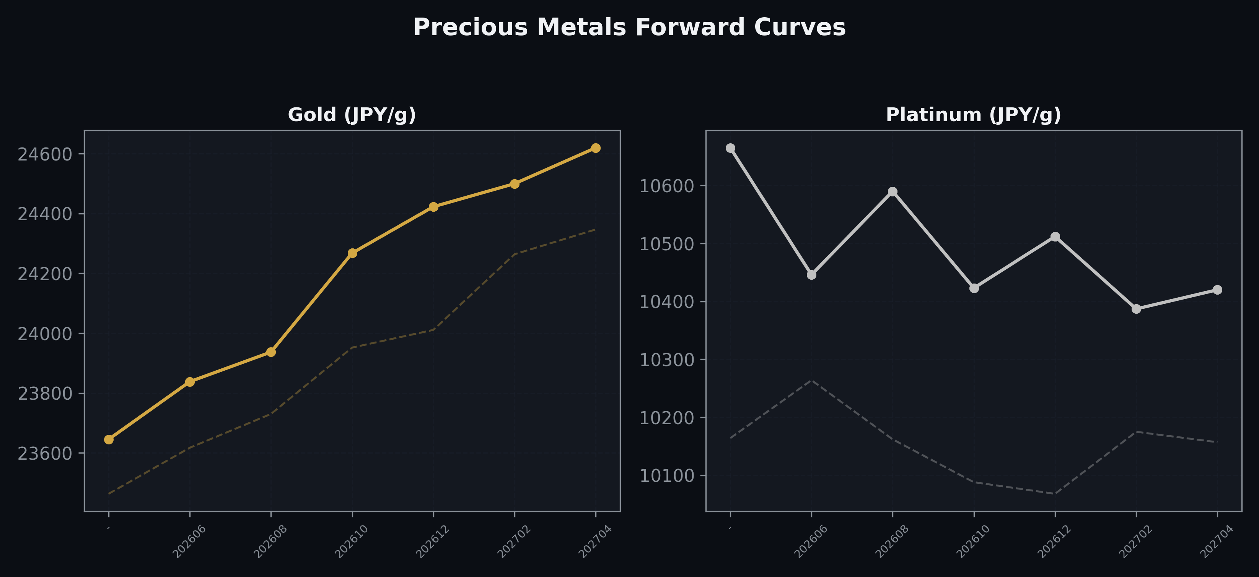
Precious Metals Forward Curves
Gold & Platinum (2026-05-12)

Slide 5
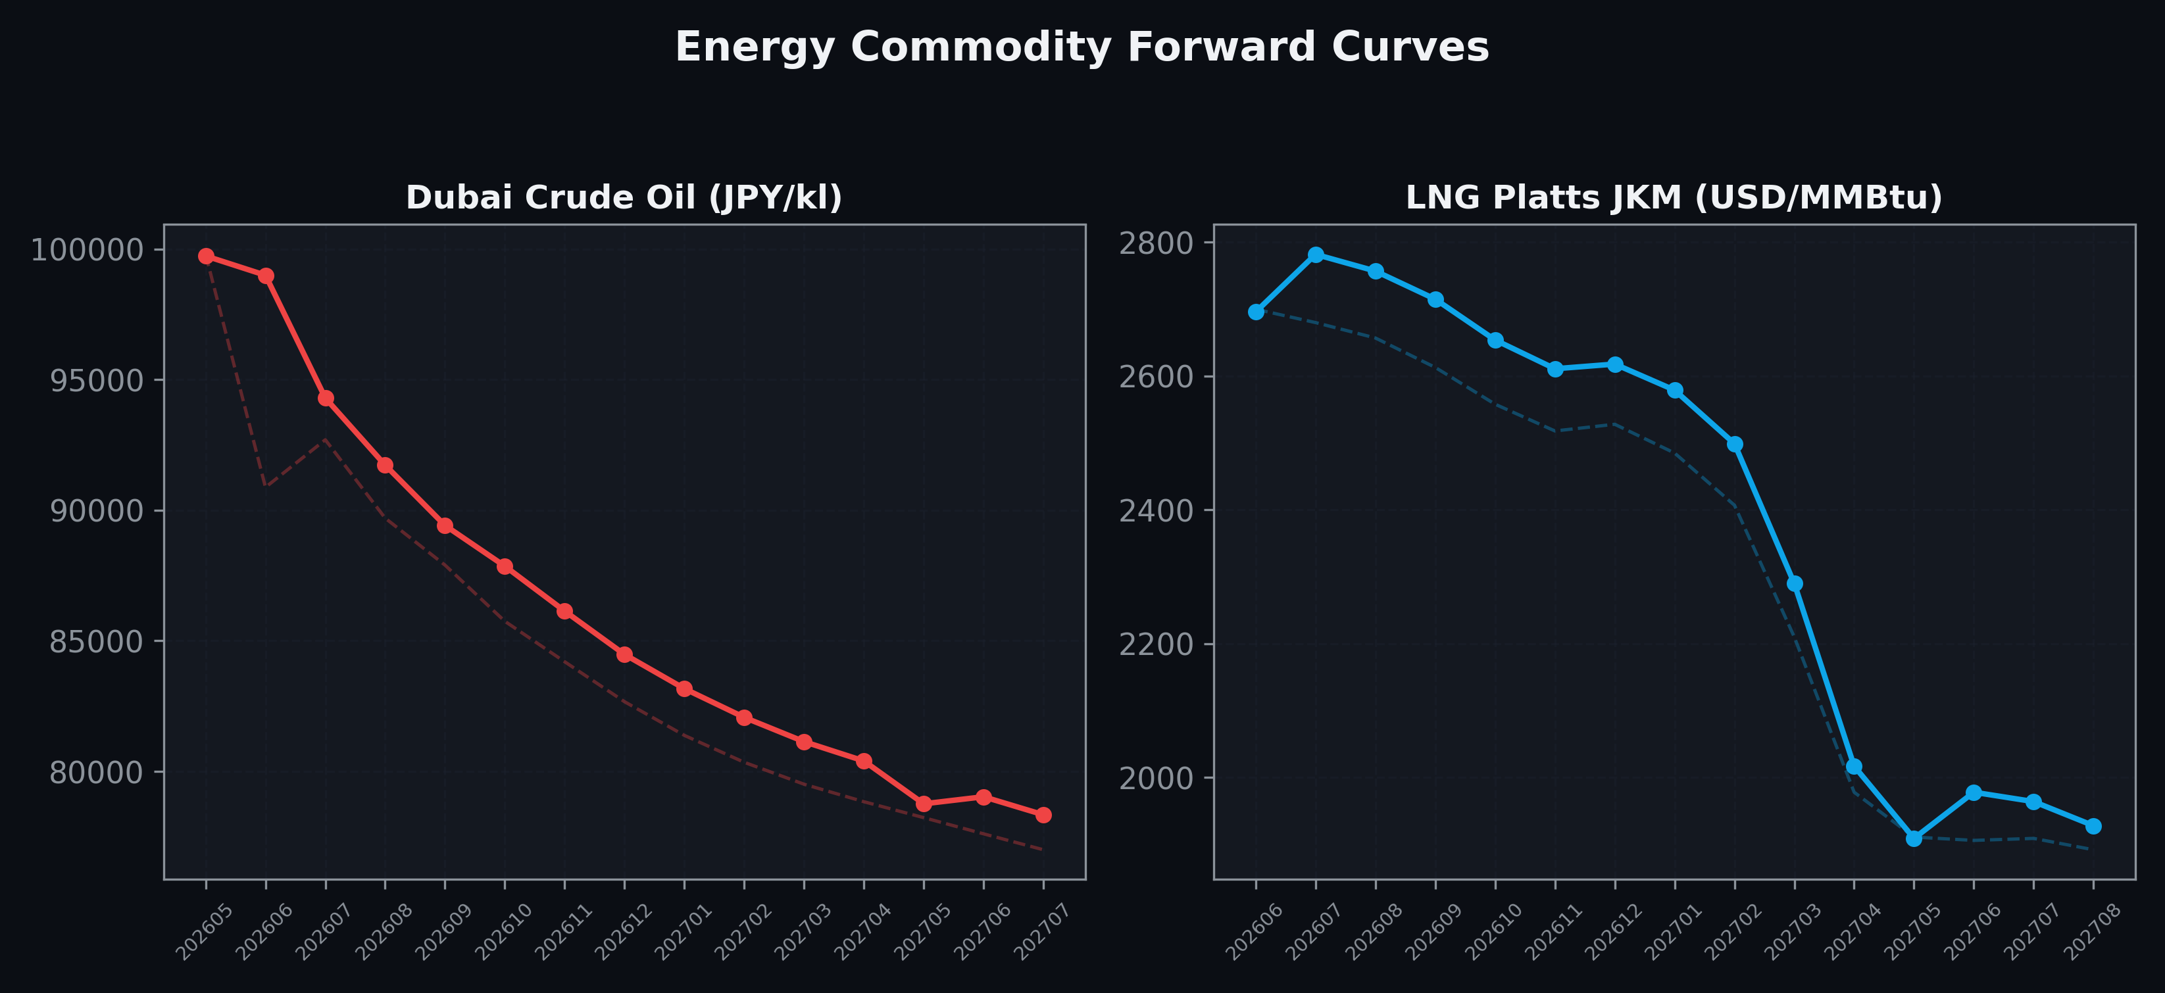
Energy Commodity Forward Curves
Dubai Crude Oil & LNG Platts JKM (2026-05-12)

Slide 6
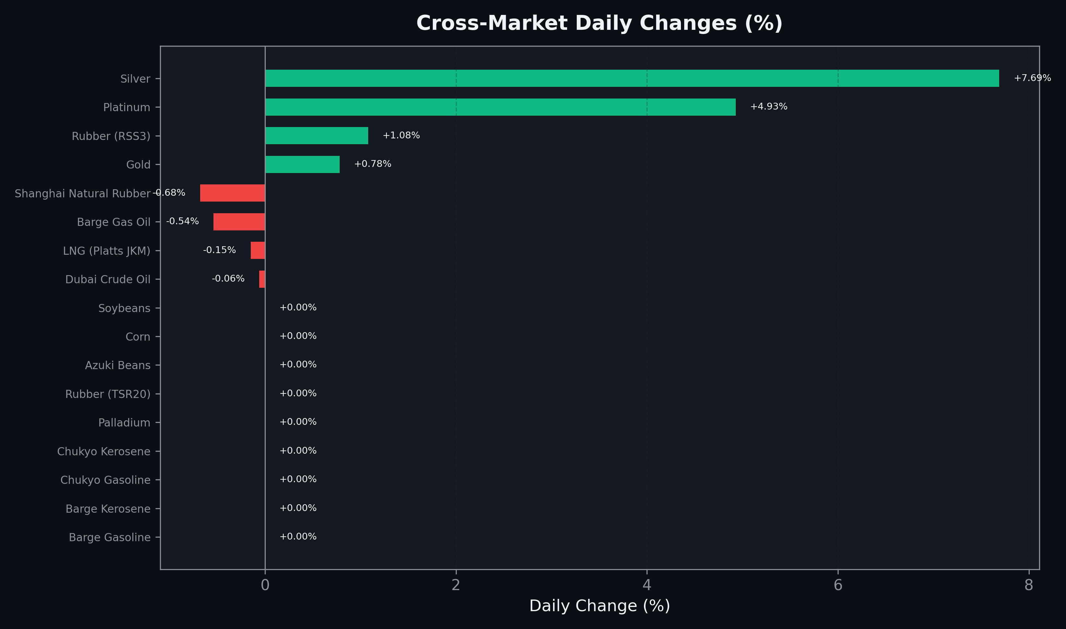
Cross-Market Daily Changes
All commodities sorted by absolute % change

Slide 7
Top Power Futures Movers
Largest absolute settlement price changes vs previous day (2026-05-12)
Instrument | Underlying | Month | Price | Prev | Change | % Chg
FUT_EWPW_260514 | Power West Peak (Weekly) | 20260515 | 13.20 | 12.28 | +0.92 | +7.49%
FUT_EWBW_260514 | Power West Base (Weekly) | 20260515 | 11.60 | 11.11 | +0.49 | +4.41%
FUT_ECPY_280328 | 電力(中部・年度日中) | 202804 | 14.58 | 14.14 | +0.44 | +3.11%
FUT_EEPY_280328 | Power East Peak (Yearly) | 202804 | 15.89 | 15.47 | +0.42 | +2.71%
FUT_EEBW_260514 | Power East Base (Weekly) | 20260515 | 16.13 | 15.73 | +0.40 | +2.54%
FUT_ECP_280427 | 電力(中部・日中) | 202804 | 12.32 | 11.93 | +0.39 | +3.27%
FUT_EEP_280427 | Power East Peak (Monthly) | 202804 | 13.67 | 13.29 | +0.38 | +2.86%
FUT_EWPW_260604 | Power West Peak (Weekly) | 20260605 | 17.44 | 17.06 | +0.38 | +2.23%
FUT_EEB_270330 | Power East Base (Monthly) | 202703 | 15.80 | 15.45 | +0.35 | +2.27%
FUT_EEPW_260521 | Power East Peak (Weekly) | 20260522 | 18.89 | 18.56 | +0.33 | +1.78%
FUT_EWPW_260521 | Power West Peak (Weekly) | 20260522 | 11.48 | 11.17 | +0.31 | +2.78%
FUT_EEPW_260514 | Power East Peak (Weekly) | 20260515 | 19.16 | 18.87 | +0.29 | +1.54%
FUT_EWPY_280328 | Power West Peak (Yearly) | 202804 | 14.29 | 14.00 | +0.29 | +2.07%
FUT_EWP_280427 | Power West Peak (Monthly) | 202804 | 12.11 | 11.82 | +0.29 | +2.45%
FUT_EEB_270226 | Power East Base (Monthly) | 202702 | 17.95 | 17.72 | +0.23 | +1.30%

