Slide 1
Daily Market Report
Trade Date: 2026-06-08
JPX Derivative & Commodity Analytics
DataServer In-House

Slide 2
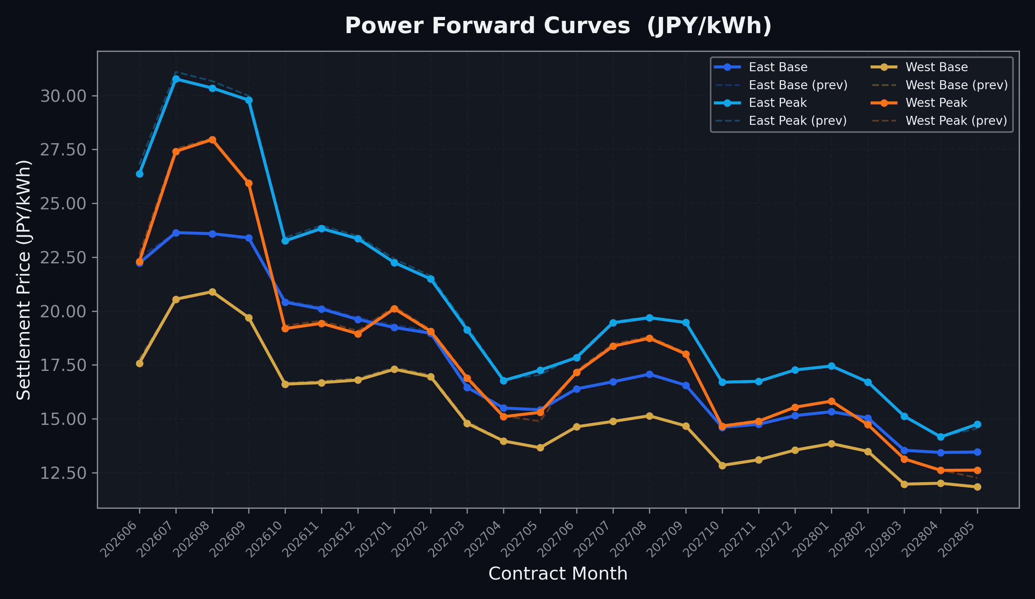
Power Forward Curves
East/West Base & Peak monthly contracts (2026-06-08)

Slide 3
Commodity Snapshot
Front-month settlement prices as of 2026-06-08
Category | Asset | Contract | Settlement | Unit | Change | % Chg
Energy | Barge Gas Oil | 202607 | 106,900.00 | JPY/kl | -300.00 | -0.28%
Energy | Barge Gasoline | 202607 | 100,000.00 | JPY/kl | +0.00 | +0.00%
Energy | Barge Kerosene | 202607 | 110,000.00 | JPY/kl | +0.00 | +0.00%
Energy | Chukyo Gasoline | 202607 | 95,000.00 | JPY/kl | +0.00 | +0.00%
Energy | Chukyo Kerosene | 202607 | 105,000.00 | JPY/kl | +0.00 | +0.00%
Energy | Dubai Crude Oil | 202606 | 90,800.00 | JPY/kl | -2800.00 | -2.99%
Energy | LNG (Platts JKM) | 202607 | 3,045.00 | USD/MMBtu | +40.00 | +1.33%
Metals | Gold | - | 22,167.00 | JPY/g | -658.00 | -2.88%
Metals | Palladium | 202606 | 6,500.00 | JPY/g | -300.00 | -4.41%
Metals | Platinum | - | 9,017.00 | JPY/g | -613.00 | -6.37%
Metals | Silver | 202606 | 355.00 | JPY/10g | -24.00 | -6.33%
Industrial | Rubber (RSS3) | 202606 | 412.40 | JPY/kg | -3.80 | -0.91%
Industrial | Rubber (TSR20) | 202607 | 360.00 | JPY/kg | -5.00 | -1.37%
Industrial | Shanghai Natural Rubber | 202609 | 17,670.00 | JPY/kg | +20.00 | +0.11%
Agriculture | Azuki Beans | 202606 | 12,300.00 | JPY/bag | +0.00 | +0.00%
Agriculture | Corn | 202607 | 39,000.00 | JPY/t | +0.00 | +0.00%
Agriculture | Soybeans | 202606 | 64,000.00 | JPY/t | +0.00 | +0.00%

Slide 4
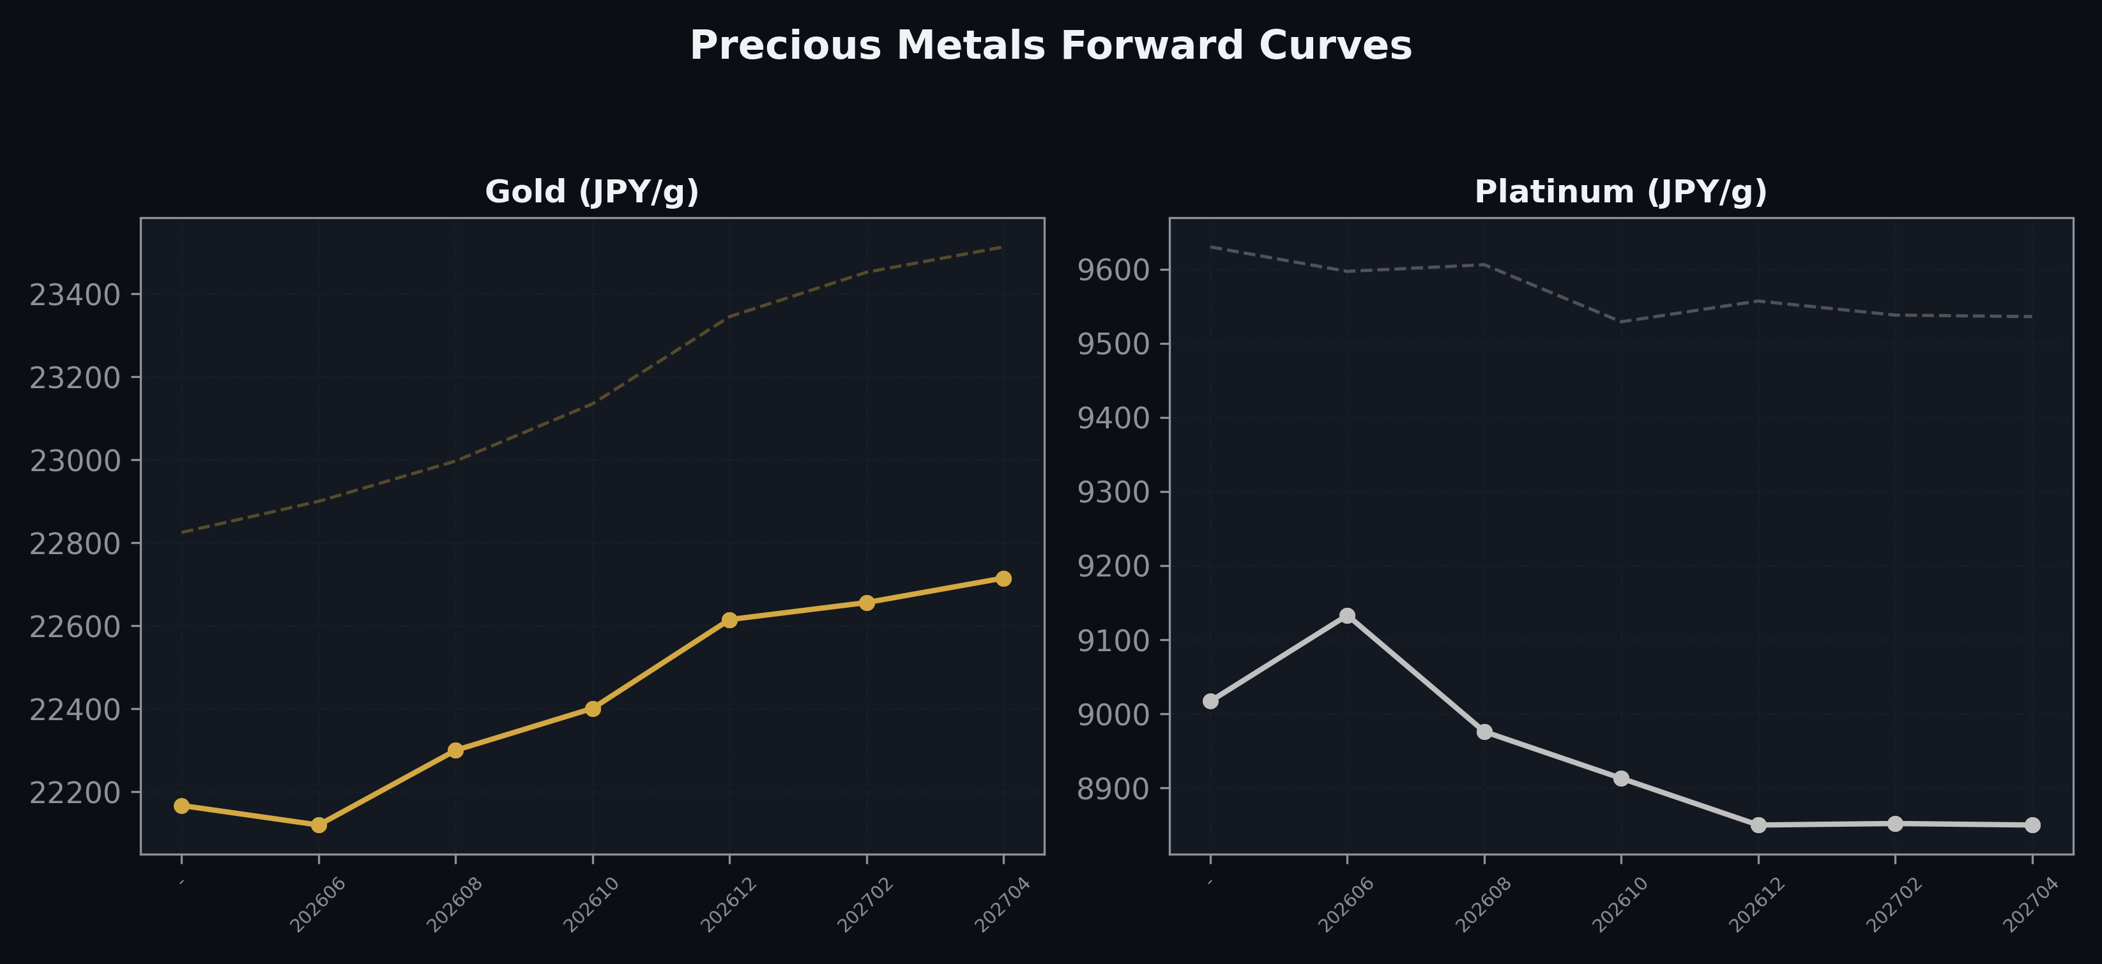
Precious Metals Forward Curves
Gold & Platinum (2026-06-08)

Slide 5
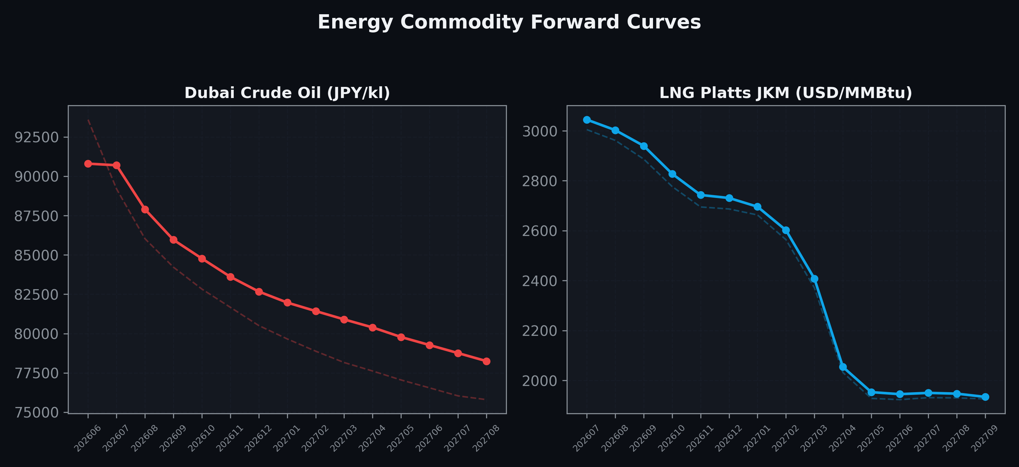
Energy Commodity Forward Curves
Dubai Crude Oil & LNG Platts JKM (2026-06-08)

Slide 6
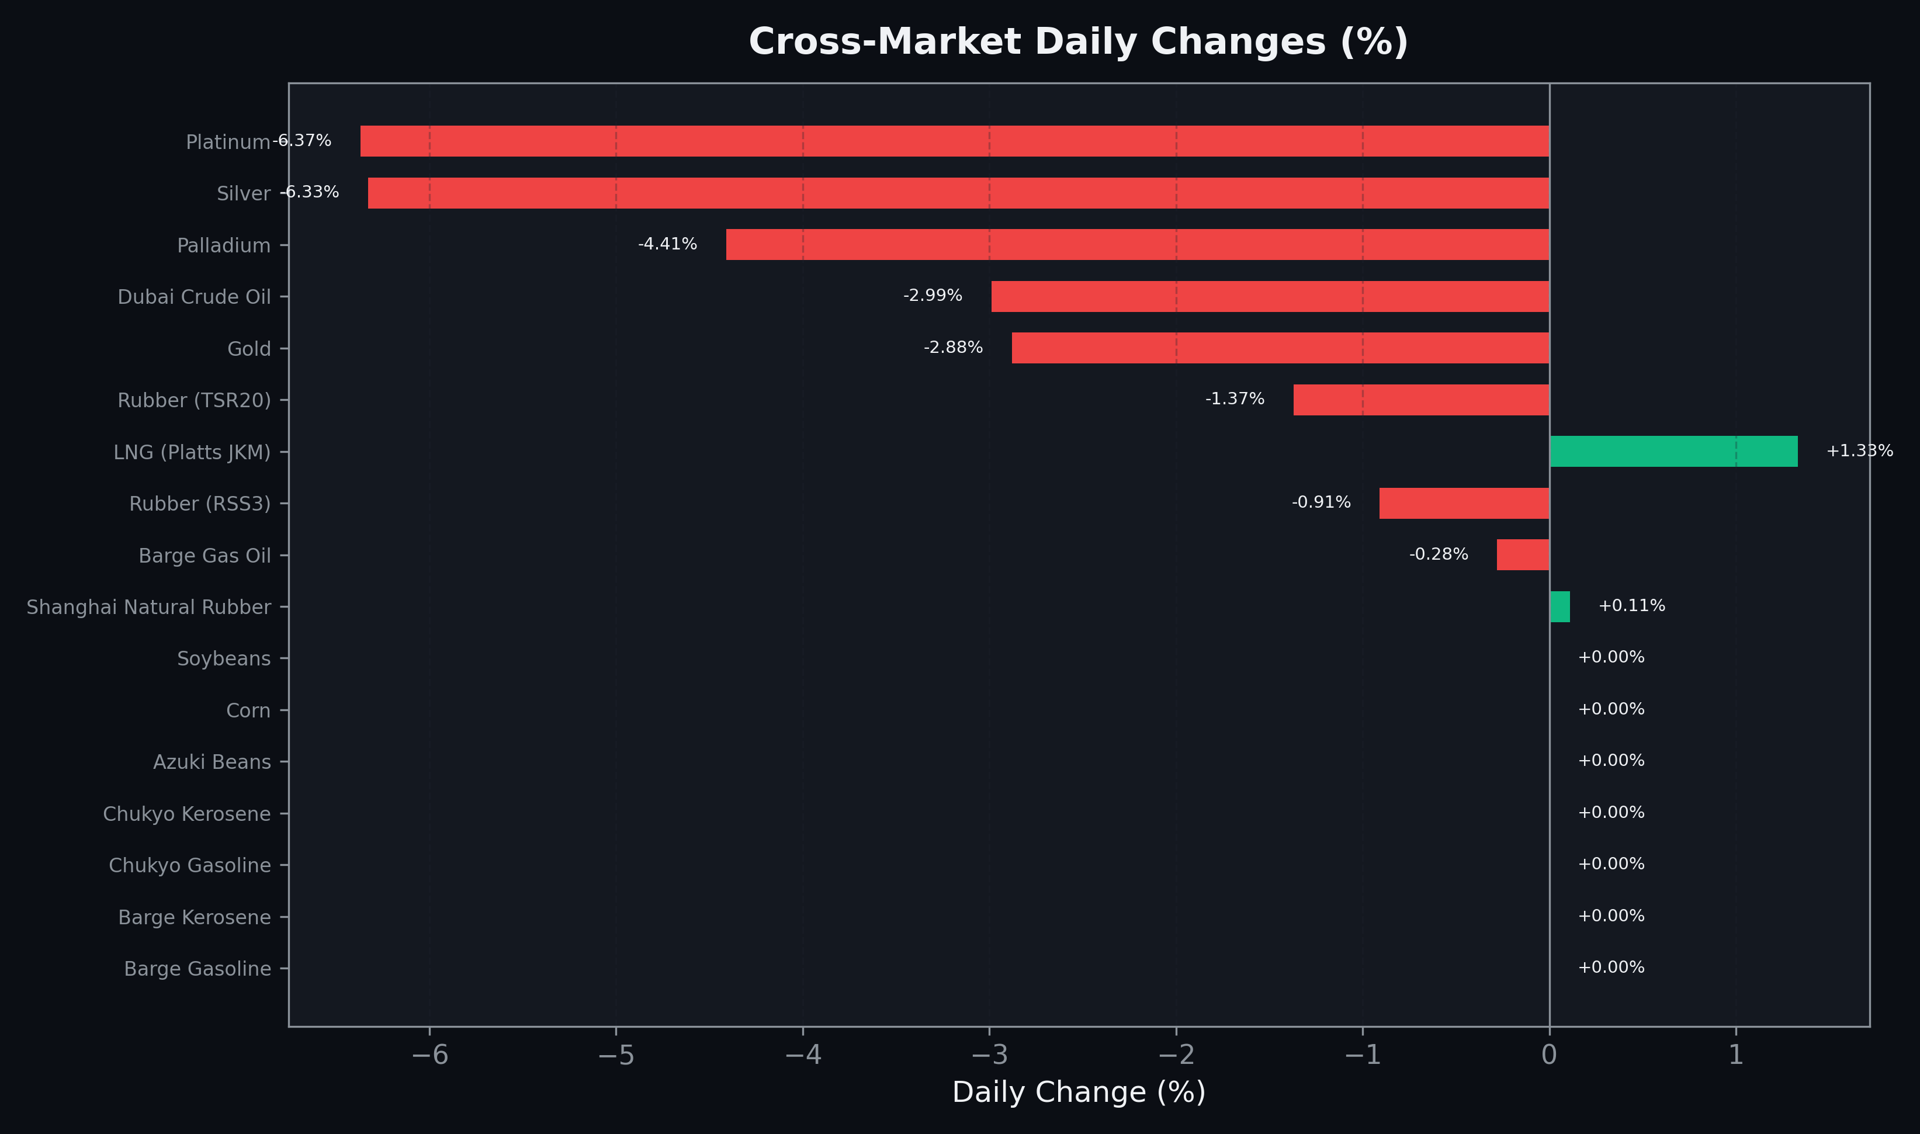
Cross-Market Daily Changes
All commodities sorted by absolute % change

Slide 7
Top Power Futures Movers
Largest absolute settlement price changes vs previous day (2026-06-08)
Instrument | Underlying | Month | Price | Prev | Change | % Chg
FUT_EEBW_260611 | Power East Base (Weekly) | 20260612 | 21.24 | 22.93 | -1.69 | -7.37%
FUT_EWBW_260611 | Power West Base (Weekly) | 20260612 | 17.23 | 18.15 | -0.92 | -5.07%
FUT_EWPW_260611 | Power West Peak (Weekly) | 20260612 | 21.23 | 22.04 | -0.81 | -3.68%
FUT_EEPW_260611 | Power East Peak (Weekly) | 20260612 | 25.54 | 26.14 | -0.60 | -2.30%
FUT_EEP_260629 | Power East Peak (Monthly) | 202606 | 26.37 | 26.80 | -0.43 | -1.60%
FUT_EWP_270528 | Power West Peak (Monthly) | 202705 | 15.30 | 14.89 | +0.41 | +2.75%
FUT_EEPW_260618 | Power East Peak (Weekly) | 20260619 | 25.38 | 25.76 | -0.38 | -1.48%
FUT_EEPW_260625 | Power East Peak (Weekly) | 20260626 | 25.98 | 26.34 | -0.36 | -1.37%
FUT_EWP_280530 | Power West Peak (Monthly) | 202805 | 12.62 | 12.26 | +0.36 | +2.94%
FUT_EWP_260629 | Power West Peak (Monthly) | 202606 | 22.30 | 22.64 | -0.34 | -1.50%
FUT_ECP_270528 | 電力(中部・日中) | 202705 | 15.45 | 15.12 | +0.33 | +2.18%
FUT_EEP_260730 | Power East Peak (Monthly) | 202607 | 30.77 | 31.10 | -0.33 | -1.06%
FUT_EEP_260828 | Power East Peak (Monthly) | 202608 | 30.35 | 30.67 | -0.32 | -1.04%
FUT_EEBW_260618 | Power East Base (Weekly) | 20260619 | 22.82 | 23.12 | -0.30 | -1.30%
FUT_EWPW_260618 | Power West Peak (Weekly) | 20260619 | 21.89 | 22.19 | -0.30 | -1.35%

