Slide 1
Daily Market Report
Trade Date: 2026-04-24
JPX Derivative & Commodity Analytics
DataServer In-House

Slide 2
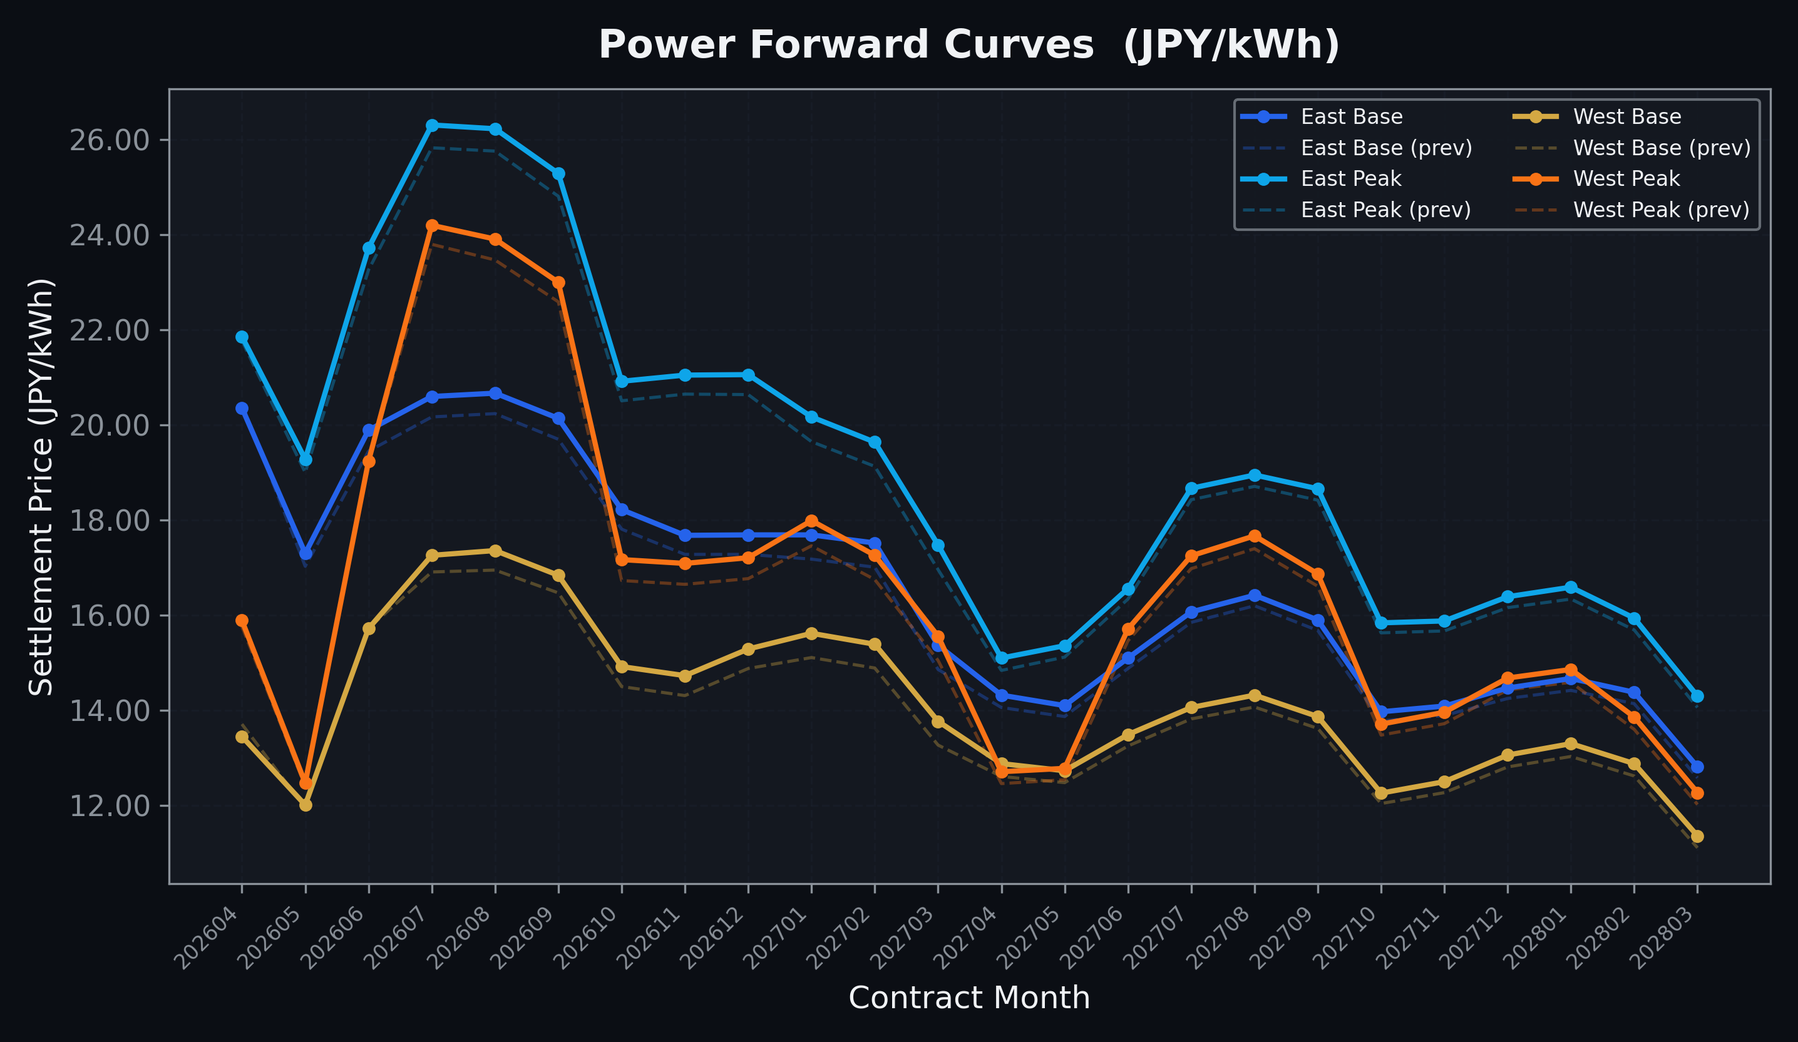
Power Forward Curves
East/West Base & Peak monthly contracts (2026-04-24)

Slide 3
Commodity Snapshot
Front-month settlement prices as of 2026-04-24
Category | Asset | Contract | Settlement | Unit | Change | % Chg
Energy | Barge Gas Oil | 202605 | 115,100.00 | JPY/kl | +0.00 | +0.00%
Energy | Barge Gasoline | 202605 | 105,000.00 | JPY/kl | +0.00 | +0.00%
Energy | Barge Kerosene | 202605 | 105,000.00 | JPY/kl | +0.00 | +0.00%
Energy | Chukyo Gasoline | 202605 | 105,000.00 | JPY/kl | +0.00 | +0.00%
Energy | Chukyo Kerosene | 202605 | 105,000.00 | JPY/kl | +0.00 | +0.00%
Energy | Dubai Crude Oil | 202604 | 105,770.00 | JPY/kl | +1240.00 | +1.19%
Energy | LNG (Platts JKM) | 202606 | 2,666.00 | USD/MMBtu | +70.00 | +2.70%
Metals | Gold | - | 23,857.00 | JPY/g | -279.00 | -1.16%
Metals | Palladium | 202604 | 7,900.00 | JPY/g | +0.00 | +0.00%
Metals | Platinum | - | 10,081.00 | JPY/g | -162.00 | -1.58%
Metals | Silver | 202604 | 383.10 | JPY/10g | +0.00 | +0.00%
Industrial | Rubber (RSS3) | 202605 | 386.60 | JPY/kg | +3.80 | +0.99%
Industrial | Rubber (TSR20) | 202605 | 330.00 | JPY/kg | +0.00 | +0.00%
Industrial | Shanghai Natural Rubber | 202605 | 16,935.00 | JPY/kg | -105.00 | -0.62%
Agriculture | Azuki Beans | 202604 | 12,300.00 | JPY/bag | +0.00 | +0.00%
Agriculture | Corn | 202607 | 39,000.00 | JPY/t | +0.00 | +0.00%
Agriculture | Soybeans | 202606 | 64,000.00 | JPY/t | +0.00 | +0.00%

Slide 4
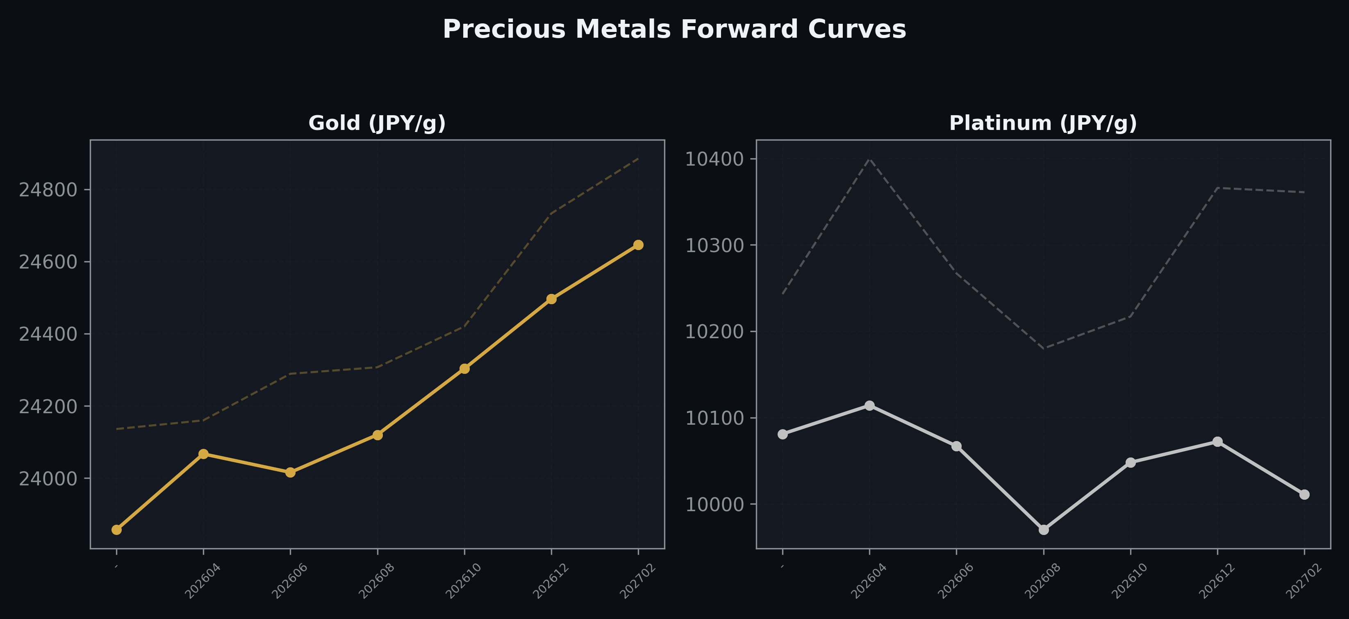
Precious Metals Forward Curves
Gold & Platinum (2026-04-24)

Slide 5
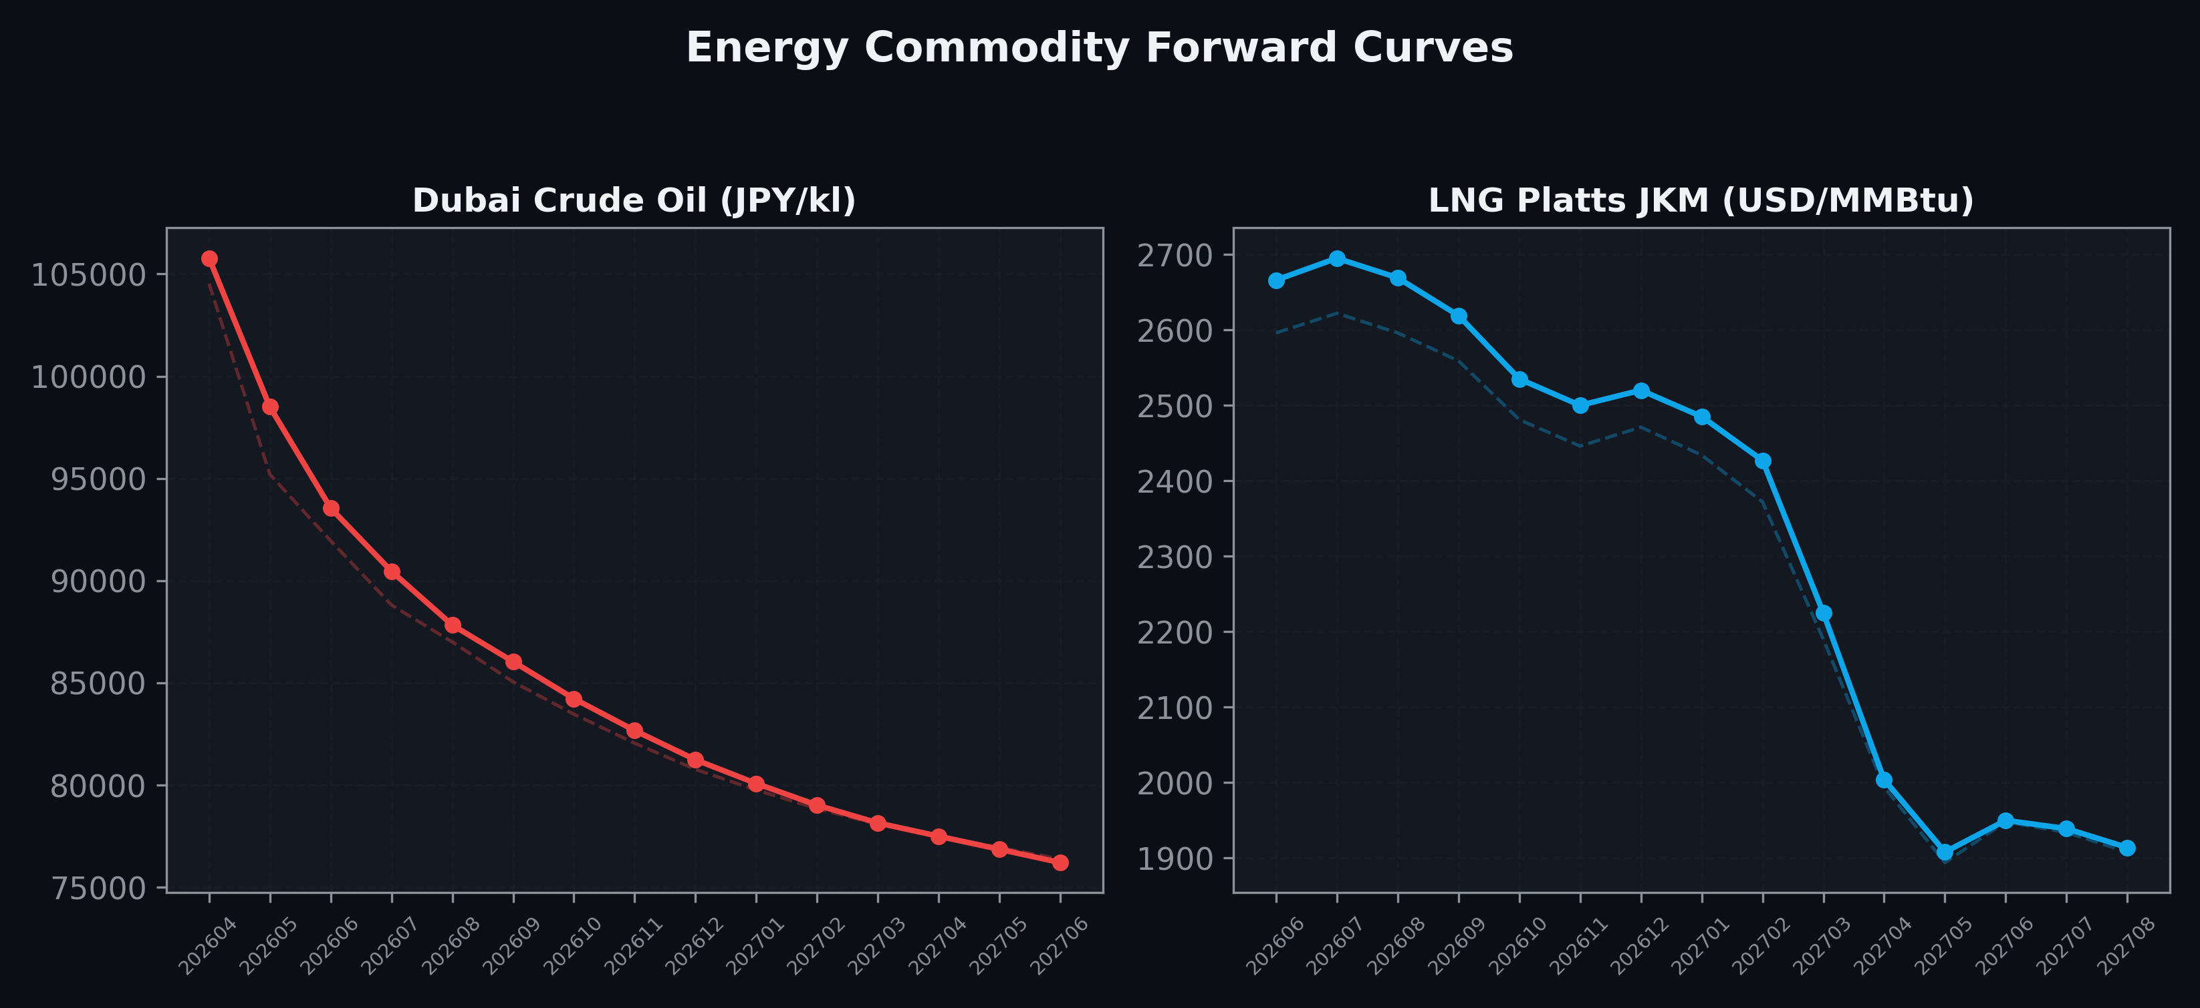
Energy Commodity Forward Curves
Dubai Crude Oil & LNG Platts JKM (2026-04-24)

Slide 6
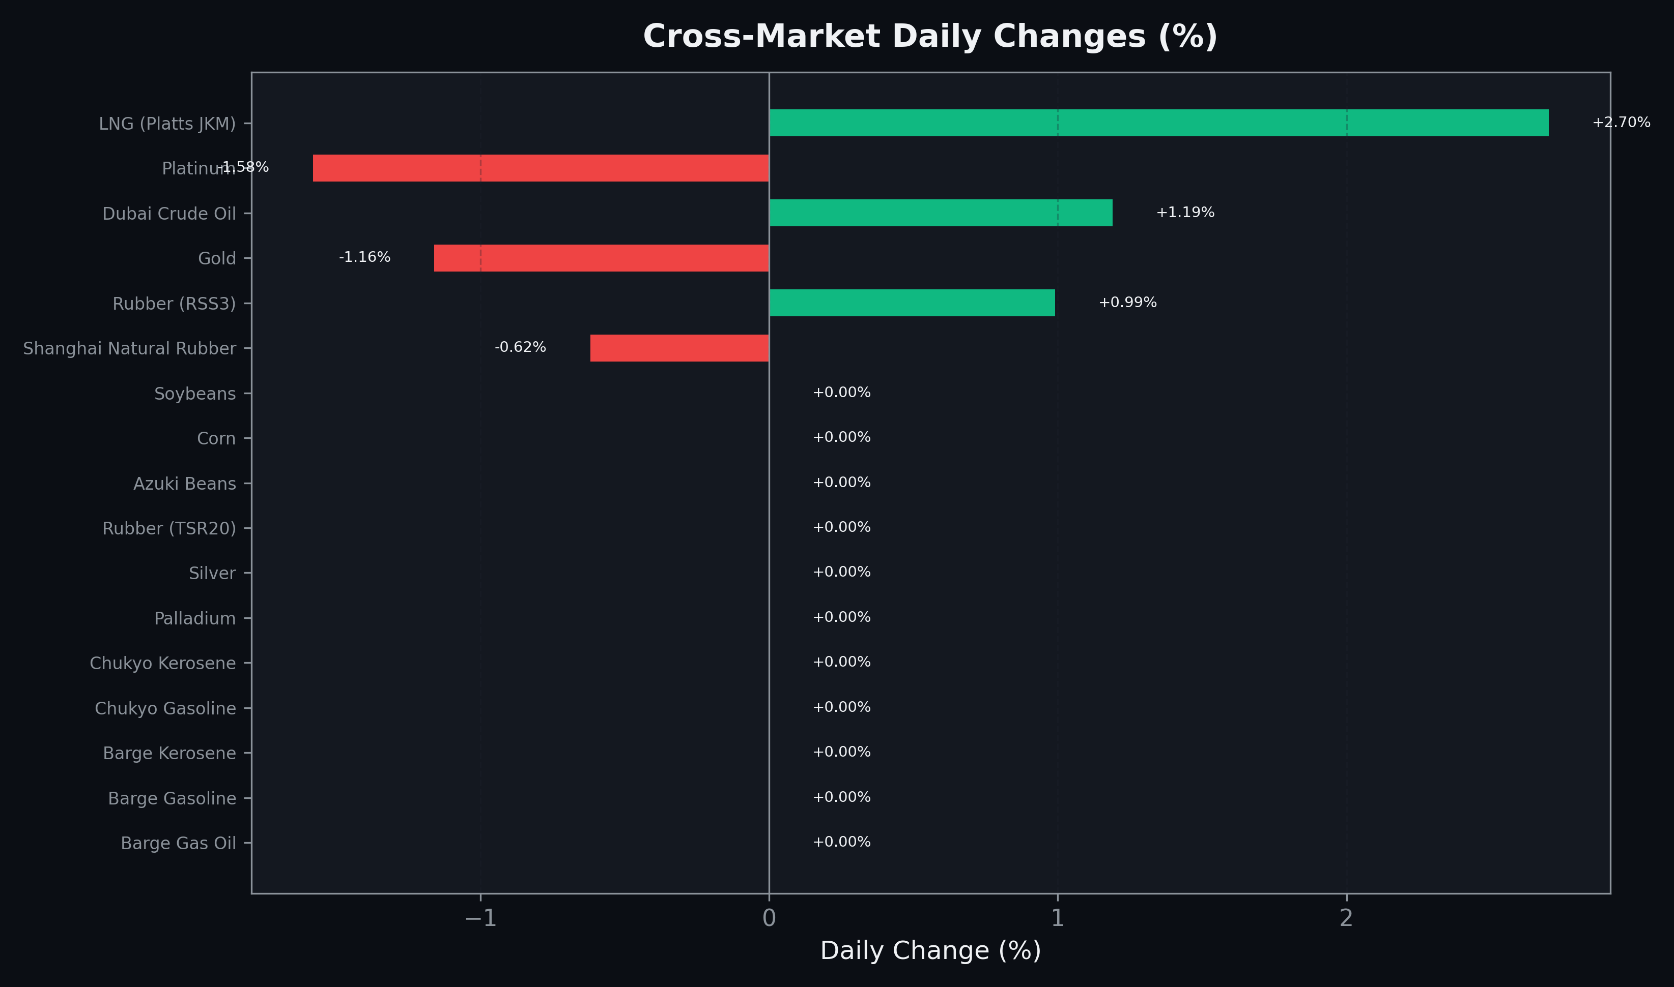
Cross-Market Daily Changes
All commodities sorted by absolute % change

Slide 7
Top Power Futures Movers
Largest absolute settlement price changes vs previous day (2026-04-24)
Instrument | Underlying | Month | Price | Prev | Change | % Chg
FUT_ECP_261029 | 電力(中部・日中) | 202610 | 19.20 | 18.51 | +0.69 | +3.73%
FUT_ECP_261127 | 電力(中部・日中) | 202611 | 18.57 | 18.03 | +0.54 | +3.00%
FUT_ECP_261228 | 電力(中部・日中) | 202612 | 18.42 | 17.88 | +0.54 | +3.02%
FUT_EWP_270128 | Power West Peak (Monthly) | 202701 | 17.99 | 17.46 | +0.53 | +3.04%
FUT_EEP_270128 | Power East Peak (Monthly) | 202701 | 20.17 | 19.65 | +0.52 | +2.65%
FUT_EEP_270330 | Power East Peak (Monthly) | 202703 | 17.48 | 16.96 | +0.52 | +3.07%
FUT_EEB_270129 | Power East Base (Monthly) | 202701 | 17.69 | 17.18 | +0.51 | +2.97%
FUT_EEB_270226 | Power East Base (Monthly) | 202702 | 17.52 | 17.01 | +0.51 | +3.00%
FUT_EEB_270330 | Power East Base (Monthly) | 202703 | 15.37 | 14.86 | +0.51 | +3.43%
FUT_EEP_270225 | Power East Peak (Monthly) | 202702 | 19.64 | 19.13 | +0.51 | +2.67%
FUT_EWB_270129 | Power West Base (Monthly) | 202701 | 15.62 | 15.11 | +0.51 | +3.38%
FUT_EWP_270225 | Power West Peak (Monthly) | 202702 | 17.26 | 16.75 | +0.51 | +3.04%
FUT_EWP_270330 | Power West Peak (Monthly) | 202703 | 15.56 | 15.05 | +0.51 | +3.39%
FUT_EWB_270226 | Power West Base (Monthly) | 202702 | 15.39 | 14.89 | +0.50 | +3.36%
FUT_EWB_270330 | Power West Base (Monthly) | 202703 | 13.77 | 13.27 | +0.50 | +3.77%

