Slide 1
Daily Market Report
Trade Date: 2026-04-21
JPX Derivative & Commodity Analytics
DataServer In-House

Slide 2
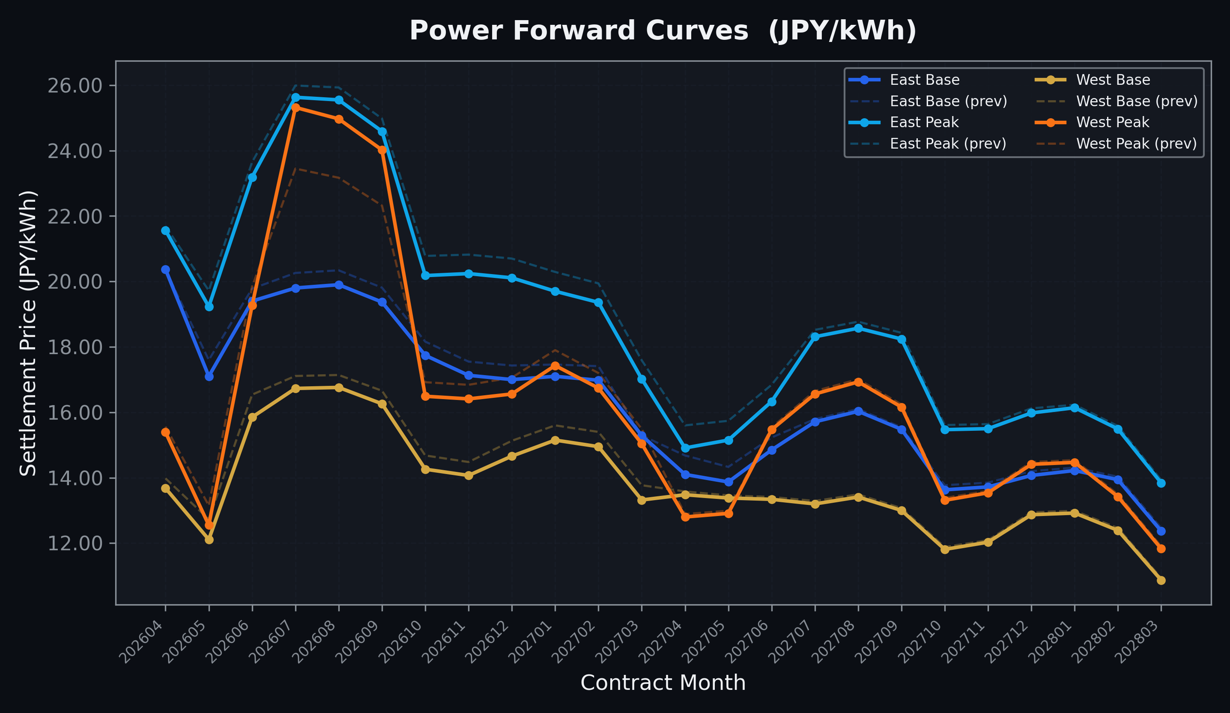
Power Forward Curves
East/West Base & Peak monthly contracts (2026-04-21)

Slide 3
Commodity Snapshot
Front-month settlement prices as of 2026-04-21
Category | Asset | Contract | Settlement | Unit | Change | % Chg
Energy | Barge Gas Oil | 202605 | 114,900.00 | JPY/kl | +0.00 | +0.00%
Energy | Barge Gasoline | 202605 | 105,000.00 | JPY/kl | +0.00 | +0.00%
Energy | Barge Kerosene | 202605 | 105,000.00 | JPY/kl | +0.00 | +0.00%
Energy | Chukyo Gasoline | 202605 | 105,000.00 | JPY/kl | +0.00 | +0.00%
Energy | Chukyo Kerosene | 202605 | 105,000.00 | JPY/kl | +0.00 | +0.00%
Energy | Dubai Crude Oil | 202604 | 101,220.00 | JPY/kl | +1640.00 | +1.65%
Energy | LNG (Platts JKM) | 202606 | 2,388.00 | USD/MMBtu | -41.00 | -1.69%
Metals | Gold | - | 24,486.00 | JPY/g | +111.00 | +0.46%
Metals | Palladium | 202604 | 8,000.00 | JPY/g | +0.00 | +0.00%
Metals | Platinum | - | 10,544.00 | JPY/g | -34.00 | -0.32%
Metals | Silver | 202604 | 383.10 | JPY/10g | +0.00 | +0.00%
Industrial | Rubber (RSS3) | 202604 | 379.80 | JPY/kg | +1.50 | +0.40%
Industrial | Rubber (TSR20) | 202605 | 325.00 | JPY/kg | +0.00 | +0.00%
Industrial | Shanghai Natural Rubber | 202605 | 16,935.00 | JPY/kg | -15.00 | -0.09%
Agriculture | Azuki Beans | 202604 | 12,300.00 | JPY/bag | +0.00 | +0.00%
Agriculture | Corn | 202607 | 39,000.00 | JPY/t | +0.00 | +0.00%
Agriculture | Soybeans | 202606 | 64,000.00 | JPY/t | +0.00 | +0.00%

Slide 4
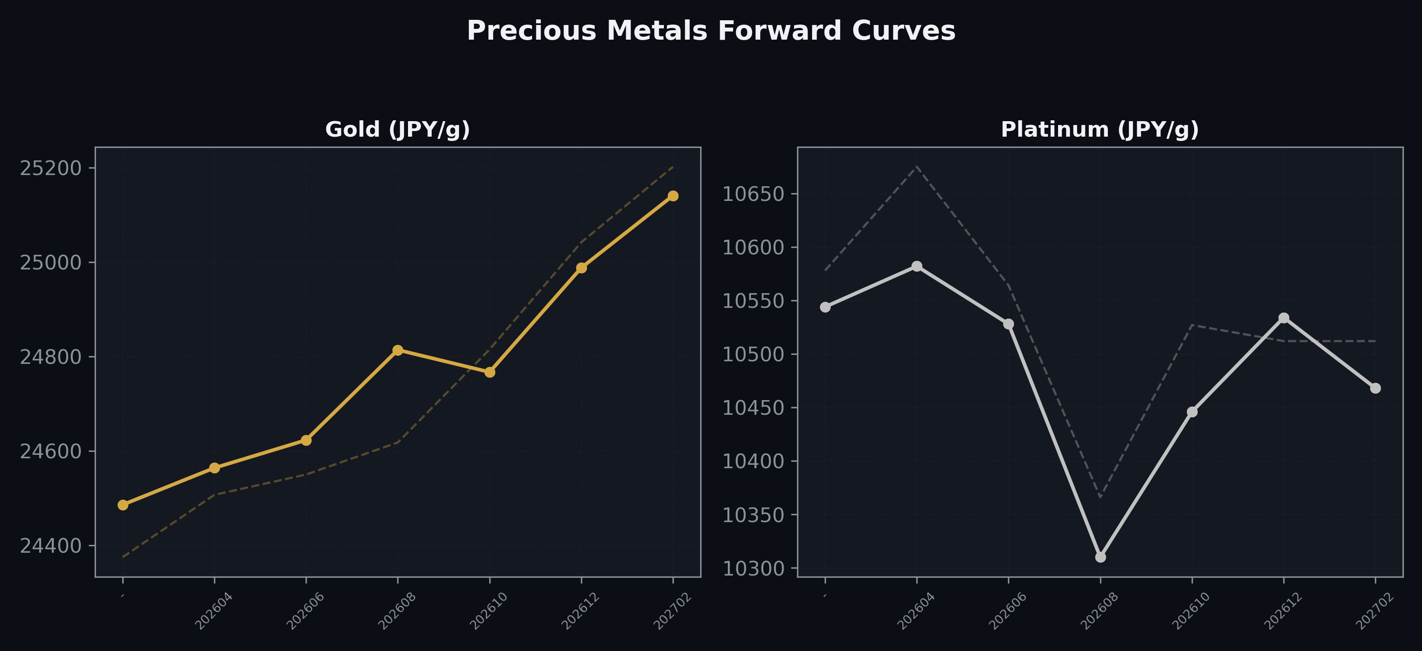
Precious Metals Forward Curves
Gold & Platinum (2026-04-21)

Slide 5
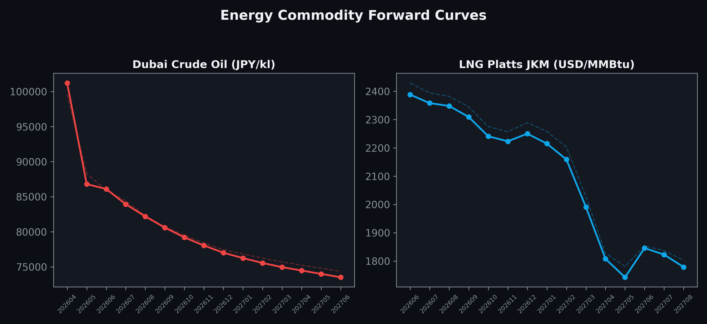
Energy Commodity Forward Curves
Dubai Crude Oil & LNG Platts JKM (2026-04-21)

Slide 6
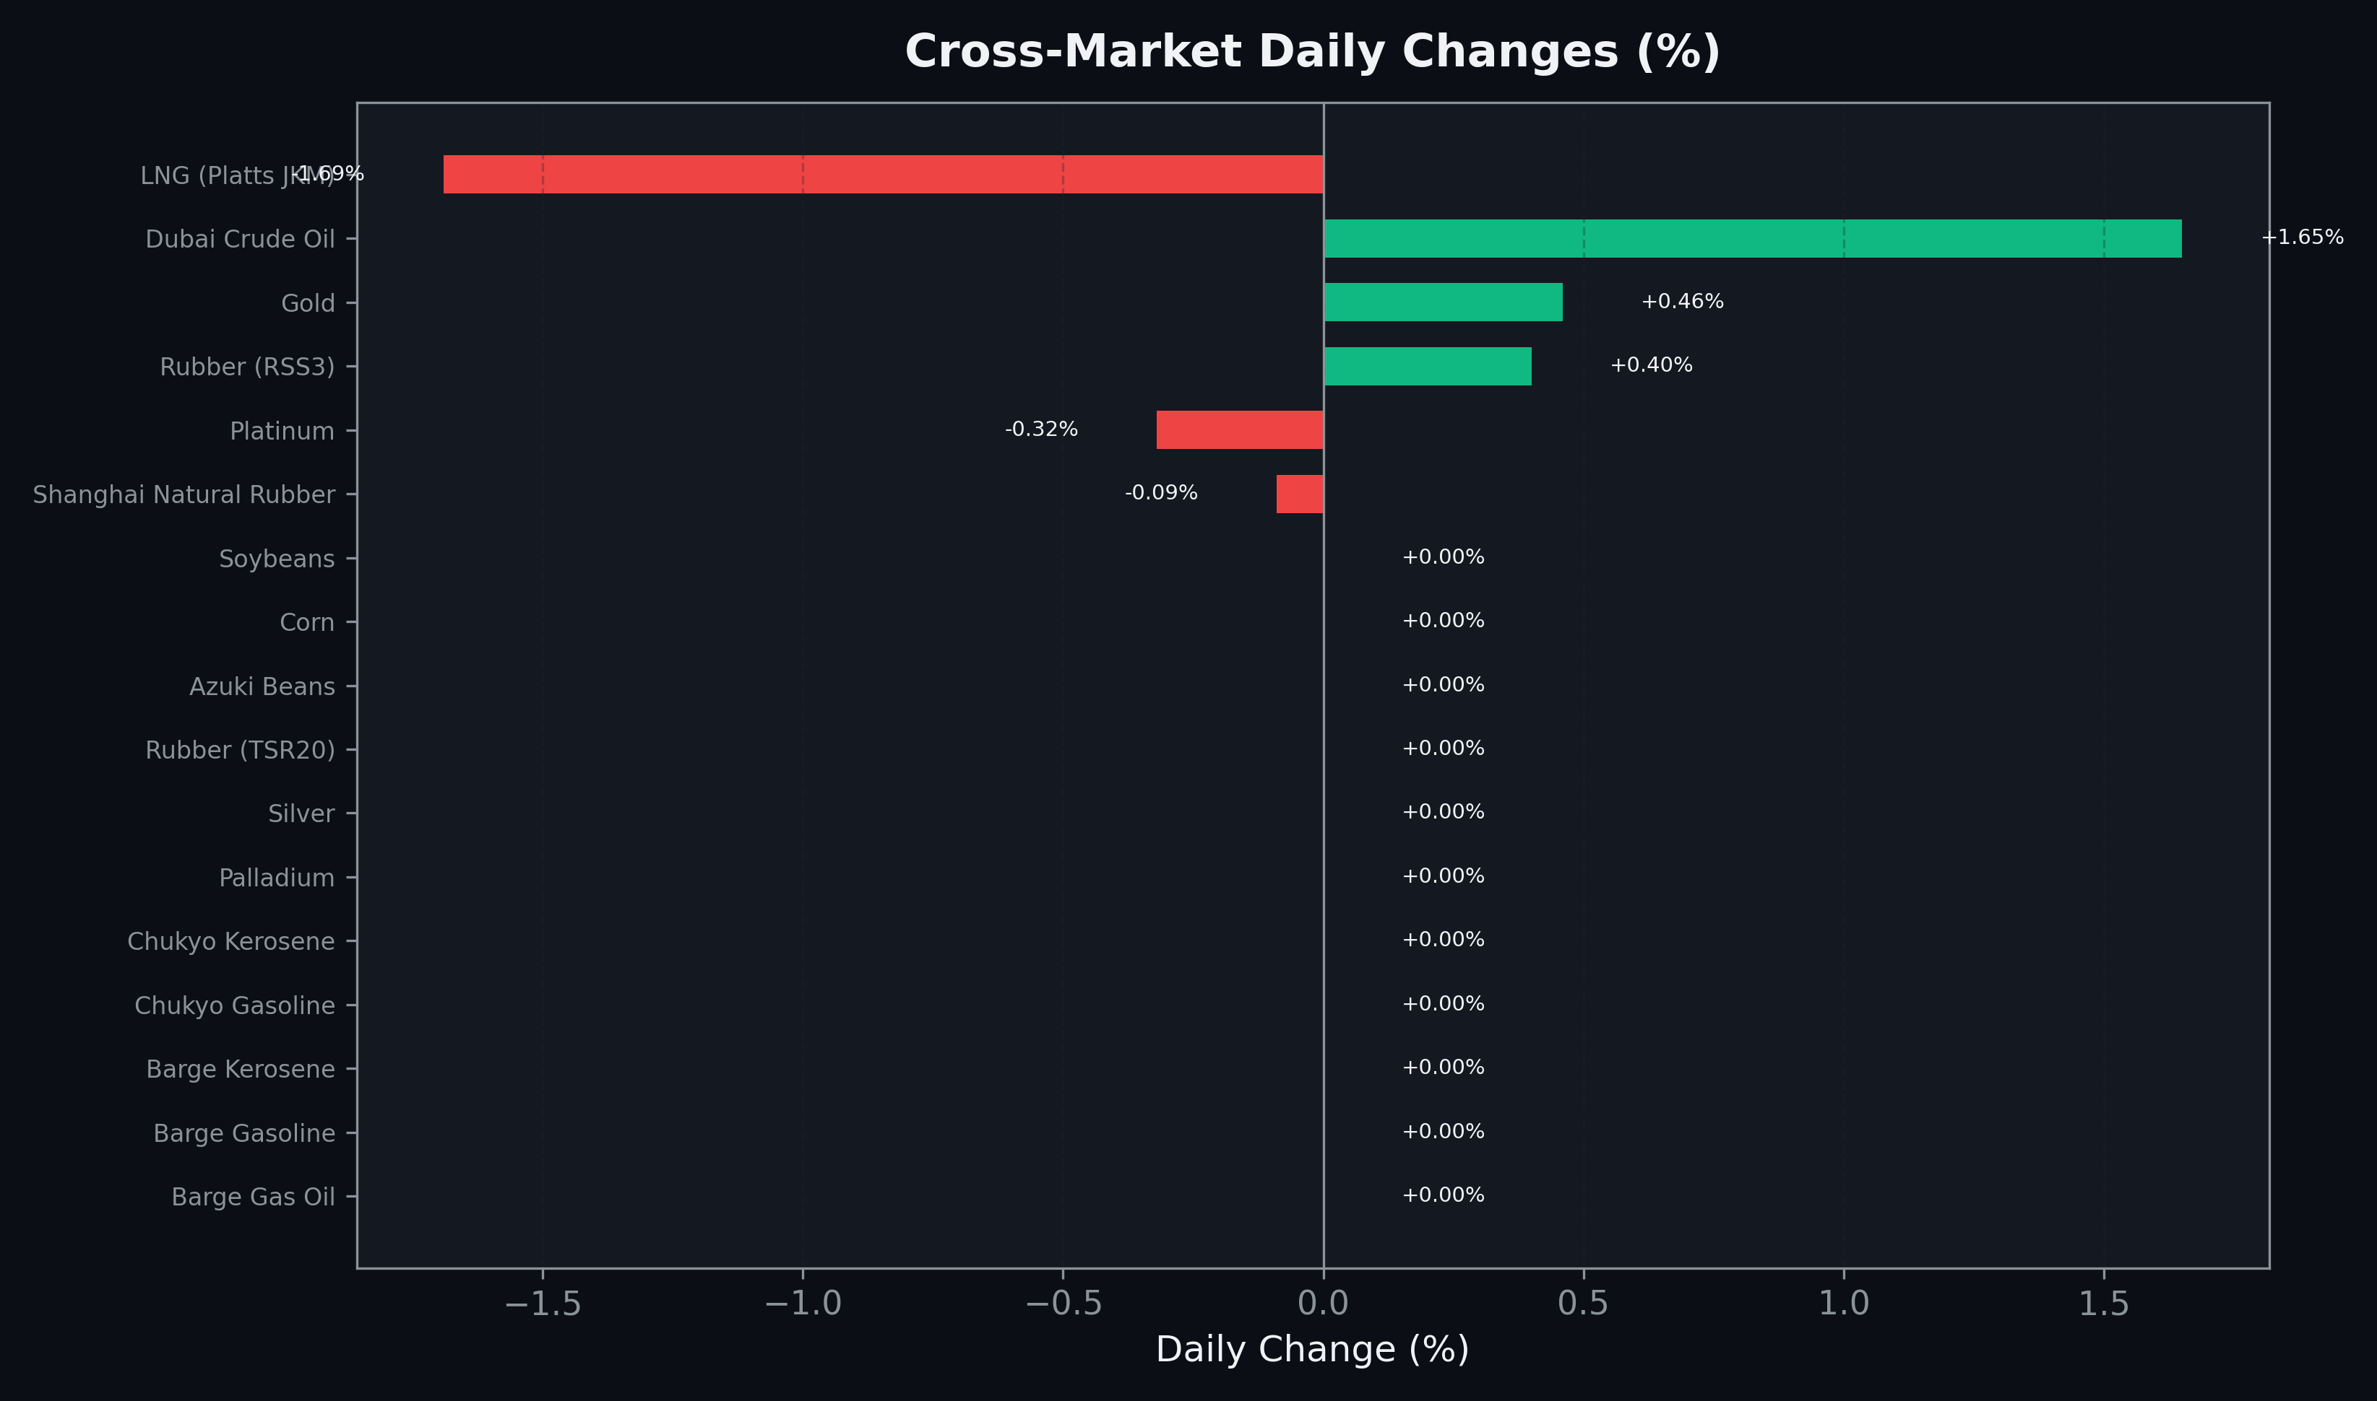
Cross-Market Daily Changes
All commodities sorted by absolute % change

Slide 7
Top Power Futures Movers
Largest absolute settlement price changes vs previous day (2026-04-21)
Instrument | Underlying | Month | Price | Prev | Change | % Chg
FUT_EWP_260730 | Power West Peak (Monthly) | 202607 | 25.32 | 23.45 | +1.87 | +7.97%
FUT_EWP_260828 | Power West Peak (Monthly) | 202608 | 24.97 | 23.17 | +1.80 | +7.77%
FUT_EWP_260929 | Power West Peak (Monthly) | 202609 | 24.02 | 22.32 | +1.70 | +7.62%
FUT_EWBW_260521 | Power West Base (Weekly) | 20260522 | 12.23 | 13.11 | -0.88 | -6.71%
FUT_EWPW_260521 | Power West Peak (Weekly) | 20260522 | 11.41 | 12.24 | -0.83 | -6.78%
FUT_EEPW_260514 | Power East Peak (Weekly) | 20260515 | 18.69 | 19.46 | -0.77 | -3.96%
FUT_EEPW_260507 | Power East Peak (Weekly) | 20260508 | 17.97 | 18.73 | -0.76 | -4.06%
FUT_EEPW_260521 | Power East Peak (Weekly) | 20260522 | 19.11 | 19.82 | -0.71 | -3.58%
FUT_EEP_270428 | Power East Peak (Monthly) | 202704 | 14.91 | 15.60 | -0.69 | -4.42%
FUT_EWB_260629 | Power West Base (Monthly) | 202606 | 15.85 | 16.54 | -0.69 | -4.17%
FUT_EEBW_260521 | Power East Base (Weekly) | 20260522 | 17.79 | 18.47 | -0.68 | -3.68%
FUT_EWPW_260514 | Power West Peak (Weekly) | 20260515 | 11.20 | 11.87 | -0.67 | -5.64%
FUT_EWBW_260514 | Power West Base (Weekly) | 20260515 | 11.99 | 12.65 | -0.66 | -5.22%
FUT_EEBW_260514 | Power East Base (Weekly) | 20260515 | 17.43 | 18.06 | -0.63 | -3.49%
FUT_EWB_260529 | Power West Base (Monthly) | 202605 | 12.11 | 12.73 | -0.62 | -4.87%

