Slide 1
Daily Market Report
Trade Date: 2026-05-07
JPX Derivative & Commodity Analytics
DataServer In-House

Slide 2
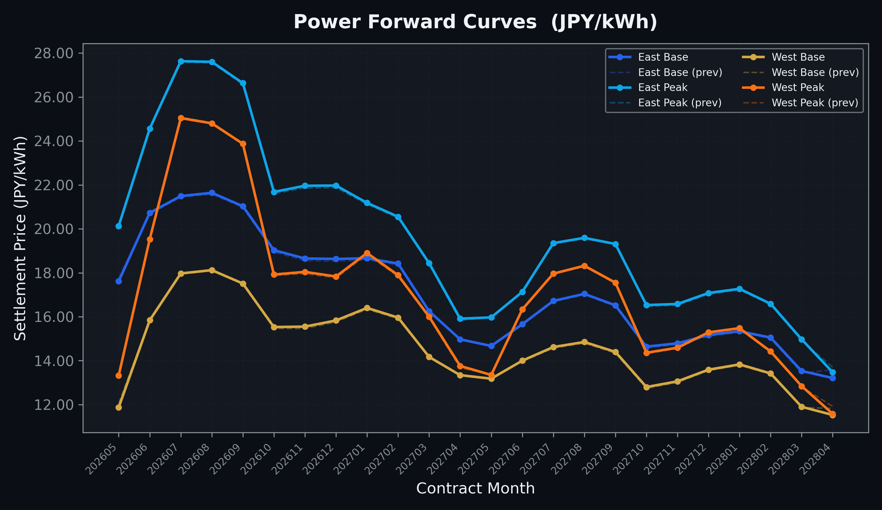
Power Forward Curves
East/West Base & Peak monthly contracts (2026-05-07)

Slide 3
Commodity Snapshot
Front-month settlement prices as of 2026-05-07
Category | Asset | Contract | Settlement | Unit | Change | % Chg
Energy | Barge Gas Oil | 202606 | 111,700.00 | JPY/kl | -600.00 | -0.53%
Energy | Barge Gasoline | 202606 | 100,000.00 | JPY/kl | +0.00 | +0.00%
Energy | Barge Kerosene | 202606 | 105,000.00 | JPY/kl | +0.00 | +0.00%
Energy | Chukyo Gasoline | 202606 | 100,000.00 | JPY/kl | +0.00 | +0.00%
Energy | Chukyo Kerosene | 202606 | 105,000.00 | JPY/kl | +0.00 | +0.00%
Energy | Dubai Crude Oil | 202605 | 102,000.00 | JPY/kl | -920.00 | -0.89%
Energy | LNG (Platts JKM) | 202606 | 2,687.00 | USD/MMBtu | -76.00 | -2.75%
Metals | Gold | - | 23,336.00 | JPY/g | +169.00 | +0.73%
Metals | Palladium | 202606 | 7,600.00 | JPY/g | +0.00 | +0.00%
Metals | Platinum | - | 10,239.00 | JPY/g | +438.00 | +4.47%
Metals | Silver | 202606 | 380.00 | JPY/10g | +0.00 | +0.00%
Industrial | Rubber (RSS3) | 202605 | 402.80 | JPY/kg | +6.80 | +1.72%
Industrial | Rubber (TSR20) | 202606 | 340.00 | JPY/kg | +10.00 | +3.03%
Industrial | Shanghai Natural Rubber | 202605 | 17,870.00 | JPY/kg | +445.00 | +2.55%
Agriculture | Azuki Beans | 202605 | 12,300.00 | JPY/bag | +0.00 | +0.00%
Agriculture | Corn | 202607 | 39,000.00 | JPY/t | +0.00 | +0.00%
Agriculture | Soybeans | 202606 | 64,000.00 | JPY/t | +0.00 | +0.00%

Slide 4
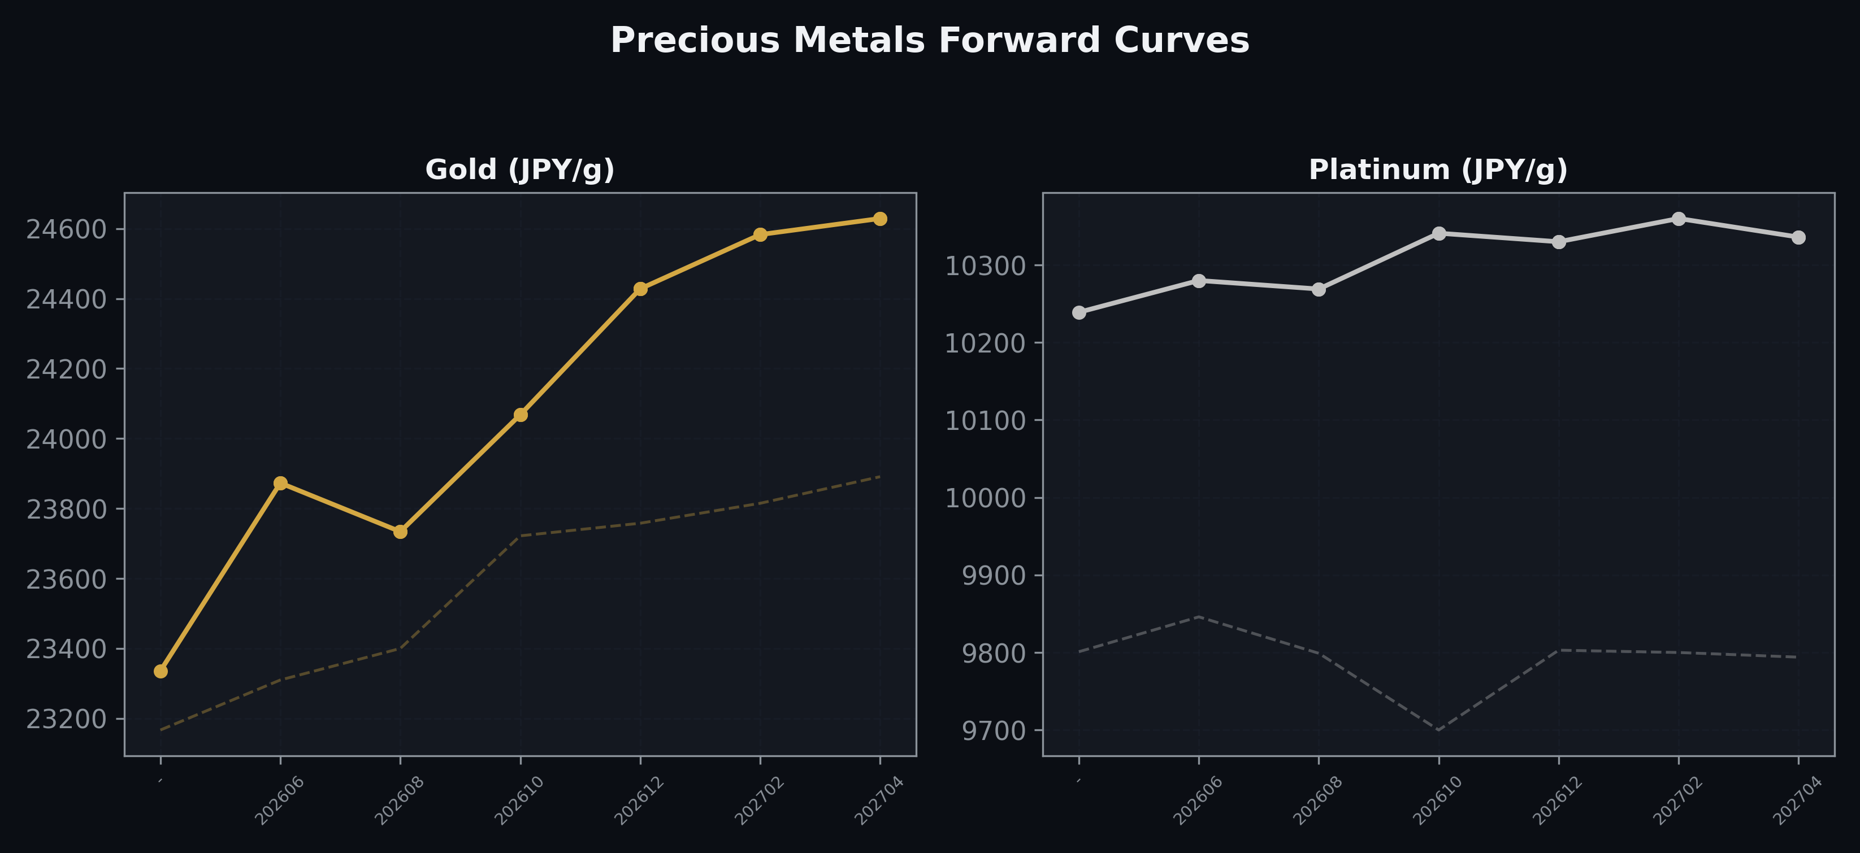
Precious Metals Forward Curves
Gold & Platinum (2026-05-07)

Slide 5
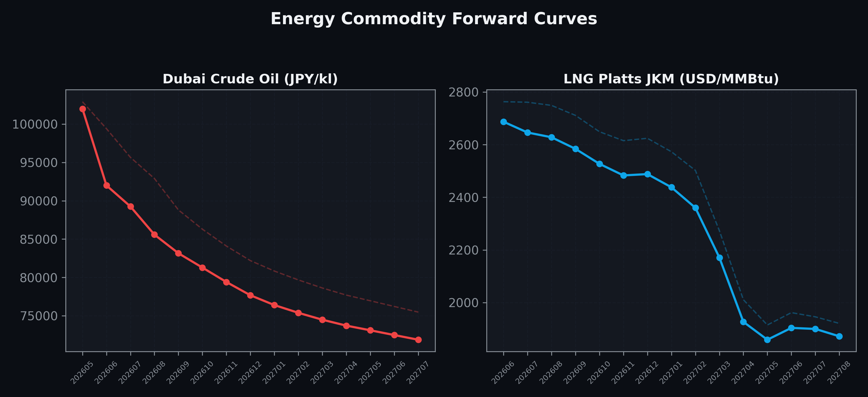
Energy Commodity Forward Curves
Dubai Crude Oil & LNG Platts JKM (2026-05-07)

Slide 6
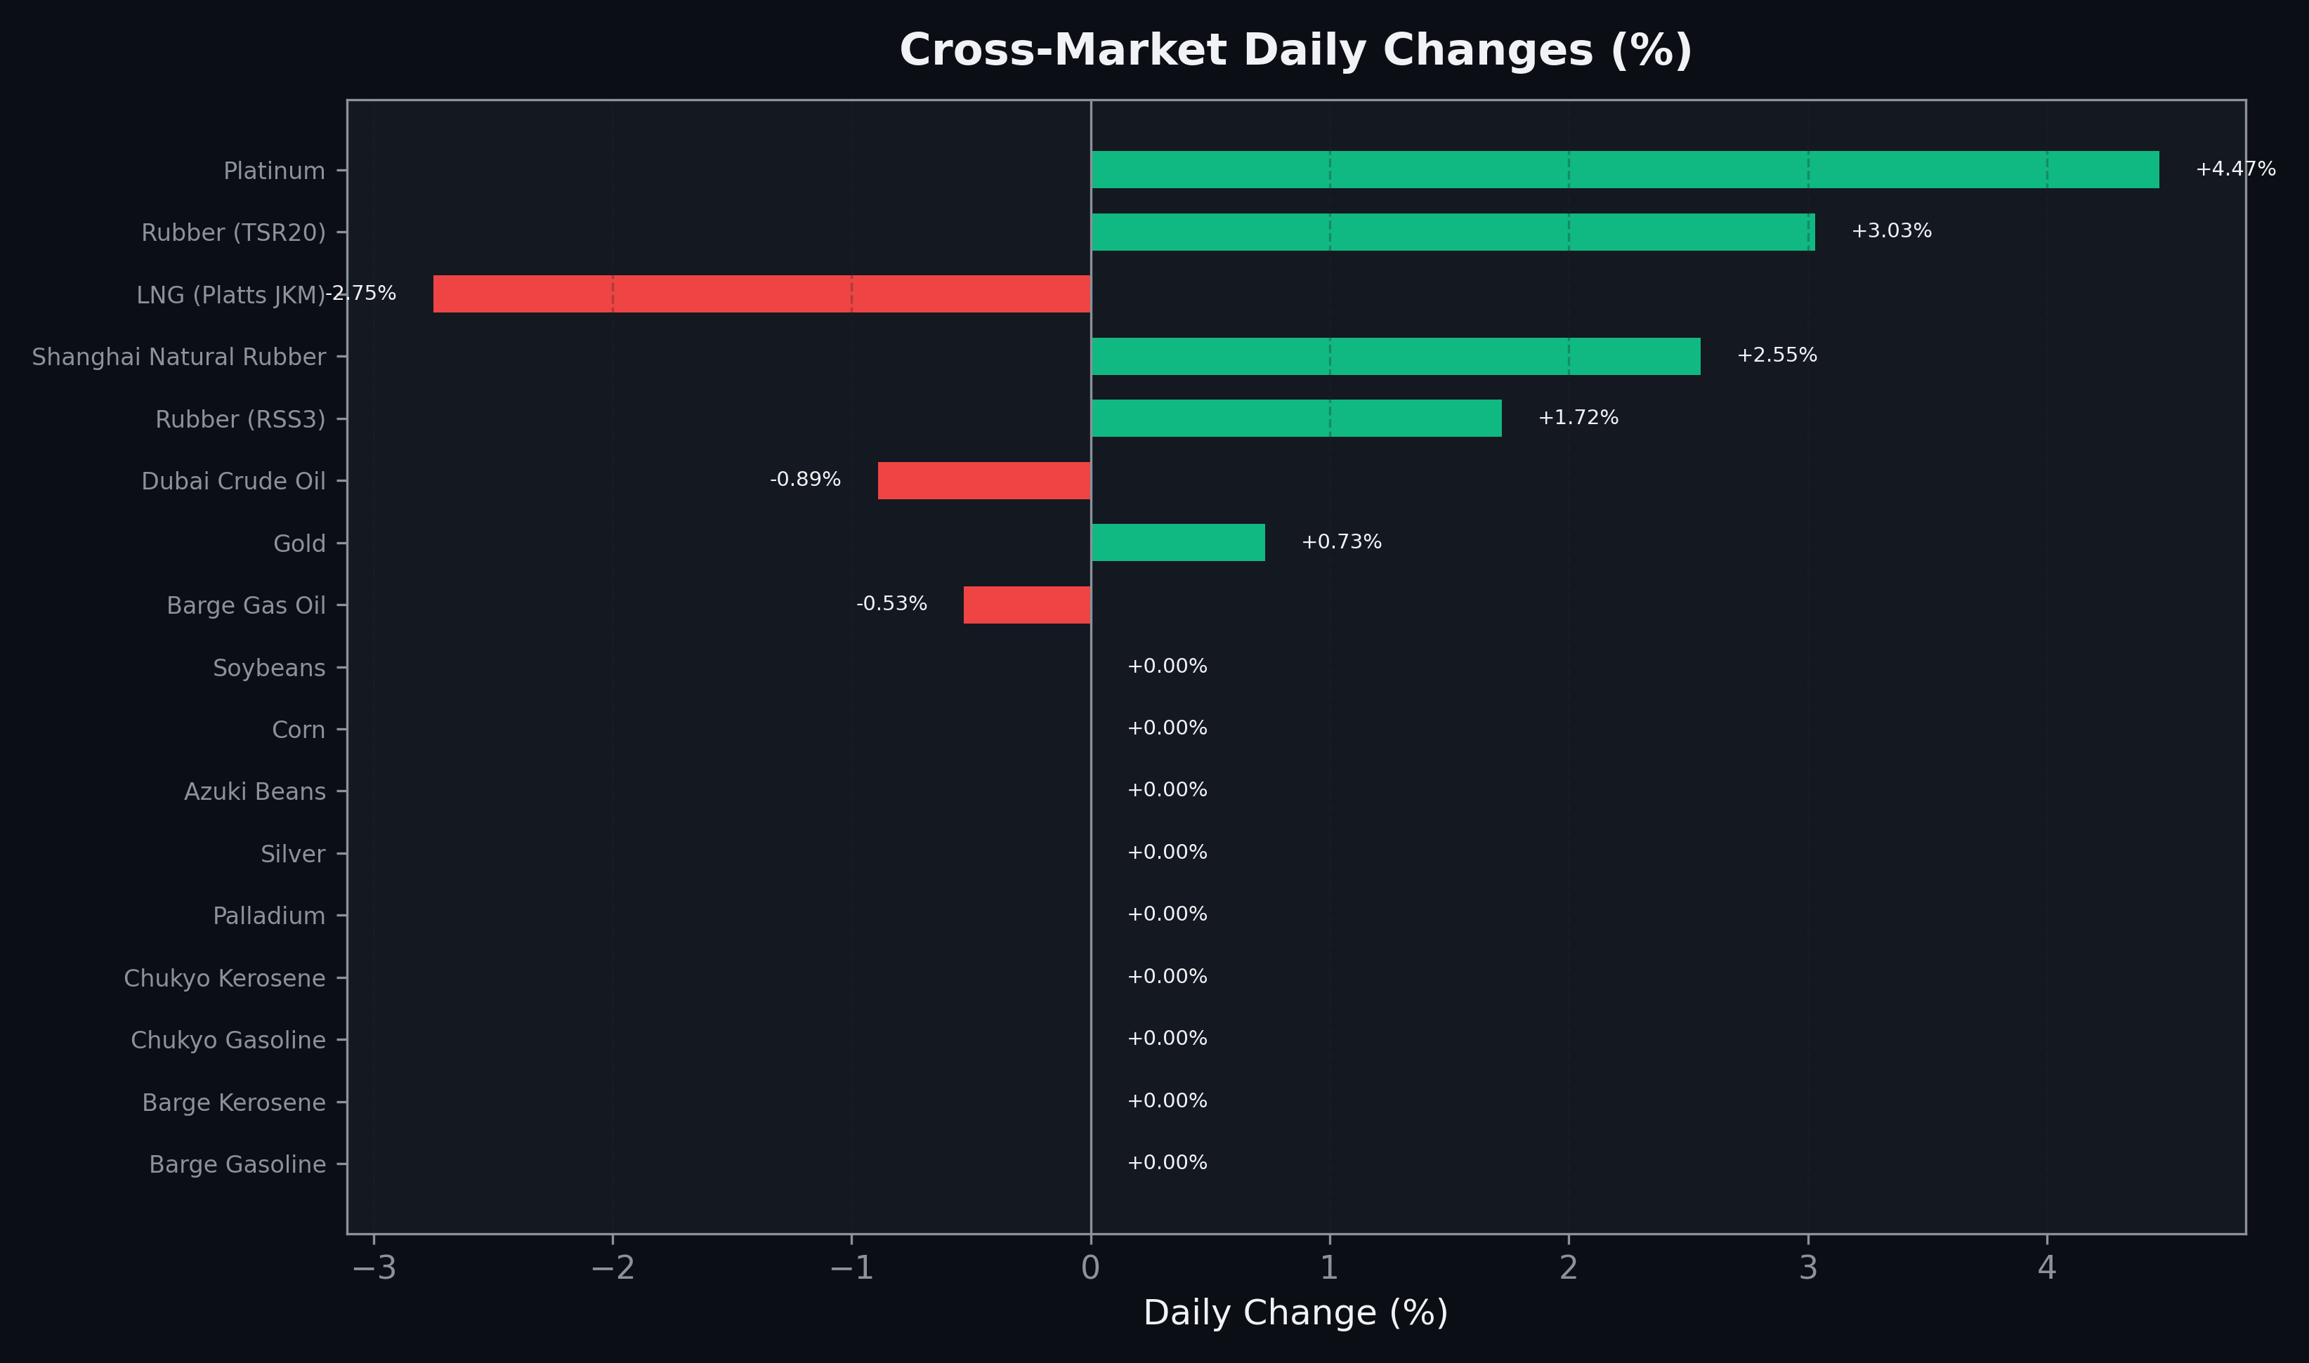
Cross-Market Daily Changes
All commodities sorted by absolute % change

Slide 7
Top Power Futures Movers
Largest absolute settlement price changes vs previous day (2026-05-07)
Instrument | Underlying | Month | Price | Prev | Change | % Chg
FUT_EWPW_260507 | Power West Peak (Weekly) | 20260508 | 14.65 | 11.14 | +3.51 | +31.51%
FUT_EEBW_260507 | Power East Base (Weekly) | 20260508 | 13.46 | 16.39 | -2.93 | -17.88%
FUT_EWBW_260507 | Power West Base (Weekly) | 20260508 | 9.08 | 10.97 | -1.89 | -17.23%
FUT_EWPW_260604 | Power West Peak (Weekly) | 20260605 | 17.42 | 15.77 | +1.65 | +10.46%
FUT_EEPW_260604 | Power East Peak (Weekly) | 20260605 | 23.02 | 21.76 | +1.26 | +5.79%
FUT_EEPW_260507 | Power East Peak (Weekly) | 20260508 | 19.93 | 18.68 | +1.25 | +6.69%
FUT_EWPY_280328 | Power West Peak (Yearly) | 202804 | 13.39 | 14.09 | -0.70 | -4.97%
FUT_EEPY_280328 | Power East Peak (Yearly) | 202804 | 15.09 | 15.68 | -0.59 | -3.76%
FUT_EEBW_260604 | Power East Base (Weekly) | 20260605 | 20.21 | 19.71 | +0.50 | +2.54%
FUT_EWPW_260528 | Power West Peak (Weekly) | 20260529 | 12.00 | 12.48 | -0.48 | -3.85%
FUT_EWBW_260604 | Power West Base (Weekly) | 20260605 | 14.56 | 14.14 | +0.42 | +2.97%
FUT_EWBW_260528 | Power West Base (Weekly) | 20260529 | 12.23 | 12.62 | -0.39 | -3.09%
FUT_EEB_280428 | Power East Base (Monthly) | 202804 | 13.21 | 13.58 | -0.37 | -2.72%
FUT_EWP_280427 | Power West Peak (Monthly) | 202804 | 11.58 | 11.92 | -0.34 | -2.85%
FUT_ECPY_280328 | 電力(中部・年度日中) | 202804 | 13.89 | 14.21 | -0.32 | -2.25%

