Slide 1
Daily Market Report
Trade Date: 2026-06-29
JPX Derivative & Commodity Analytics
DataServer In-House

Slide 2
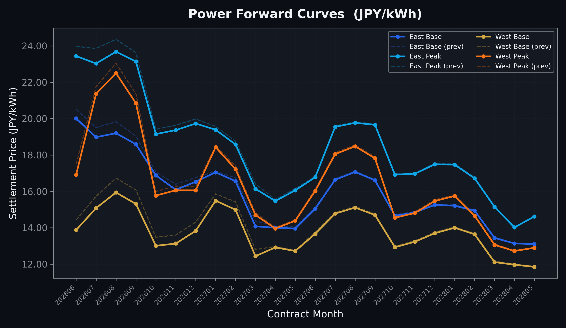
Power Forward Curves
East/West Base & Peak monthly contracts (2026-06-29)

Slide 3
Commodity Snapshot
Front-month settlement prices as of 2026-06-29
Category | Asset | Contract | Settlement | Unit | Change | % Chg
Energy | Barge Gas Oil | 202608 | 105,100.00 | JPY/kl | -100.00 | -0.10%
Energy | Barge Gasoline | 202608 | 97,000.00 | JPY/kl | +0.00 | +0.00%
Energy | Barge Kerosene | 202608 | 108,000.00 | JPY/kl | +0.00 | +0.00%
Energy | Chukyo Gasoline | 202608 | 95,000.00 | JPY/kl | +0.00 | +0.00%
Energy | Chukyo Kerosene | 202608 | 105,000.00 | JPY/kl | +0.00 | +0.00%
Energy | Dubai Crude Oil | 202606 | 80,150.00 | JPY/kl | -410.00 | -0.51%
Energy | LNG (Platts JKM) | 202608 | 2,515.00 | USD/MMBtu | +36.00 | +1.45%
Metals | Gold | - | 21,143.00 | JPY/g | +276.00 | +1.32%
Metals | Palladium | 202608 | 6,400.00 | JPY/g | +0.00 | +0.00%
Metals | Platinum | - | 8,385.00 | JPY/g | +398.00 | +4.98%
Metals | Silver | 202608 | 300.00 | JPY/10g | -25.00 | -7.69%
Industrial | Rubber (RSS3) | 202607 | 400.00 | JPY/kg | -2.30 | -0.57%
Industrial | Rubber (TSR20) | 202607 | 340.00 | JPY/kg | +0.00 | +0.00%
Industrial | Shanghai Natural Rubber | 202609 | 16,700.00 | JPY/kg | +90.00 | +0.54%
Agriculture | Azuki Beans | 202607 | 12,300.00 | JPY/bag | +0.00 | +0.00%
Agriculture | Corn | 202609 | 39,000.00 | JPY/t | +0.00 | +0.00%
Agriculture | Soybeans | 202608 | 64,000.00 | JPY/t | +0.00 | +0.00%

Slide 4
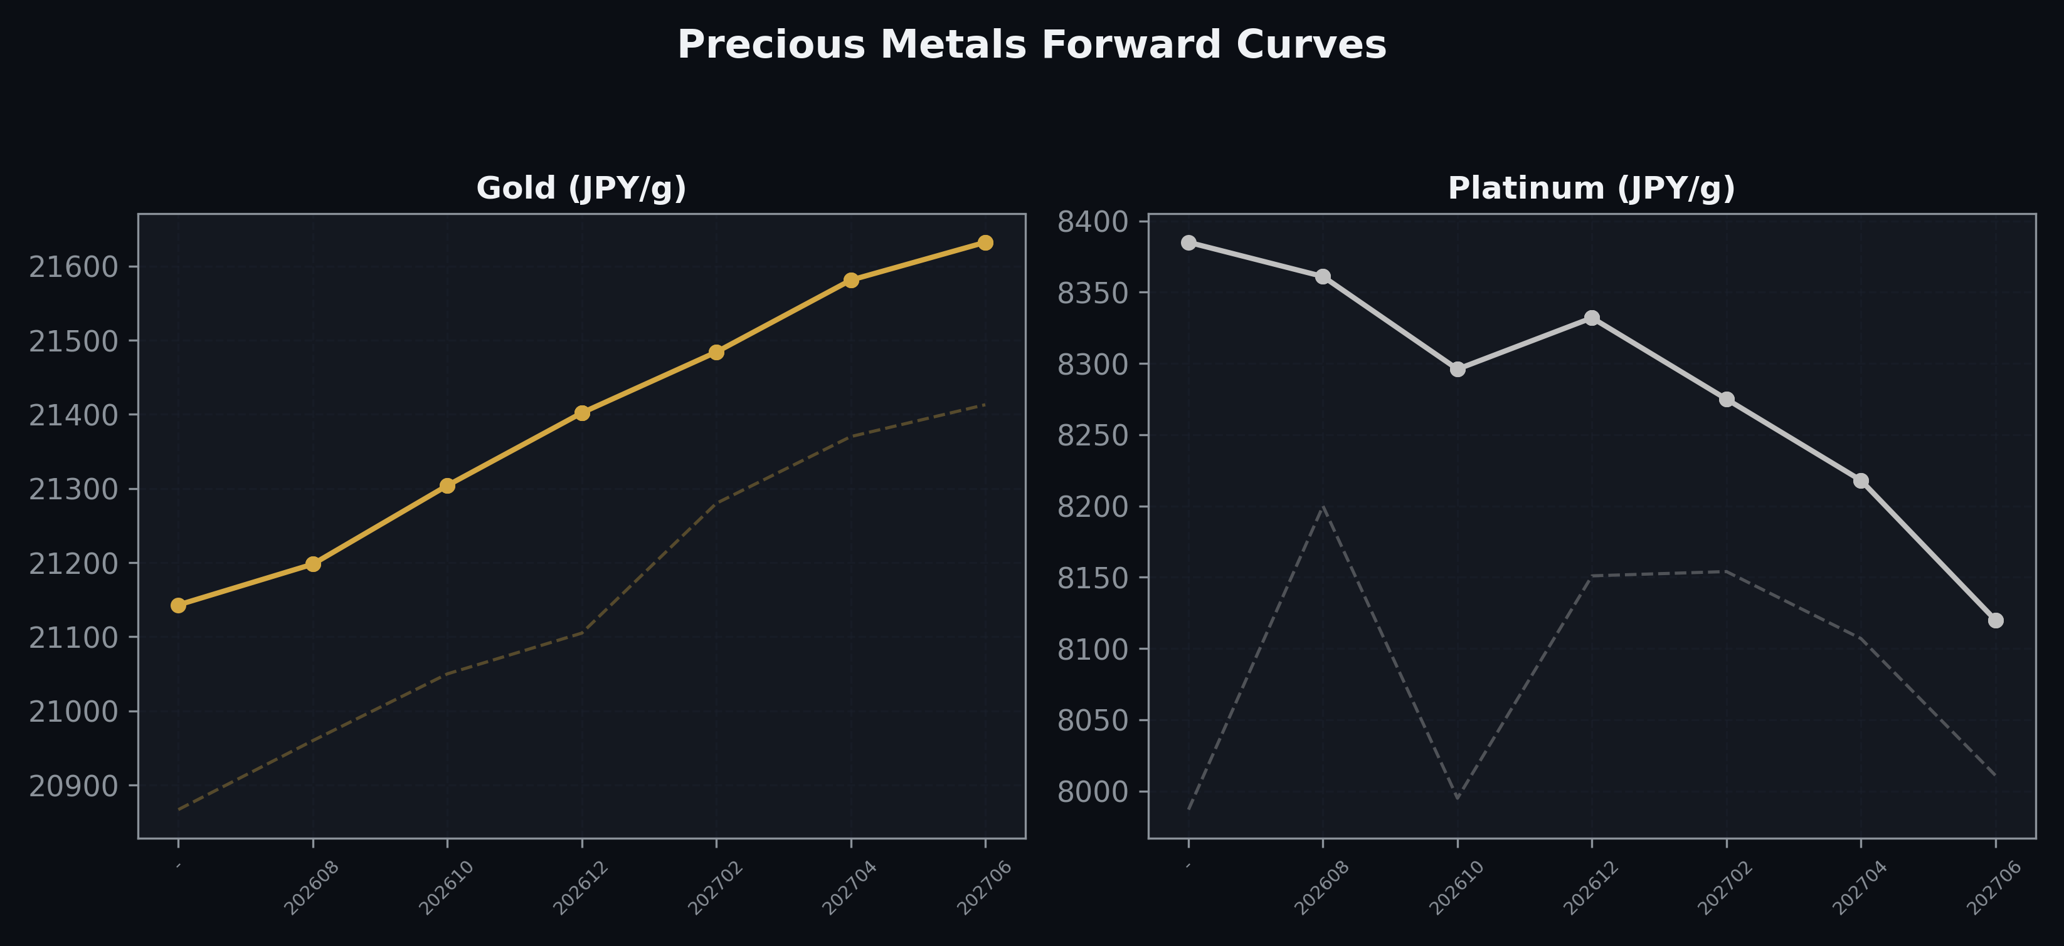
Precious Metals Forward Curves
Gold & Platinum (2026-06-29)

Slide 5
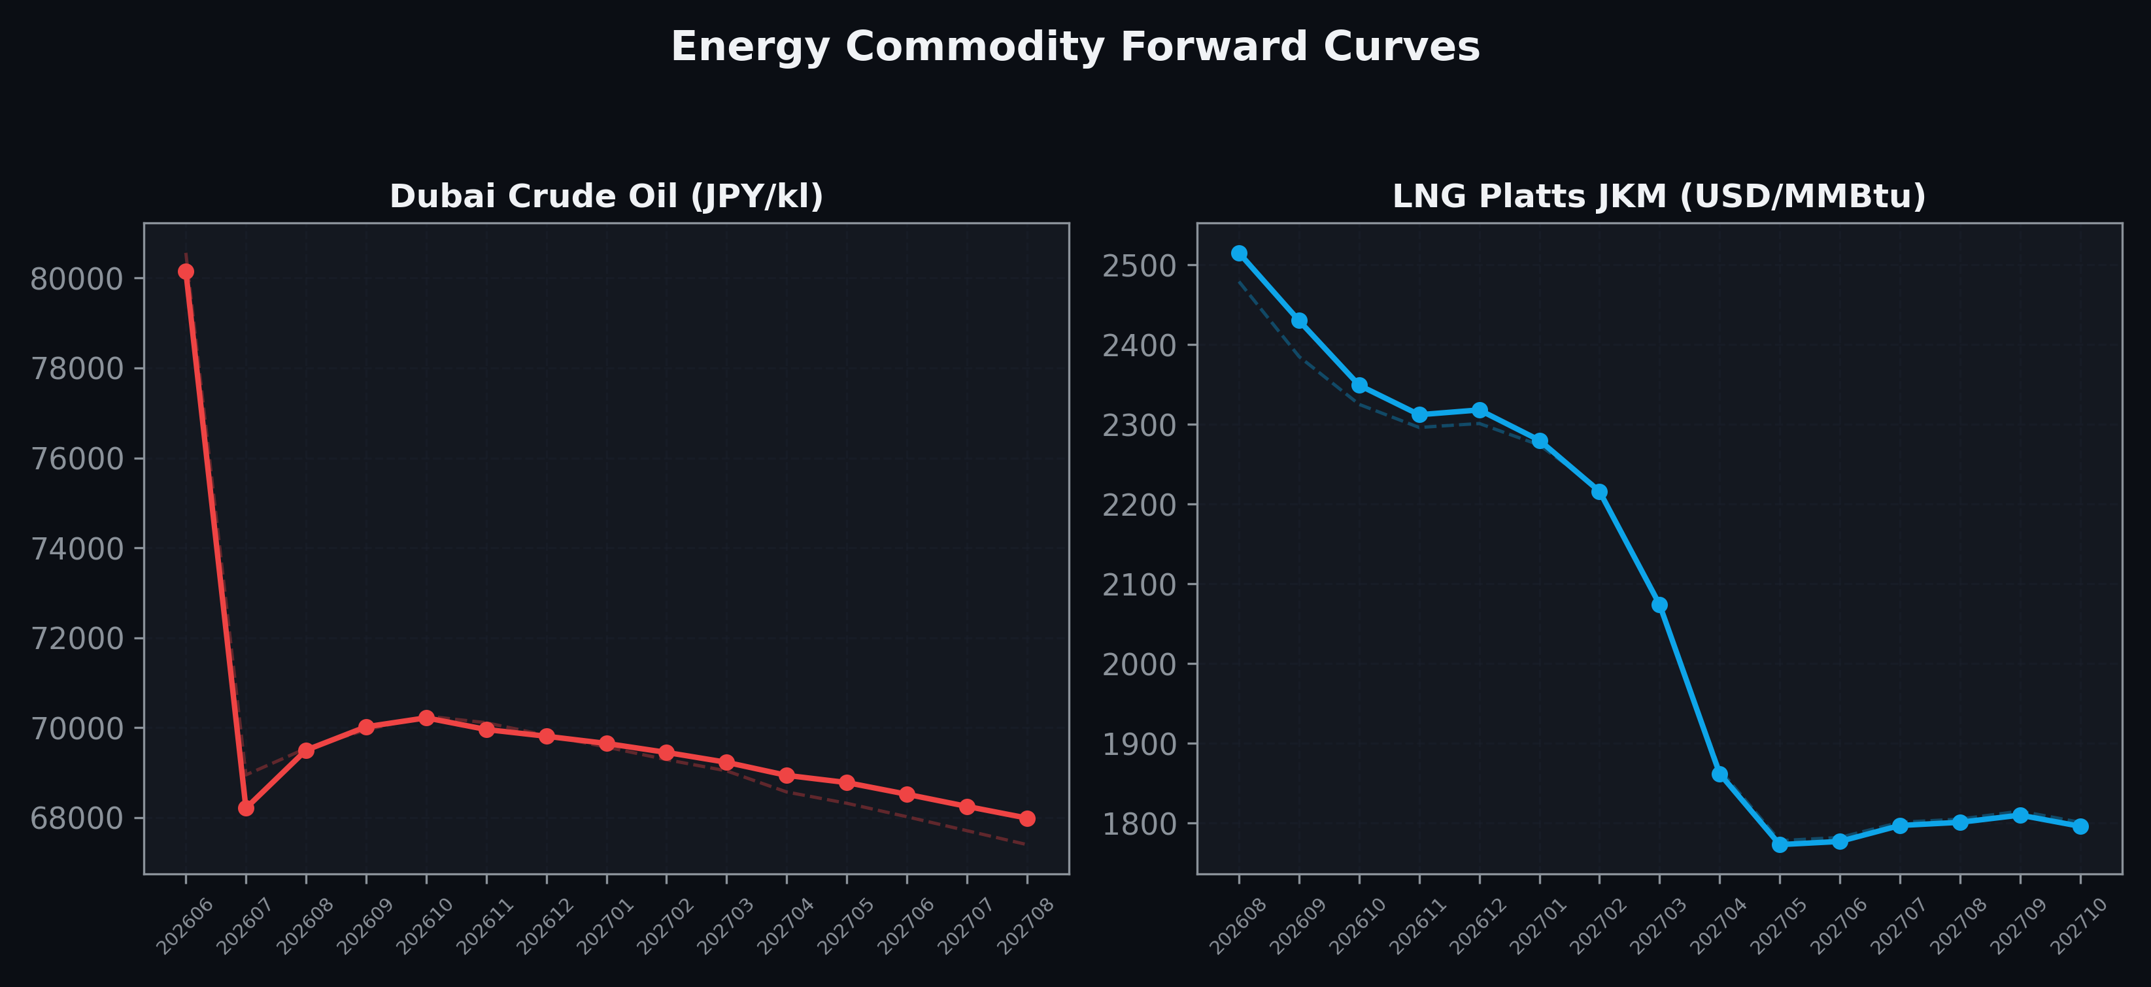
Energy Commodity Forward Curves
Dubai Crude Oil & LNG Platts JKM (2026-06-29)

Slide 6
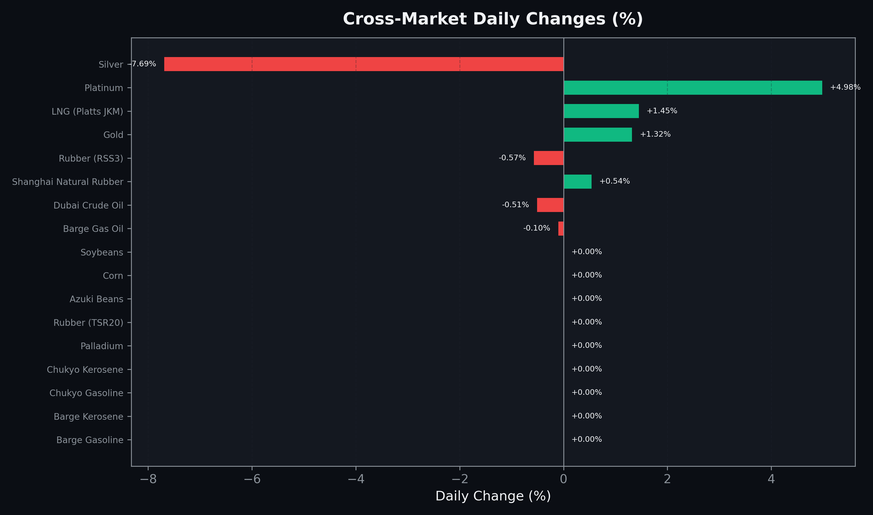
Cross-Market Daily Changes
All commodities sorted by absolute % change

Slide 7
Top Power Futures Movers
Largest absolute settlement price changes vs previous day (2026-06-29)
Instrument | Underlying | Month | Price | Prev | Change | % Chg
FUT_EWPW_260702 | Power West Peak (Weekly) | 20260703 | 15.27 | 18.16 | -2.89 | -15.91%
FUT_EWBW_260702 | Power West Base (Weekly) | 20260703 | 10.90 | 13.72 | -2.82 | -20.55%
FUT_EEPW_260702 | Power East Peak (Weekly) | 20260703 | 20.23 | 22.43 | -2.20 | -9.81%
FUT_EEBW_260702 | Power East Base (Weekly) | 20260703 | 16.93 | 19.07 | -2.14 | -11.22%
FUT_EEP_260730 | Power East Peak (Monthly) | 202607 | 23.03 | 23.86 | -0.83 | -3.48%
FUT_EWB_260828 | Power West Base (Monthly) | 202608 | 15.94 | 16.73 | -0.79 | -4.72%
FUT_EWB_260929 | Power West Base (Monthly) | 202609 | 15.31 | 16.08 | -0.77 | -4.79%
FUT_EEP_260828 | Power East Peak (Monthly) | 202608 | 23.68 | 24.36 | -0.68 | -2.79%
FUT_EWB_260730 | Power West Base (Monthly) | 202607 | 15.08 | 15.73 | -0.65 | -4.13%
FUT_EEPW_260730 | Power East Peak (Weekly) | 20260731 | 23.52 | 24.16 | -0.64 | -2.65%
FUT_ECP_260828 | 電力(中部・日中) | 202608 | 23.52 | 24.15 | -0.63 | -2.61%
FUT_EEB_260828 | Power East Base (Monthly) | 202608 | 19.20 | 19.83 | -0.63 | -3.18%
FUT_ECB_260828 | 電力(中部・ベース) | 202608 | 18.14 | 18.72 | -0.58 | -3.10%
FUT_EEPW_260723 | Power East Peak (Weekly) | 20260724 | 23.91 | 24.49 | -0.58 | -2.37%
FUT_EWP_260629 | Power West Peak (Monthly) | 202606 | 16.92 | 17.50 | -0.58 | -3.31%

