Slide 1
Daily Market Report
Trade Date: 2026-04-30
JPX Derivative & Commodity Analytics
DataServer In-House

Slide 2
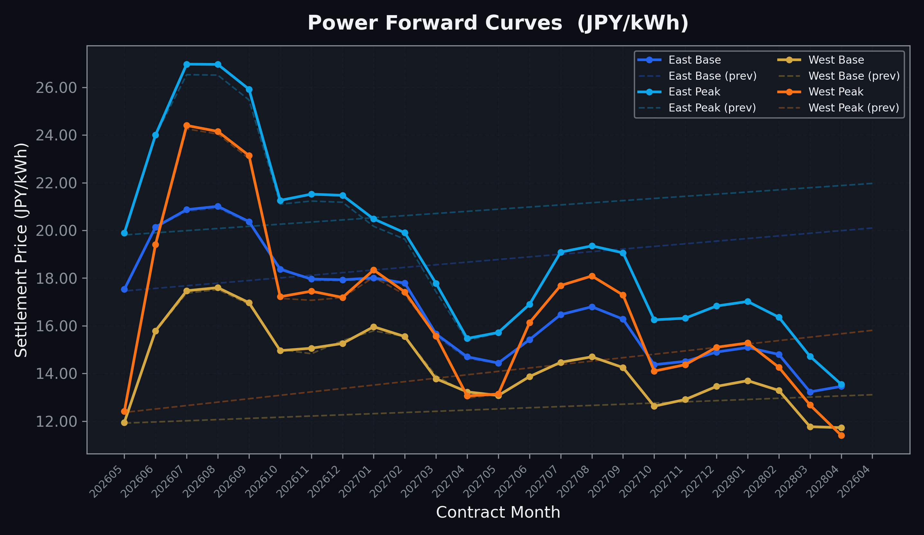
Power Forward Curves
East/West Base & Peak monthly contracts (2026-04-30)

Slide 3
Commodity Snapshot
Front-month settlement prices as of 2026-04-30
Category | Asset | Contract | Settlement | Unit | Change | % Chg
Energy | Barge Gas Oil | 202606 | 113,000.00 | JPY/kl | -100.00 | -0.09%
Energy | Barge Gasoline | 202606 | 100,000.00 | JPY/kl | +0.00 | +0.00%
Energy | Barge Kerosene | 202606 | 105,000.00 | JPY/kl | +0.00 | +0.00%
Energy | Chukyo Gasoline | 202606 | 100,000.00 | JPY/kl | +0.00 | +0.00%
Energy | Chukyo Kerosene | 202606 | 105,000.00 | JPY/kl | +0.00 | +0.00%
Energy | Dubai Crude Oil | 202604 | 106,020.00 | JPY/kl | +120.00 | +0.11%
Energy | LNG (Platts JKM) | 202606 | 2,829.00 | USD/MMBtu | +177.00 | +6.67%
Metals | Gold | - | 23,434.00 | JPY/g | -129.00 | -0.55%
Metals | Palladium | 202606 | 7,600.00 | JPY/g | +0.00 | +0.00%
Metals | Platinum | - | 9,746.00 | JPY/g | -83.00 | -0.84%
Metals | Silver | 202606 | 380.00 | JPY/10g | -10.00 | -2.56%
Industrial | Rubber (RSS3) | 202605 | 396.10 | JPY/kg | +8.20 | +2.11%
Industrial | Rubber (TSR20) | 202605 | 330.00 | JPY/kg | +0.00 | +0.00%
Industrial | Shanghai Natural Rubber | 202605 | 16,860.00 | JPY/kg | -290.00 | -1.69%
Agriculture | Azuki Beans | 202605 | 12,300.00 | JPY/bag | +0.00 | +0.00%
Agriculture | Corn | 202607 | 39,000.00 | JPY/t | +0.00 | +0.00%
Agriculture | Soybeans | 202606 | 64,000.00 | JPY/t | +0.00 | +0.00%

Slide 4
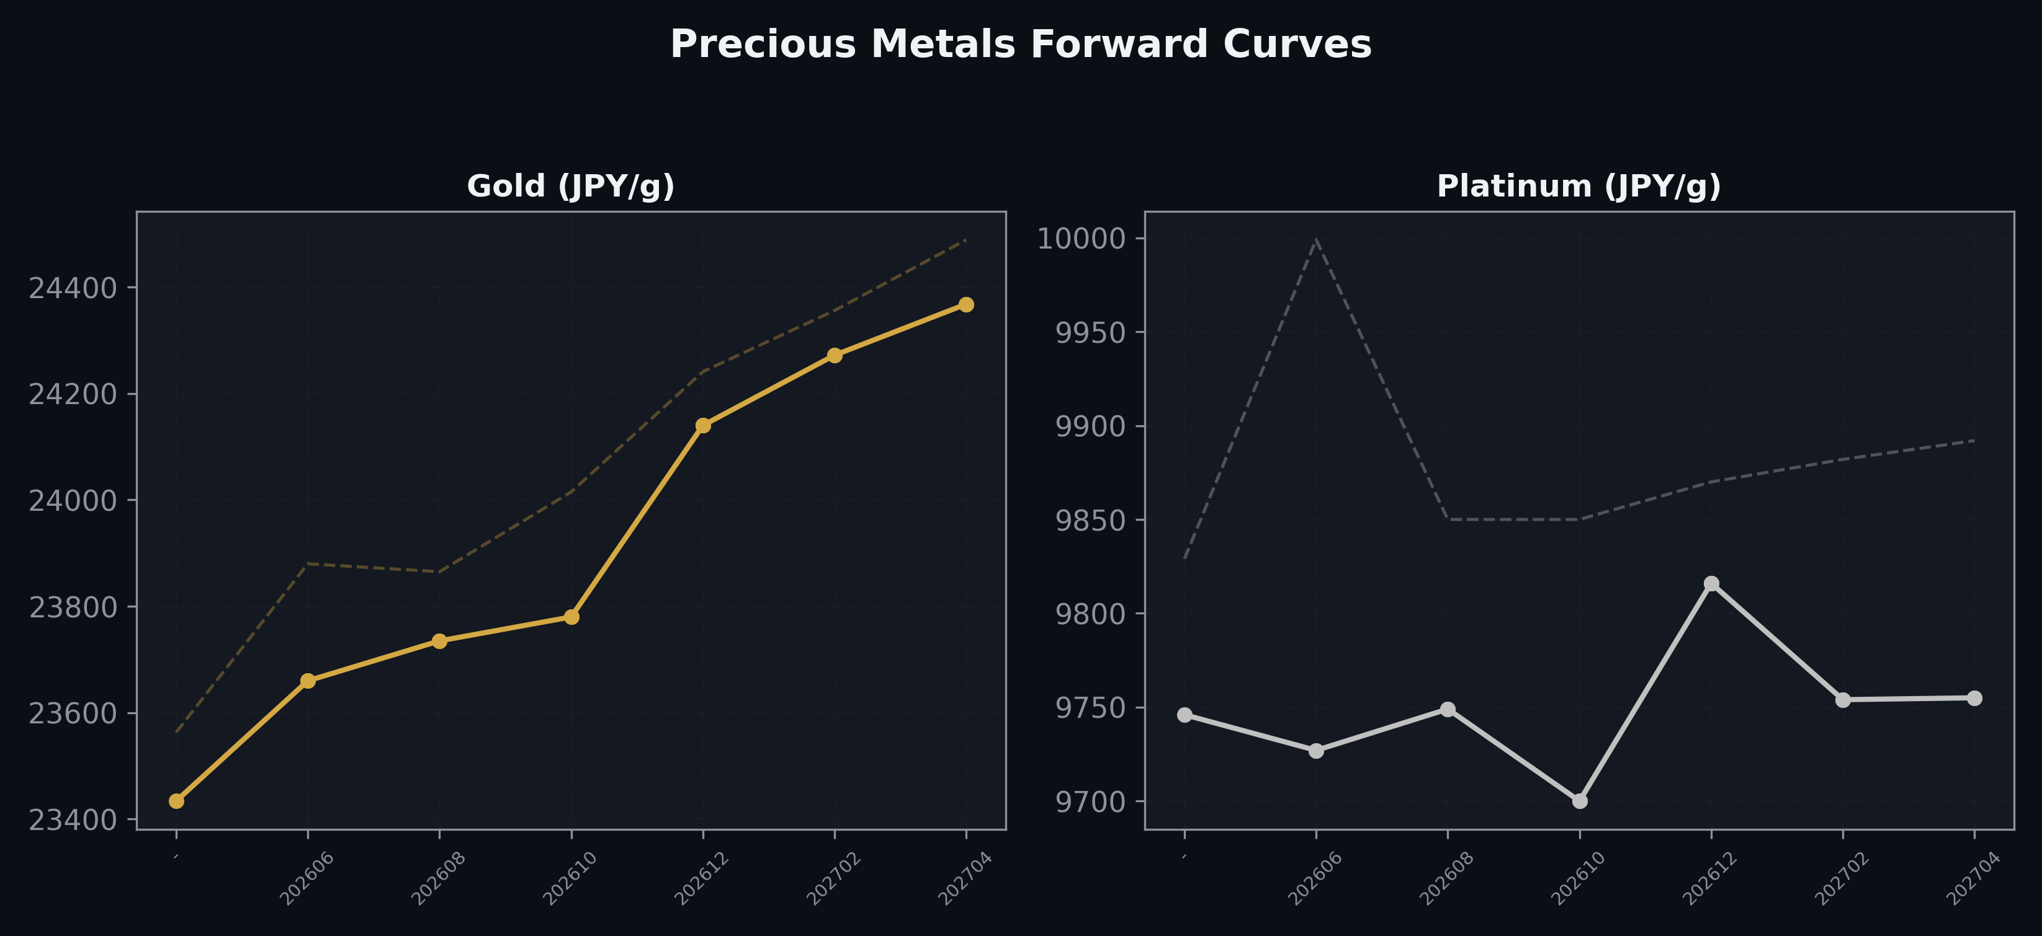
Precious Metals Forward Curves
Gold & Platinum (2026-04-30)

Slide 5
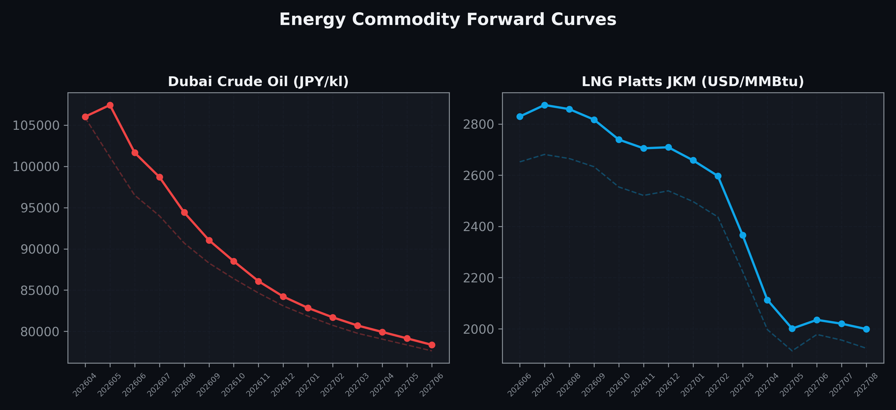
Energy Commodity Forward Curves
Dubai Crude Oil & LNG Platts JKM (2026-04-30)

Slide 6
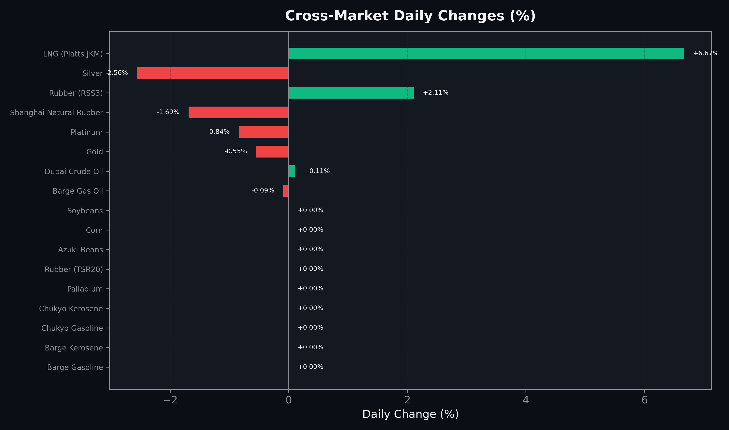
Cross-Market Daily Changes
All commodities sorted by absolute % change

Slide 7
Top Power Futures Movers
Largest absolute settlement price changes vs previous day (2026-04-30)
Instrument | Underlying | Month | Price | Prev | Change | % Chg
FUT_EEPW_260528 | Power East Peak (Weekly) | 20260529 | 20.53 | 19.98 | +0.55 | +2.75%
FUT_EEBW_260528 | Power East Base (Weekly) | 20260529 | 18.79 | 18.25 | +0.54 | +2.96%
FUT_EEP_260828 | Power East Peak (Monthly) | 202608 | 26.96 | 26.51 | +0.45 | +1.70%
FUT_EEP_260929 | Power East Peak (Monthly) | 202609 | 25.92 | 25.47 | +0.45 | +1.77%
FUT_ECP_261029 | 電力(中部・日中) | 202610 | 19.12 | 19.56 | -0.44 | -2.25%
FUT_EEP_260730 | Power East Peak (Monthly) | 202607 | 26.97 | 26.53 | +0.44 | +1.66%
FUT_EEPW_260507 | Power East Peak (Weekly) | 20260508 | 18.38 | 18.00 | +0.38 | +2.11%
FUT_EWP_261127 | Power West Peak (Monthly) | 202611 | 17.45 | 17.07 | +0.38 | +2.23%
FUT_EEP_270330 | Power East Peak (Monthly) | 202703 | 17.78 | 17.43 | +0.35 | +2.01%
FUT_EEP_270128 | Power East Peak (Monthly) | 202701 | 20.48 | 20.17 | +0.31 | +1.54%
FUT_EWP_270128 | Power West Peak (Monthly) | 202701 | 18.34 | 18.04 | +0.30 | +1.66%
FUT_EEP_261127 | Power East Peak (Monthly) | 202611 | 21.52 | 21.23 | +0.29 | +1.37%
FUT_EEP_261228 | Power East Peak (Monthly) | 202612 | 21.47 | 21.18 | +0.29 | +1.37%
FUT_EEBW_260430 | Power East Base (Weekly) | 20260501 | 18.01 | 17.72 | +0.29 | +1.64%
FUT_EWBW_260430 | Power West Base (Weekly) | 20260501 | 10.82 | 10.54 | +0.28 | +2.66%

