Slide 1
Daily Market Report
Trade Date: 2026-06-23
JPX Derivative & Commodity Analytics
DataServer In-House

Slide 2
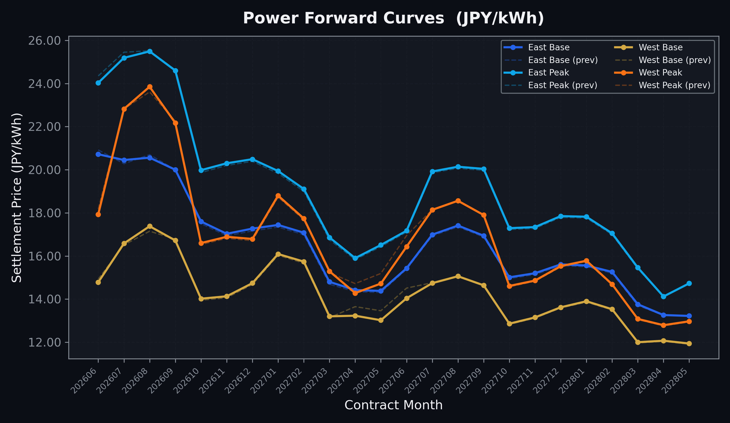
Power Forward Curves
East/West Base & Peak monthly contracts (2026-06-23)

Slide 3
Commodity Snapshot
Front-month settlement prices as of 2026-06-23
Category | Asset | Contract | Settlement | Unit | Change | % Chg
Energy | Barge Gas Oil | 202607 | 105,100.00 | JPY/kl | +0.00 | +0.00%
Energy | Barge Gasoline | 202607 | 98,000.00 | JPY/kl | +0.00 | +0.00%
Energy | Barge Kerosene | 202607 | 109,000.00 | JPY/kl | +0.00 | +0.00%
Energy | Chukyo Gasoline | 202607 | 94,000.00 | JPY/kl | -1000.00 | -1.05%
Energy | Chukyo Kerosene | 202607 | 105,000.00 | JPY/kl | +0.00 | +0.00%
Energy | Dubai Crude Oil | 202606 | 81,200.00 | JPY/kl | -200.00 | -0.25%
Energy | LNG (Platts JKM) | 202608 | 2,558.00 | USD/MMBtu | +30.00 | +1.19%
Metals | Gold | - | 21,434.00 | JPY/g | -228.00 | -1.05%
Metals | Palladium | 202606 | 6,600.00 | JPY/g | +0.00 | +0.00%
Metals | Platinum | - | 8,527.00 | JPY/g | +43.00 | +0.51%
Metals | Silver | 202606 | 340.00 | JPY/10g | +0.00 | +0.00%
Industrial | Rubber (RSS3) | 202606 | 427.80 | JPY/kg | -4.30 | -1.00%
Industrial | Rubber (TSR20) | 202607 | 365.00 | JPY/kg | +0.00 | +0.00%
Industrial | Shanghai Natural Rubber | 202609 | 17,500.00 | JPY/kg | -50.00 | -0.28%
Agriculture | Azuki Beans | 202606 | 12,300.00 | JPY/bag | +0.00 | +0.00%
Agriculture | Corn | 202609 | 39,000.00 | JPY/t | +0.00 | +0.00%
Agriculture | Soybeans | 202608 | 64,000.00 | JPY/t | +0.00 | +0.00%

Slide 4
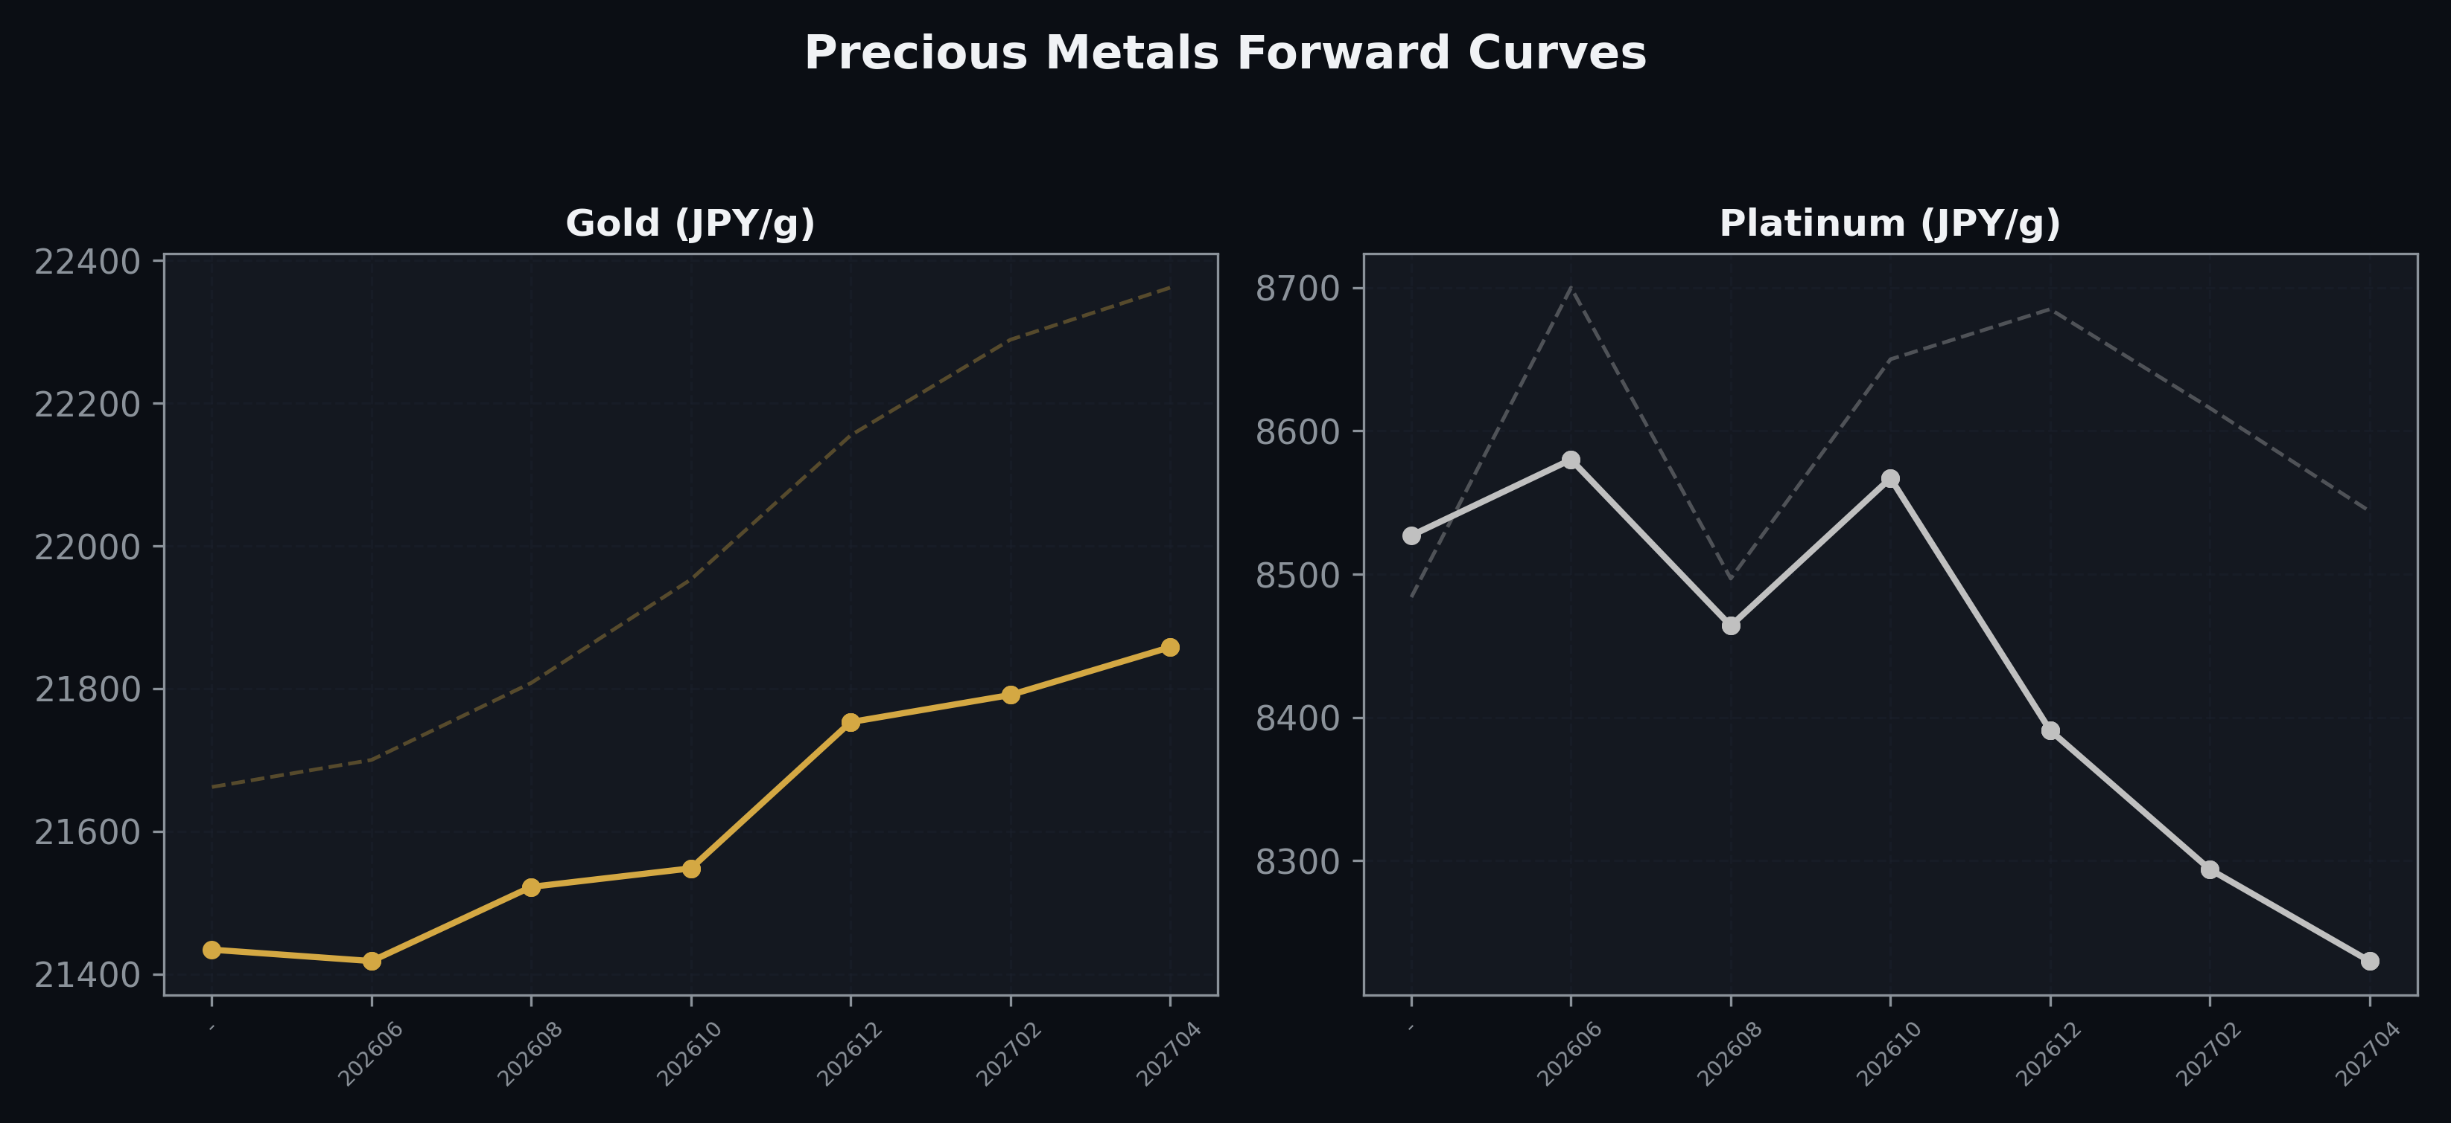
Precious Metals Forward Curves
Gold & Platinum (2026-06-23)

Slide 5
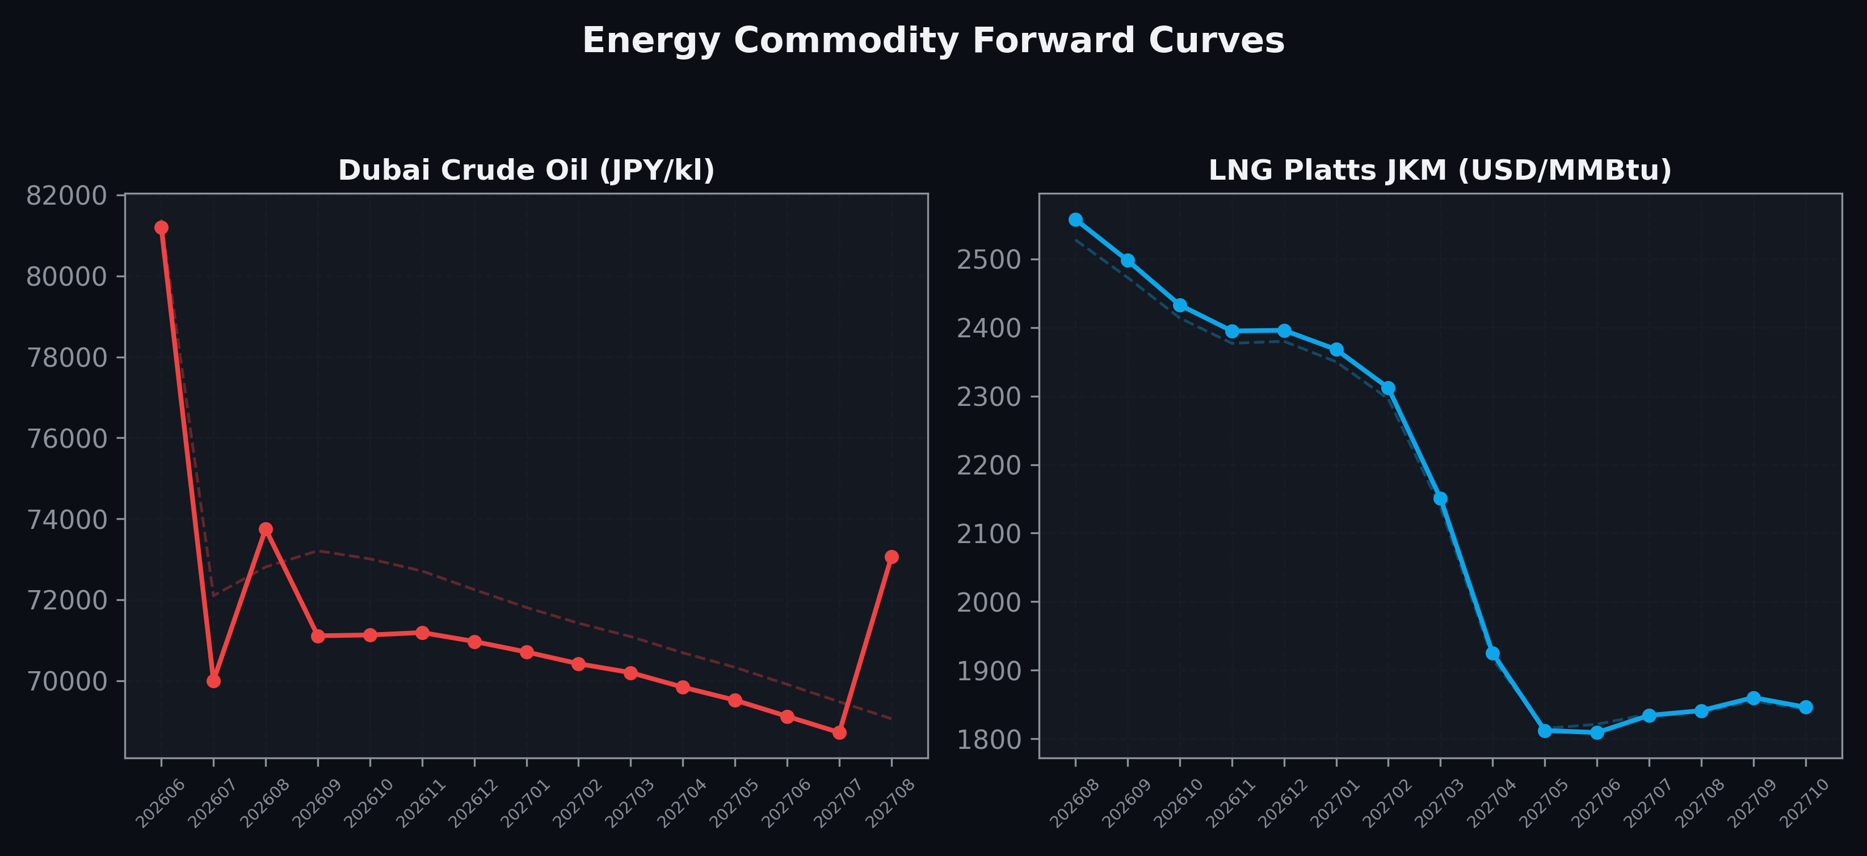
Energy Commodity Forward Curves
Dubai Crude Oil & LNG Platts JKM (2026-06-23)

Slide 6
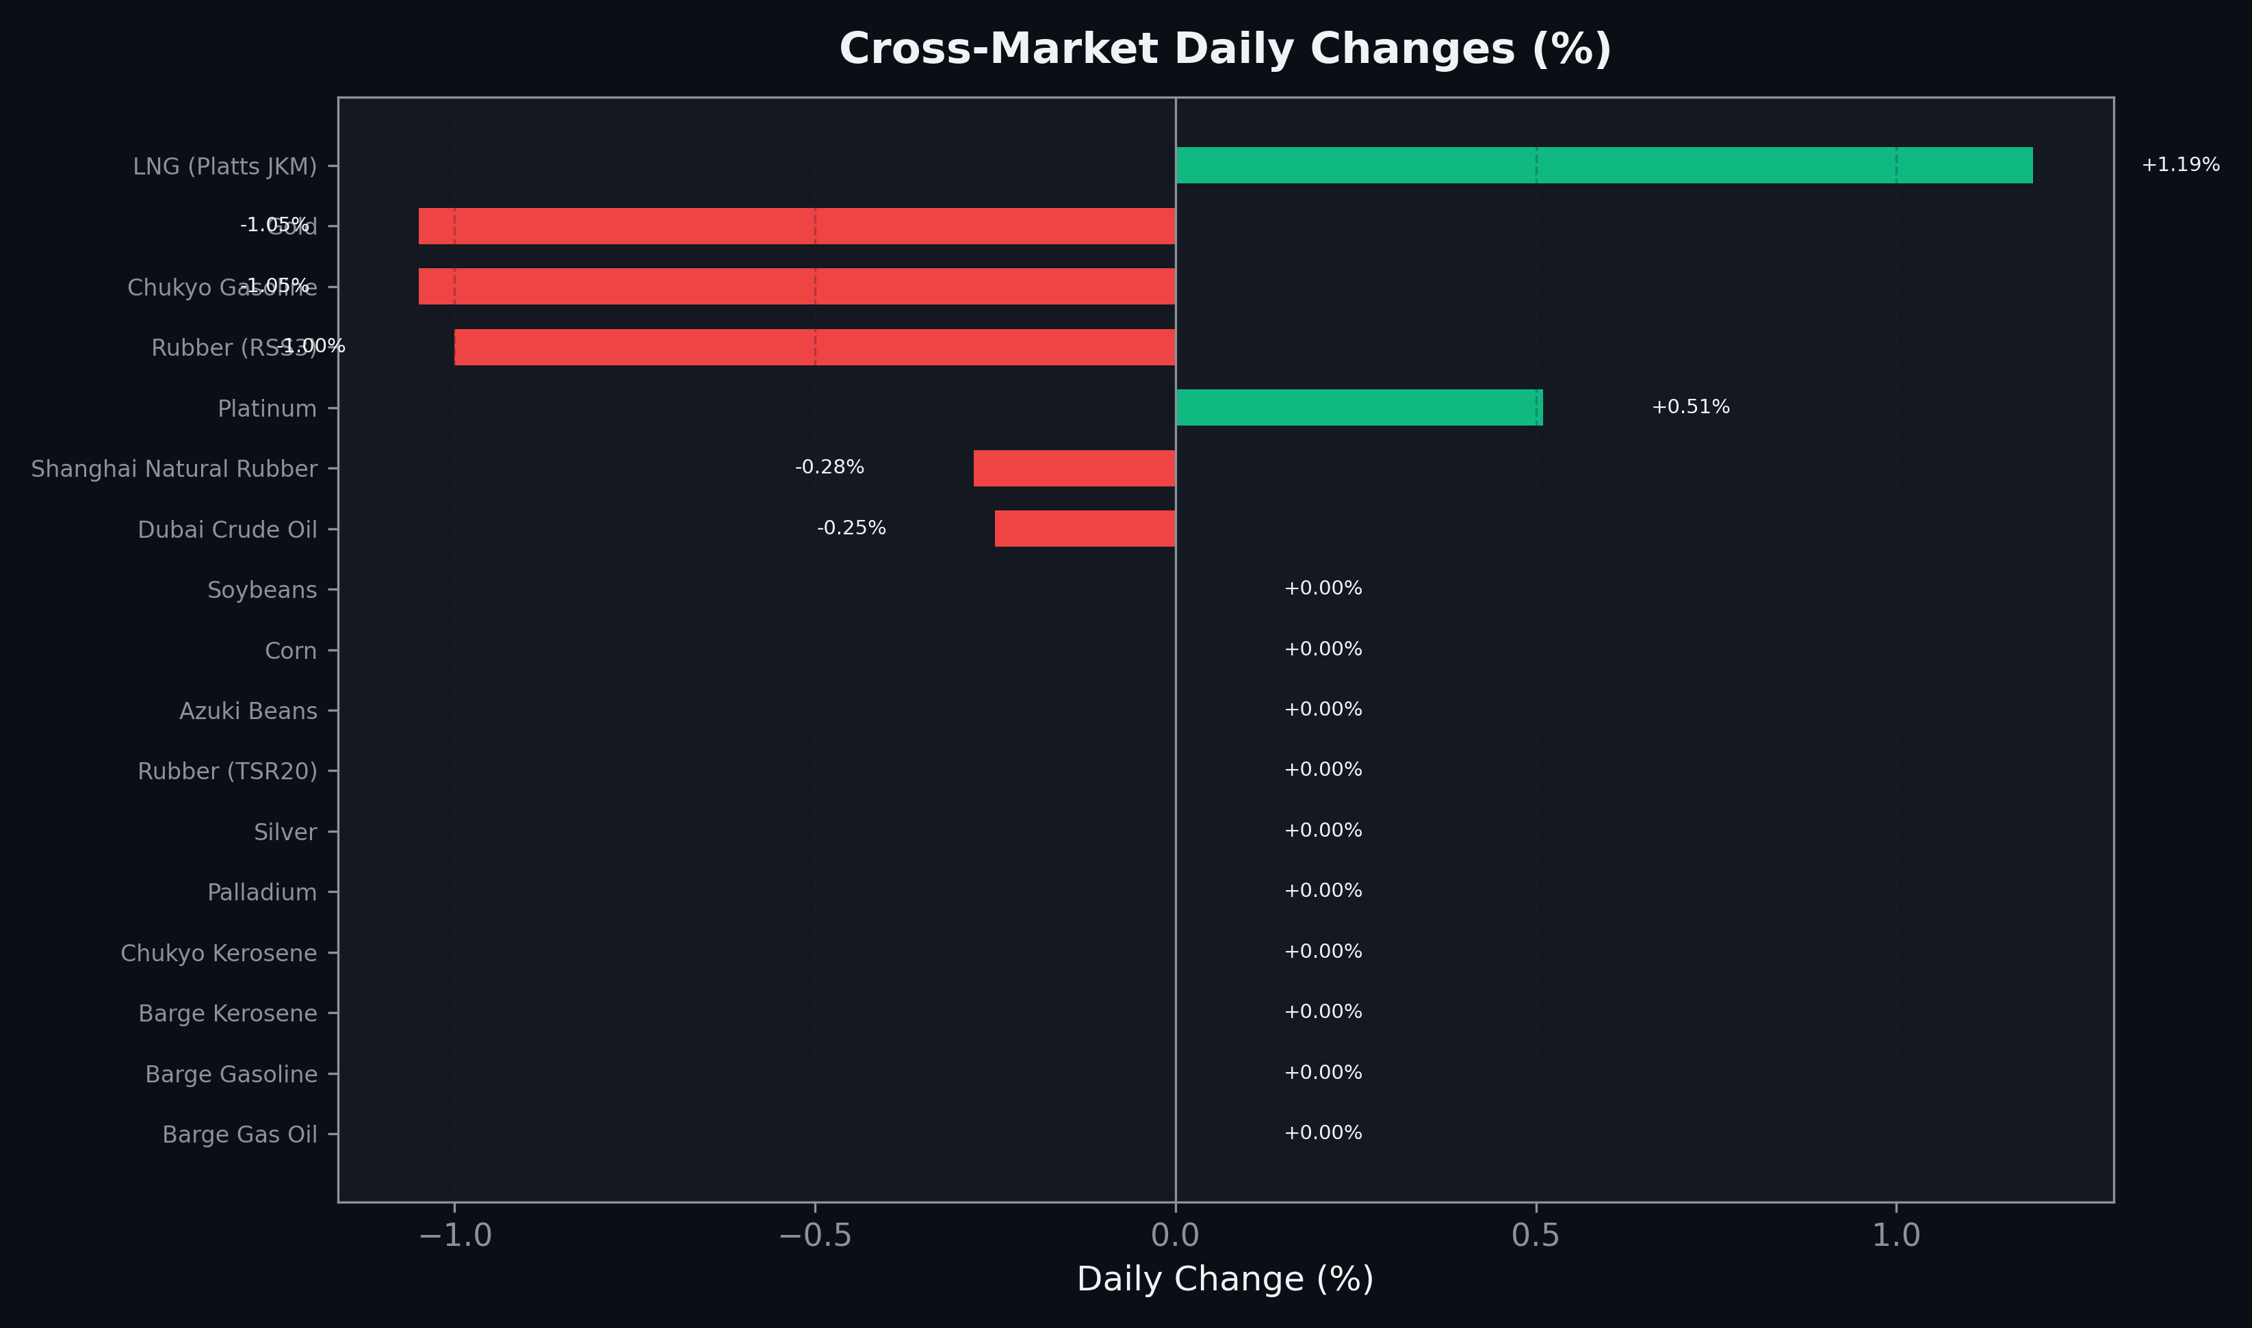
Cross-Market Daily Changes
All commodities sorted by absolute % change

Slide 7
Top Power Futures Movers
Largest absolute settlement price changes vs previous day (2026-06-23)
Instrument | Underlying | Month | Price | Prev | Change | % Chg
FUT_EEPW_260625 | Power East Peak (Weekly) | 20260626 | 20.55 | 21.83 | -1.28 | -5.86%
FUT_EWPW_260625 | Power West Peak (Weekly) | 20260626 | 15.26 | 16.25 | -0.99 | -6.09%
FUT_EWPW_260702 | Power West Peak (Weekly) | 20260703 | 19.44 | 19.99 | -0.55 | -2.75%
FUT_EEBW_260625 | Power East Base (Weekly) | 20260626 | 18.98 | 19.52 | -0.54 | -2.77%
FUT_EWP_270629 | Power West Peak (Monthly) | 202706 | 16.43 | 16.95 | -0.52 | -3.07%
FUT_EWB_270629 | Power West Base (Monthly) | 202706 | 14.04 | 14.51 | -0.47 | -3.24%
FUT_EWP_270528 | Power West Peak (Monthly) | 202705 | 14.72 | 15.19 | -0.47 | -3.09%
FUT_EWBW_260625 | Power West Base (Weekly) | 20260626 | 12.63 | 13.09 | -0.46 | -3.51%
FUT_EWB_270528 | Power West Base (Monthly) | 202705 | 13.02 | 13.46 | -0.44 | -3.27%
FUT_EWP_270428 | Power West Peak (Monthly) | 202704 | 14.28 | 14.72 | -0.44 | -2.99%
FUT_EWB_270428 | Power West Base (Monthly) | 202704 | 13.23 | 13.65 | -0.42 | -3.08%
FUT_EEBW_260702 | Power East Base (Weekly) | 20260703 | 19.79 | 20.14 | -0.35 | -1.74%
FUT_EEP_260629 | Power East Peak (Monthly) | 202606 | 24.03 | 24.35 | -0.32 | -1.31%
FUT_ECP_260629 | 電力(中部・日中) | 202606 | 21.16 | 21.44 | -0.28 | -1.31%
FUT_EEP_260730 | Power East Peak (Monthly) | 202607 | 25.19 | 25.45 | -0.26 | -1.02%

