Slide 1
Daily Market Report
Trade Date: 2026-06-03
JPX Derivative & Commodity Analytics
DataServer In-House

Slide 2
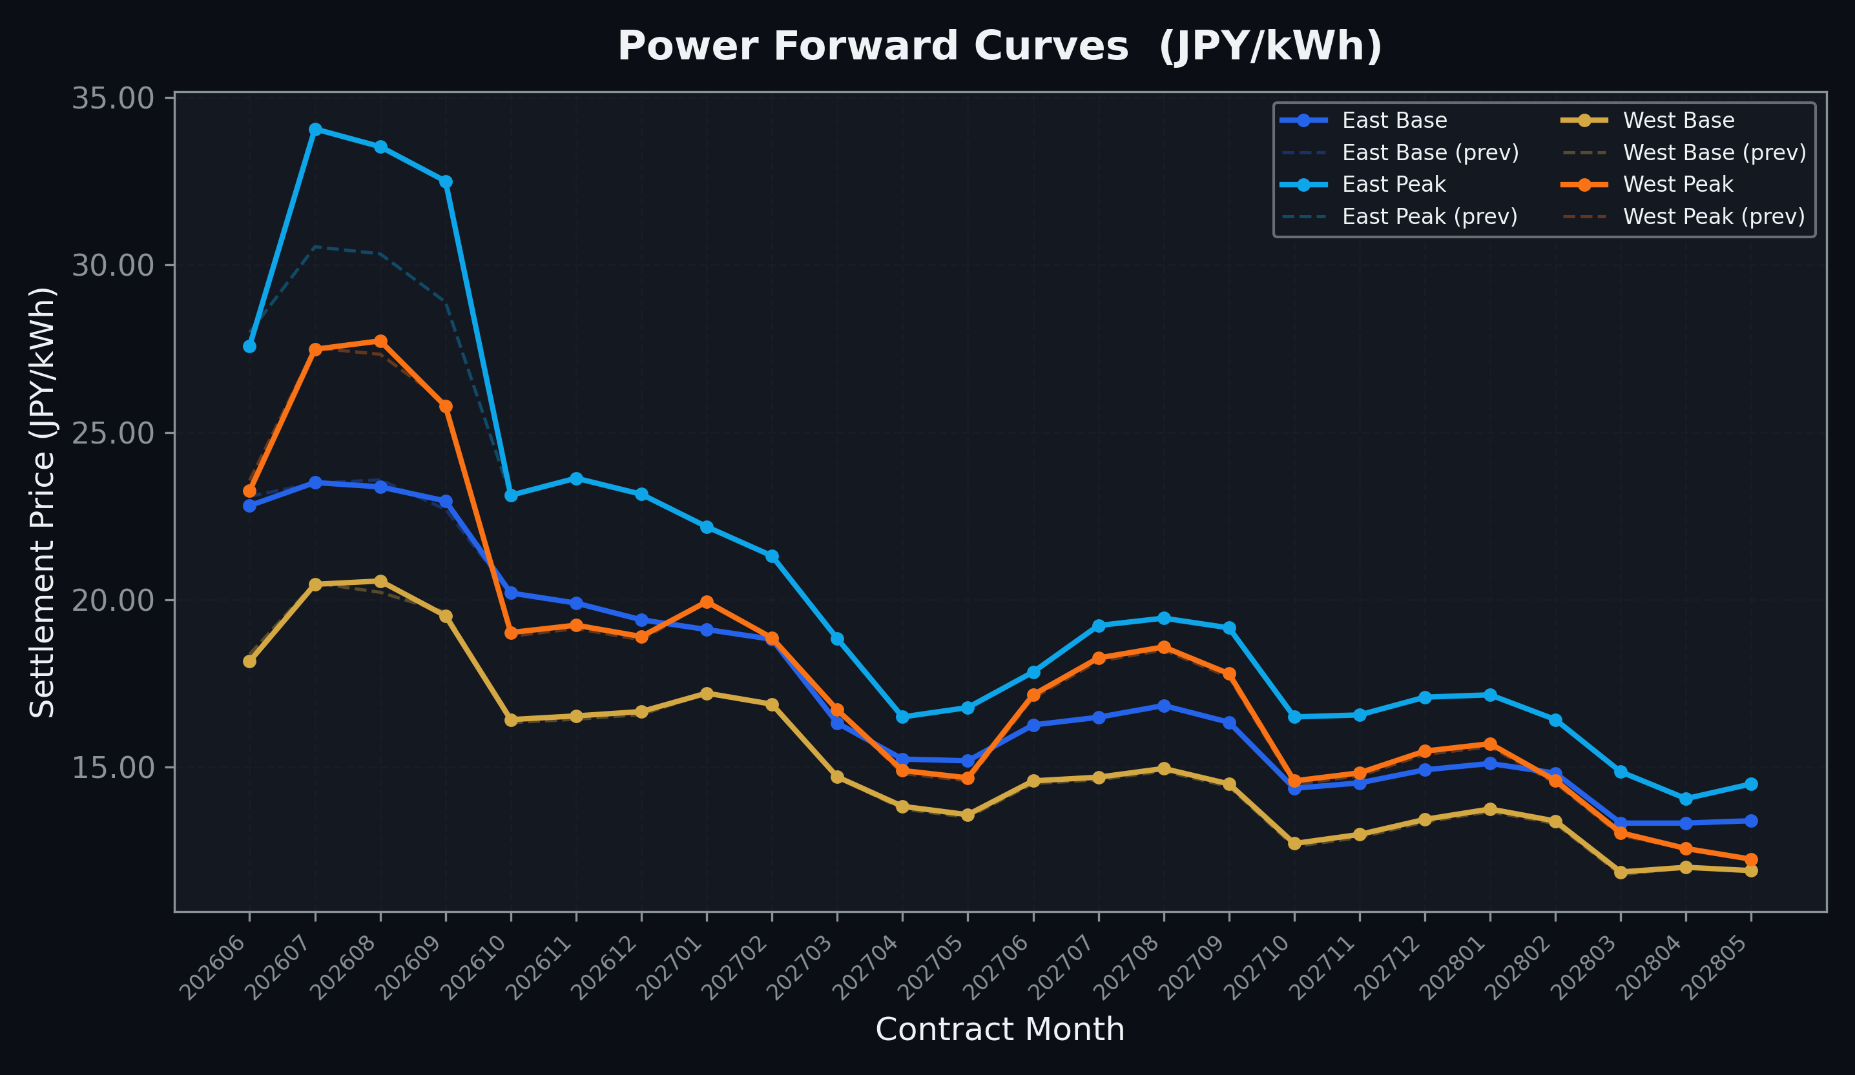
Power Forward Curves
East/West Base & Peak monthly contracts (2026-06-03)

Slide 3
Commodity Snapshot
Front-month settlement prices as of 2026-06-03
Category | Asset | Contract | Settlement | Unit | Change | % Chg
Energy | Barge Gas Oil | 202607 | 108,400.00 | JPY/kl | +0.00 | +0.00%
Energy | Barge Gasoline | 202607 | 100,000.00 | JPY/kl | +0.00 | +0.00%
Energy | Barge Kerosene | 202607 | 110,000.00 | JPY/kl | +5000.00 | +4.76%
Energy | Chukyo Gasoline | 202607 | 95,000.00 | JPY/kl | +0.00 | +0.00%
Energy | Chukyo Kerosene | 202607 | 105,000.00 | JPY/kl | +0.00 | +0.00%
Energy | Dubai Crude Oil | 202606 | 94,490.00 | JPY/kl | +1900.00 | +2.05%
Energy | LNG (Platts JKM) | 202607 | 2,970.00 | USD/MMBtu | +12.00 | +0.41%
Metals | Gold | - | 22,904.00 | JPY/g | -479.00 | -2.05%
Metals | Palladium | 202606 | 7,000.00 | JPY/g | +0.00 | +0.00%
Metals | Platinum | - | 9,871.00 | JPY/g | +57.00 | +0.58%
Metals | Silver | 202606 | 390.00 | JPY/10g | +0.00 | +0.00%
Industrial | Rubber (RSS3) | 202606 | 423.80 | JPY/kg | +10.30 | +2.49%
Industrial | Rubber (TSR20) | 202607 | 365.00 | JPY/kg | +5.00 | +1.39%
Industrial | Shanghai Natural Rubber | 202609 | 18,320.00 | JPY/kg | -315.00 | -1.69%
Agriculture | Azuki Beans | 202606 | 12,300.00 | JPY/bag | +0.00 | +0.00%
Agriculture | Corn | 202607 | 39,000.00 | JPY/t | +0.00 | +0.00%
Agriculture | Soybeans | 202606 | 64,000.00 | JPY/t | +0.00 | +0.00%

Slide 4
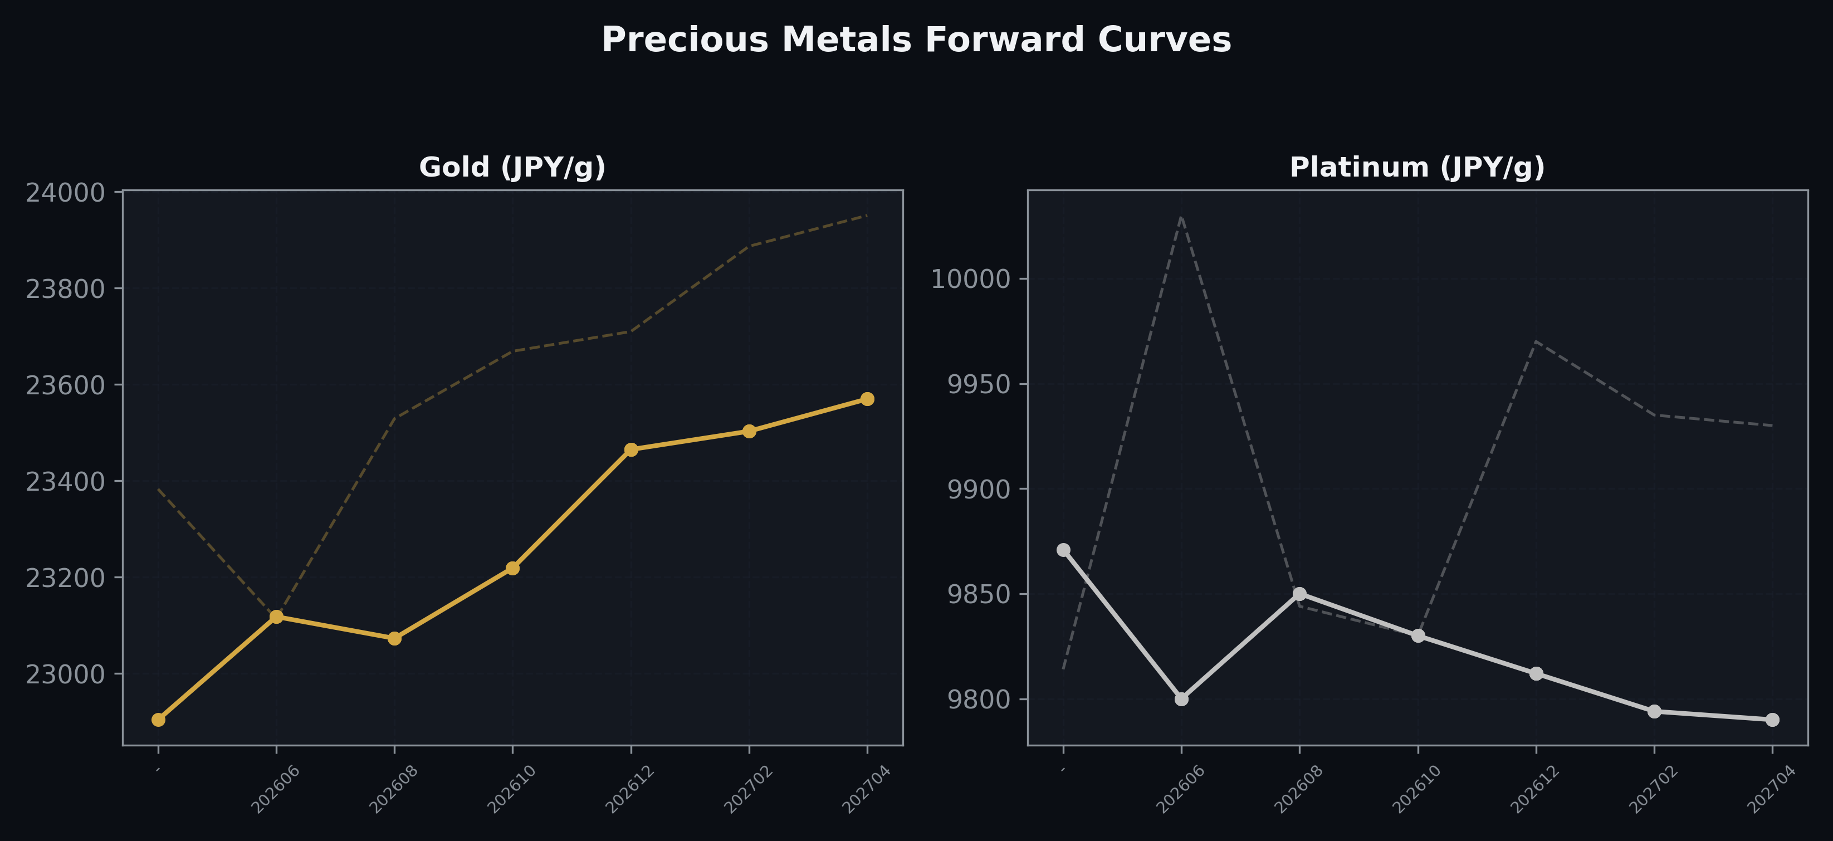
Precious Metals Forward Curves
Gold & Platinum (2026-06-03)

Slide 5
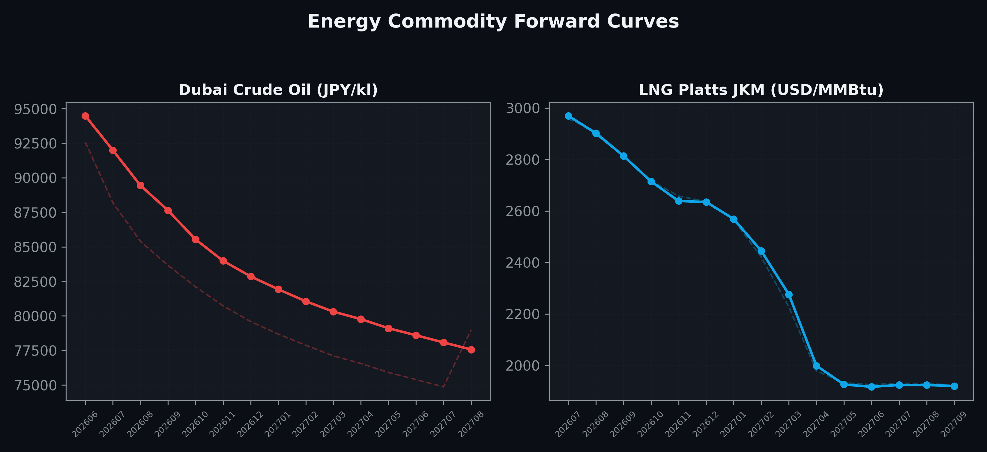
Energy Commodity Forward Curves
Dubai Crude Oil & LNG Platts JKM (2026-06-03)

Slide 6
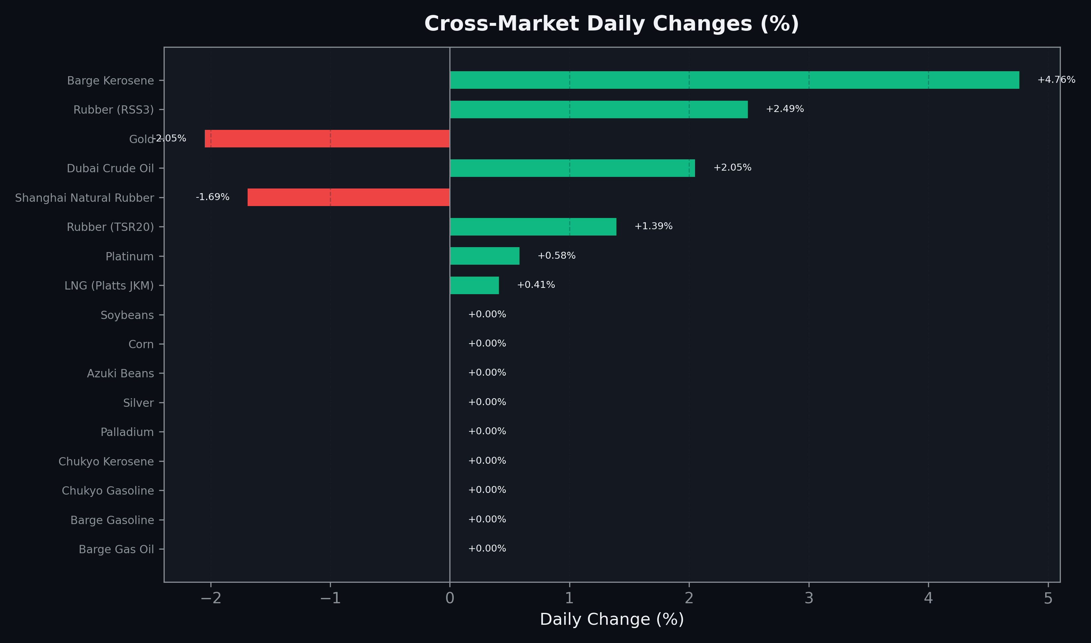
Cross-Market Daily Changes
All commodities sorted by absolute % change

Slide 7
Top Power Futures Movers
Largest absolute settlement price changes vs previous day (2026-06-03)
Instrument | Underlying | Month | Price | Prev | Change | % Chg
FUT_EEP_260929 | Power East Peak (Monthly) | 202609 | 32.50 | 28.89 | +3.61 | +12.50%
FUT_EEP_260730 | Power East Peak (Monthly) | 202607 | 34.06 | 30.54 | +3.52 | +11.53%
FUT_EEP_260828 | Power East Peak (Monthly) | 202608 | 33.53 | 30.33 | +3.20 | +10.55%
FUT_EEPW_260604 | Power East Peak (Weekly) | 20260605 | 27.73 | 28.36 | -0.63 | -2.22%
FUT_EWPW_260625 | Power West Peak (Weekly) | 20260626 | 22.80 | 23.30 | -0.50 | -2.15%
FUT_EWBW_260625 | Power West Base (Weekly) | 20260626 | 18.37 | 18.83 | -0.46 | -2.44%
FUT_EEBW_260625 | Power East Base (Weekly) | 20260626 | 23.17 | 23.62 | -0.45 | -1.91%
FUT_EEP_260629 | Power East Peak (Monthly) | 202606 | 27.58 | 27.98 | -0.40 | -1.43%
FUT_EWP_260828 | Power West Peak (Monthly) | 202608 | 27.73 | 27.33 | +0.40 | +1.46%
FUT_EEBW_260618 | Power East Base (Weekly) | 20260619 | 23.36 | 23.75 | -0.39 | -1.64%
FUT_EEBW_260611 | Power East Base (Weekly) | 20260612 | 23.34 | 23.72 | -0.38 | -1.60%
FUT_EEPW_260625 | Power East Peak (Weekly) | 20260626 | 26.66 | 27.03 | -0.37 | -1.37%
FUT_EWBW_260618 | Power West Base (Weekly) | 20260619 | 18.53 | 18.89 | -0.36 | -1.91%
FUT_EWPW_260618 | Power West Peak (Weekly) | 20260619 | 22.48 | 22.84 | -0.36 | -1.58%
FUT_EWB_260828 | Power West Base (Monthly) | 202608 | 20.56 | 20.22 | +0.34 | +1.68%

