Slide 1
Daily Market Report
Trade Date: 2026-03-24
JPX Derivative & Commodity Analytics
DataServer In-House

Slide 2
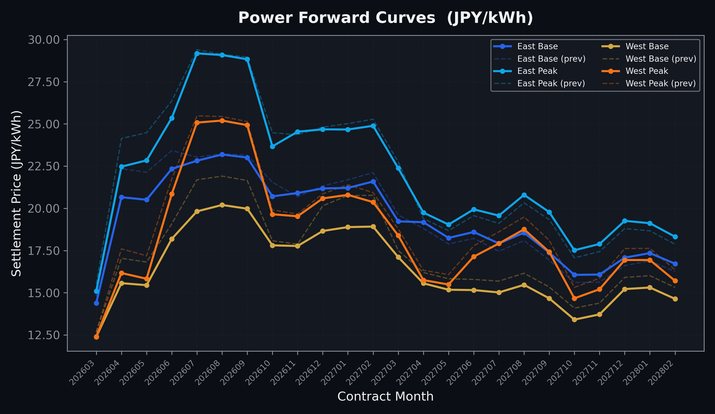
Power Forward Curves
East/West Base & Peak monthly contracts (2026-03-24)

Slide 3
Commodity Snapshot
Front-month settlement prices as of 2026-03-24
Category | Asset | Contract | Settlement | Unit | Change | % Chg
Energy | Barge Gas Oil | 202604 | 112,900.00 | JPY/kl | -3000.00 | -2.59%
Energy | Barge Gasoline | 202604 | 150,000.00 | JPY/kl | +0.00 | +0.00%
Energy | Barge Kerosene | 202604 | 140,000.00 | JPY/kl | +0.00 | +0.00%
Energy | Chukyo Gasoline | 202604 | 140,000.00 | JPY/kl | +0.00 | +0.00%
Energy | Chukyo Kerosene | 202604 | 130,000.00 | JPY/kl | +0.00 | +0.00%
Energy | Dubai Crude Oil | 202603 | 134,680.00 | JPY/kl | -1380.00 | -1.01%
Energy | LNG (Platts JKM) | 202605 | 3,335.00 | USD/MMBtu | -132.00 | -3.81%
Metals | Gold | - | 22,396.00 | JPY/g | +713.00 | +3.29%
Metals | Palladium | 202604 | 7,200.00 | JPY/g | +0.00 | +0.00%
Metals | Platinum | - | 9,165.00 | JPY/g | +389.00 | +4.43%
Metals | Silver | 202604 | 350.00 | JPY/10g | +0.00 | +0.00%
Industrial | Rubber (RSS3) | 202603 | 370.00 | JPY/kg | +0.00 | +0.00%
Industrial | Rubber (TSR20) | 202604 | 307.00 | JPY/kg | +0.00 | +0.00%
Industrial | Shanghai Natural Rubber | 202605 | 16,245.00 | JPY/kg | +115.00 | +0.71%
Agriculture | Azuki Beans | 202603 | 12,300.00 | JPY/bag | +0.00 | +0.00%
Agriculture | Corn | 202605 | 39,000.00 | JPY/t | +0.00 | +0.00%
Agriculture | Soybeans | 202604 | 64,000.00 | JPY/t | +0.00 | +0.00%

Slide 4
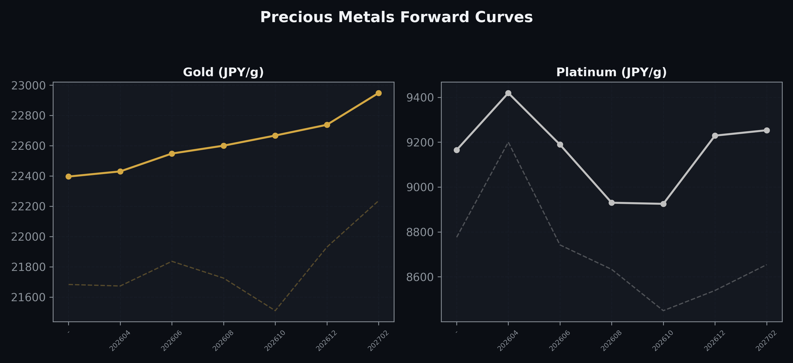
Precious Metals Forward Curves
Gold & Platinum (2026-03-24)

Slide 5
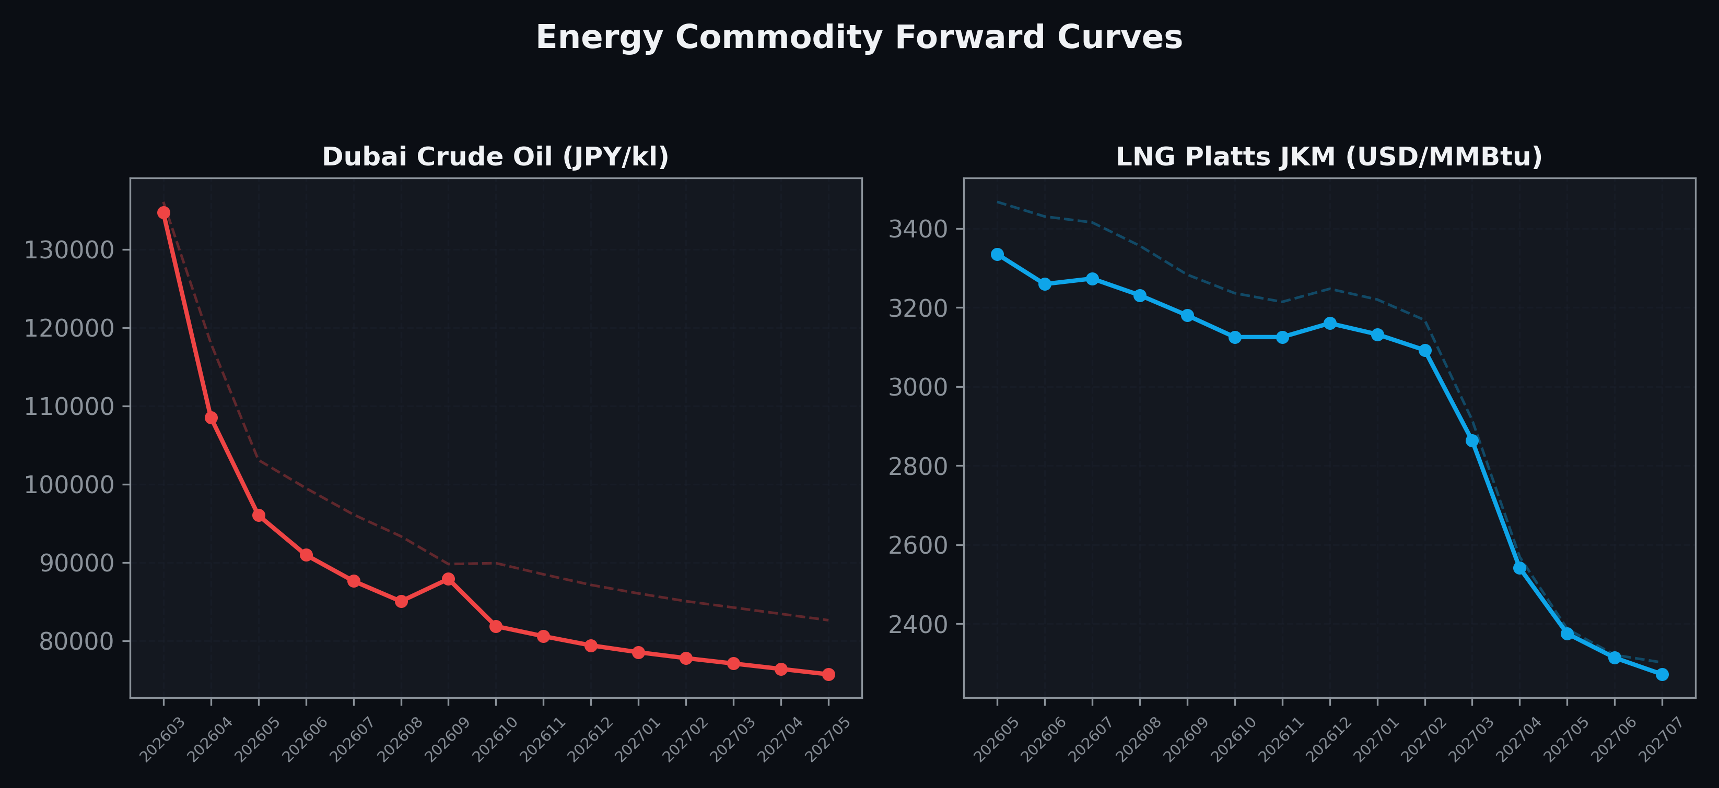
Energy Commodity Forward Curves
Dubai Crude Oil & LNG Platts JKM (2026-03-24)

Slide 6
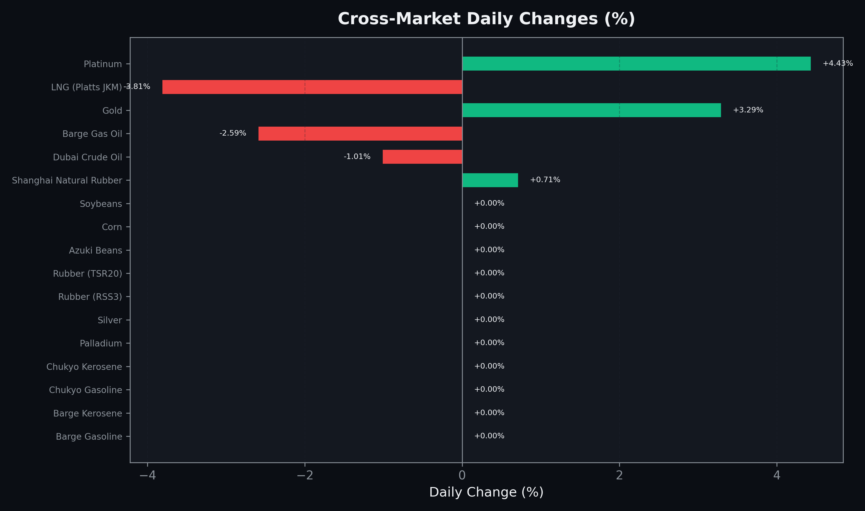
Cross-Market Daily Changes
All commodities sorted by absolute % change

Slide 7
Top Power Futures Movers
Largest absolute settlement price changes vs previous day (2026-03-24)
Instrument | Underlying | Month | Price | Prev | Change | % Chg
FUT_EWB_260730 | Power West Base (Monthly) | 202607 | 19.82 | 21.69 | -1.87 | -8.62%
FUT_EWB_270129 | Power West Base (Monthly) | 202701 | 18.89 | 20.76 | -1.87 | -9.01%
FUT_EWB_270226 | Power West Base (Monthly) | 202702 | 18.92 | 20.77 | -1.85 | -8.91%
FUT_EWB_260828 | Power West Base (Monthly) | 202608 | 20.20 | 21.91 | -1.71 | -7.80%
FUT_EEB_260428 | Power East Base (Monthly) | 202604 | 20.66 | 22.35 | -1.69 | -7.56%
FUT_EEP_260428 | Power East Peak (Monthly) | 202604 | 22.47 | 24.14 | -1.67 | -6.92%
FUT_EWB_260929 | Power West Base (Monthly) | 202609 | 19.98 | 21.65 | -1.67 | -7.71%
FUT_EEP_260528 | Power East Peak (Monthly) | 202605 | 22.84 | 24.48 | -1.64 | -6.70%
FUT_EEB_260529 | Power East Base (Monthly) | 202605 | 20.51 | 22.14 | -1.63 | -7.36%
FUT_EWBW_260409 | Power West Base (Weekly) | 20260410 | 15.32 | 16.90 | -1.58 | -9.35%
FUT_EWB_261230 | Power West Base (Monthly) | 202612 | 18.66 | 20.15 | -1.49 | -7.39%
FUT_EWB_260428 | Power West Base (Monthly) | 202604 | 15.57 | 17.04 | -1.47 | -8.63%
FUT_EWP_260428 | Power West Peak (Monthly) | 202604 | 16.17 | 17.60 | -1.43 | -8.12%
FUT_EEBW_260416 | Power East Base (Weekly) | 20260417 | 19.54 | 20.95 | -1.41 | -6.73%
FUT_EWB_260529 | Power West Base (Monthly) | 202605 | 15.45 | 16.82 | -1.37 | -8.15%

