Slide 1
Daily Market Report
Trade Date: 2026-06-18
JPX Derivative & Commodity Analytics
DataServer In-House

Slide 2
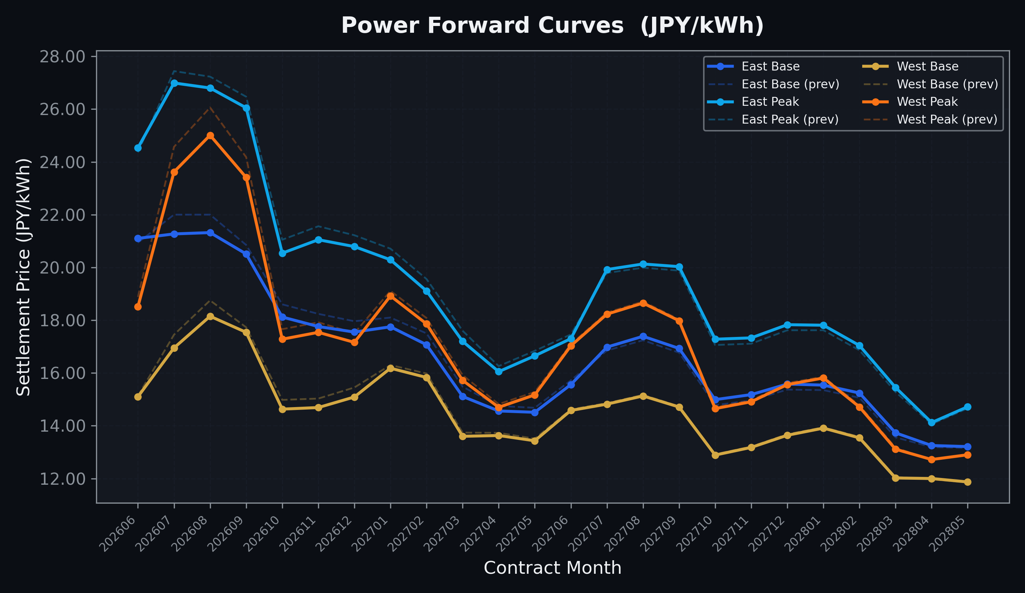
Power Forward Curves
East/West Base & Peak monthly contracts (2026-06-18)

Slide 3
Commodity Snapshot
Front-month settlement prices as of 2026-06-18
Category | Asset | Contract | Settlement | Unit | Change | % Chg
Energy | Barge Gas Oil | 202607 | 105,200.00 | JPY/kl | +100.00 | +0.10%
Energy | Barge Gasoline | 202607 | 98,000.00 | JPY/kl | +0.00 | +0.00%
Energy | Barge Kerosene | 202607 | 109,000.00 | JPY/kl | +0.00 | +0.00%
Energy | Chukyo Gasoline | 202607 | 95,000.00 | JPY/kl | +0.00 | +0.00%
Energy | Chukyo Kerosene | 202607 | 105,000.00 | JPY/kl | +0.00 | +0.00%
Energy | Dubai Crude Oil | 202606 | 81,960.00 | JPY/kl | +1180.00 | +1.46%
Energy | LNG (Platts JKM) | 202608 | 2,485.00 | USD/MMBtu | -62.00 | -2.43%
Metals | Gold | - | 22,207.00 | JPY/g | -131.00 | -0.59%
Metals | Palladium | 202606 | 6,900.00 | JPY/g | +0.00 | +0.00%
Metals | Platinum | - | 9,242.00 | JPY/g | +50.00 | +0.54%
Metals | Silver | 202606 | 350.00 | JPY/10g | +0.00 | +0.00%
Industrial | Rubber (RSS3) | 202606 | 430.80 | JPY/kg | +0.80 | +0.19%
Industrial | Rubber (TSR20) | 202607 | 365.00 | JPY/kg | +0.00 | +0.00%
Industrial | Shanghai Natural Rubber | 202609 | 17,740.00 | JPY/kg | -310.00 | -1.72%
Agriculture | Azuki Beans | 202606 | 12,300.00 | JPY/bag | +0.00 | +0.00%
Agriculture | Corn | 202609 | 39,000.00 | JPY/t | +0.00 | +0.00%
Agriculture | Soybeans | 202608 | 64,000.00 | JPY/t | +0.00 | +0.00%

Slide 4
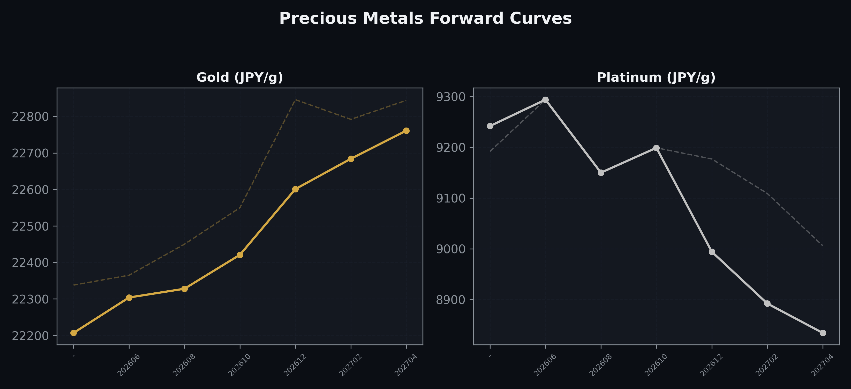
Precious Metals Forward Curves
Gold & Platinum (2026-06-18)

Slide 5
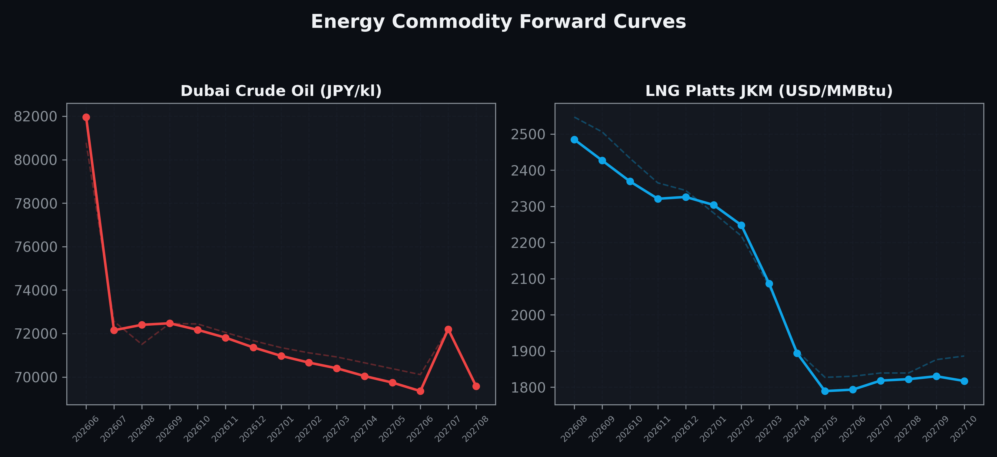
Energy Commodity Forward Curves
Dubai Crude Oil & LNG Platts JKM (2026-06-18)

Slide 6
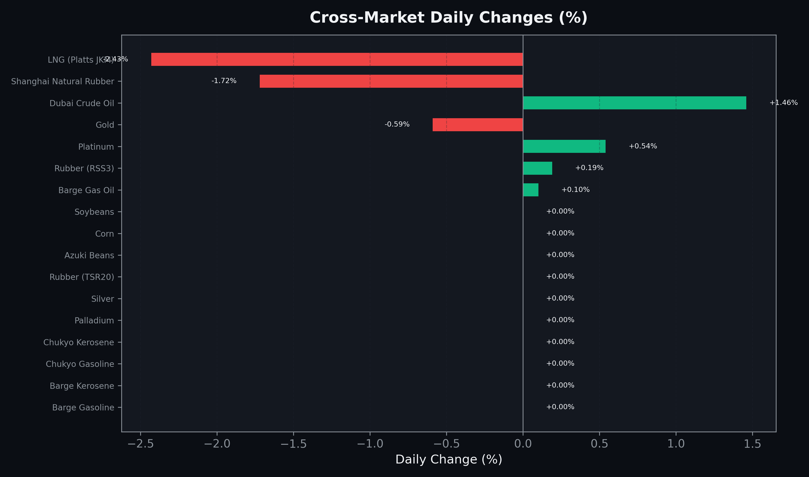
Cross-Market Daily Changes
All commodities sorted by absolute % change

Slide 7
Top Power Futures Movers
Largest absolute settlement price changes vs previous day (2026-06-18)
Instrument | Underlying | Month | Price | Prev | Change | % Chg
FUT_EWP_260828 | Power West Peak (Monthly) | 202608 | 25.01 | 26.06 | -1.05 | -4.03%
FUT_EWP_260730 | Power West Peak (Monthly) | 202607 | 23.62 | 24.57 | -0.95 | -3.87%
FUT_EWPW_260625 | Power West Peak (Weekly) | 20260626 | 17.68 | 18.56 | -0.88 | -4.74%
FUT_EWP_260929 | Power West Peak (Monthly) | 202609 | 23.41 | 24.18 | -0.77 | -3.18%
FUT_ECP_260730 | 電力(中部・日中) | 202607 | 25.46 | 26.20 | -0.74 | -2.82%
FUT_EEB_260730 | Power East Base (Monthly) | 202607 | 21.27 | 22.00 | -0.73 | -3.32%
FUT_EEB_260828 | Power East Base (Monthly) | 202608 | 21.32 | 22.00 | -0.68 | -3.09%
FUT_EWBW_260618 | Power West Base (Weekly) | 20260619 | 13.57 | 12.90 | +0.67 | +5.19%
FUT_EWPW_260618 | Power West Peak (Weekly) | 20260619 | 16.88 | 16.21 | +0.67 | +4.13%
FUT_EWPW_260709 | Power West Peak (Weekly) | 20260710 | 22.08 | 22.75 | -0.67 | -2.95%
FUT_EWPW_260716 | Power West Peak (Weekly) | 20260717 | 22.20 | 22.83 | -0.63 | -2.76%
FUT_ECP_261029 | 電力(中部・日中) | 202610 | 18.92 | 19.53 | -0.61 | -3.12%
FUT_EWB_260828 | Power West Base (Monthly) | 202608 | 18.15 | 18.75 | -0.60 | -3.20%
FUT_EWPW_260702 | Power West Peak (Weekly) | 20260703 | 20.73 | 21.33 | -0.60 | -2.81%
FUT_ECP_261127 | 電力(中部・日中) | 202611 | 18.59 | 19.14 | -0.55 | -2.87%

