Slide 1
Daily Market Report
Trade Date: 2026-06-19
JPX Derivative & Commodity Analytics
DataServer In-House

Slide 2
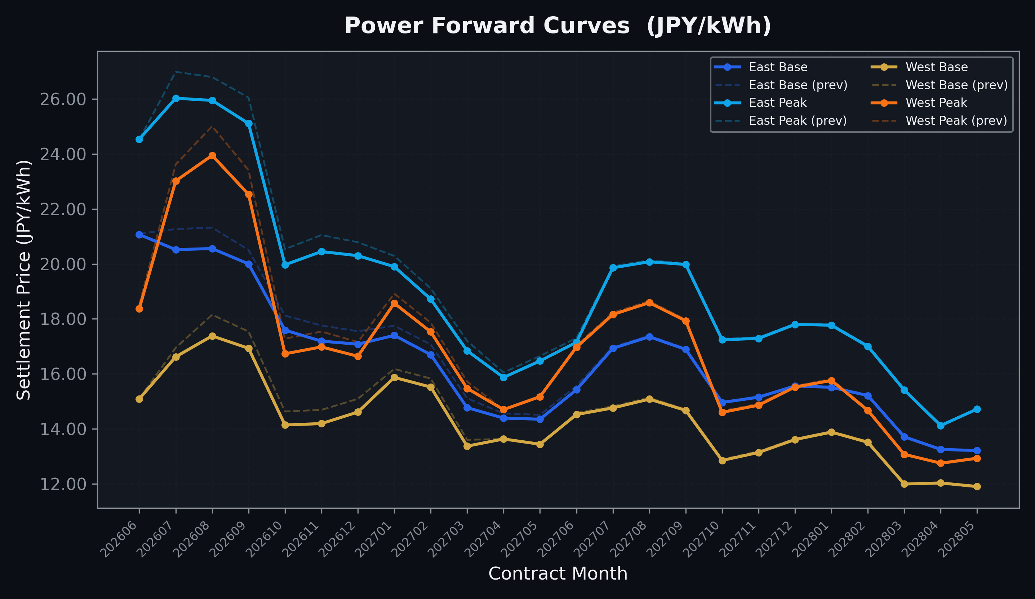
Power Forward Curves
East/West Base & Peak monthly contracts (2026-06-19)

Slide 3
Commodity Snapshot
Front-month settlement prices as of 2026-06-19
Category | Asset | Contract | Settlement | Unit | Change | % Chg
Energy | Barge Gas Oil | 202607 | 105,200.00 | JPY/kl | +0.00 | +0.00%
Energy | Barge Gasoline | 202607 | 98,000.00 | JPY/kl | +0.00 | +0.00%
Energy | Barge Kerosene | 202607 | 109,000.00 | JPY/kl | +0.00 | +0.00%
Energy | Chukyo Gasoline | 202607 | 95,000.00 | JPY/kl | +0.00 | +0.00%
Energy | Chukyo Kerosene | 202607 | 105,000.00 | JPY/kl | +0.00 | +0.00%
Energy | Dubai Crude Oil | 202606 | 81,830.00 | JPY/kl | -130.00 | -0.16%
Energy | LNG (Platts JKM) | 202608 | 2,463.00 | USD/MMBtu | -22.00 | -0.89%
Metals | Gold | - | 21,692.00 | JPY/g | -515.00 | -2.32%
Metals | Palladium | 202606 | 6,600.00 | JPY/g | -300.00 | -4.35%
Metals | Platinum | - | 8,514.00 | JPY/g | -728.00 | -7.88%
Metals | Silver | 202606 | 340.00 | JPY/10g | -10.00 | -2.86%
Industrial | Rubber (RSS3) | 202606 | 429.90 | JPY/kg | -0.90 | -0.21%
Industrial | Rubber (TSR20) | 202607 | 365.00 | JPY/kg | +0.00 | +0.00%
Industrial | Shanghai Natural Rubber | 202609 | 17,850.00 | JPY/kg | +110.00 | +0.62%
Agriculture | Azuki Beans | 202606 | 12,300.00 | JPY/bag | +0.00 | +0.00%
Agriculture | Corn | 202609 | 39,000.00 | JPY/t | +0.00 | +0.00%
Agriculture | Soybeans | 202608 | 64,000.00 | JPY/t | +0.00 | +0.00%

Slide 4
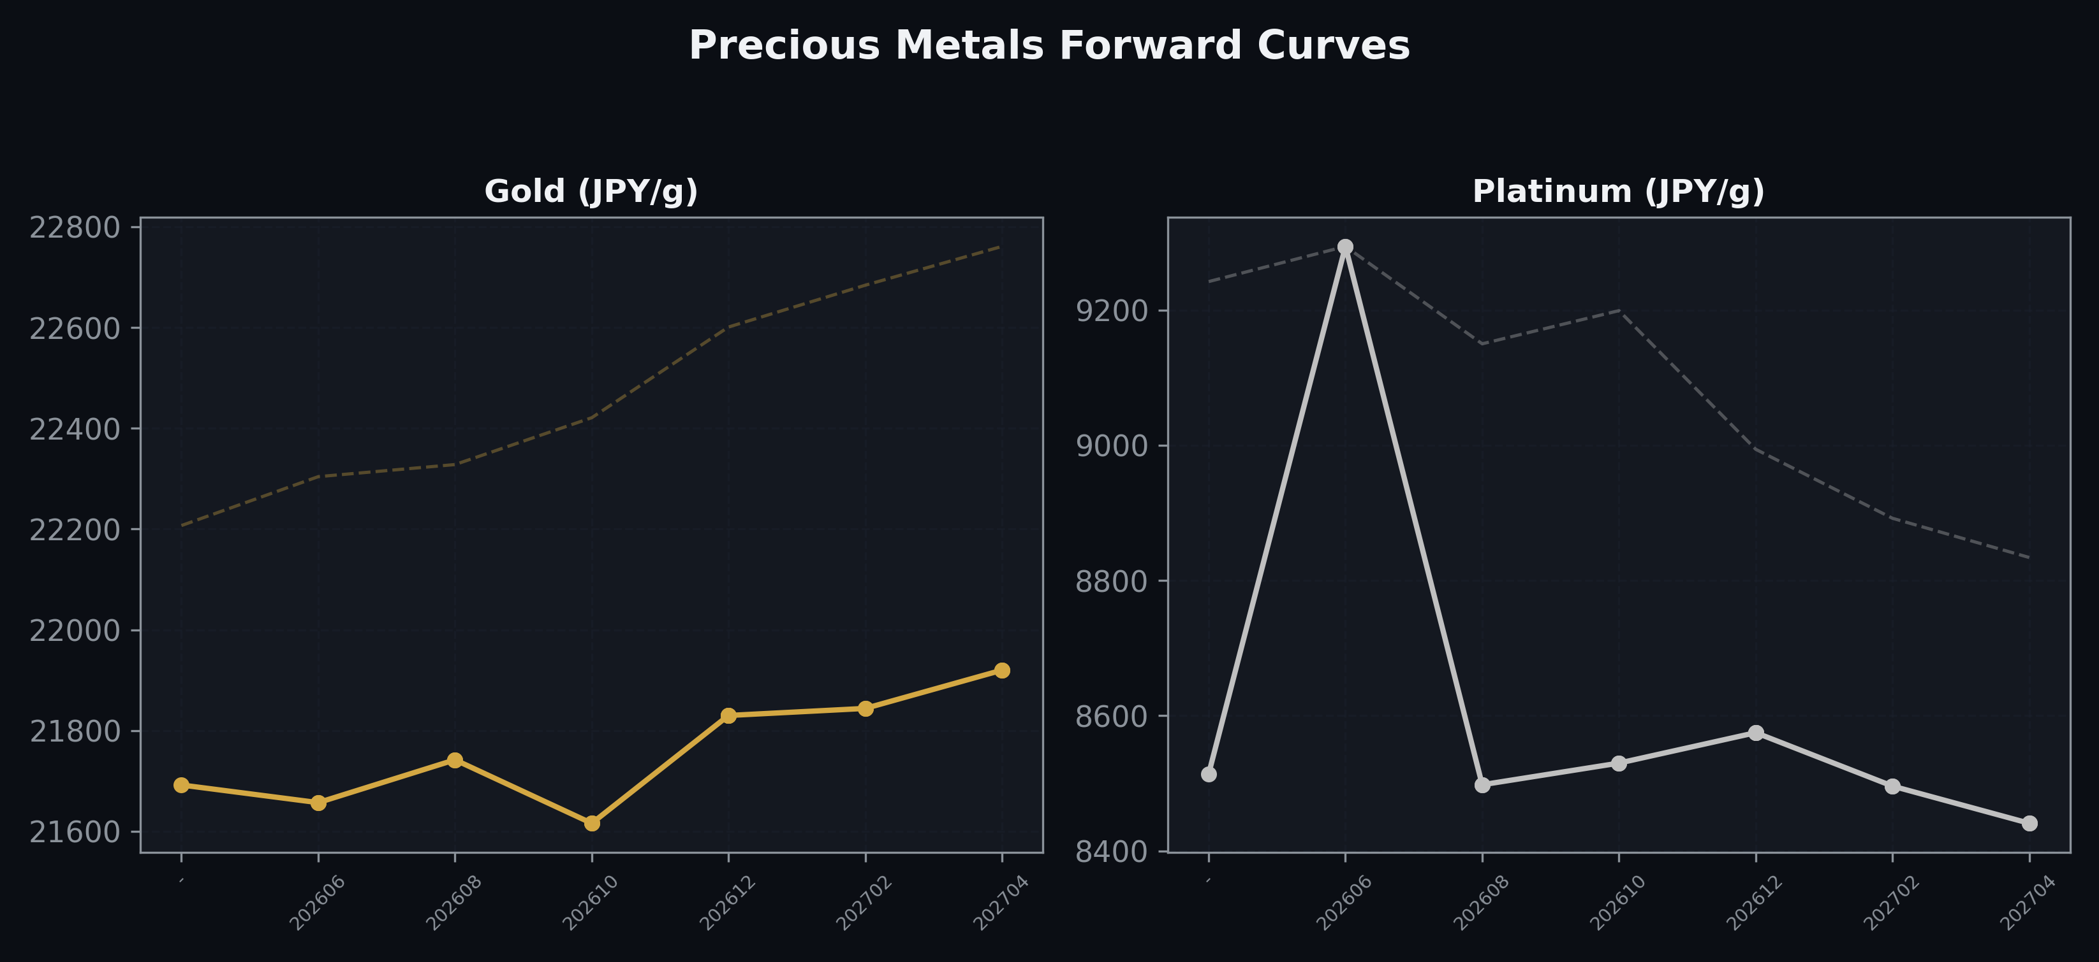
Precious Metals Forward Curves
Gold & Platinum (2026-06-19)

Slide 5
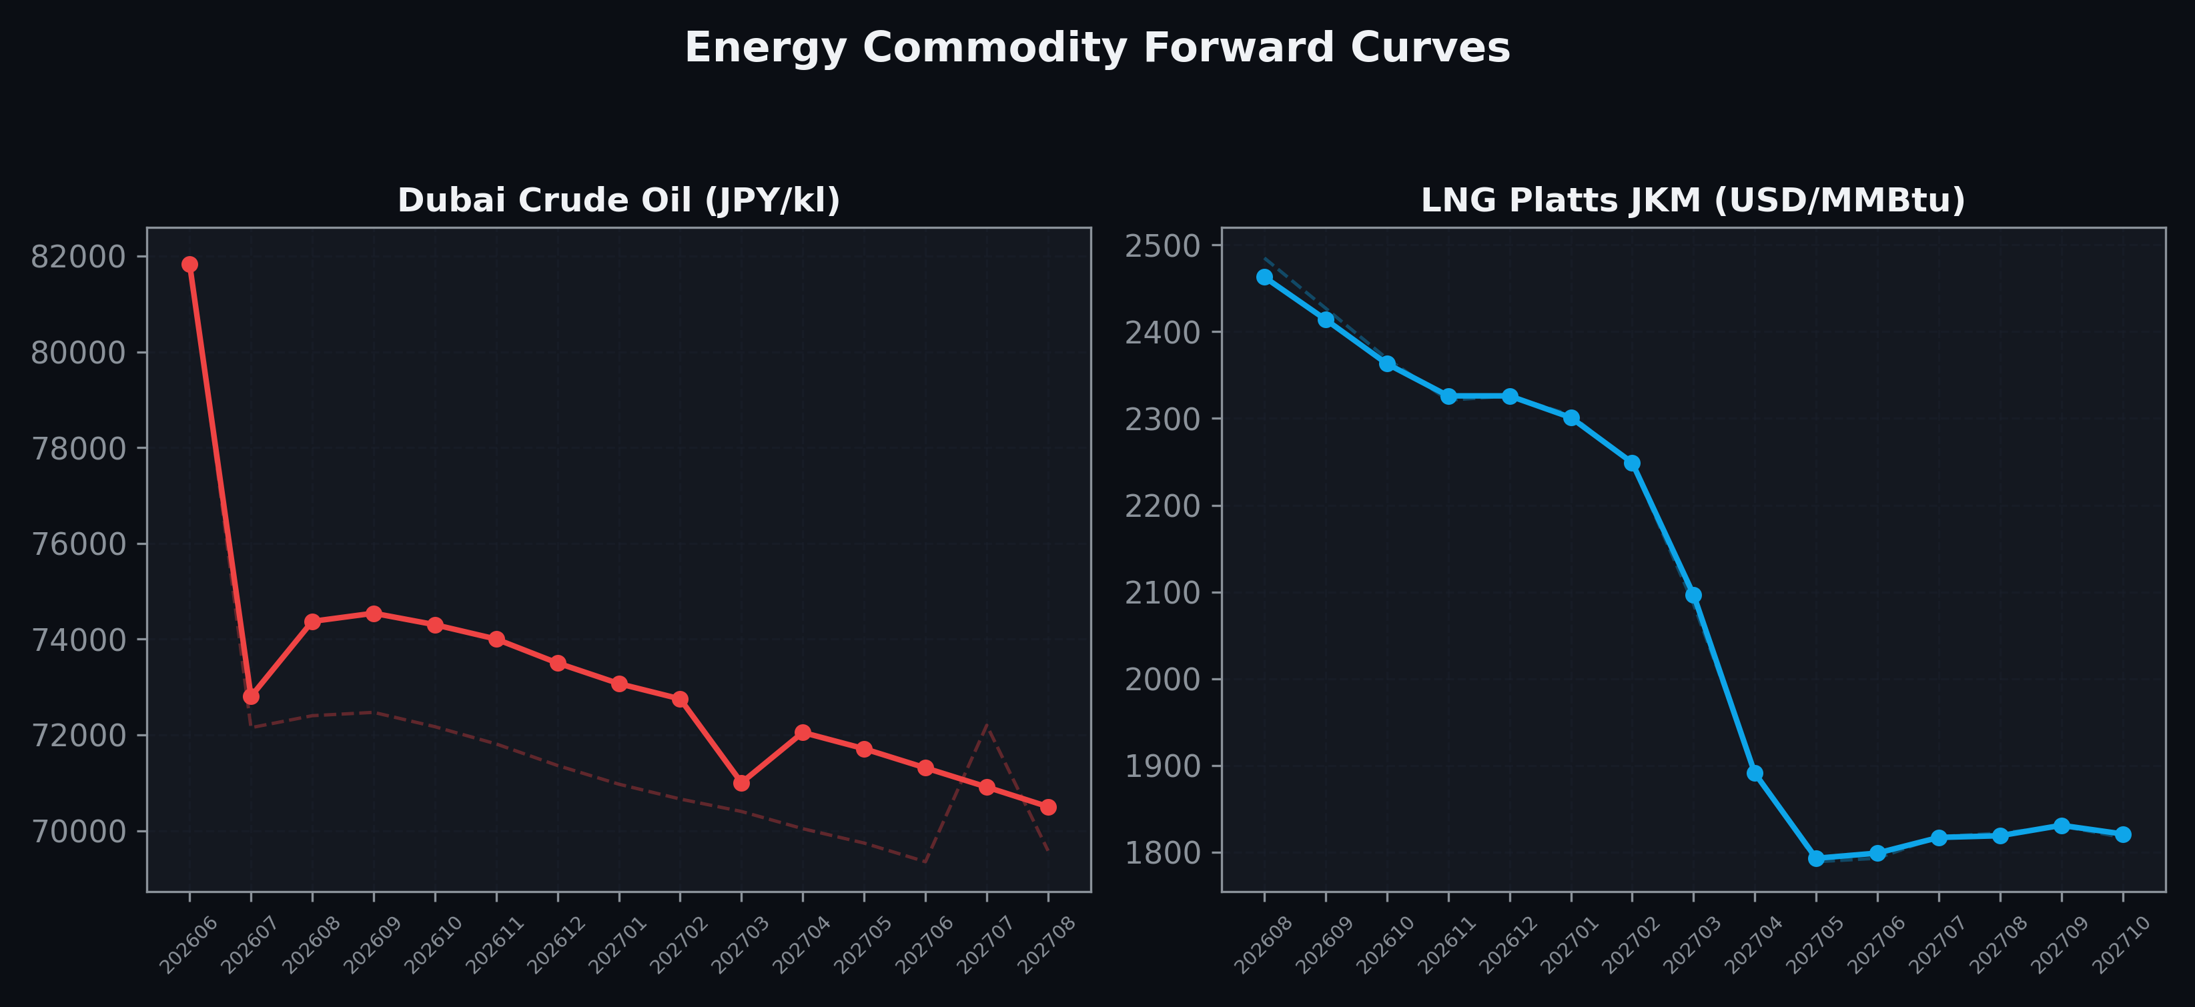
Energy Commodity Forward Curves
Dubai Crude Oil & LNG Platts JKM (2026-06-19)

Slide 6
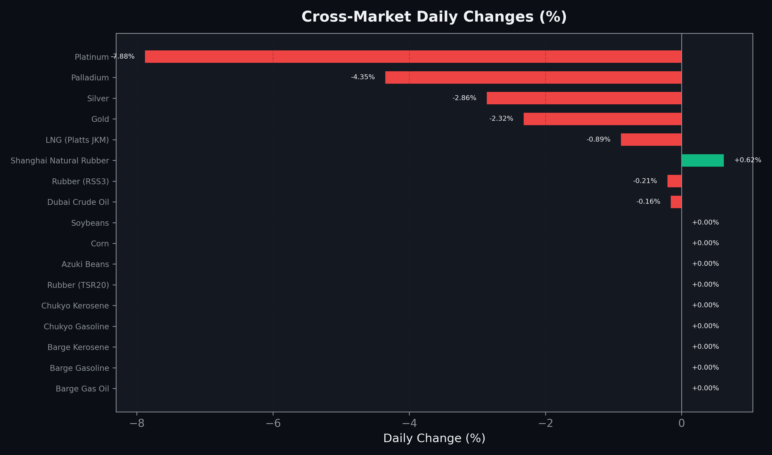
Cross-Market Daily Changes
All commodities sorted by absolute % change

Slide 7
Top Power Futures Movers
Largest absolute settlement price changes vs previous day (2026-06-19)
Instrument | Underlying | Month | Price | Prev | Change | % Chg
FUT_EWP_260828 | Power West Peak (Monthly) | 202608 | 23.95 | 25.01 | -1.06 | -4.24%
FUT_ECP_260730 | 電力(中部・日中) | 202607 | 24.43 | 25.46 | -1.03 | -4.05%
FUT_ECP_260929 | 電力(中部・日中) | 202609 | 24.35 | 25.37 | -1.02 | -4.02%
FUT_EEPW_260716 | Power East Peak (Weekly) | 20260717 | 25.68 | 26.68 | -1.00 | -3.75%
FUT_ECP_260828 | 電力(中部・日中) | 202608 | 25.11 | 26.09 | -0.98 | -3.76%
FUT_EEP_260730 | Power East Peak (Monthly) | 202607 | 26.03 | 26.99 | -0.96 | -3.56%
FUT_EEPW_260709 | Power East Peak (Weekly) | 20260710 | 25.27 | 26.22 | -0.95 | -3.62%
FUT_EEP_260929 | Power East Peak (Monthly) | 202609 | 25.11 | 26.05 | -0.94 | -3.61%
FUT_EWP_260929 | Power West Peak (Monthly) | 202609 | 22.53 | 23.41 | -0.88 | -3.76%
FUT_EEP_260828 | Power East Peak (Monthly) | 202608 | 25.95 | 26.80 | -0.85 | -3.17%
FUT_ECB_260929 | 電力(中部・ベース) | 202609 | 18.62 | 19.43 | -0.81 | -4.17%
FUT_EWB_260828 | Power West Base (Monthly) | 202608 | 17.38 | 18.15 | -0.77 | -4.24%
FUT_ECB_260828 | 電力(中部・ベース) | 202608 | 19.37 | 20.13 | -0.76 | -3.78%
FUT_EEB_260828 | Power East Base (Monthly) | 202608 | 20.56 | 21.32 | -0.76 | -3.56%
FUT_EEB_260730 | Power East Base (Monthly) | 202607 | 20.52 | 21.27 | -0.75 | -3.53%

