Slide 1
Daily Market Report
Trade Date: 2026-04-17
JPX Derivative & Commodity Analytics
DataServer In-House

Slide 2
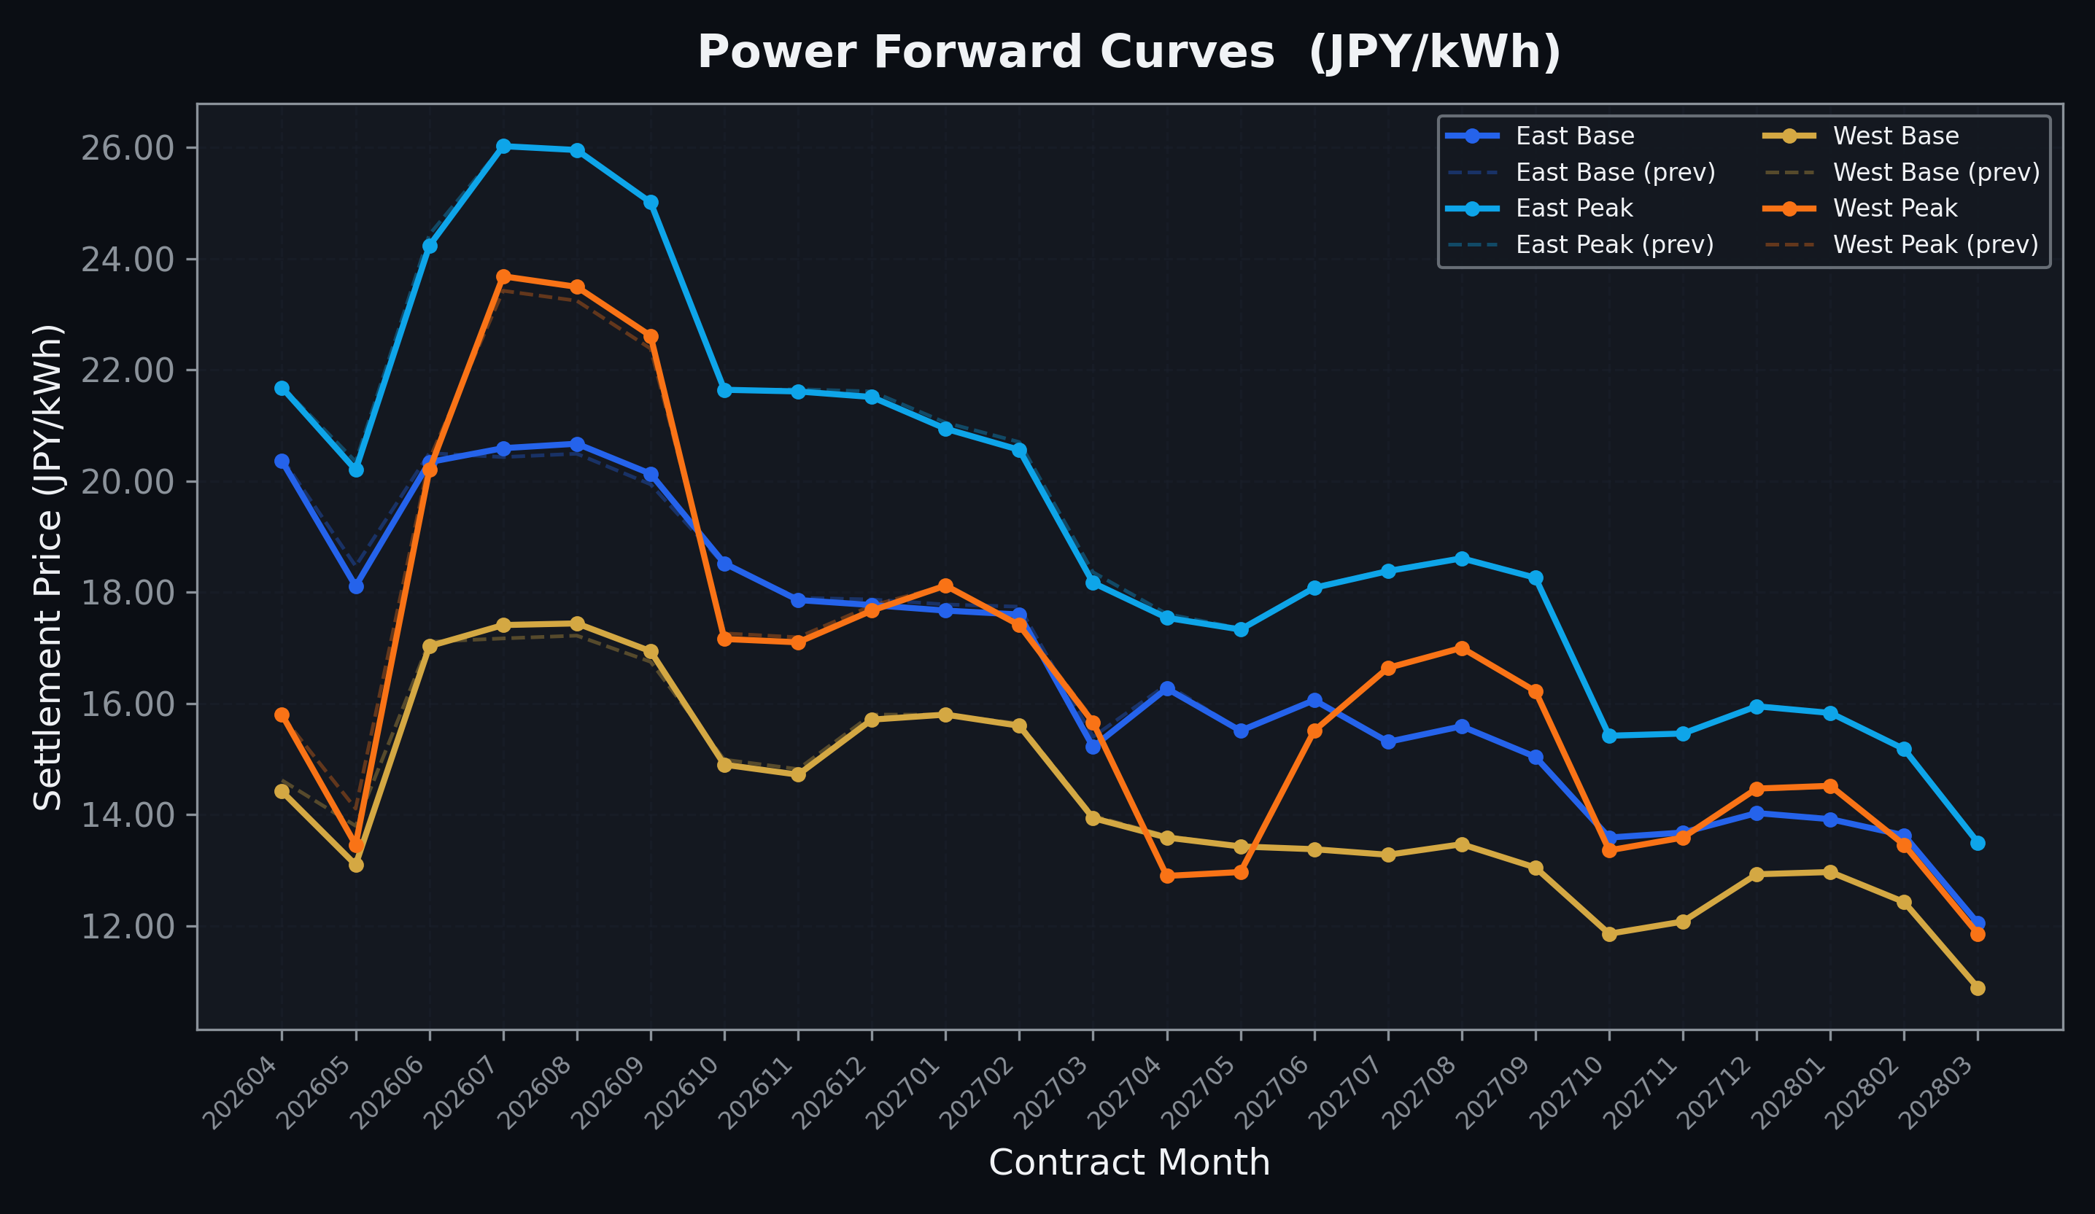
Power Forward Curves
East/West Base & Peak monthly contracts (2026-04-17)

Slide 3
Commodity Snapshot
Front-month settlement prices as of 2026-04-17
Category | Asset | Contract | Settlement | Unit | Change | % Chg
Energy | Barge Gas Oil | 202605 | 115,900.00 | JPY/kl | +100.00 | +0.09%
Energy | Barge Gasoline | 202605 | 105,000.00 | JPY/kl | +0.00 | +0.00%
Energy | Barge Kerosene | 202605 | 105,000.00 | JPY/kl | +0.00 | +0.00%
Energy | Chukyo Gasoline | 202605 | 105,000.00 | JPY/kl | +0.00 | +0.00%
Energy | Chukyo Kerosene | 202605 | 105,000.00 | JPY/kl | +0.00 | +0.00%
Energy | Dubai Crude Oil | 202604 | 104,140.00 | JPY/kl | +80.00 | +0.08%
Energy | LNG (Platts JKM) | 202606 | 2,547.00 | USD/MMBtu | +47.00 | +1.88%
Metals | Gold | - | 24,422.00 | JPY/g | -103.00 | -0.42%
Metals | Palladium | 202604 | 8,000.00 | JPY/g | +0.00 | +0.00%
Metals | Platinum | - | 10,741.00 | JPY/g | +55.00 | +0.51%
Metals | Silver | 202604 | 383.10 | JPY/10g | +0.00 | +0.00%
Industrial | Rubber (RSS3) | 202604 | 375.00 | JPY/kg | -4.00 | -1.06%
Industrial | Rubber (TSR20) | 202605 | 325.00 | JPY/kg | +0.00 | +0.00%
Industrial | Shanghai Natural Rubber | 202605 | 16,485.00 | JPY/kg | -210.00 | -1.26%
Agriculture | Azuki Beans | 202604 | 12,300.00 | JPY/bag | +0.00 | +0.00%
Agriculture | Corn | 202607 | 39,000.00 | JPY/t | +0.00 | +0.00%
Agriculture | Soybeans | 202606 | 64,000.00 | JPY/t | +0.00 | +0.00%

Slide 4
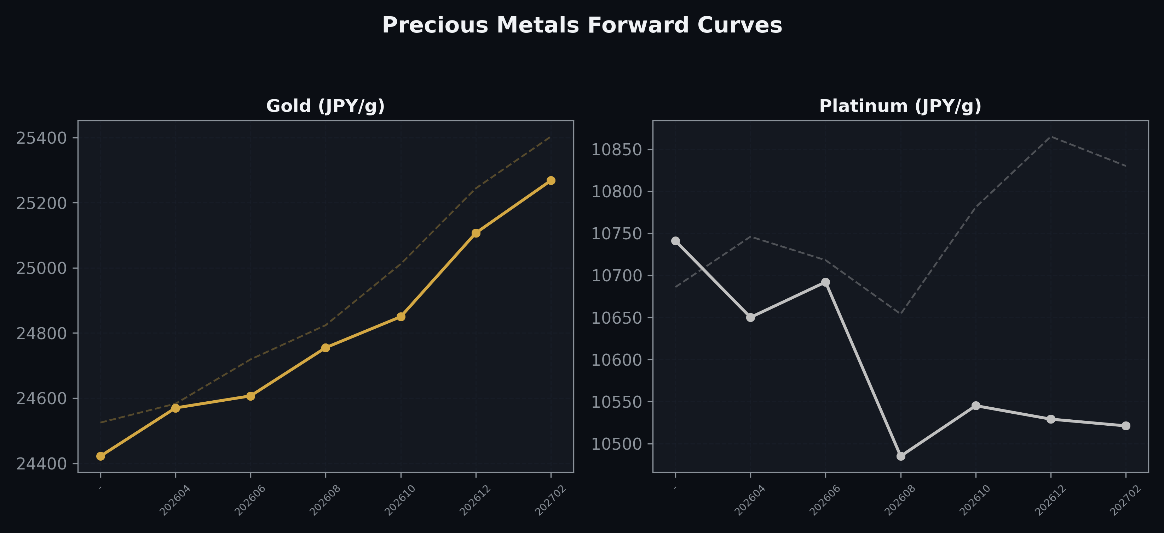
Precious Metals Forward Curves
Gold & Platinum (2026-04-17)

Slide 5
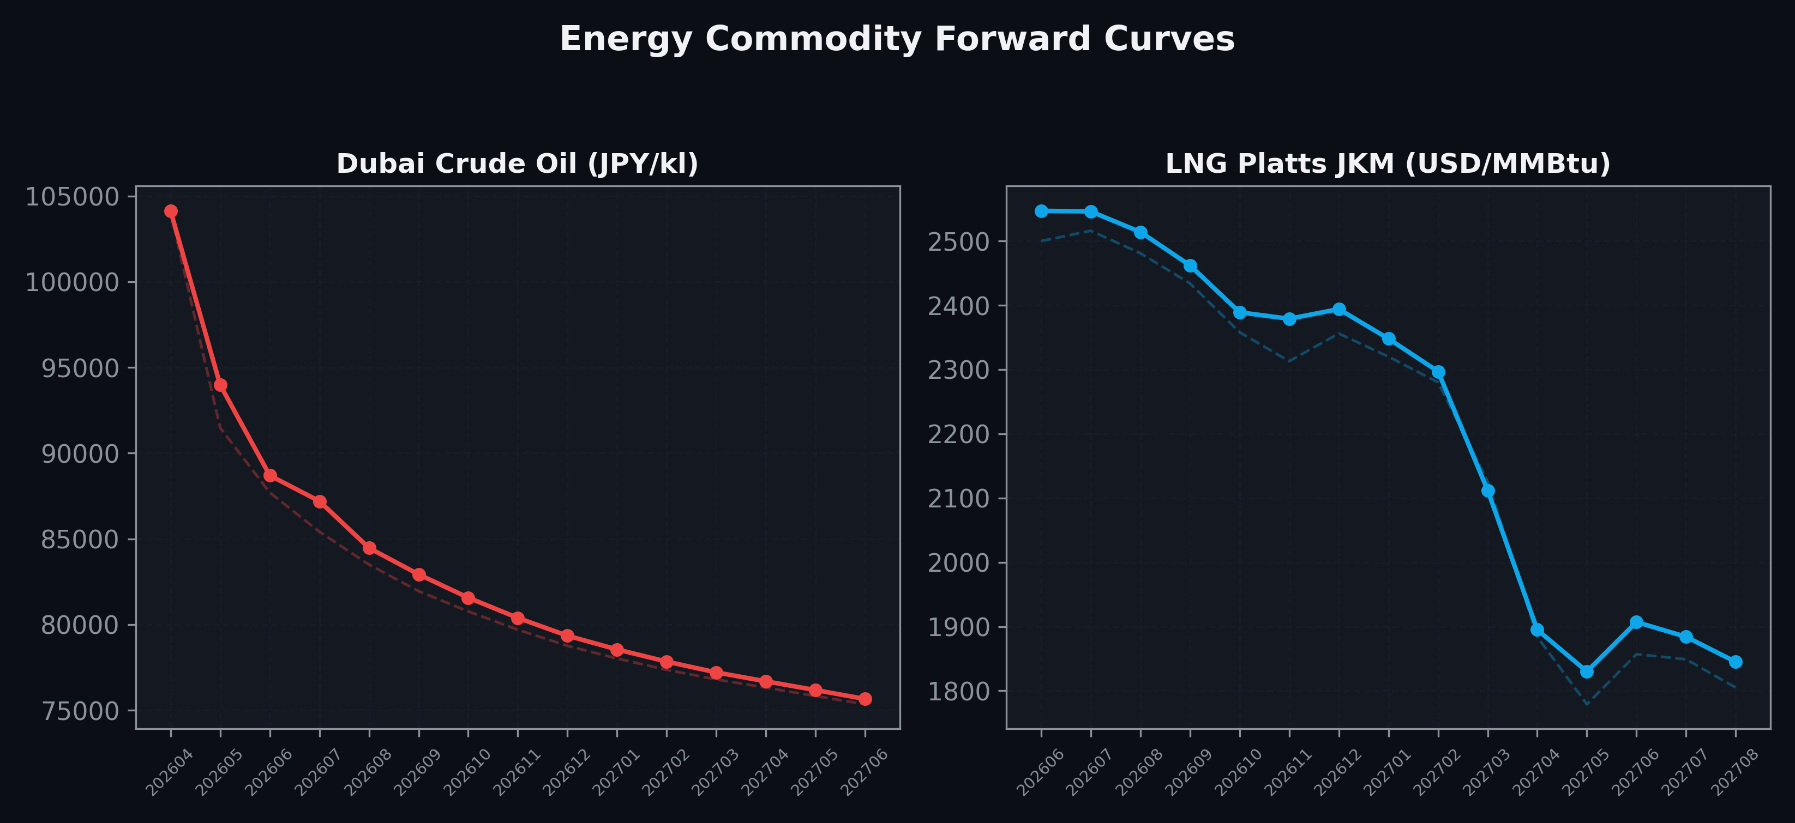
Energy Commodity Forward Curves
Dubai Crude Oil & LNG Platts JKM (2026-04-17)

Slide 6
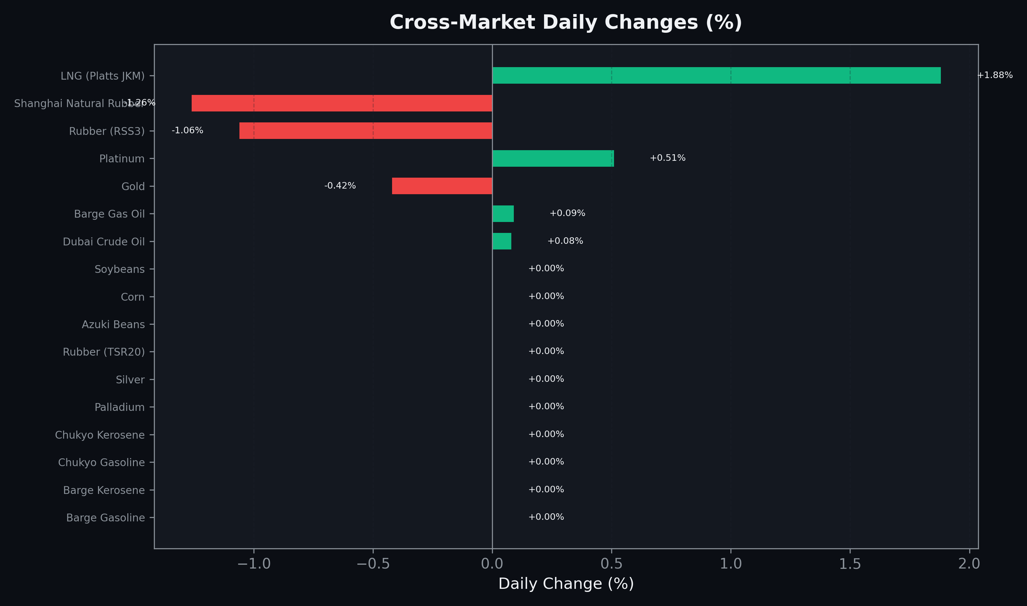
Cross-Market Daily Changes
All commodities sorted by absolute % change

Slide 7
Top Power Futures Movers
Largest absolute settlement price changes vs previous day (2026-04-17)
Instrument | Underlying | Month | Price | Prev | Change | % Chg
FUT_EWB_260529 | Power West Base (Monthly) | 202605 | 13.10 | 13.80 | -0.70 | -5.07%
FUT_EWP_260528 | Power West Peak (Monthly) | 202605 | 13.46 | 14.11 | -0.65 | -4.61%
FUT_ECB_260529 | 電力(中部・ベース) | 202605 | 16.31 | 16.70 | -0.39 | -2.34%
FUT_ECP_260528 | 電力(中部・日中) | 202605 | 16.88 | 17.26 | -0.38 | -2.20%
FUT_EEB_260529 | Power East Base (Monthly) | 202605 | 18.11 | 18.47 | -0.36 | -1.95%
FUT_EWPW_260507 | Power West Peak (Weekly) | 20260508 | 11.86 | 12.21 | -0.35 | -2.87%
FUT_EWBW_260514 | Power West Base (Weekly) | 20260515 | 13.11 | 13.45 | -0.34 | -2.53%
FUT_EWPW_260514 | Power West Peak (Weekly) | 20260515 | 12.28 | 12.60 | -0.32 | -2.54%
FUT_EWBW_260507 | Power West Base (Weekly) | 20260508 | 12.30 | 12.60 | -0.30 | -2.38%
FUT_ECB_260629 | 電力(中部・ベース) | 202606 | 19.00 | 19.26 | -0.26 | -1.35%
FUT_EWP_260730 | Power West Peak (Monthly) | 202607 | 23.68 | 23.42 | +0.26 | +1.11%
FUT_EWP_260828 | Power West Peak (Monthly) | 202608 | 23.49 | 23.24 | +0.25 | +1.08%
FUT_EWB_260730 | Power West Base (Monthly) | 202607 | 17.41 | 17.17 | +0.24 | +1.40%
FUT_ECP_260629 | 電力(中部・日中) | 202606 | 21.52 | 21.75 | -0.23 | -1.06%
FUT_EWP_260929 | Power West Peak (Monthly) | 202609 | 22.61 | 22.38 | +0.23 | +1.03%

