Slide 1
Daily Market Report
Trade Date: 2026-04-08
JPX Derivative & Commodity Analytics
DataServer In-House

Slide 2
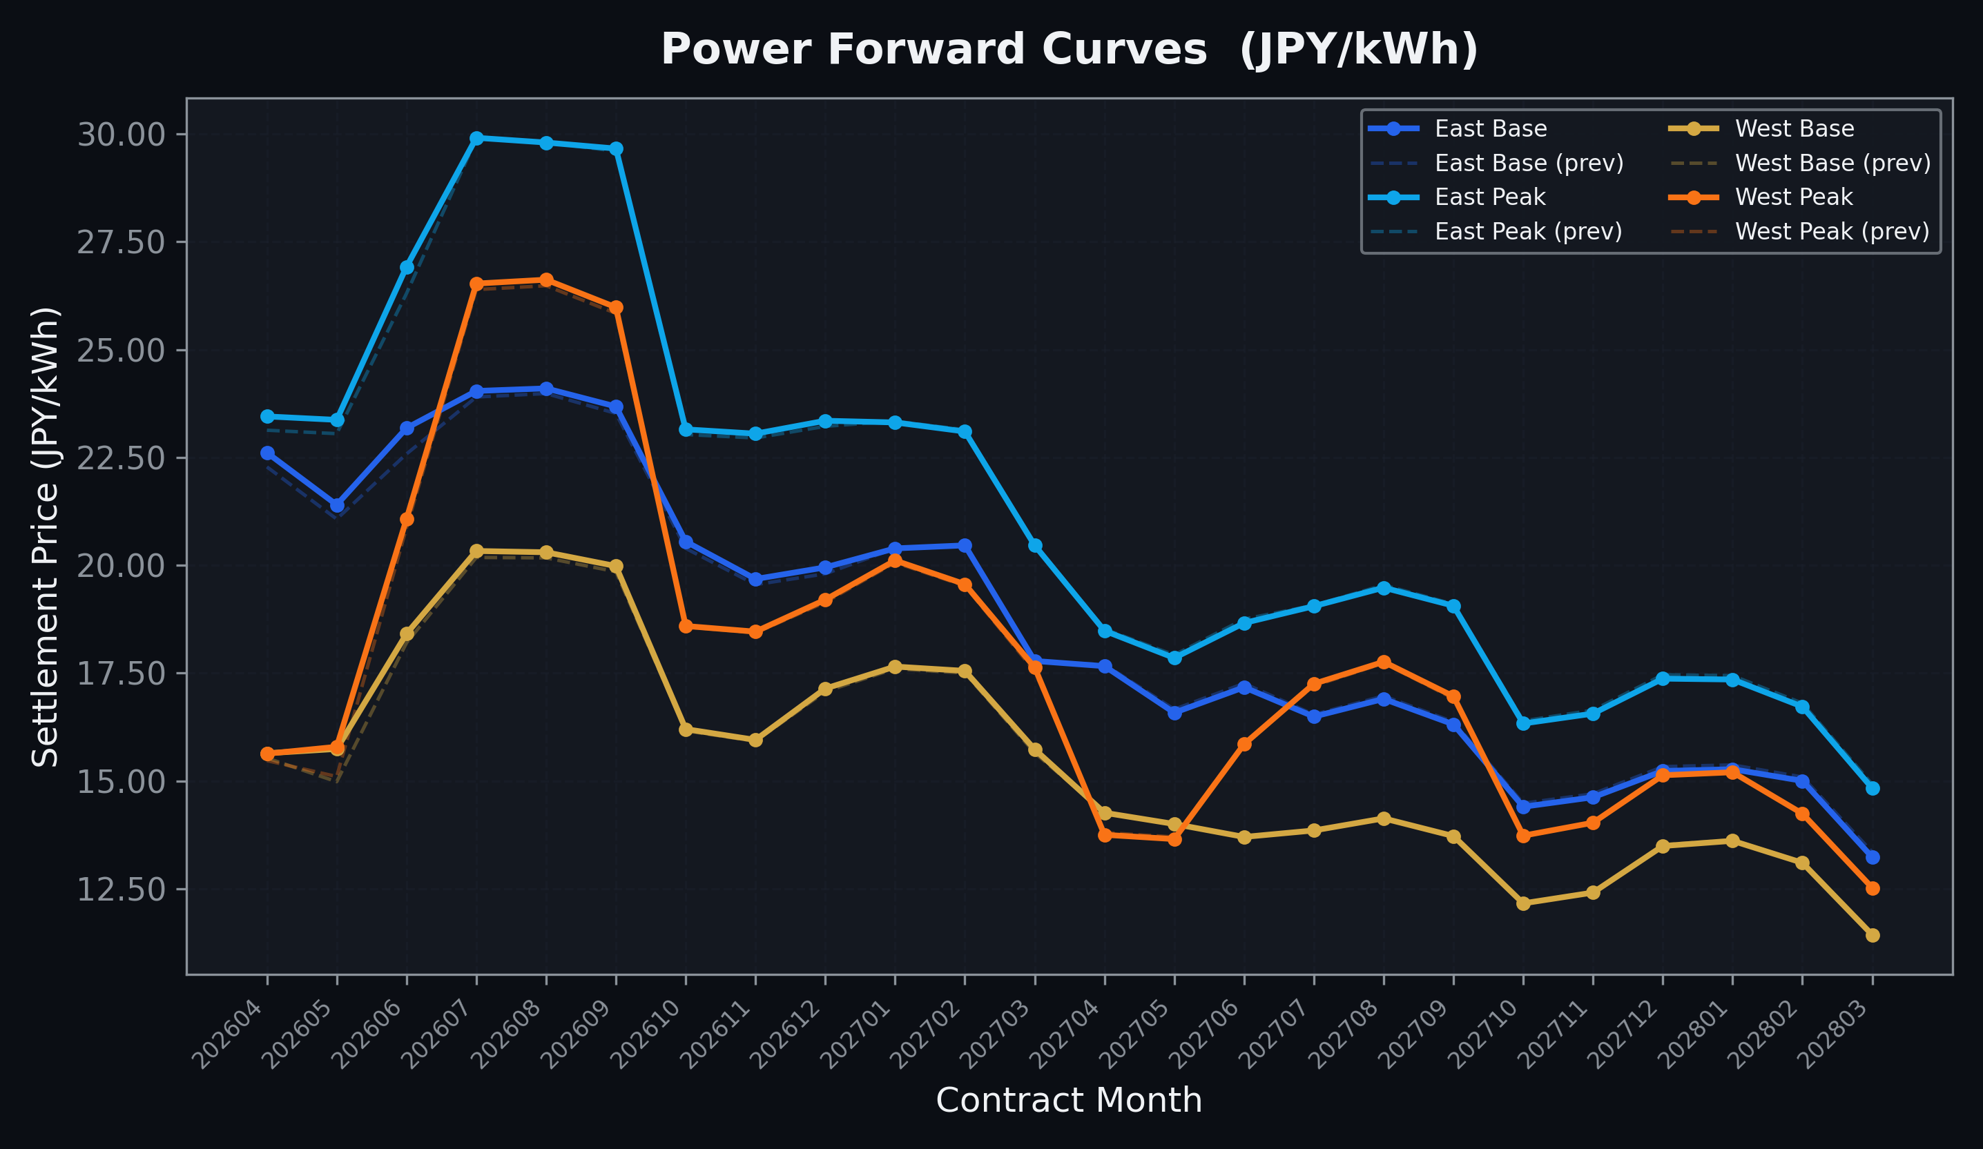
Power Forward Curves
East/West Base & Peak monthly contracts (2026-04-08)

Slide 3
Commodity Snapshot
Front-month settlement prices as of 2026-04-08
Category | Asset | Contract | Settlement | Unit | Change | % Chg
Energy | Barge Gas Oil | 202605 | 110,800.00 | JPY/kl | -500.00 | -0.45%
Energy | Barge Gasoline | 202605 | 115,000.00 | JPY/kl | -5000.00 | -4.17%
Energy | Barge Kerosene | 202605 | 105,000.00 | JPY/kl | -5000.00 | -4.55%
Energy | Chukyo Gasoline | 202605 | 110,000.00 | JPY/kl | +0.00 | +0.00%
Energy | Chukyo Kerosene | 202605 | 105,000.00 | JPY/kl | +0.00 | +0.00%
Energy | Dubai Crude Oil | 202604 | 118,170.00 | JPY/kl | -1150.00 | -0.96%
Energy | LNG (Platts JKM) | 202605 | 3,130.00 | USD/MMBtu | -2.00 | -0.06%
Metals | Gold | - | 24,349.00 | JPY/g | +635.00 | +2.68%
Metals | Palladium | 202604 | 7,500.00 | JPY/g | +0.00 | +0.00%
Metals | Platinum | - | 10,055.00 | JPY/g | +45.00 | +0.45%
Metals | Silver | 202604 | 365.00 | JPY/10g | +0.00 | +0.00%
Industrial | Rubber (RSS3) | 202604 | 383.30 | JPY/kg | -3.40 | -0.88%
Industrial | Rubber (TSR20) | 202605 | 320.00 | JPY/kg | +0.00 | +0.00%
Industrial | Shanghai Natural Rubber | 202605 | 17,010.00 | JPY/kg | +85.00 | +0.50%
Agriculture | Azuki Beans | 202604 | 12,300.00 | JPY/bag | +0.00 | +0.00%
Agriculture | Corn | 202605 | 39,000.00 | JPY/t | +0.00 | +0.00%
Agriculture | Soybeans | 202604 | 64,000.00 | JPY/t | +0.00 | +0.00%

Slide 4
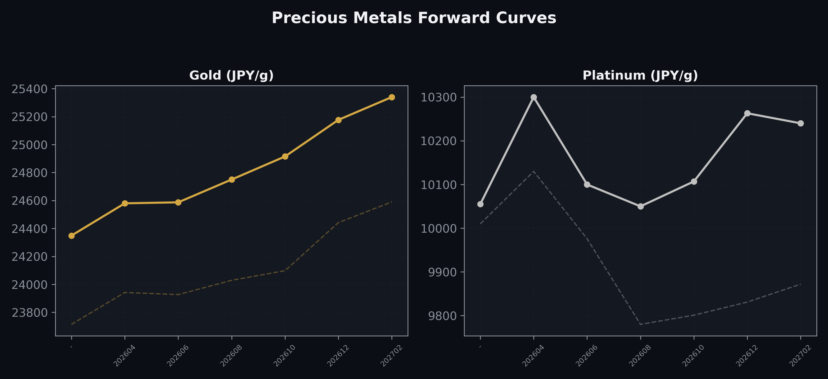
Precious Metals Forward Curves
Gold & Platinum (2026-04-08)

Slide 5
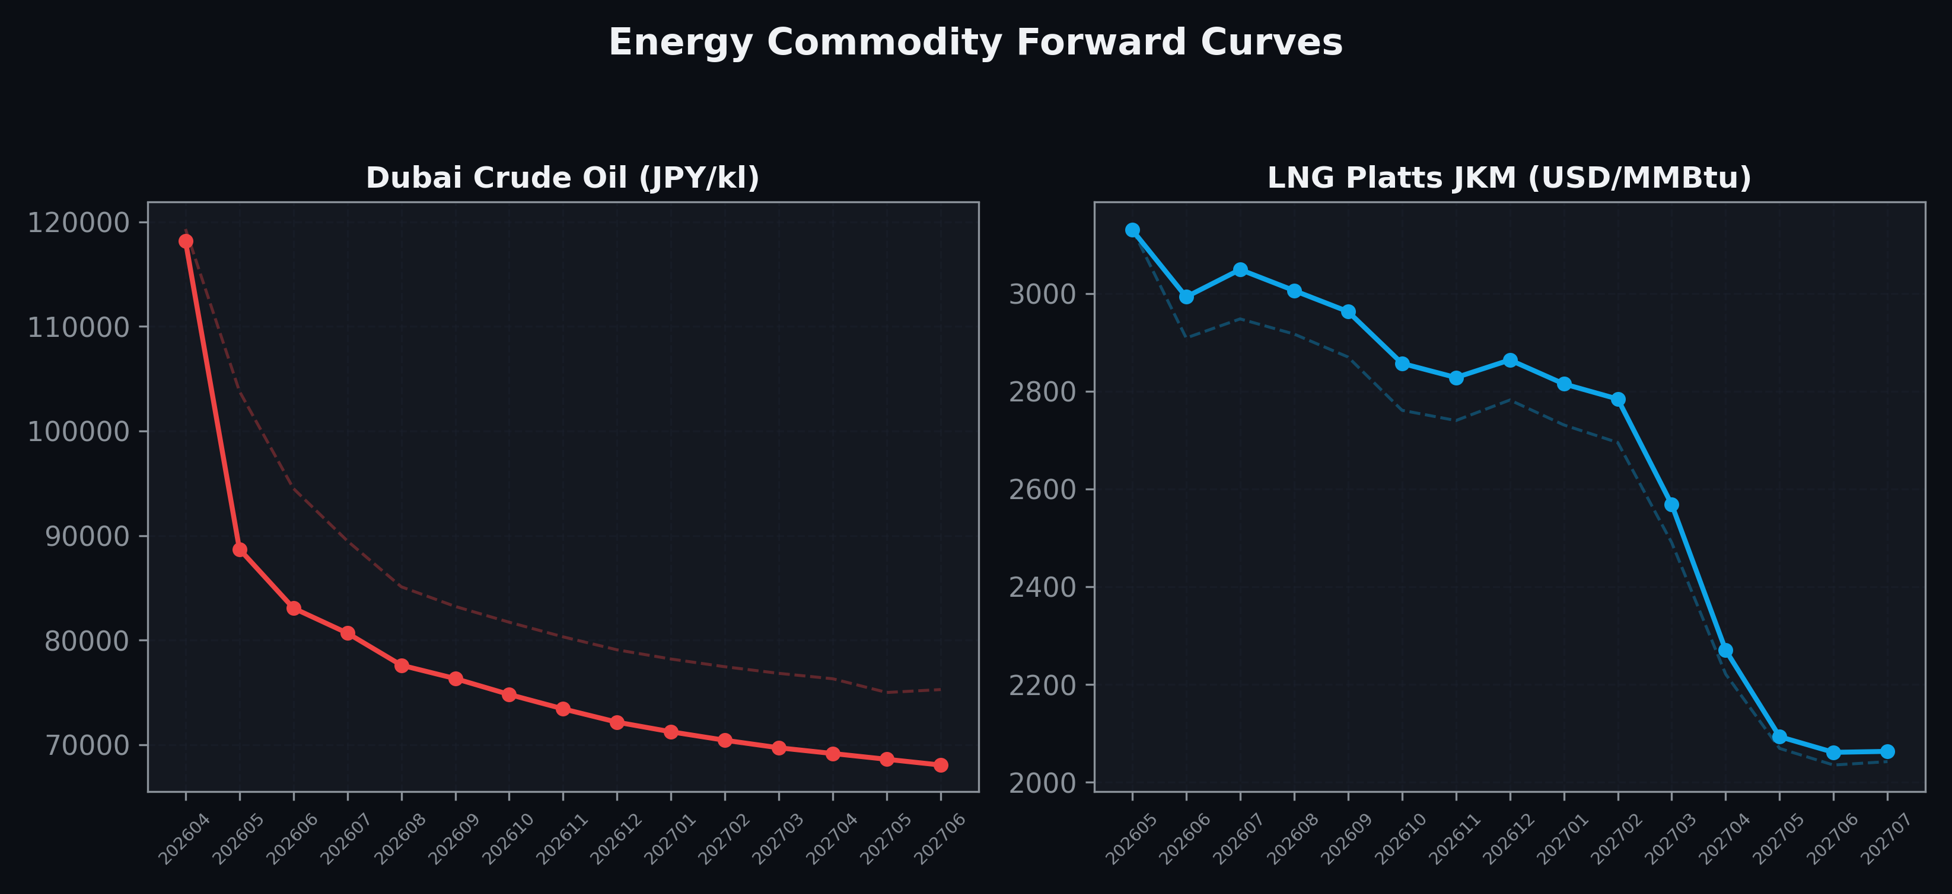
Energy Commodity Forward Curves
Dubai Crude Oil & LNG Platts JKM (2026-04-08)

Slide 6
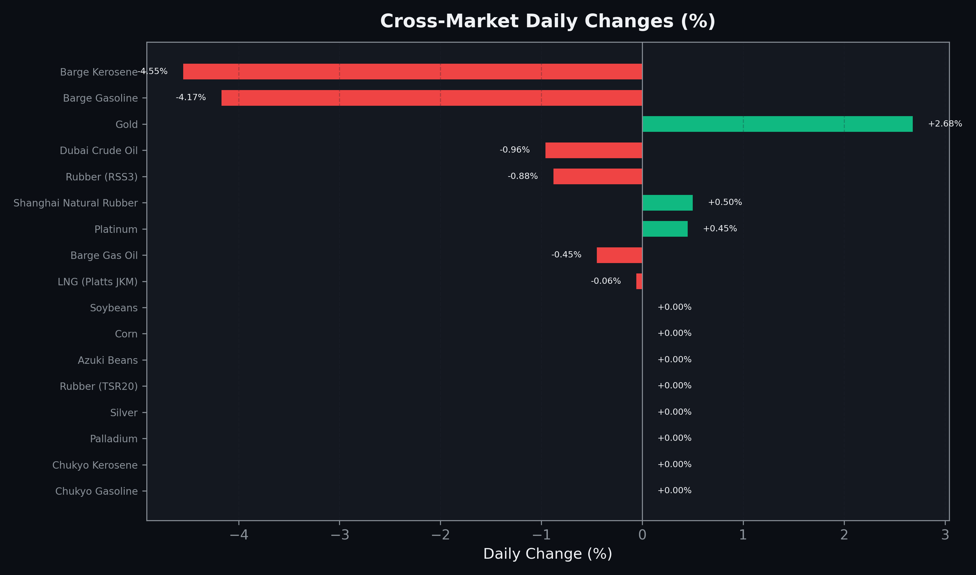
Cross-Market Daily Changes
All commodities sorted by absolute % change

Slide 7
Top Power Futures Movers
Largest absolute settlement price changes vs previous day (2026-04-08)
Instrument | Underlying | Month | Price | Prev | Change | % Chg
FUT_EWPW_260409 | Power West Peak (Weekly) | 20260410 | 17.84 | 16.83 | +1.01 | +6.00%
FUT_EWBW_260409 | Power West Base (Weekly) | 20260410 | 15.20 | 14.42 | +0.78 | +5.41%
FUT_EWB_260529 | Power West Base (Monthly) | 202605 | 15.74 | 14.98 | +0.76 | +5.07%
FUT_EWP_260528 | Power West Peak (Monthly) | 202605 | 15.79 | 15.10 | +0.69 | +4.57%
FUT_EEP_260629 | Power East Peak (Monthly) | 202606 | 26.92 | 26.30 | +0.62 | +2.36%
FUT_EEB_260629 | Power East Base (Monthly) | 202606 | 23.18 | 22.58 | +0.60 | +2.66%
FUT_EEPW_260423 | Power East Peak (Weekly) | 20260424 | 24.45 | 23.88 | +0.57 | +2.39%
FUT_EEPW_260428 | Power East Peak (Weekly) | 20260501 | 19.71 | 19.21 | +0.50 | +2.60%
FUT_EEBW_260416 | Power East Base (Weekly) | 20260417 | 22.73 | 22.29 | +0.44 | +1.97%
FUT_EEPW_260409 | Power East Peak (Weekly) | 20260410 | 21.21 | 21.62 | -0.41 | -1.90%
FUT_EEB_260428 | Power East Base (Monthly) | 202604 | 22.61 | 22.28 | +0.33 | +1.48%
FUT_EEB_260529 | Power East Base (Monthly) | 202605 | 21.40 | 21.07 | +0.33 | +1.57%
FUT_EEP_260428 | Power East Peak (Monthly) | 202604 | 23.45 | 23.13 | +0.32 | +1.38%
FUT_EEP_260528 | Power East Peak (Monthly) | 202605 | 23.37 | 23.05 | +0.32 | +1.39%
FUT_EWBW_260416 | Power West Base (Weekly) | 20260417 | 16.16 | 15.84 | +0.32 | +2.02%

