Slide 1
Daily Market Report
Trade Date: 2026-05-27
JPX Derivative & Commodity Analytics
DataServer In-House

Slide 2
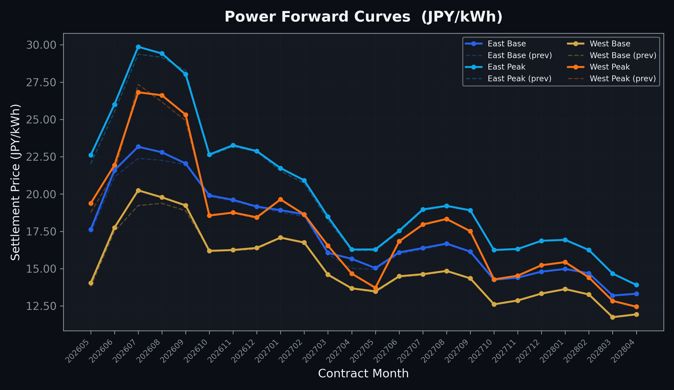
Power Forward Curves
East/West Base & Peak monthly contracts (2026-05-27)

Slide 3
Commodity Snapshot
Front-month settlement prices as of 2026-05-27
Category | Asset | Contract | Settlement | Unit | Change | % Chg
Energy | Barge Gas Oil | 202607 | 111,000.00 | JPY/kl | +1600.00 | +1.46%
Energy | Barge Gasoline | 202607 | 100,000.00 | JPY/kl | +0.00 | +0.00%
Energy | Barge Kerosene | 202607 | 105,000.00 | JPY/kl | +0.00 | +0.00%
Energy | Chukyo Gasoline | 202607 | 95,000.00 | JPY/kl | +0.00 | +0.00%
Energy | Chukyo Kerosene | 202607 | 105,000.00 | JPY/kl | +0.00 | +0.00%
Energy | Dubai Crude Oil | 202605 | 102,180.00 | JPY/kl | +890.00 | +0.88%
Energy | LNG (Platts JKM) | 202607 | 2,895.00 | USD/MMBtu | -32.00 | -1.09%
Metals | Gold | - | 22,904.00 | JPY/g | -128.00 | -0.56%
Metals | Palladium | 202606 | 7,000.00 | JPY/g | +0.00 | +0.00%
Metals | Platinum | - | 9,728.00 | JPY/g | +60.00 | +0.62%
Metals | Silver | 202606 | 390.00 | JPY/10g | +0.00 | +0.00%
Industrial | Rubber (RSS3) | 202606 | 401.00 | JPY/kg | +8.40 | +2.14%
Industrial | Rubber (TSR20) | 202606 | 350.00 | JPY/kg | +0.00 | +0.00%
Industrial | Shanghai Natural Rubber | 202609 | 17,630.00 | JPY/kg | +255.00 | +1.47%
Agriculture | Azuki Beans | 202606 | 12,300.00 | JPY/bag | +0.00 | +0.00%
Agriculture | Corn | 202607 | 39,000.00 | JPY/t | +0.00 | +0.00%
Agriculture | Soybeans | 202606 | 64,000.00 | JPY/t | +0.00 | +0.00%

Slide 4
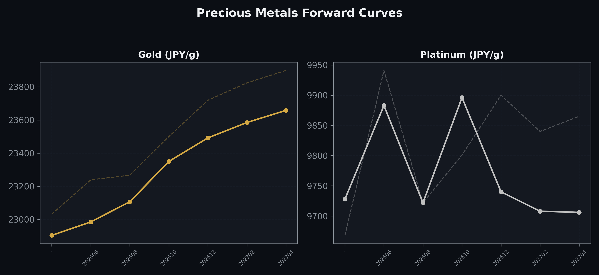
Precious Metals Forward Curves
Gold & Platinum (2026-05-27)

Slide 5
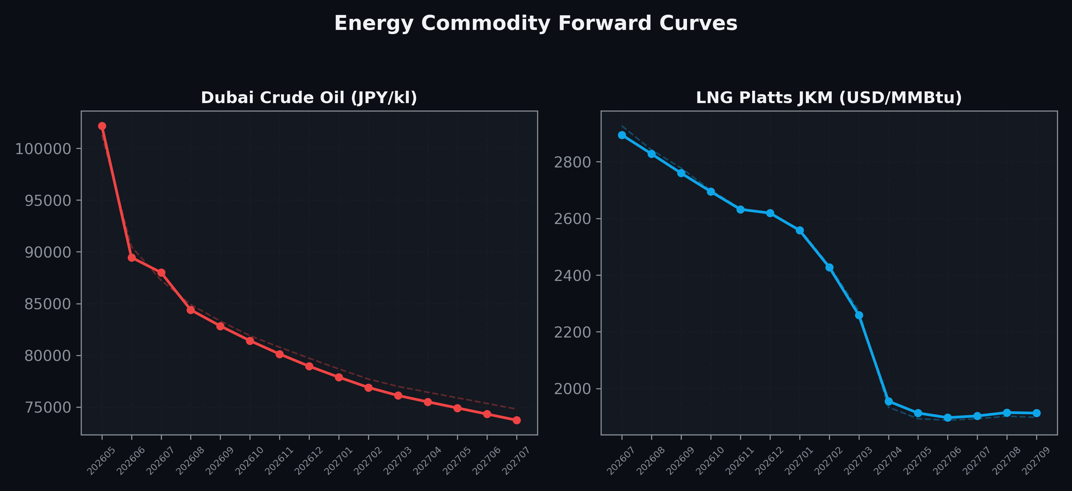
Energy Commodity Forward Curves
Dubai Crude Oil & LNG Platts JKM (2026-05-27)

Slide 6
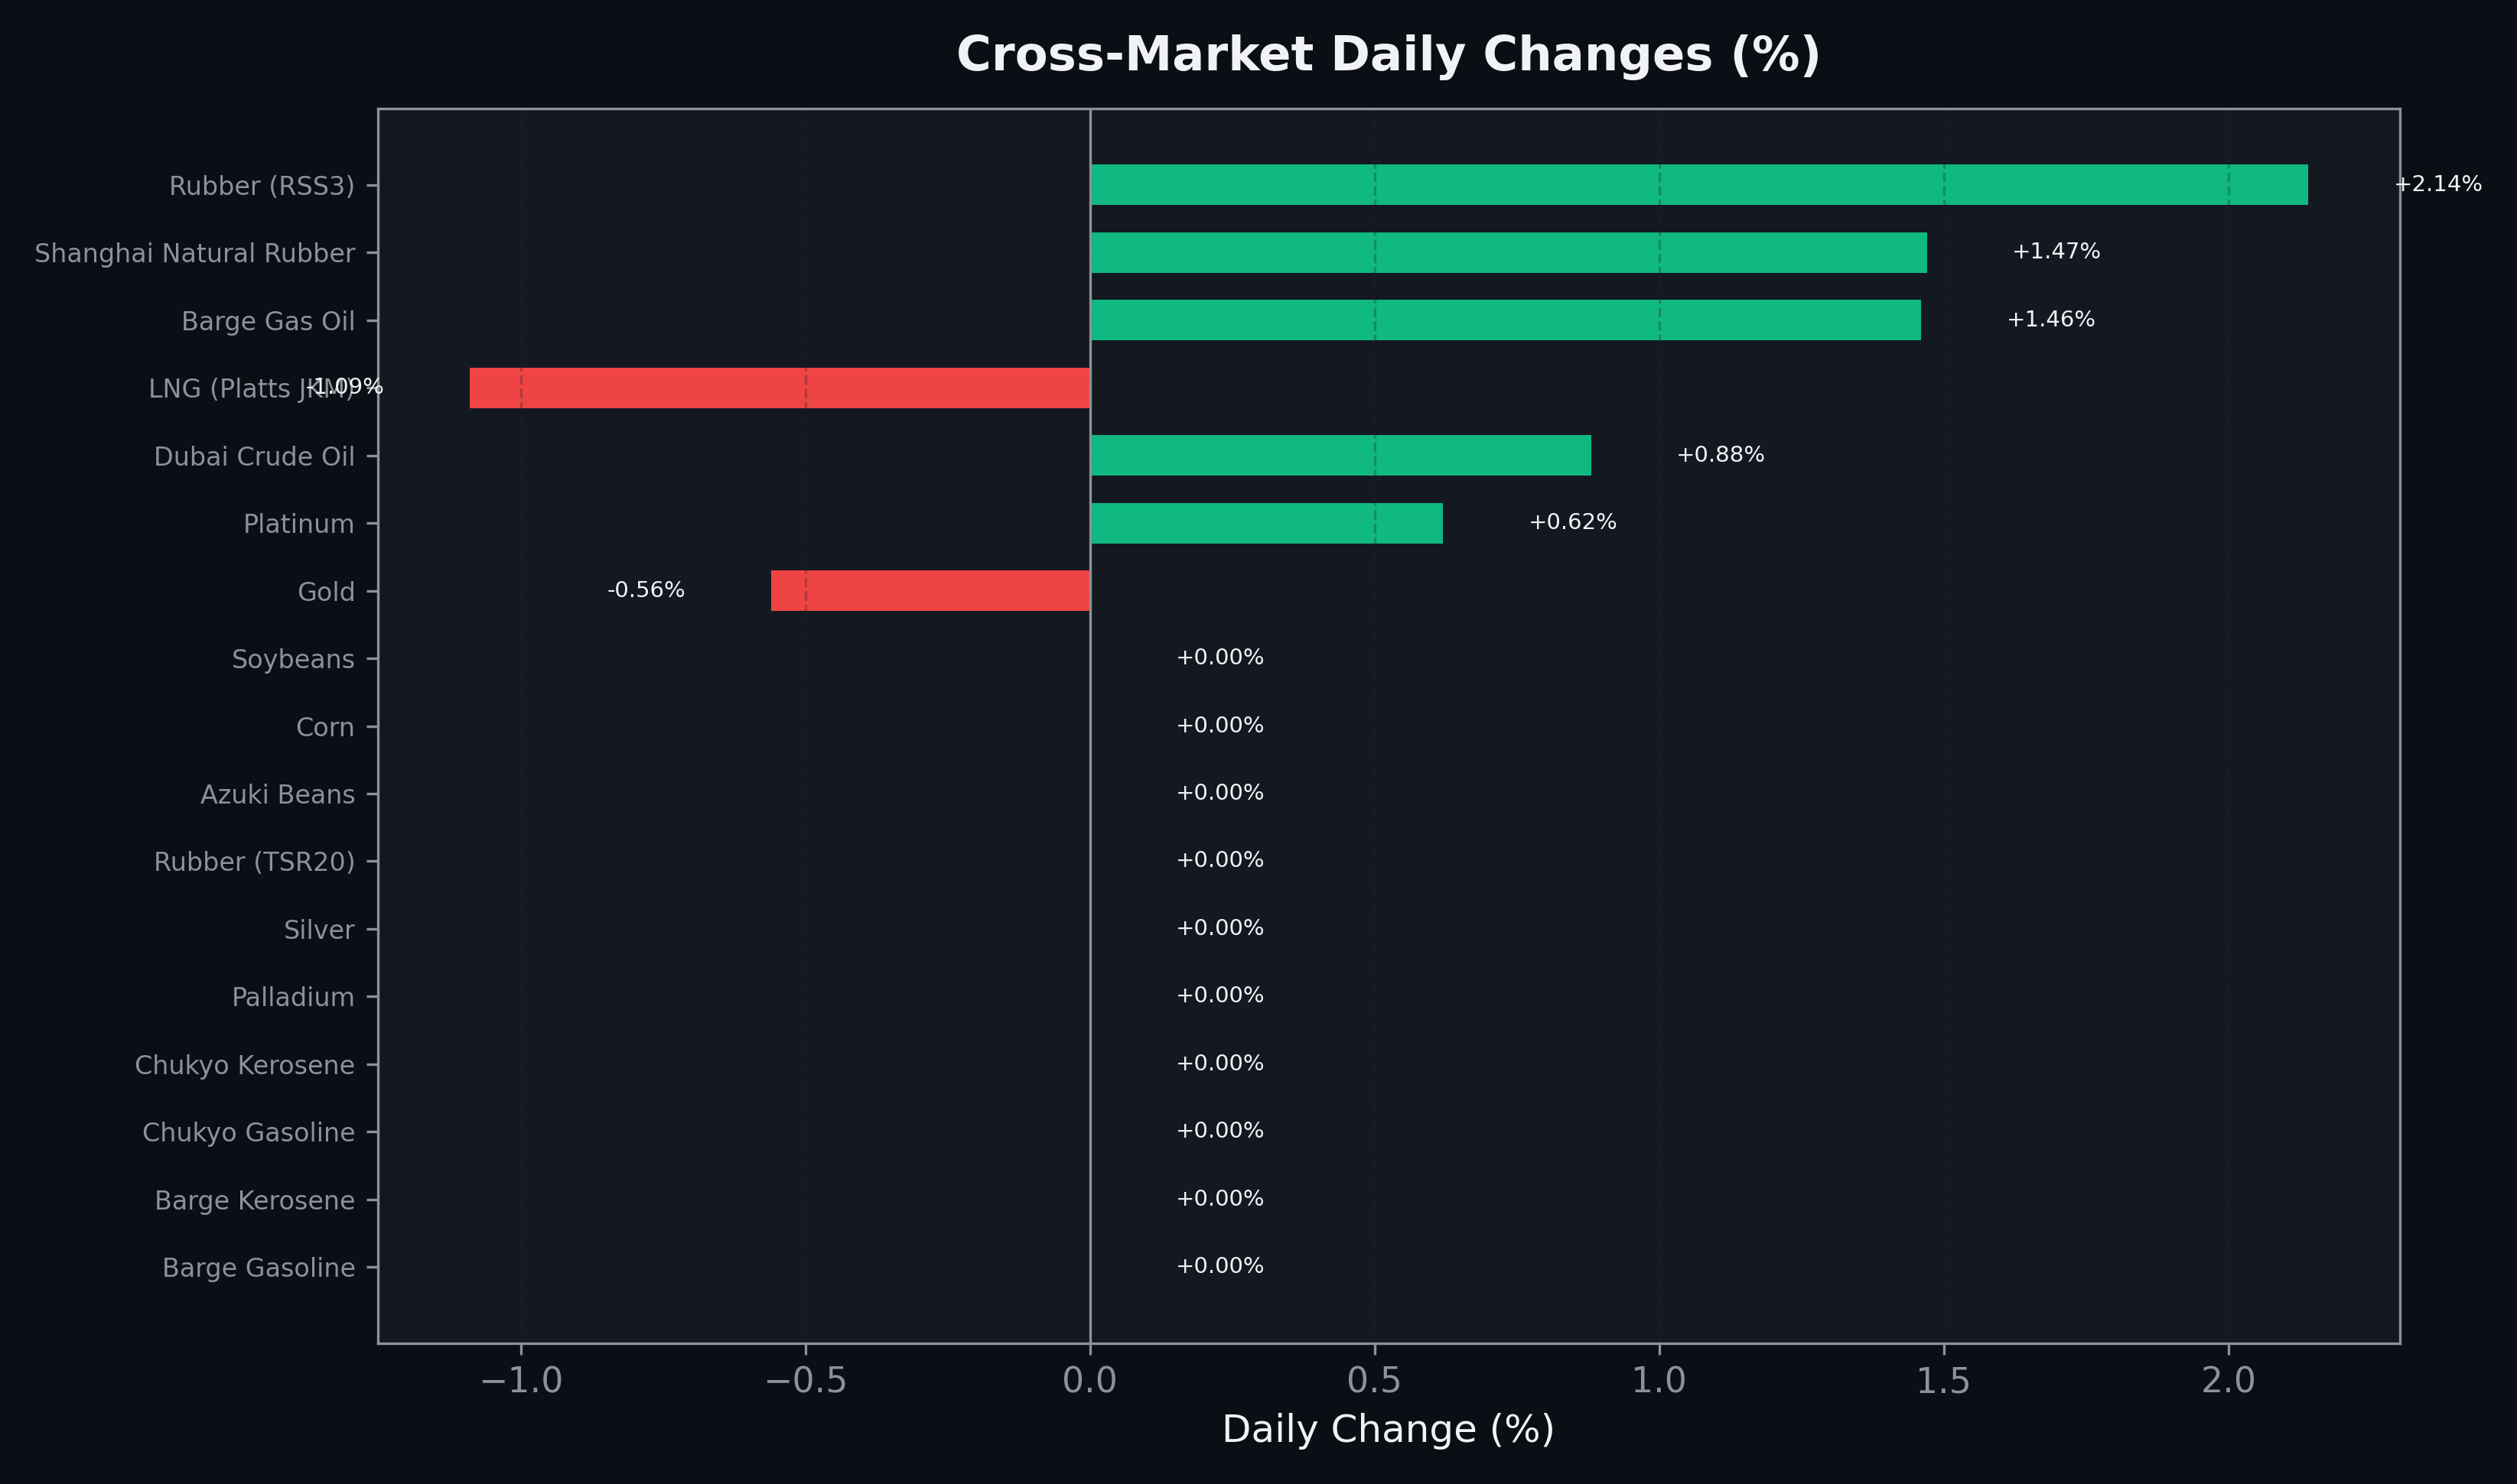
Cross-Market Daily Changes
All commodities sorted by absolute % change

Slide 7
Top Power Futures Movers
Largest absolute settlement price changes vs previous day (2026-05-27)
Instrument | Underlying | Month | Price | Prev | Change | % Chg
FUT_EWPW_260528 | Power West Peak (Weekly) | 20260529 | 22.04 | 19.81 | +2.23 | +11.26%
FUT_EEPW_260528 | Power East Peak (Weekly) | 20260529 | 25.70 | 23.83 | +1.87 | +7.85%
FUT_ECP_260730 | 電力(中部・日中) | 202607 | 28.03 | 26.94 | +1.09 | +4.05%
FUT_EWB_260730 | Power West Base (Monthly) | 202607 | 20.25 | 19.23 | +1.02 | +5.30%
FUT_EWBW_260528 | Power West Base (Weekly) | 20260529 | 17.96 | 17.05 | +0.91 | +5.34%
FUT_EWPW_260625 | Power West Peak (Weekly) | 20260626 | 21.99 | 21.13 | +0.86 | +4.07%
FUT_ECB_260730 | 電力(中部・ベース) | 202607 | 22.22 | 21.44 | +0.78 | +3.64%
FUT_EEB_260730 | Power East Base (Monthly) | 202607 | 23.17 | 22.39 | +0.78 | +3.48%
FUT_EWPW_260604 | Power West Peak (Weekly) | 20260605 | 21.17 | 20.47 | +0.70 | +3.42%
FUT_EEBW_260528 | Power East Base (Weekly) | 20260529 | 21.48 | 20.81 | +0.67 | +3.22%
FUT_EEPW_260604 | Power East Peak (Weekly) | 20260605 | 24.45 | 23.78 | +0.67 | +2.82%
FUT_EEB_270428 | Power East Base (Monthly) | 202704 | 15.66 | 15.02 | +0.64 | +4.26%
FUT_EWBW_260625 | Power West Base (Weekly) | 20260626 | 17.67 | 17.05 | +0.62 | +3.64%
FUT_EWP_260528 | Power West Peak (Monthly) | 202605 | 19.38 | 18.77 | +0.61 | +3.25%
FUT_EWPW_260618 | Power West Peak (Weekly) | 20260619 | 21.19 | 20.58 | +0.61 | +2.96%

