Slide 1
Daily Market Report
Trade Date: 2026-05-29
JPX Derivative & Commodity Analytics
DataServer In-House

Slide 2
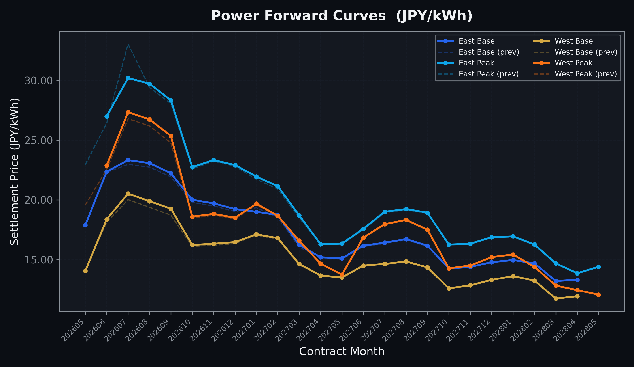
Power Forward Curves
East/West Base & Peak monthly contracts (2026-05-29)

Slide 3
Commodity Snapshot
Front-month settlement prices as of 2026-05-29
Category | Asset | Contract | Settlement | Unit | Change | % Chg
Energy | Barge Gas Oil | 202607 | 110,900.00 | JPY/kl | +0.00 | +0.00%
Energy | Barge Gasoline | 202607 | 100,000.00 | JPY/kl | +0.00 | +0.00%
Energy | Barge Kerosene | 202607 | 105,000.00 | JPY/kl | +0.00 | +0.00%
Energy | Chukyo Gasoline | 202607 | 95,000.00 | JPY/kl | +0.00 | +0.00%
Energy | Chukyo Kerosene | 202607 | 105,000.00 | JPY/kl | +0.00 | +0.00%
Energy | Dubai Crude Oil | 202605 | 101,650.00 | JPY/kl | +0.00 | +0.00%
Energy | LNG (Platts JKM) | 202607 | 2,928.00 | USD/MMBtu | +19.00 | +0.65%
Metals | Gold | - | 23,070.00 | JPY/g | +566.00 | +2.52%
Metals | Palladium | 202606 | 7,000.00 | JPY/g | +0.00 | +0.00%
Metals | Platinum | - | 9,645.00 | JPY/g | +114.00 | +1.20%
Metals | Silver | 202606 | 390.00 | JPY/10g | +0.00 | +0.00%
Industrial | Rubber (RSS3) | 202606 | 408.50 | JPY/kg | +8.50 | +2.12%
Industrial | Rubber (TSR20) | 202606 | 350.00 | JPY/kg | +0.00 | +0.00%
Industrial | Shanghai Natural Rubber | 202609 | 18,000.00 | JPY/kg | +50.00 | +0.28%
Agriculture | Azuki Beans | 202606 | 12,300.00 | JPY/bag | +0.00 | +0.00%
Agriculture | Corn | 202607 | 39,000.00 | JPY/t | +0.00 | +0.00%
Agriculture | Soybeans | 202606 | 64,000.00 | JPY/t | +0.00 | +0.00%

Slide 4
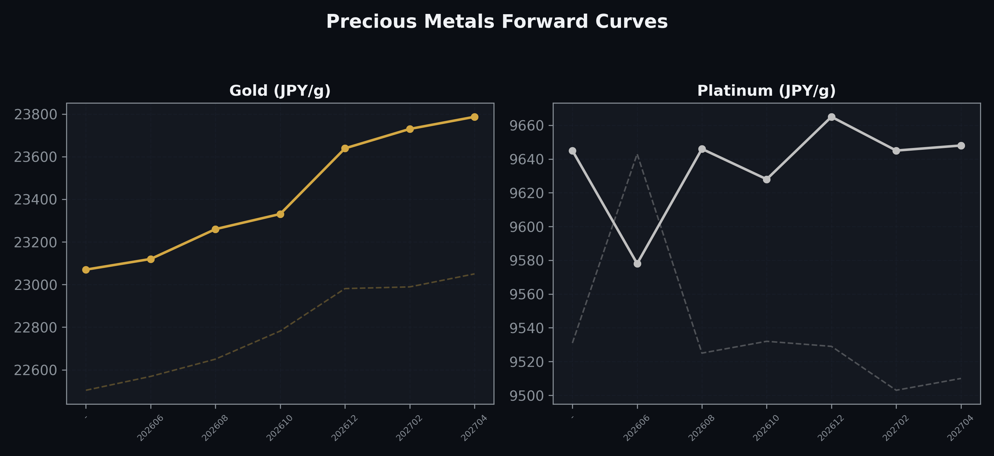
Precious Metals Forward Curves
Gold & Platinum (2026-05-29)

Slide 5
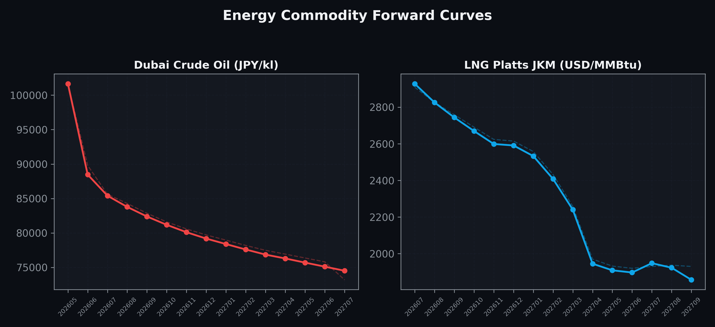
Energy Commodity Forward Curves
Dubai Crude Oil & LNG Platts JKM (2026-05-29)

Slide 6
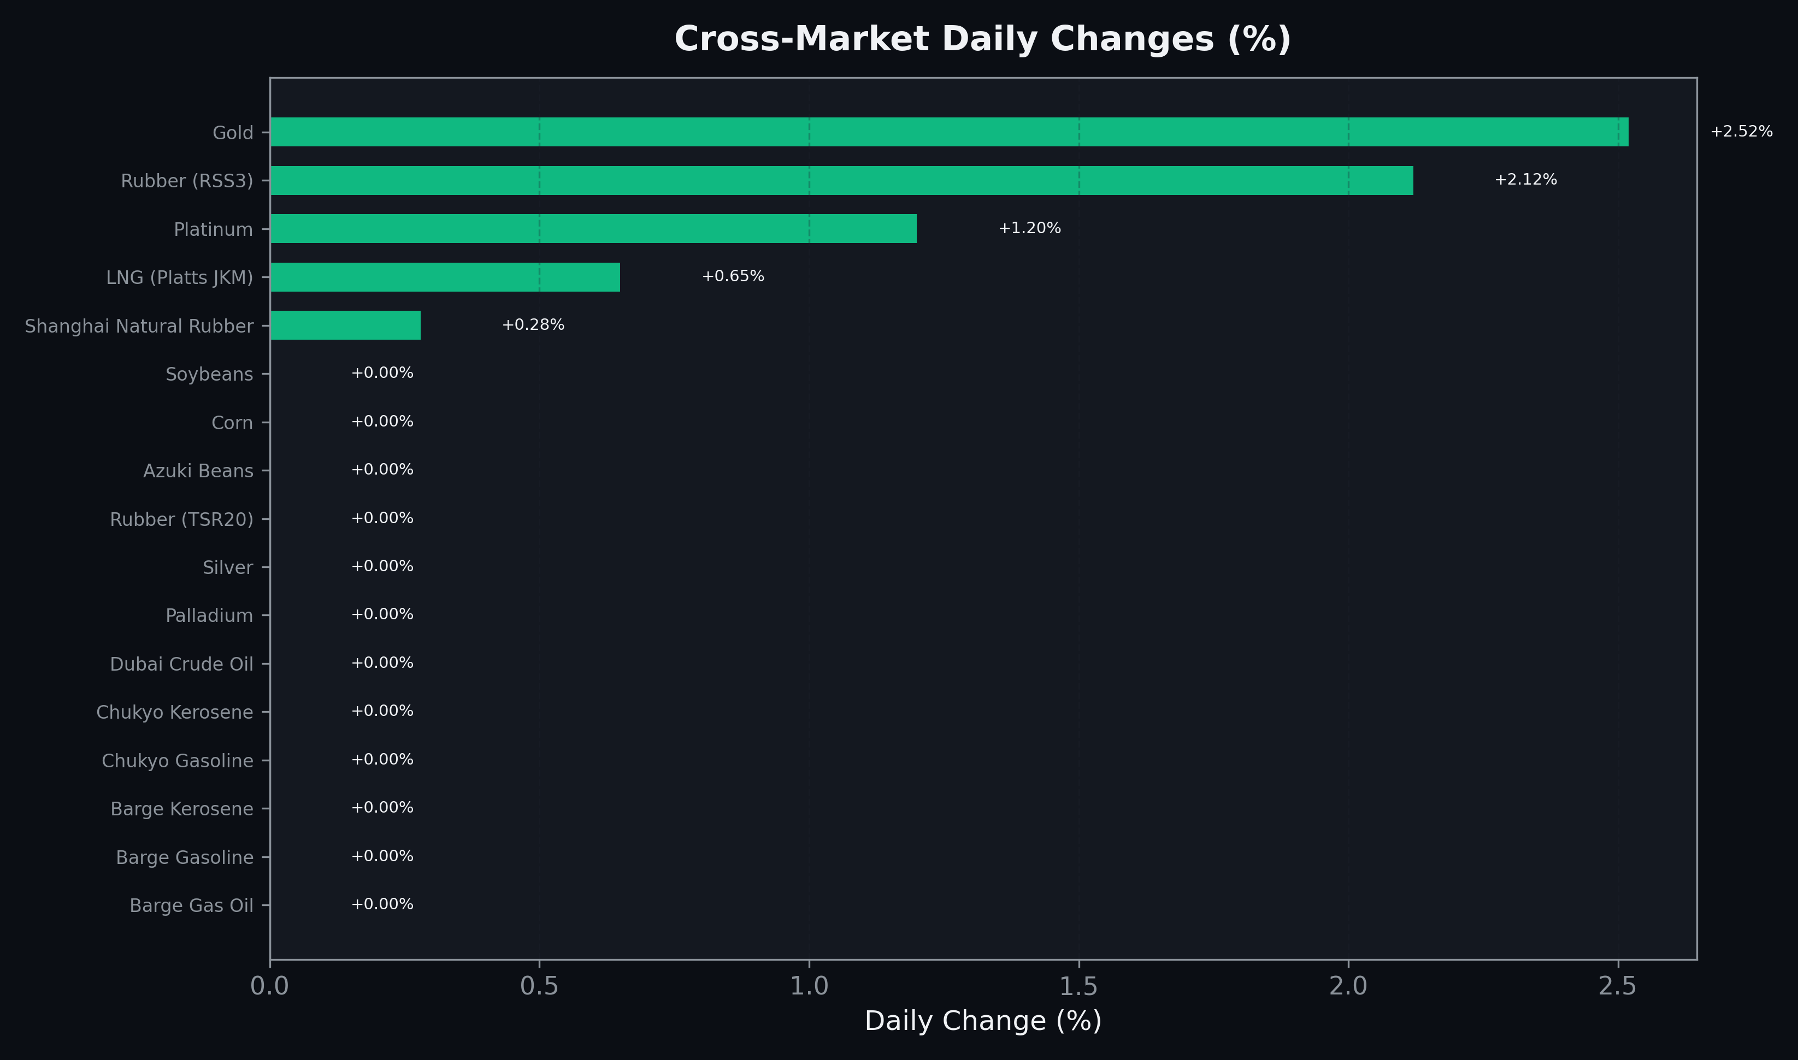
Cross-Market Daily Changes
All commodities sorted by absolute % change

Slide 7
Top Power Futures Movers
Largest absolute settlement price changes vs previous day (2026-05-29)
Instrument | Underlying | Month | Price | Prev | Change | % Chg
FUT_EEP_260730 | Power East Peak (Monthly) | 202607 | 30.20 | 33.05 | -2.85 | -8.62%
FUT_EEPW_260618 | Power East Peak (Weekly) | 20260619 | 25.38 | 24.71 | +0.67 | +2.71%
FUT_EEPW_260611 | Power East Peak (Weekly) | 20260612 | 25.20 | 24.56 | +0.64 | +2.61%
FUT_EEPW_260625 | Power East Peak (Weekly) | 20260626 | 26.10 | 25.48 | +0.62 | +2.43%
FUT_EWP_260929 | Power West Peak (Monthly) | 202609 | 25.36 | 24.77 | +0.59 | +2.38%
FUT_EEPW_260604 | Power East Peak (Weekly) | 20260605 | 25.51 | 24.93 | +0.58 | +2.33%
FUT_EEP_260629 | Power East Peak (Monthly) | 202606 | 27.00 | 26.43 | +0.57 | +2.16%
FUT_EWP_260730 | Power West Peak (Monthly) | 202607 | 27.35 | 26.79 | +0.56 | +2.09%
FUT_EWB_260929 | Power West Base (Monthly) | 202609 | 19.27 | 18.72 | +0.55 | +2.94%
FUT_EWP_260828 | Power West Peak (Monthly) | 202608 | 26.74 | 26.20 | +0.54 | +2.06%
FUT_EWB_260730 | Power West Base (Monthly) | 202607 | 20.53 | 20.02 | +0.51 | +2.55%
FUT_EWB_260828 | Power West Base (Monthly) | 202608 | 19.89 | 19.39 | +0.50 | +2.58%
FUT_EWPW_260618 | Power West Peak (Weekly) | 20260619 | 22.33 | 21.84 | +0.49 | +2.24%
FUT_EEBW_260625 | Power East Base (Weekly) | 20260626 | 22.48 | 22.00 | +0.48 | +2.18%
FUT_ECB_260629 | 電力(中部・ベース) | 202606 | 20.76 | 20.31 | +0.45 | +2.22%

