Slide 1
Daily Market Report
Trade Date: 2026-07-01
JPX Derivative & Commodity Analytics
DataServer In-House

Slide 2
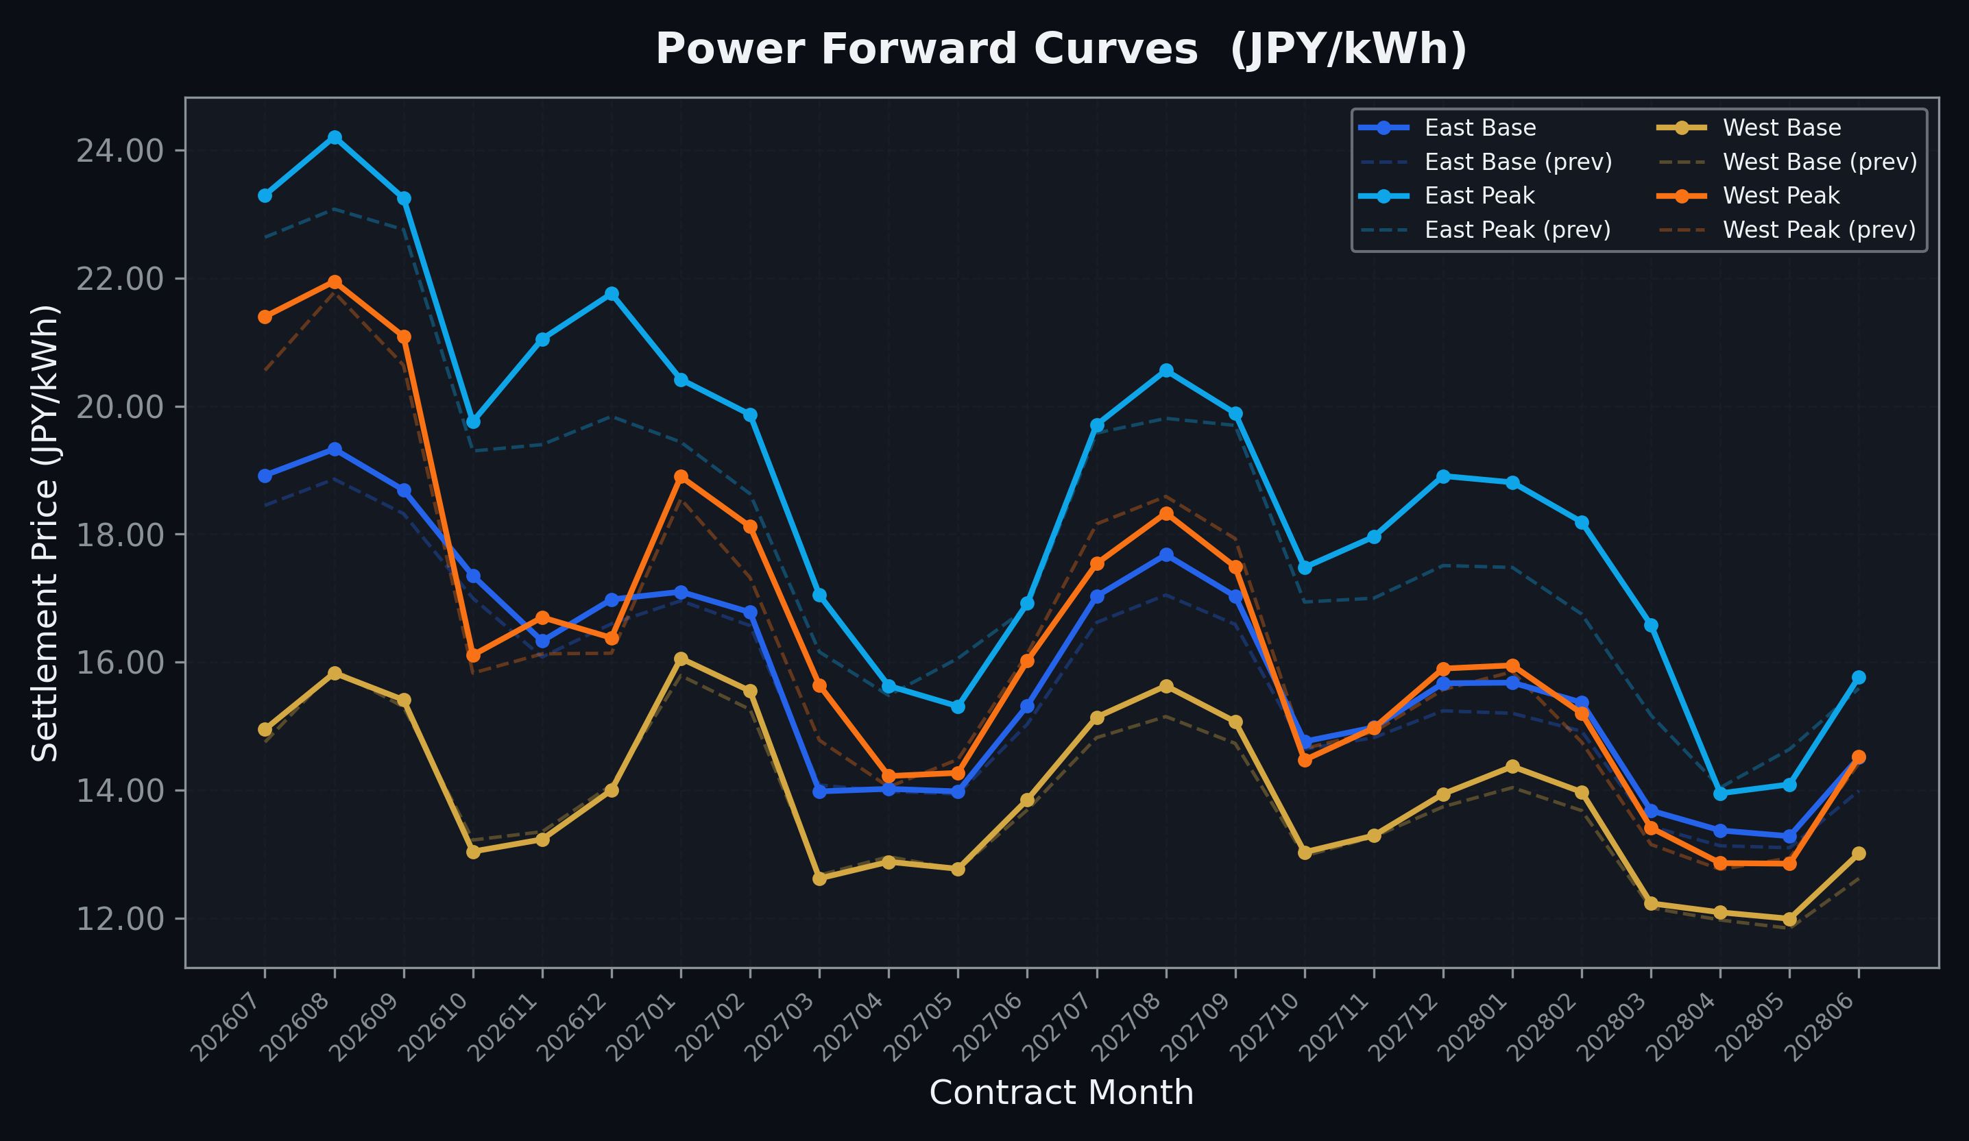
Power Forward Curves
East/West Base & Peak monthly contracts (2026-07-01)

Slide 3
Commodity Snapshot
Front-month settlement prices as of 2026-07-01
Category | Asset | Contract | Settlement | Unit | Change | % Chg
Energy | Barge Gas Oil | 202608 | 105,500.00 | JPY/kl | +100.00 | +0.09%
Energy | Barge Gasoline | 202608 | 97,000.00 | JPY/kl | +0.00 | +0.00%
Energy | Barge Kerosene | 202608 | 108,000.00 | JPY/kl | +0.00 | +0.00%
Energy | Chukyo Gasoline | 202608 | 95,000.00 | JPY/kl | +0.00 | +0.00%
Energy | Chukyo Kerosene | 202608 | 105,000.00 | JPY/kl | +0.00 | +0.00%
Energy | Dubai Crude Oil | 202607 | 70,440.00 | JPY/kl | -9710.00 | -12.11%
Energy | LNG (Platts JKM) | 202608 | 2,637.00 | USD/MMBtu | +57.00 | +2.21%
Metals | Gold | - | 20,802.00 | JPY/g | -413.00 | -1.95%
Metals | Palladium | 202608 | 6,400.00 | JPY/g | +0.00 | +0.00%
Metals | Platinum | - | 8,027.00 | JPY/g | -198.00 | -2.41%
Metals | Silver | 202608 | 300.00 | JPY/10g | +0.00 | +0.00%
Industrial | Rubber (RSS3) | 202607 | 406.80 | JPY/kg | +0.80 | +0.20%
Industrial | Rubber (TSR20) | 202608 | 340.00 | JPY/kg | +0.00 | +0.00%
Industrial | Shanghai Natural Rubber | 202609 | 16,450.00 | JPY/kg | -270.00 | -1.61%
Agriculture | Azuki Beans | 202607 | 12,300.00 | JPY/bag | +0.00 | +0.00%
Agriculture | Corn | 202609 | 39,000.00 | JPY/t | +0.00 | +0.00%
Agriculture | Soybeans | 202608 | 64,000.00 | JPY/t | +0.00 | +0.00%

Slide 4
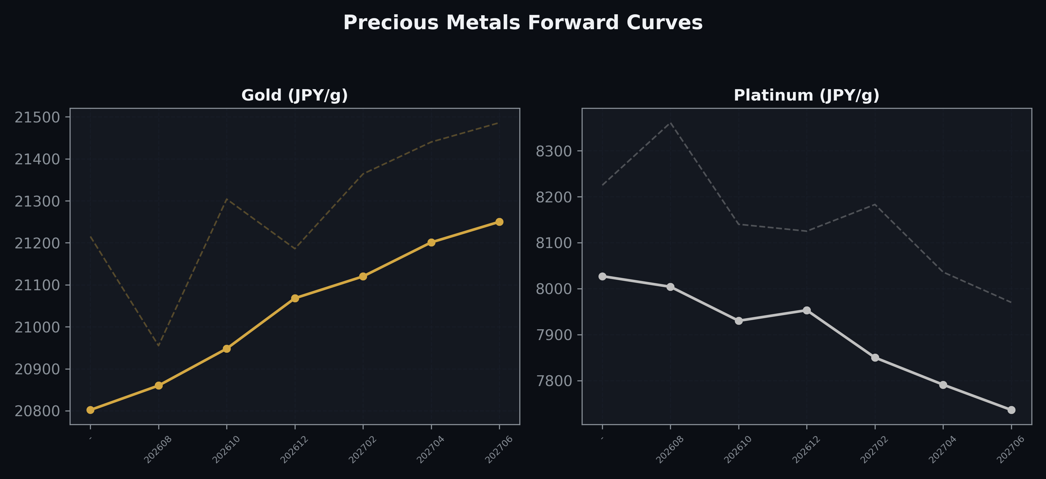
Precious Metals Forward Curves
Gold & Platinum (2026-07-01)

Slide 5
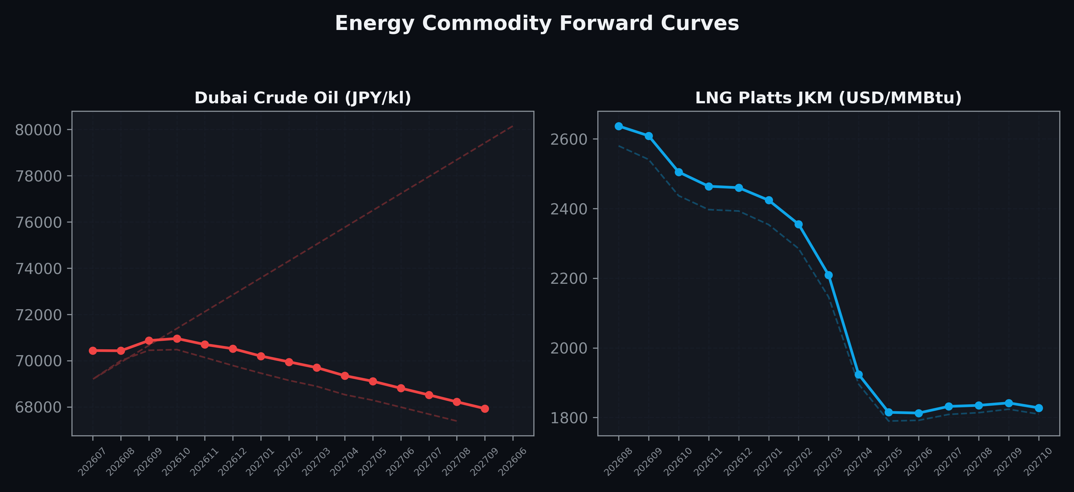
Energy Commodity Forward Curves
Dubai Crude Oil & LNG Platts JKM (2026-07-01)

Slide 6
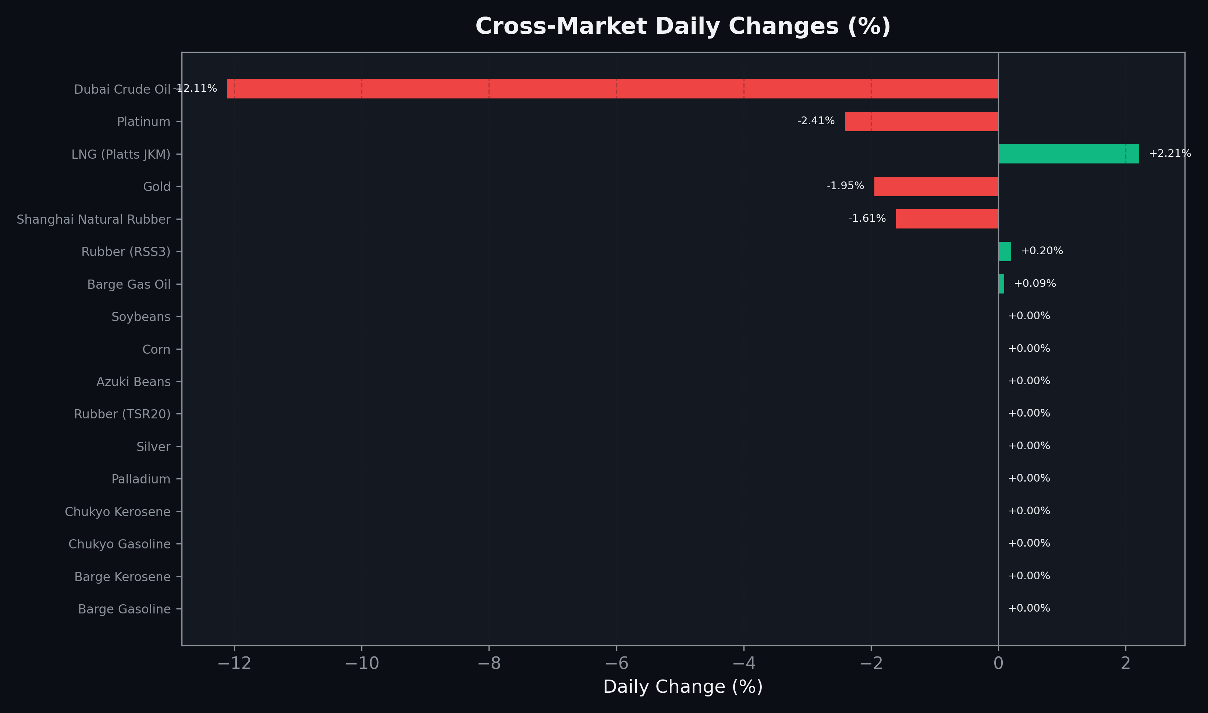
Cross-Market Daily Changes
All commodities sorted by absolute % change

Slide 7
Top Power Futures Movers
Largest absolute settlement price changes vs previous day (2026-07-01)
Instrument | Underlying | Month | Price | Prev | Change | % Chg
FUT_EEP_261228 | Power East Peak (Monthly) | 202612 | 21.76 | 19.84 | +1.92 | +9.68%
FUT_EEP_261127 | Power East Peak (Monthly) | 202611 | 21.05 | 19.40 | +1.65 | +8.51%
FUT_ECP_280228 | 電力(中部・日中) | 202802 | 17.09 | 15.61 | +1.48 | +9.48%
FUT_EEP_280228 | Power East Peak (Monthly) | 202802 | 18.19 | 16.75 | +1.44 | +8.60%
FUT_EEP_280330 | Power East Peak (Monthly) | 202803 | 16.58 | 15.17 | +1.41 | +9.29%
FUT_EEP_271228 | Power East Peak (Monthly) | 202712 | 18.91 | 17.51 | +1.40 | +8.00%
FUT_EEP_280128 | Power East Peak (Monthly) | 202801 | 18.81 | 17.48 | +1.33 | +7.61%
FUT_ECP_280128 | 電力(中部・日中) | 202801 | 17.68 | 16.40 | +1.28 | +7.80%
FUT_ECP_280330 | 電力(中部・日中) | 202803 | 15.26 | 14.00 | +1.26 | +9.00%
FUT_EEP_270225 | Power East Peak (Monthly) | 202702 | 19.87 | 18.63 | +1.24 | +6.66%
FUT_EEP_260828 | Power East Peak (Monthly) | 202608 | 24.21 | 23.08 | +1.13 | +4.90%
FUT_ECP_271228 | 電力(中部・日中) | 202712 | 17.42 | 16.30 | +1.12 | +6.87%
FUT_EEP_270128 | Power East Peak (Monthly) | 202701 | 20.42 | 19.44 | +0.98 | +5.04%
FUT_EEP_271129 | Power East Peak (Monthly) | 202711 | 17.96 | 17.00 | +0.96 | +5.65%
FUT_ECP_260828 | 電力(中部・日中) | 202608 | 23.58 | 22.69 | +0.89 | +3.92%

