Slide 1
Daily Market Report
Trade Date: 2026-06-10
JPX Derivative & Commodity Analytics
DataServer In-House

Slide 2
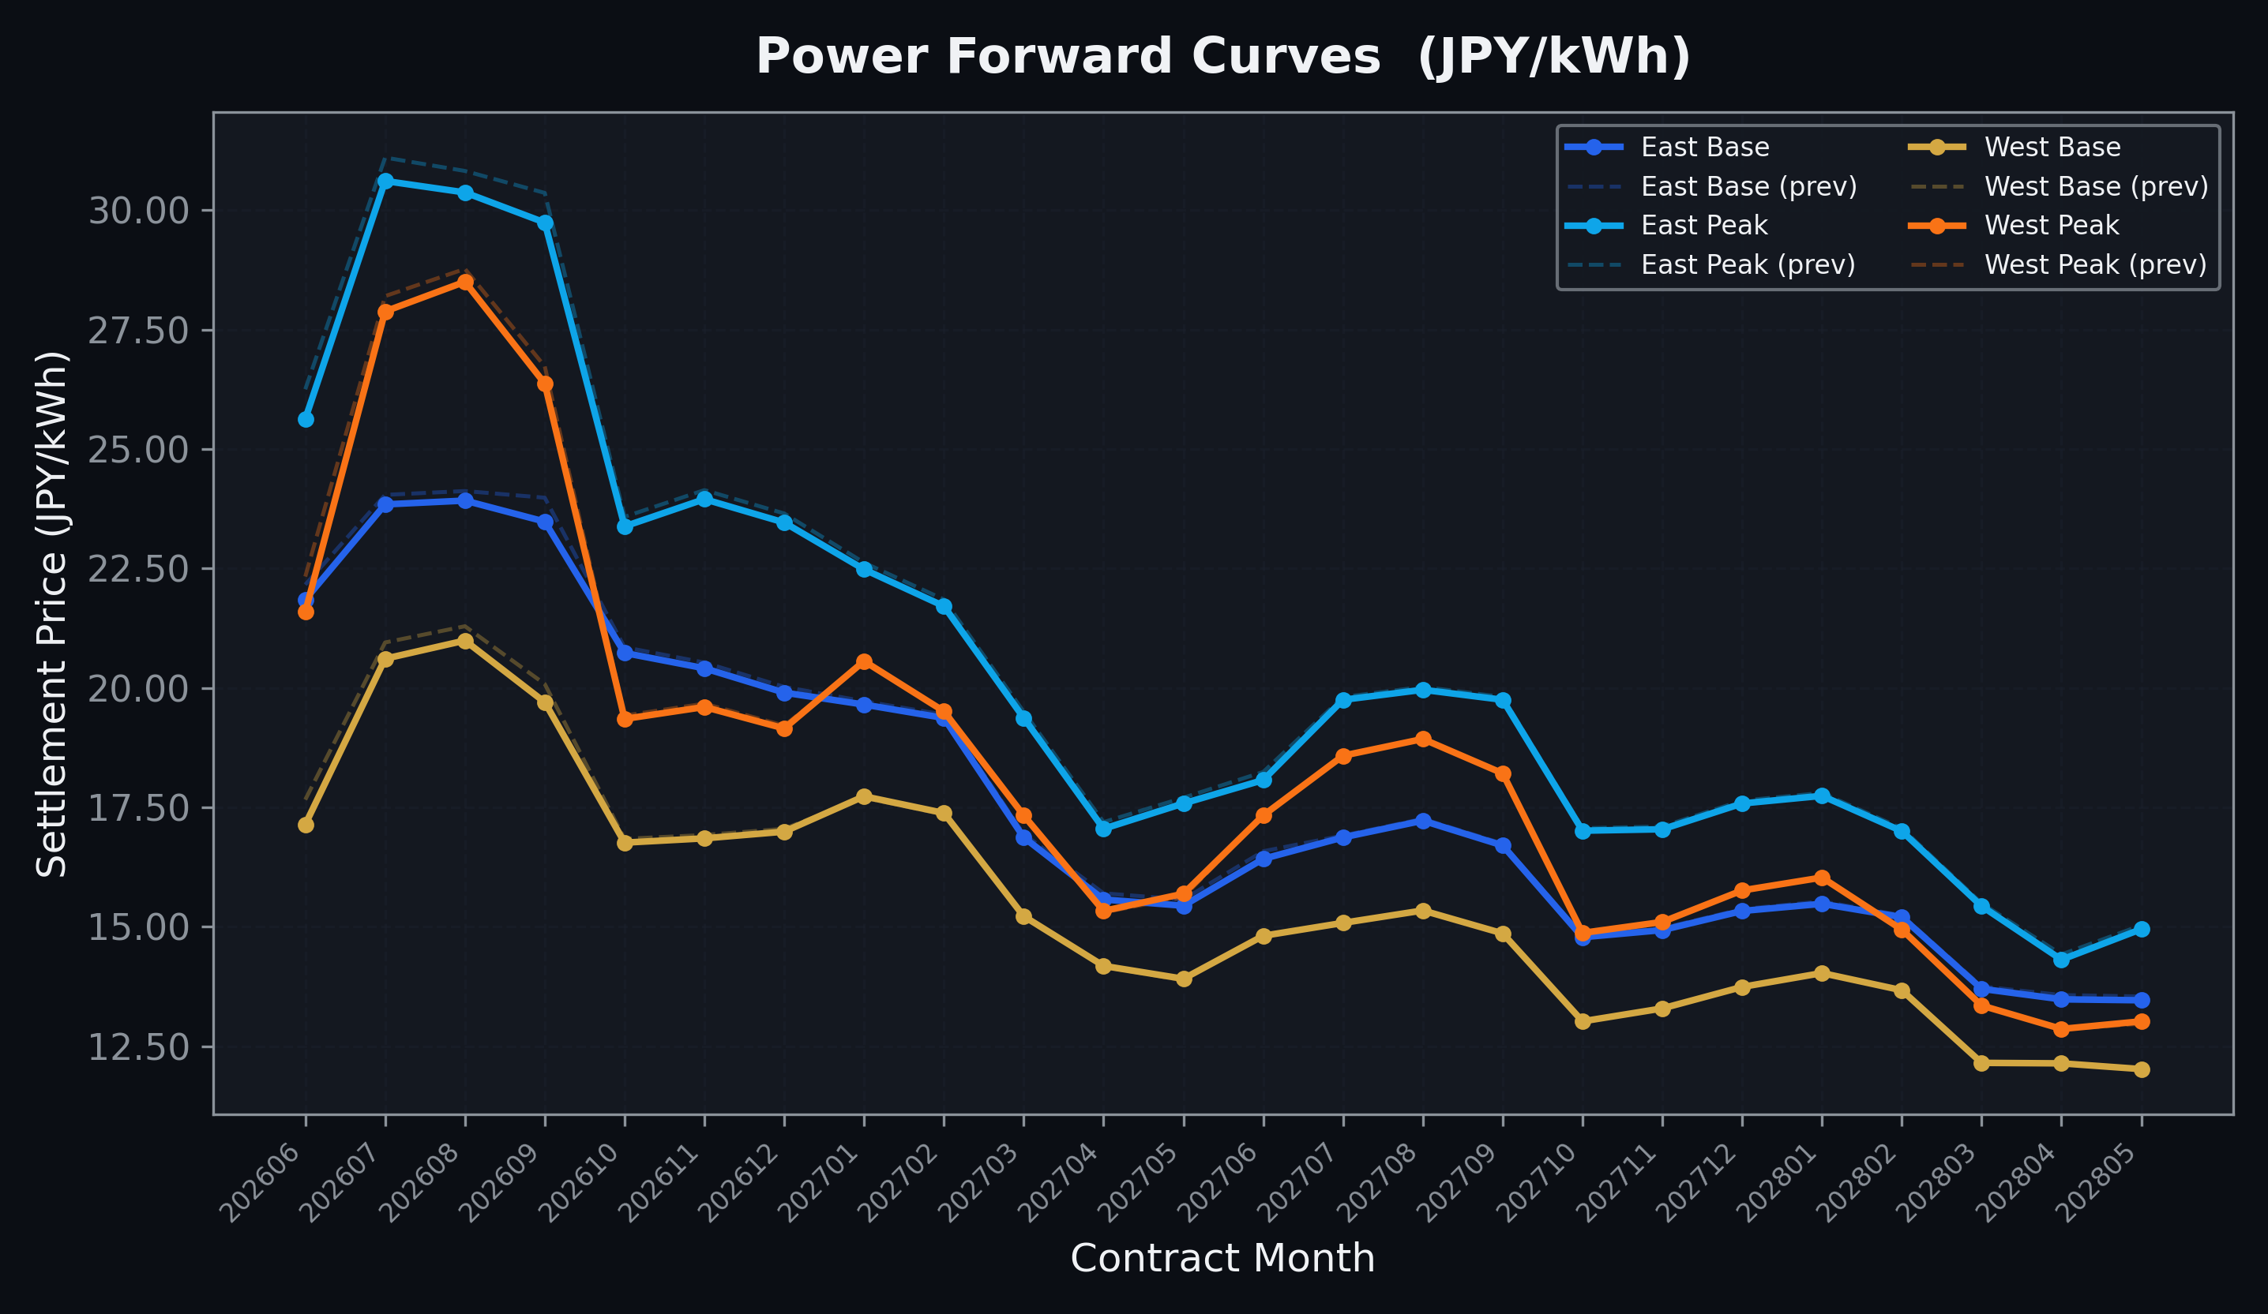
Power Forward Curves
East/West Base & Peak monthly contracts (2026-06-10)

Slide 3
Commodity Snapshot
Front-month settlement prices as of 2026-06-10
Category | Asset | Contract | Settlement | Unit | Change | % Chg
Energy | Barge Gas Oil | 202607 | 106,500.00 | JPY/kl | +0.00 | +0.00%
Energy | Barge Gasoline | 202607 | 100,000.00 | JPY/kl | +0.00 | +0.00%
Energy | Barge Kerosene | 202607 | 110,000.00 | JPY/kl | +0.00 | +0.00%
Energy | Chukyo Gasoline | 202607 | 95,000.00 | JPY/kl | +0.00 | +0.00%
Energy | Chukyo Kerosene | 202607 | 105,000.00 | JPY/kl | +0.00 | +0.00%
Energy | Dubai Crude Oil | 202606 | 89,880.00 | JPY/kl | -1420.00 | -1.56%
Energy | LNG (Platts JKM) | 202607 | 3,020.00 | USD/MMBtu | -14.00 | -0.46%
Metals | Gold | - | 21,596.00 | JPY/g | -686.00 | -3.08%
Metals | Palladium | 202606 | 6,300.00 | JPY/g | +0.00 | +0.00%
Metals | Platinum | - | 8,610.00 | JPY/g | -368.00 | -4.10%
Metals | Silver | 202606 | 335.00 | JPY/10g | -15.00 | -4.29%
Industrial | Rubber (RSS3) | 202606 | 407.60 | JPY/kg | -2.40 | -0.59%
Industrial | Rubber (TSR20) | 202607 | 360.00 | JPY/kg | +0.00 | +0.00%
Industrial | Shanghai Natural Rubber | 202609 | 17,510.00 | JPY/kg | -210.00 | -1.19%
Agriculture | Azuki Beans | 202606 | 12,300.00 | JPY/bag | +0.00 | +0.00%
Agriculture | Corn | 202607 | 39,000.00 | JPY/t | +0.00 | +0.00%
Agriculture | Soybeans | 202606 | 64,000.00 | JPY/t | +0.00 | +0.00%

Slide 4
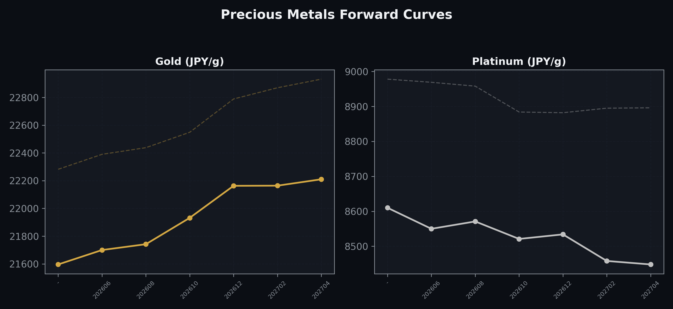
Precious Metals Forward Curves
Gold & Platinum (2026-06-10)

Slide 5
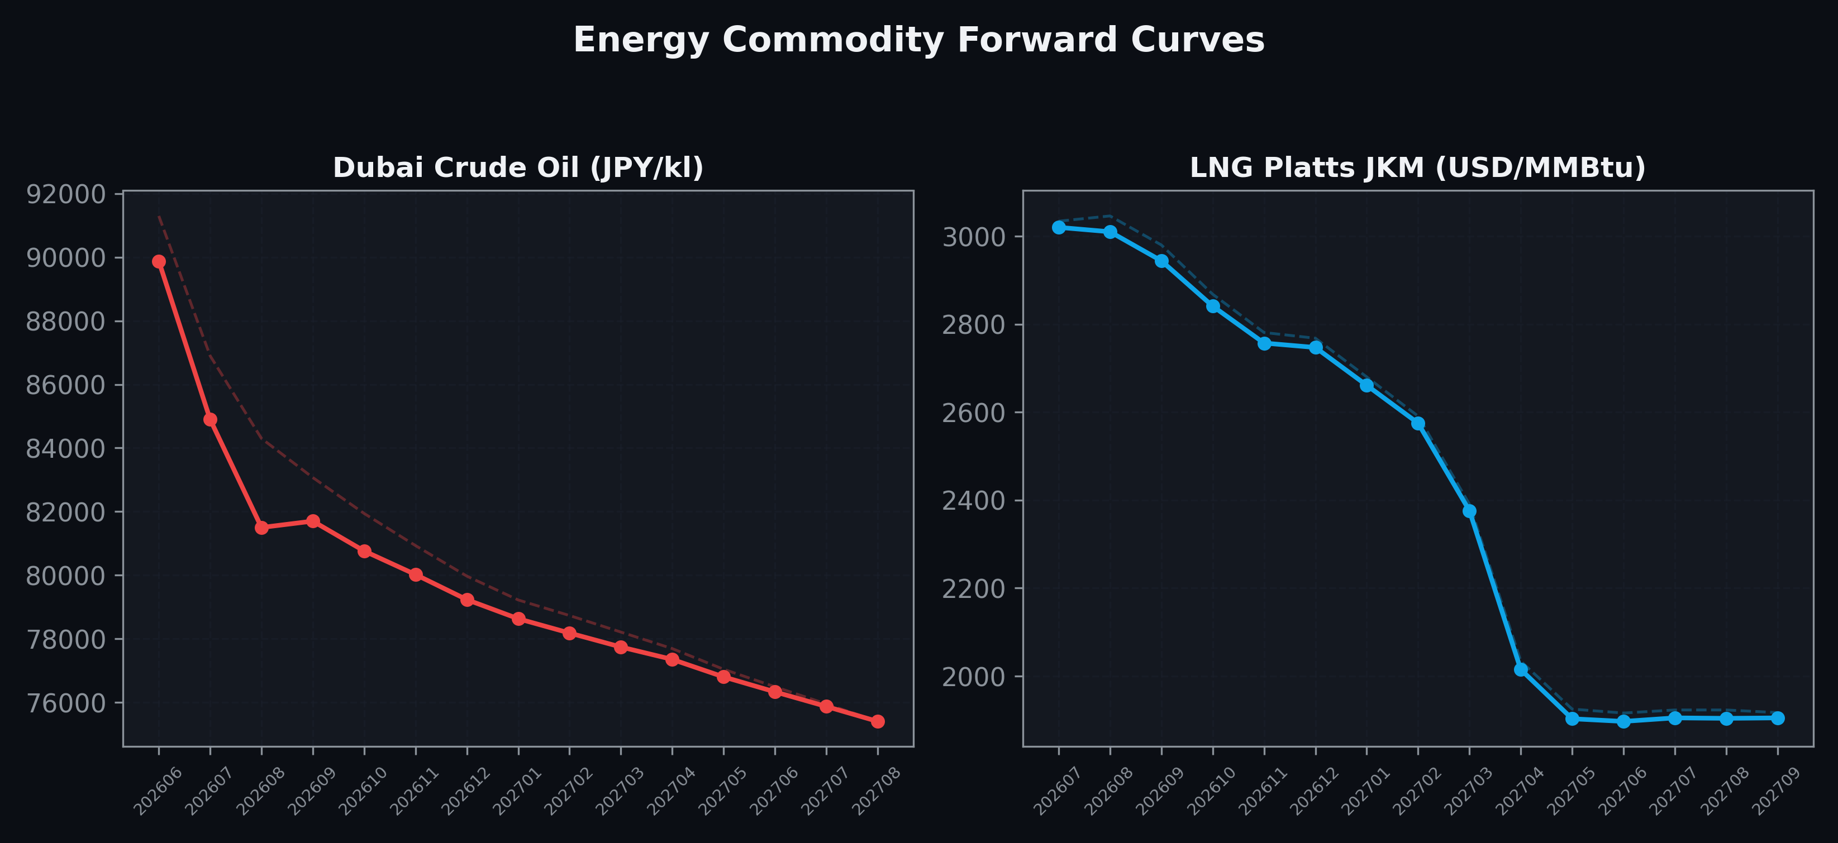
Energy Commodity Forward Curves
Dubai Crude Oil & LNG Platts JKM (2026-06-10)

Slide 6
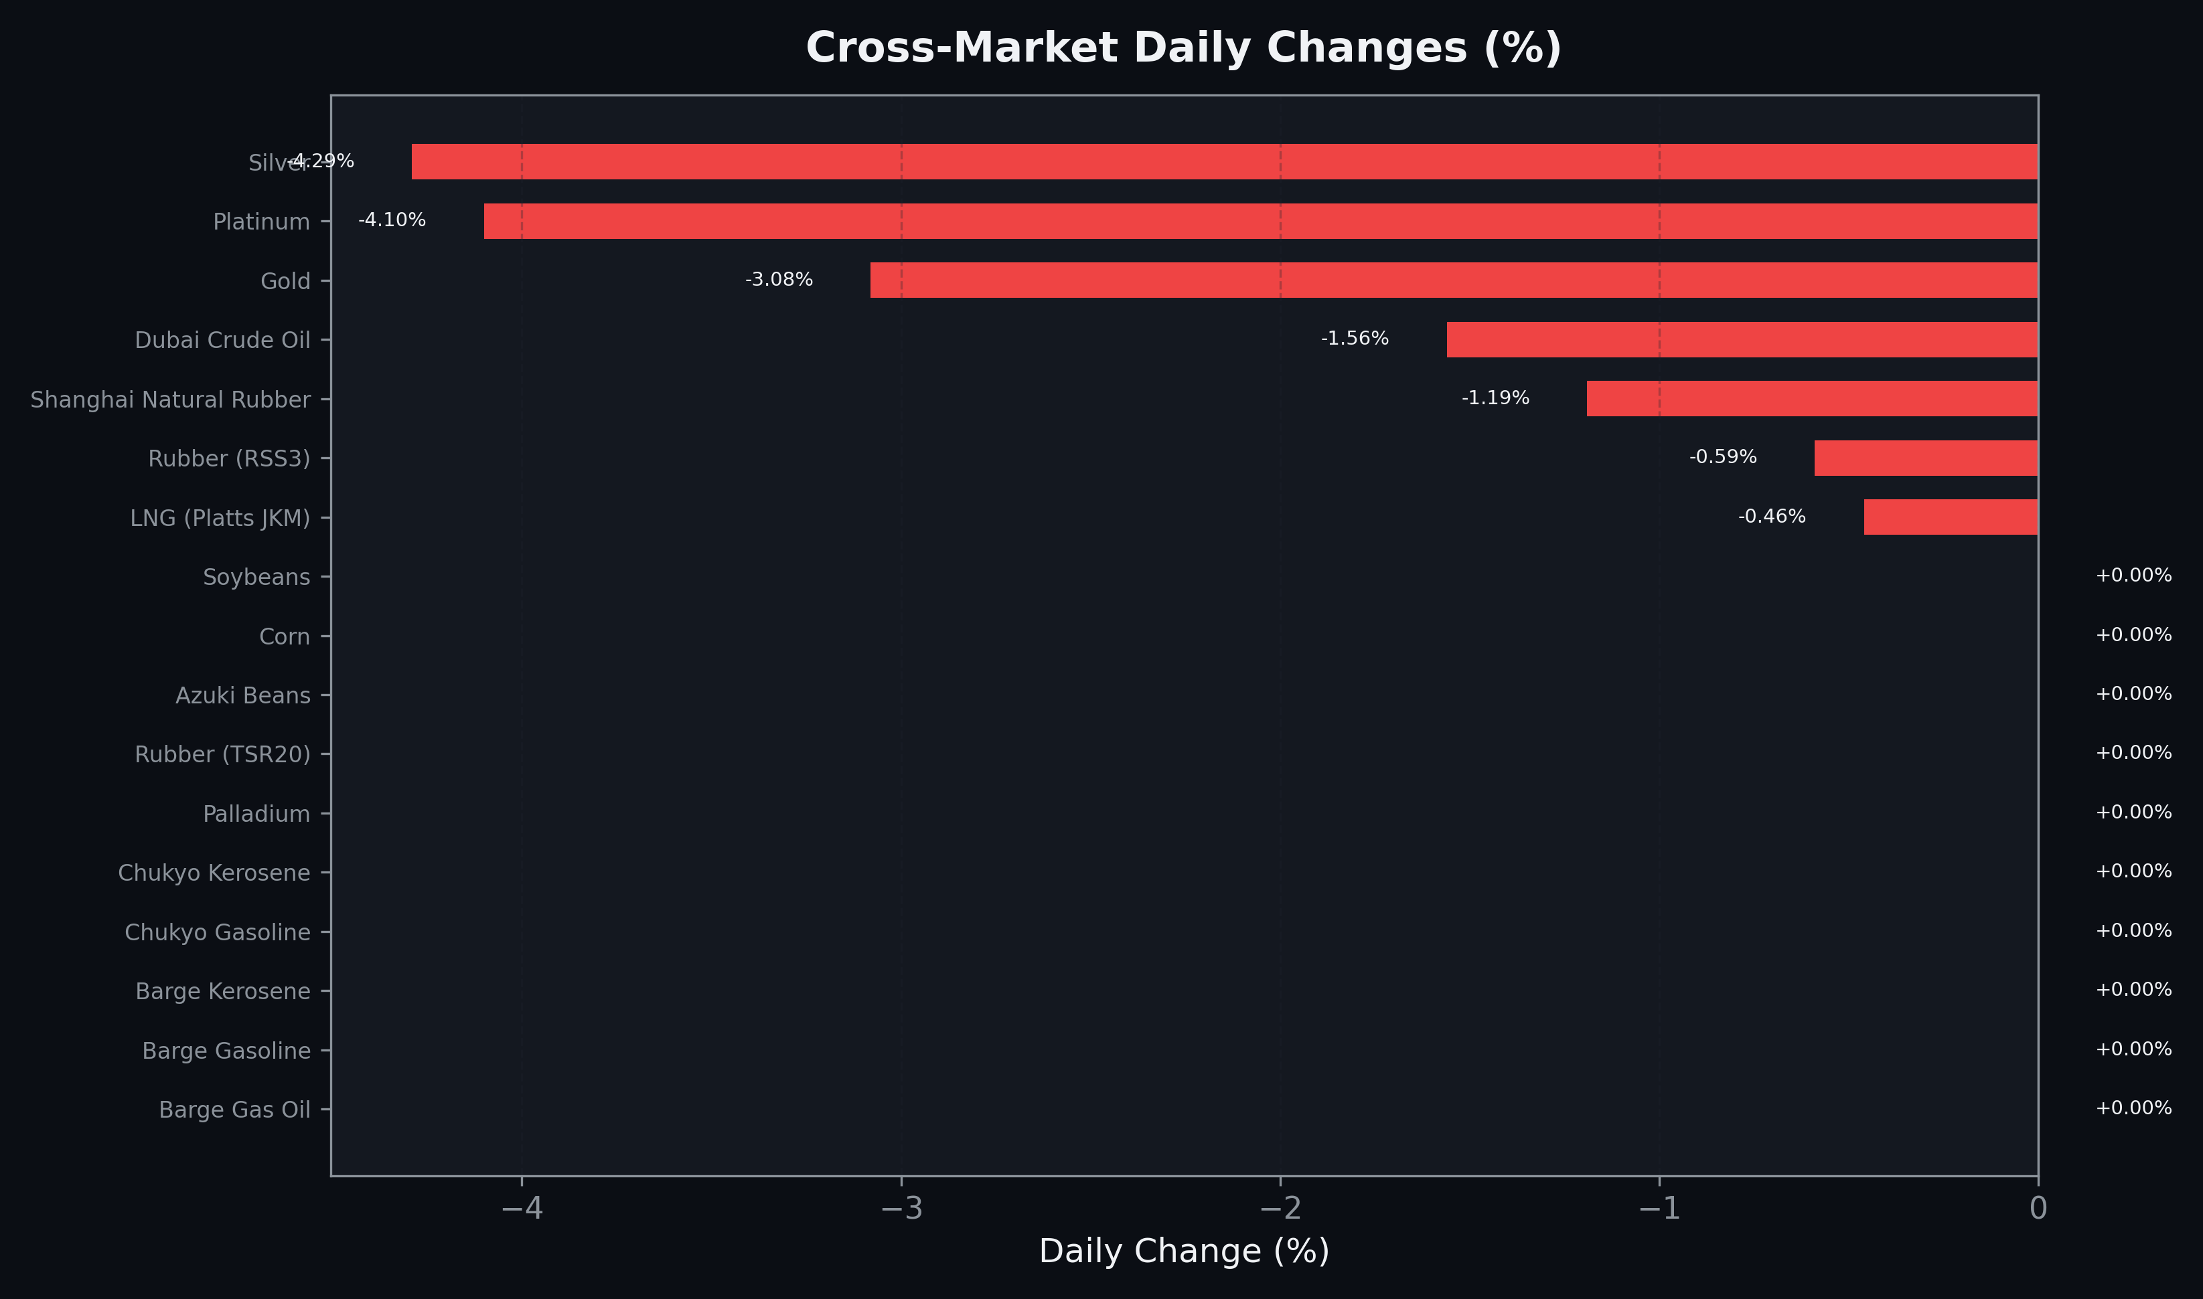
Cross-Market Daily Changes
All commodities sorted by absolute % change

Slide 7
Top Power Futures Movers
Largest absolute settlement price changes vs previous day (2026-06-10)
Instrument | Underlying | Month | Price | Prev | Change | % Chg
FUT_EWPW_260611 | Power West Peak (Weekly) | 20260612 | 17.59 | 19.57 | -1.98 | -10.12%
FUT_EEPW_260611 | Power East Peak (Weekly) | 20260612 | 23.90 | 25.01 | -1.11 | -4.44%
FUT_EWBW_260611 | Power West Base (Weekly) | 20260612 | 15.38 | 16.37 | -0.99 | -6.05%
FUT_EWPW_260618 | Power West Peak (Weekly) | 20260619 | 20.99 | 21.79 | -0.80 | -3.67%
FUT_EWP_260629 | Power West Peak (Monthly) | 202606 | 21.59 | 22.33 | -0.74 | -3.31%
FUT_EEPW_260625 | Power East Peak (Weekly) | 20260626 | 25.22 | 25.88 | -0.66 | -2.55%
FUT_EEP_260629 | Power East Peak (Monthly) | 202606 | 25.63 | 26.25 | -0.62 | -2.36%
FUT_EEP_260929 | Power East Peak (Monthly) | 202609 | 29.74 | 30.36 | -0.62 | -2.04%
FUT_EWBW_260618 | Power West Base (Weekly) | 20260619 | 17.29 | 17.87 | -0.58 | -3.25%
FUT_EWBW_260625 | Power West Base (Weekly) | 20260626 | 17.02 | 17.59 | -0.57 | -3.24%
FUT_ECP_260629 | 電力(中部・日中) | 202606 | 23.68 | 24.21 | -0.53 | -2.19%
FUT_EWB_260629 | Power West Base (Monthly) | 202606 | 17.14 | 17.66 | -0.52 | -2.94%
FUT_EWPW_260625 | Power West Peak (Weekly) | 20260626 | 21.89 | 22.41 | -0.52 | -2.32%
FUT_EEB_260929 | Power East Base (Monthly) | 202609 | 23.48 | 23.98 | -0.50 | -2.09%
FUT_EEP_260730 | Power East Peak (Monthly) | 202607 | 30.61 | 31.10 | -0.49 | -1.58%

