Slide 1
Daily Market Report
Trade Date: 2026-04-28
JPX Derivative & Commodity Analytics
DataServer In-House

Slide 2
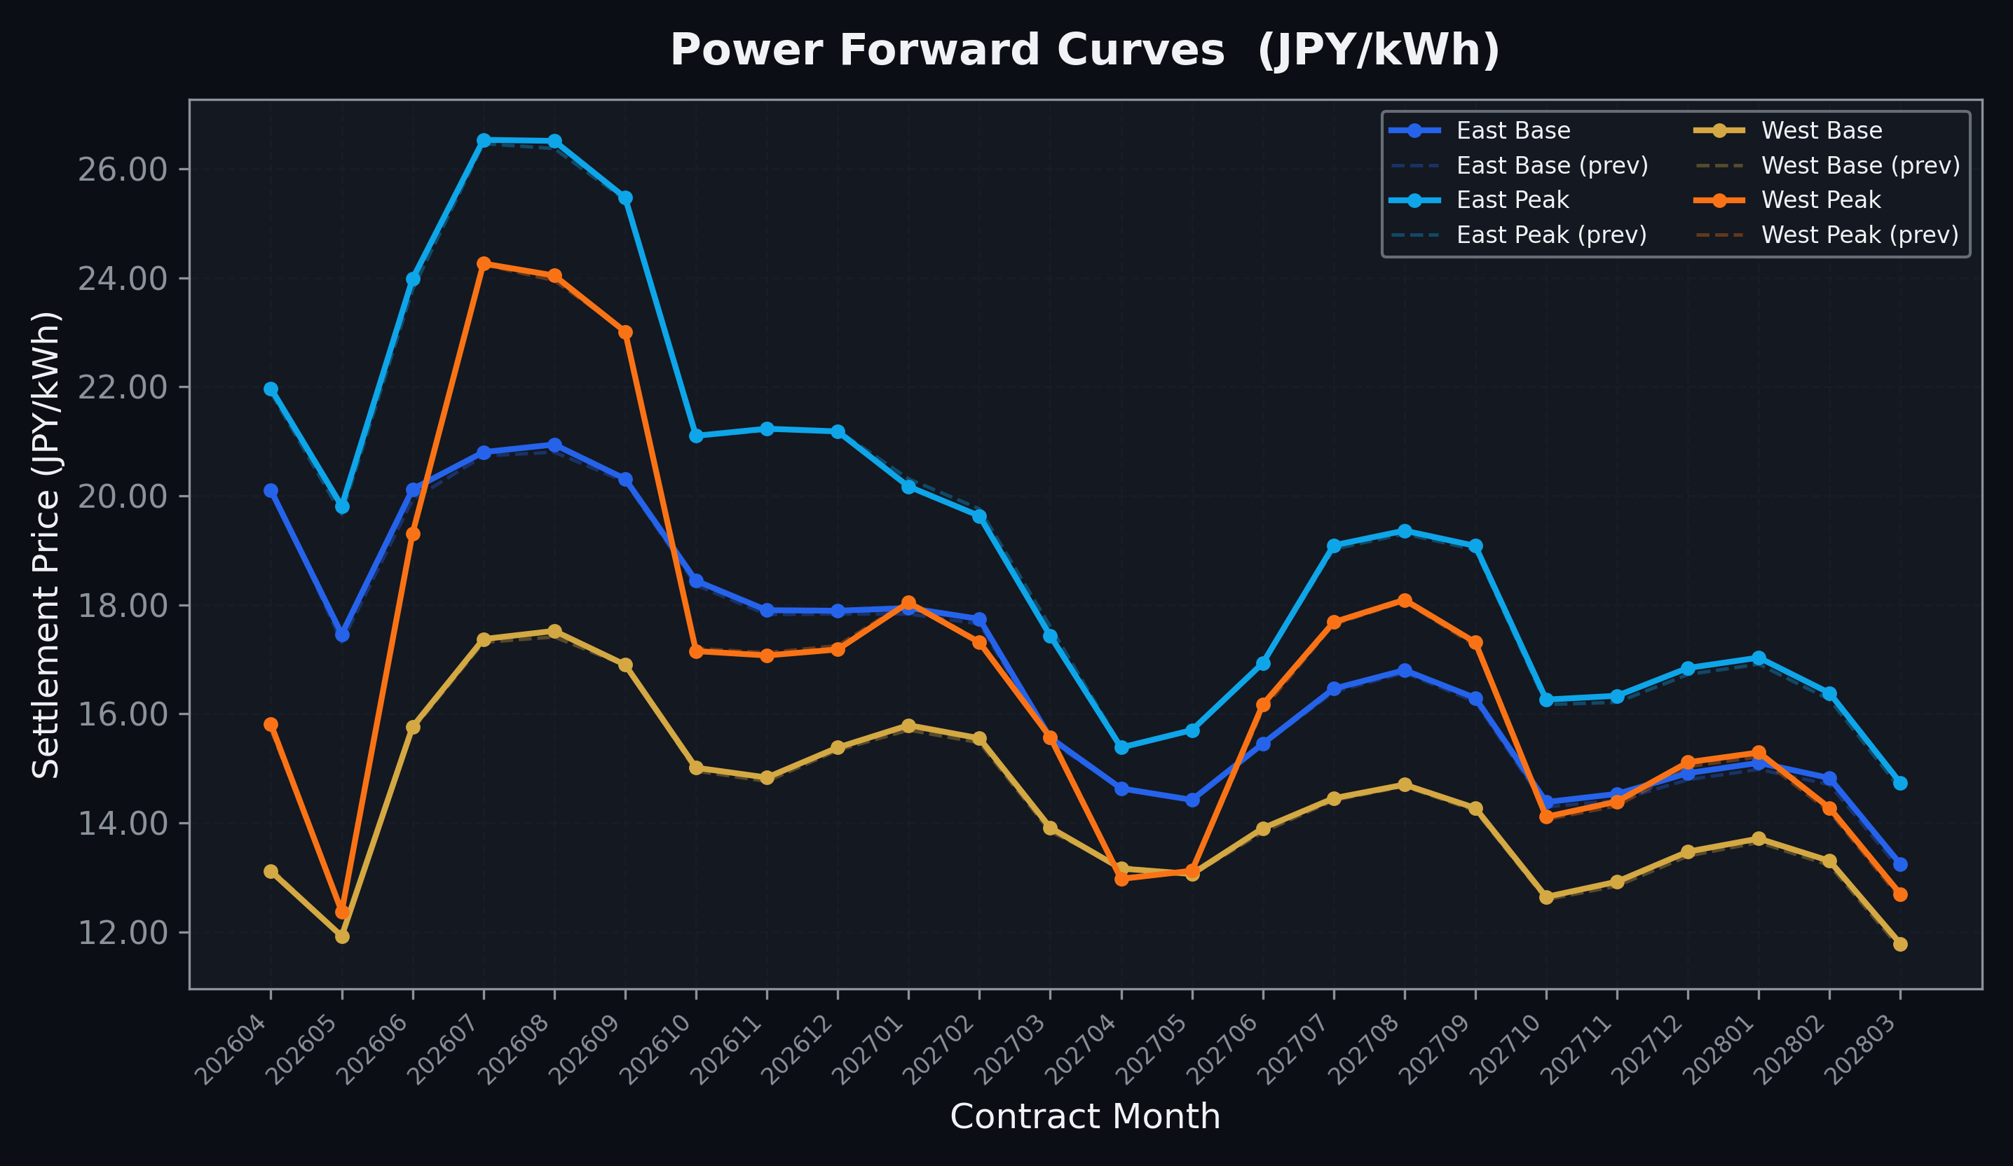
Power Forward Curves
East/West Base & Peak monthly contracts (2026-04-28)

Slide 3
Commodity Snapshot
Front-month settlement prices as of 2026-04-28
Category | Asset | Contract | Settlement | Unit | Change | % Chg
Energy | Barge Gas Oil | 202606 | 113,100.00 | JPY/kl | -1800.00 | -1.57%
Energy | Barge Gasoline | 202606 | 100,000.00 | JPY/kl | +0.00 | +0.00%
Energy | Barge Kerosene | 202606 | 105,000.00 | JPY/kl | +0.00 | +0.00%
Energy | Chukyo Gasoline | 202606 | 100,000.00 | JPY/kl | +0.00 | +0.00%
Energy | Chukyo Kerosene | 202606 | 105,000.00 | JPY/kl | +0.00 | +0.00%
Energy | Dubai Crude Oil | 202604 | 105,900.00 | JPY/kl | +100.00 | +0.09%
Energy | LNG (Platts JKM) | 202606 | 2,652.00 | USD/MMBtu | -17.00 | -0.64%
Metals | Gold | - | 23,563.00 | JPY/g | -471.00 | -1.96%
Metals | Palladium | 202606 | 7,600.00 | JPY/g | -300.00 | -3.80%
Metals | Platinum | - | 9,829.00 | JPY/g | -287.00 | -2.84%
Metals | Silver | 202606 | 390.00 | JPY/10g | +0.00 | +0.00%
Industrial | Rubber (RSS3) | 202605 | 387.90 | JPY/kg | +4.10 | +1.07%
Industrial | Rubber (TSR20) | 202605 | 330.00 | JPY/kg | +0.00 | +0.00%
Industrial | Shanghai Natural Rubber | 202605 | 17,150.00 | JPY/kg | +50.00 | +0.29%
Agriculture | Azuki Beans | 202605 | 12,300.00 | JPY/bag | +0.00 | +0.00%
Agriculture | Corn | 202607 | 39,000.00 | JPY/t | +0.00 | +0.00%
Agriculture | Soybeans | 202606 | 64,000.00 | JPY/t | +0.00 | +0.00%

Slide 4
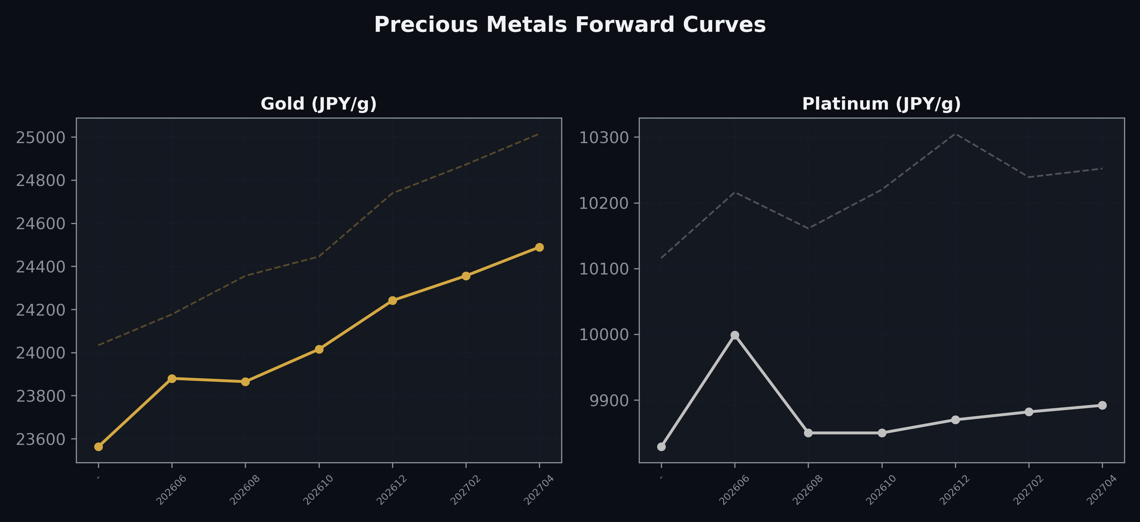
Precious Metals Forward Curves
Gold & Platinum (2026-04-28)

Slide 5
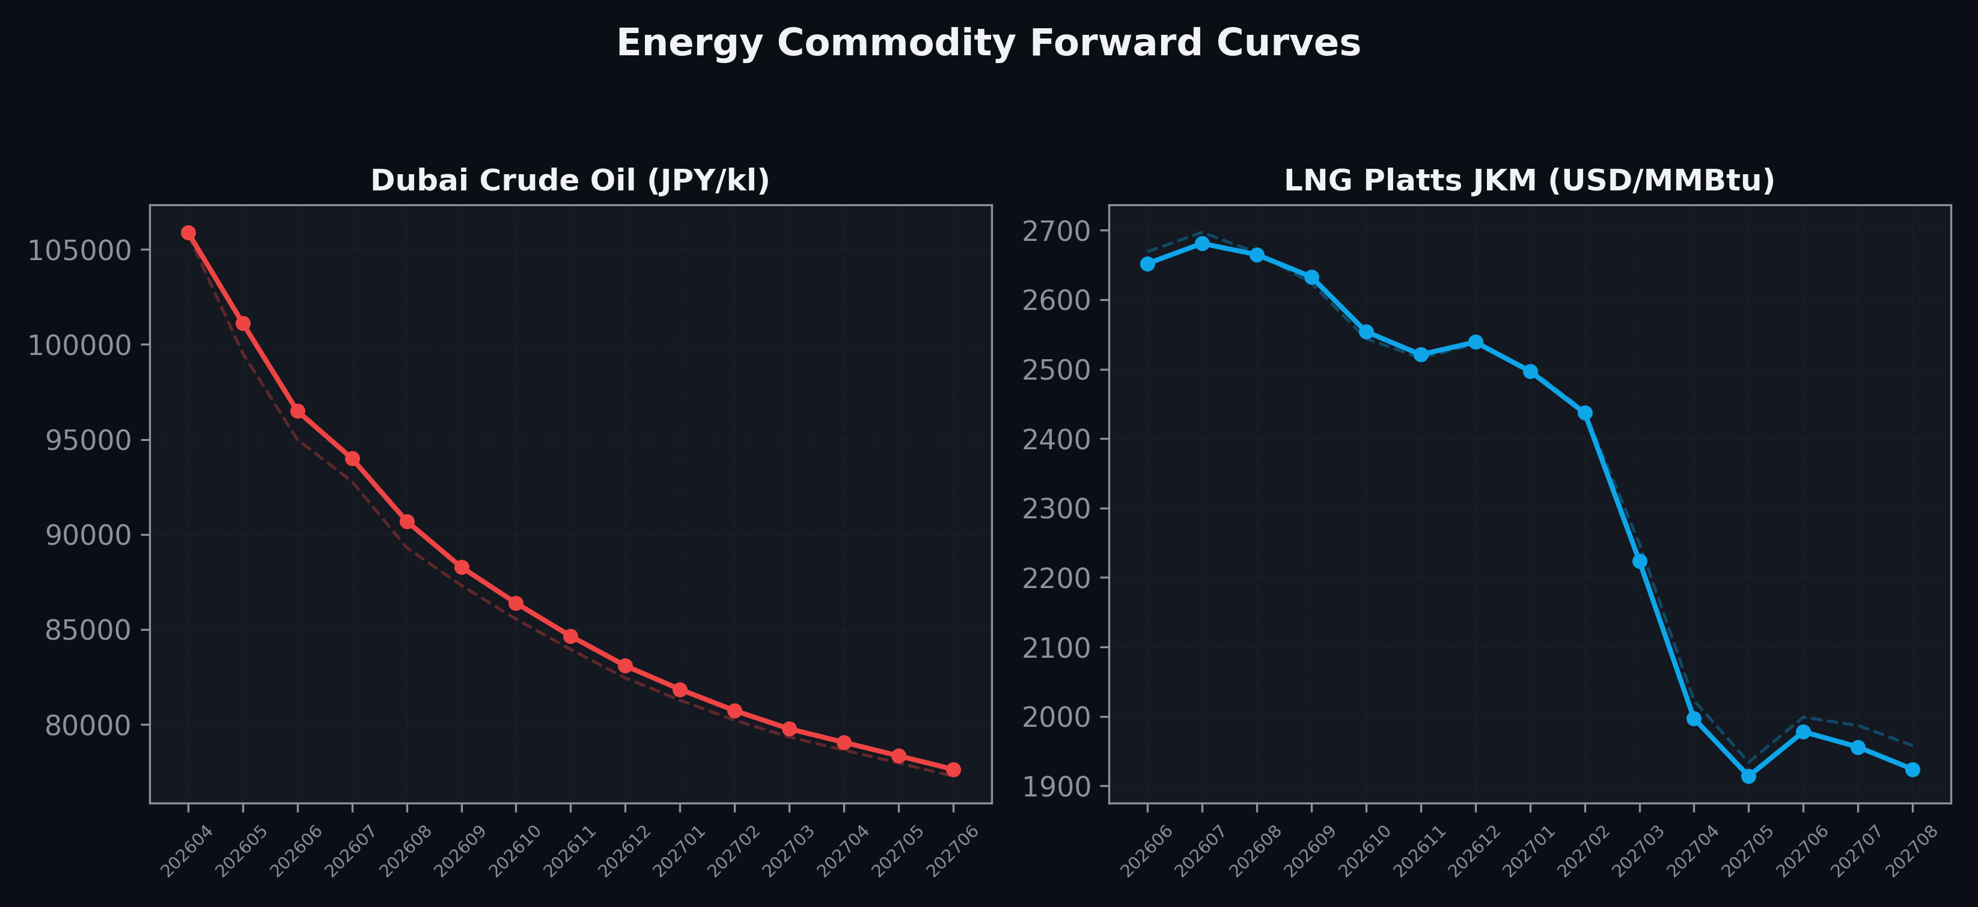
Energy Commodity Forward Curves
Dubai Crude Oil & LNG Platts JKM (2026-04-28)

Slide 6
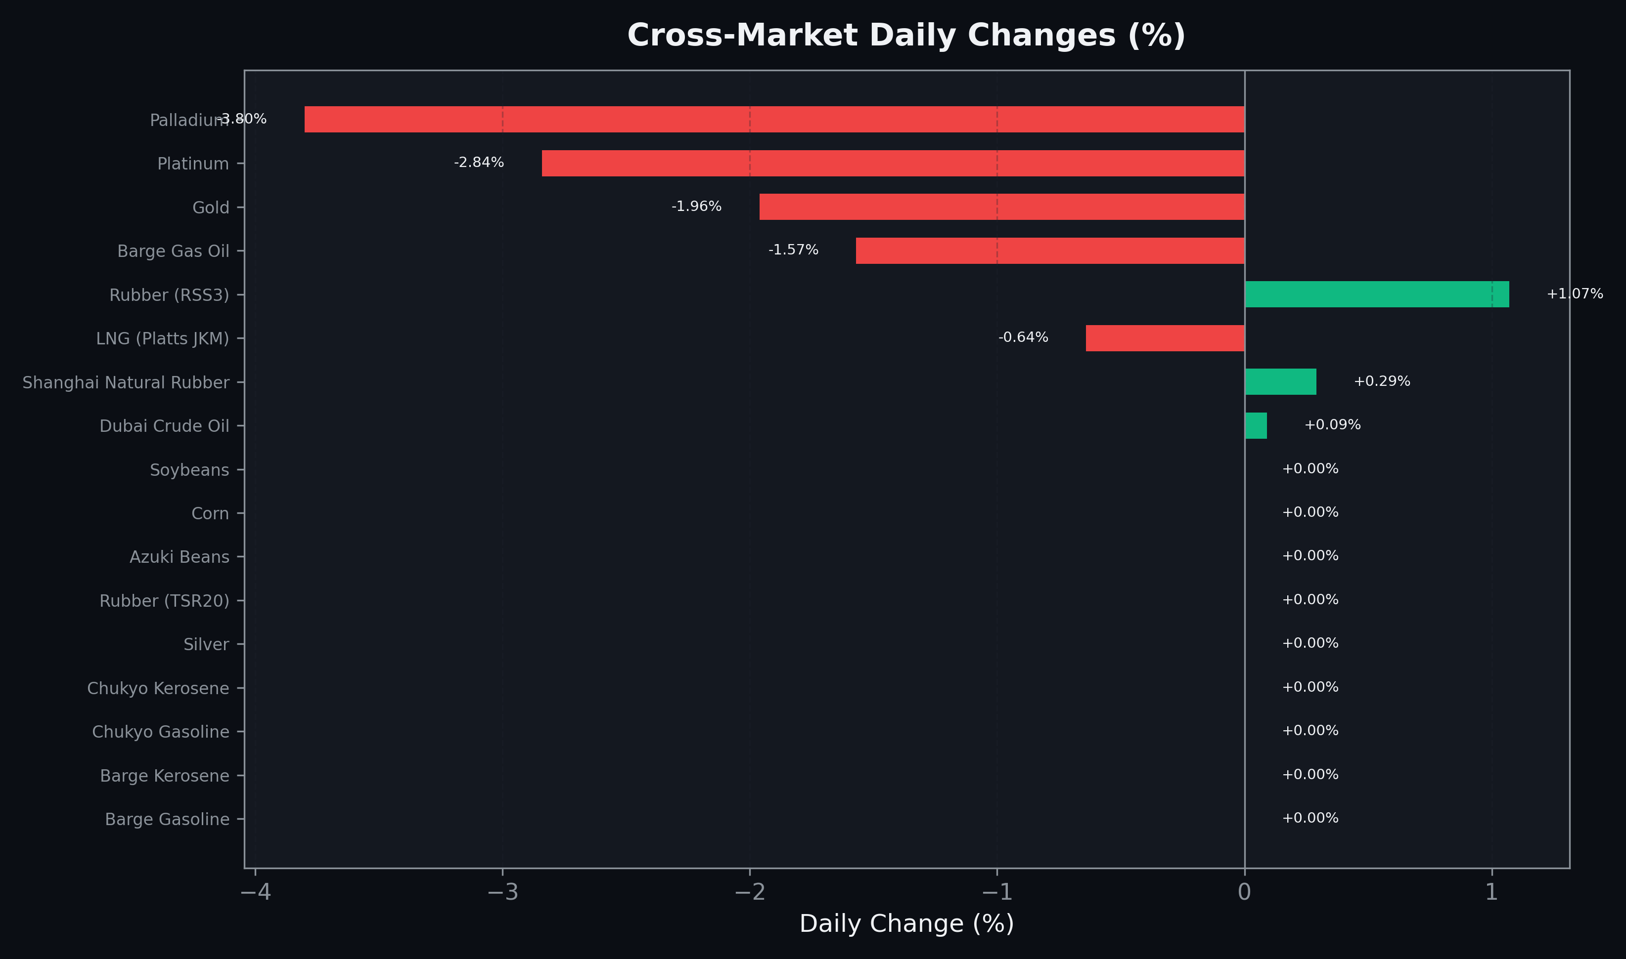
Cross-Market Daily Changes
All commodities sorted by absolute % change

Slide 7
Top Power Futures Movers
Largest absolute settlement price changes vs previous day (2026-04-28)
Instrument | Underlying | Month | Price | Prev | Change | % Chg
FUT_EEPW_260428 | Power East Peak (Weekly) | 20260501 | 20.88 | 20.51 | +0.37 | +1.80%
FUT_ECP_261127 | 電力(中部・日中) | 202611 | 18.99 | 18.69 | +0.30 | +1.61%
FUT_ECP_270225 | 電力(中部・日中) | 202702 | 18.25 | 17.95 | +0.30 | +1.67%
FUT_ECP_261228 | 電力(中部・日中) | 202612 | 18.80 | 18.53 | +0.27 | +1.46%
FUT_ECP_261029 | 電力(中部・日中) | 202610 | 19.56 | 19.32 | +0.24 | +1.24%
FUT_ECP_270330 | 電力(中部・日中) | 202703 | 16.37 | 16.16 | +0.21 | +1.30%
FUT_EEP_260629 | Power East Peak (Monthly) | 202606 | 23.98 | 23.78 | +0.20 | +0.84%
FUT_EEB_260629 | Power East Base (Monthly) | 202606 | 20.12 | 19.93 | +0.19 | +0.95%
FUT_EWBW_260430 | Power West Base (Weekly) | 20260501 | 10.54 | 10.72 | -0.18 | -1.68%
FUT_ECPY_280328 | 電力(中部・年度日中) | 202804 | 14.35 | 14.18 | +0.17 | +1.20%
FUT_EEP_270330 | Power East Peak (Monthly) | 202703 | 17.43 | 17.60 | -0.17 | -0.97%
FUT_ECBY_280328 | 電力(中部・年度ベース) | 202804 | 12.89 | 12.73 | +0.16 | +1.26%
FUT_ECP_260629 | 電力(中部・日中) | 202606 | 21.29 | 21.13 | +0.16 | +0.76%
FUT_EEBY_280328 | Power East Base (Yearly) | 202804 | 13.99 | 13.83 | +0.16 | +1.16%
FUT_EEPY_280328 | Power East Peak (Yearly) | 202804 | 15.77 | 15.61 | +0.16 | +1.02%

