Slide 1
Daily Market Report
Trade Date: 2026-03-23
JPX Derivative & Commodity Analytics
DataServer In-House

Slide 2
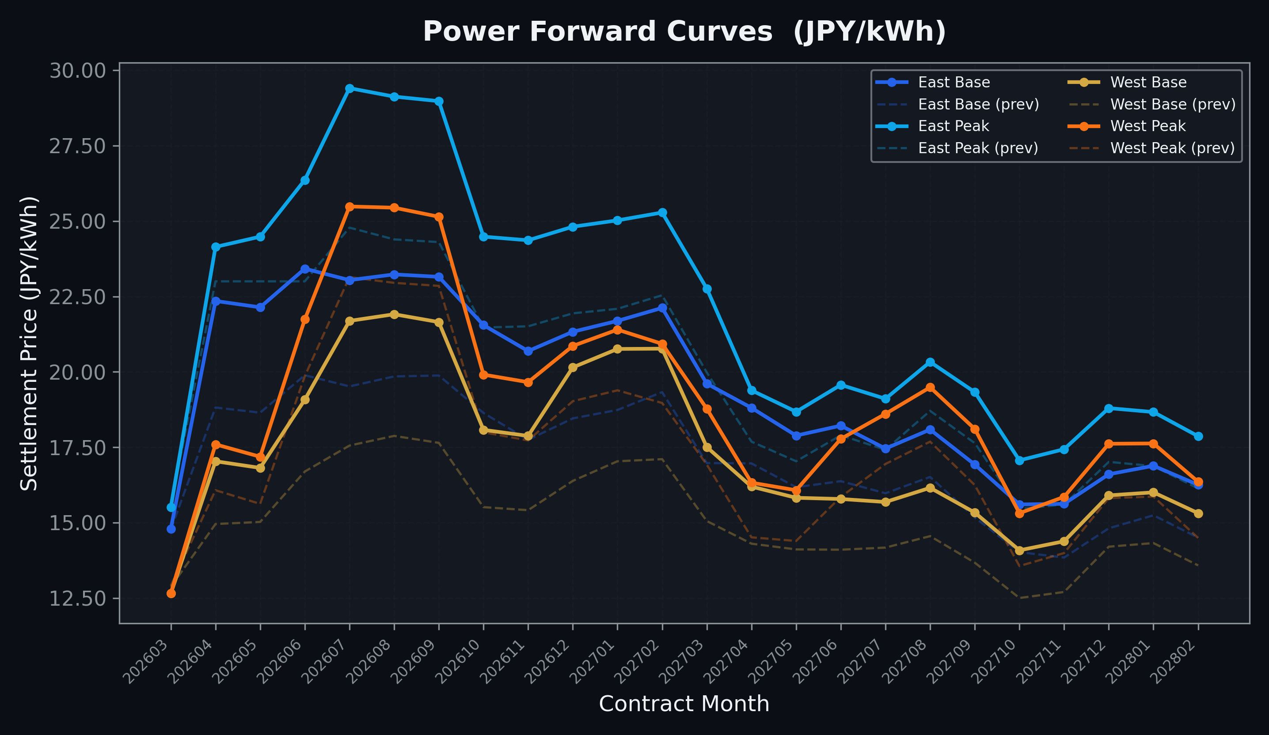
Power Forward Curves
East/West Base & Peak monthly contracts (2026-03-23)

Slide 3
Commodity Snapshot
Front-month settlement prices as of 2026-03-23
Category | Asset | Contract | Settlement | Unit | Change | % Chg
Energy | Barge Gas Oil | 202604 | 115,900.00 | JPY/kl | +0.00 | +0.00%
Energy | Barge Gasoline | 202604 | 150,000.00 | JPY/kl | +0.00 | +0.00%
Energy | Barge Kerosene | 202604 | 140,000.00 | JPY/kl | +0.00 | +0.00%
Energy | Chukyo Gasoline | 202604 | 140,000.00 | JPY/kl | +0.00 | +0.00%
Energy | Chukyo Kerosene | 202604 | 130,000.00 | JPY/kl | +0.00 | +0.00%
Energy | Dubai Crude Oil | 202603 | 136,060.00 | JPY/kl | +220.00 | +0.16%
Energy | LNG (Platts JKM) | 202605 | 3,467.00 | USD/MMBtu | +257.00 | +8.01%
Metals | Gold | - | 21,683.00 | JPY/g | -3048.00 | -12.32%
Metals | Palladium | 202604 | 7,200.00 | JPY/g | -600.00 | -7.69%
Metals | Platinum | - | 8,776.00 | JPY/g | -901.00 | -9.31%
Metals | Silver | 202604 | 350.00 | JPY/10g | -50.00 | -12.50%
Industrial | Rubber (RSS3) | 202603 | 370.00 | JPY/kg | -5.00 | -1.33%
Industrial | Rubber (TSR20) | 202604 | 307.00 | JPY/kg | -3.00 | -0.97%
Industrial | Shanghai Natural Rubber | 202605 | 16,130.00 | JPY/kg | +95.00 | +0.59%
Agriculture | Azuki Beans | 202603 | 12,300.00 | JPY/bag | +0.00 | +0.00%
Agriculture | Corn | 202605 | 39,000.00 | JPY/t | +0.00 | +0.00%
Agriculture | Soybeans | 202604 | 64,000.00 | JPY/t | +0.00 | +0.00%

Slide 4
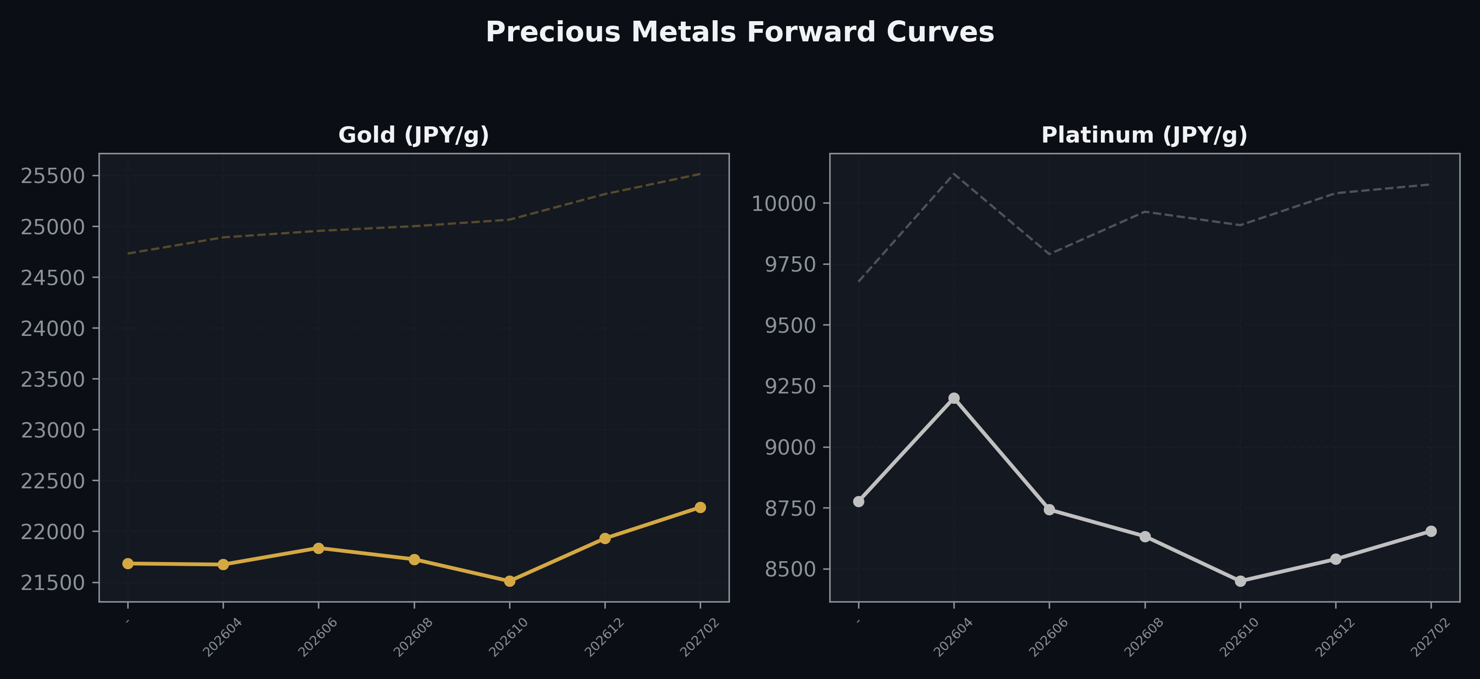
Precious Metals Forward Curves
Gold & Platinum (2026-03-23)

Slide 5
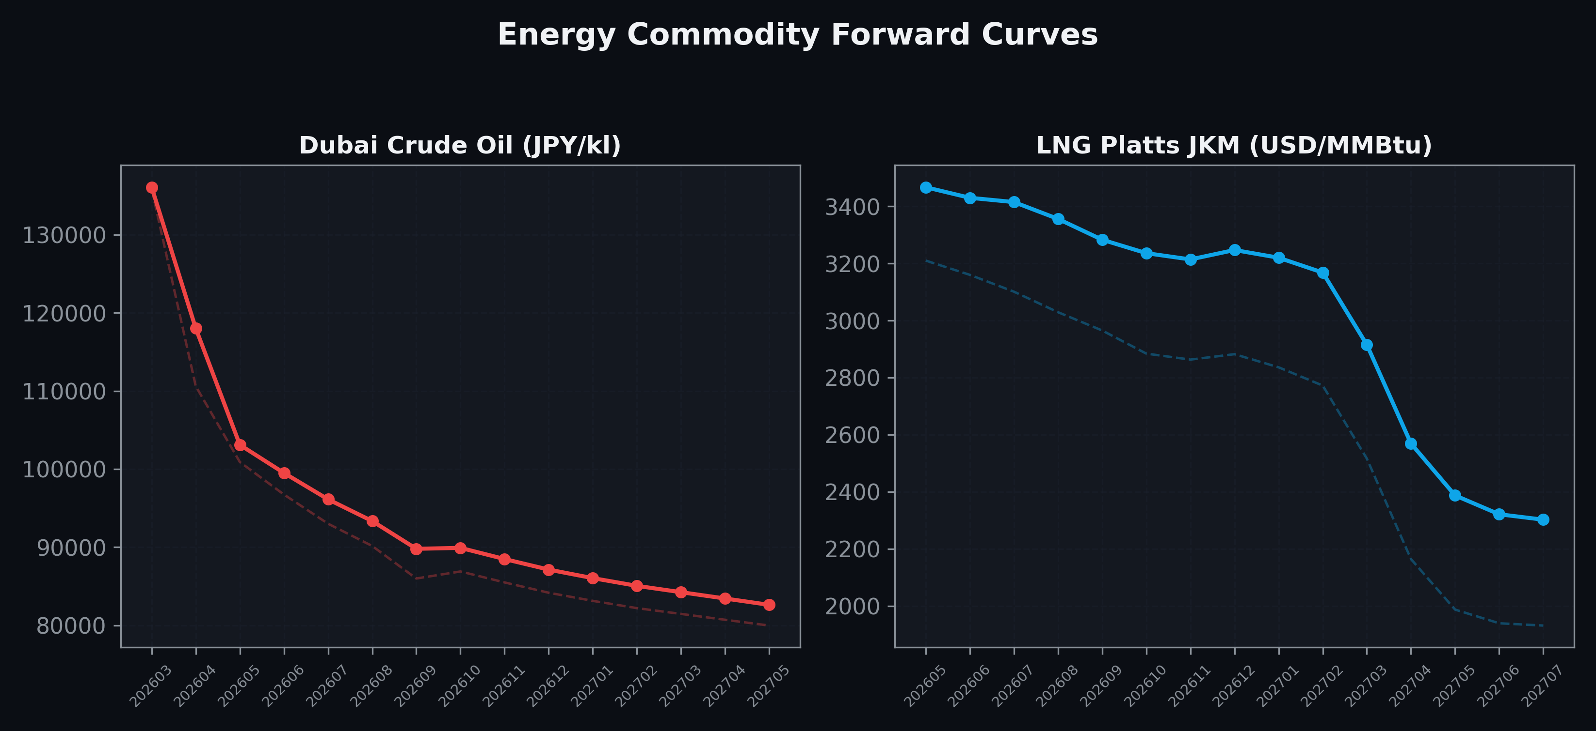
Energy Commodity Forward Curves
Dubai Crude Oil & LNG Platts JKM (2026-03-23)

Slide 6
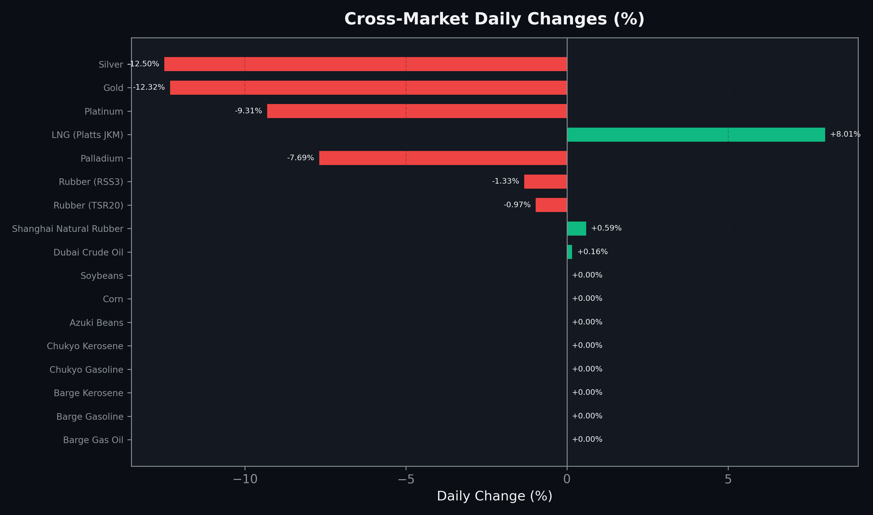
Cross-Market Daily Changes
All commodities sorted by absolute % change

Slide 7
Top Power Futures Movers
Largest absolute settlement price changes vs previous day (2026-03-23)
Instrument | Underlying | Month | Price | Prev | Change | % Chg
FUT_EEP_260828 | Power East Peak (Monthly) | 202608 | 29.12 | 24.39 | +4.73 | +19.39%
FUT_EEP_260929 | Power East Peak (Monthly) | 202609 | 28.97 | 24.30 | +4.67 | +19.22%
FUT_EEP_260730 | Power East Peak (Monthly) | 202607 | 29.40 | 24.78 | +4.62 | +18.64%
FUT_EWB_260730 | Power West Base (Monthly) | 202607 | 21.69 | 17.56 | +4.13 | +23.52%
FUT_EWB_260828 | Power West Base (Monthly) | 202608 | 21.91 | 17.88 | +4.03 | +22.54%
FUT_EWB_260929 | Power West Base (Monthly) | 202609 | 21.65 | 17.65 | +4.00 | +22.66%
FUT_EWB_261230 | Power West Base (Monthly) | 202612 | 20.15 | 16.39 | +3.76 | +22.94%
FUT_EWB_270129 | Power West Base (Monthly) | 202701 | 20.76 | 17.04 | +3.72 | +21.83%
FUT_EWB_270226 | Power West Base (Monthly) | 202702 | 20.77 | 17.11 | +3.66 | +21.39%
FUT_EEB_260428 | Power East Base (Monthly) | 202604 | 22.35 | 18.82 | +3.53 | +18.76%
FUT_EEB_260629 | Power East Base (Monthly) | 202606 | 23.42 | 19.89 | +3.53 | +17.75%
FUT_EEB_260730 | Power East Base (Monthly) | 202607 | 23.04 | 19.52 | +3.52 | +18.03%
FUT_EEB_260529 | Power East Base (Monthly) | 202605 | 22.14 | 18.65 | +3.49 | +18.71%
FUT_EEB_260828 | Power East Base (Monthly) | 202608 | 23.23 | 19.85 | +3.38 | +17.03%
FUT_EEP_260629 | Power East Peak (Monthly) | 202606 | 26.36 | 23.00 | +3.36 | +14.61%

