Slide 1
Daily Market Report
Trade Date: 2026-05-28
JPX Derivative & Commodity Analytics
DataServer In-House

Slide 2
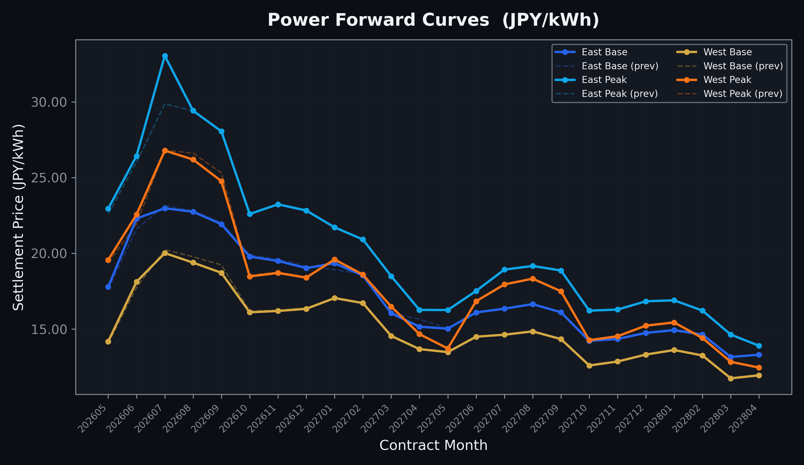
Power Forward Curves
East/West Base & Peak monthly contracts (2026-05-28)

Slide 3
Commodity Snapshot
Front-month settlement prices as of 2026-05-28
Category | Asset | Contract | Settlement | Unit | Change | % Chg
Energy | Barge Gas Oil | 202607 | 110,900.00 | JPY/kl | -100.00 | -0.09%
Energy | Barge Gasoline | 202607 | 100,000.00 | JPY/kl | +0.00 | +0.00%
Energy | Barge Kerosene | 202607 | 105,000.00 | JPY/kl | +0.00 | +0.00%
Energy | Chukyo Gasoline | 202607 | 95,000.00 | JPY/kl | +0.00 | +0.00%
Energy | Chukyo Kerosene | 202607 | 105,000.00 | JPY/kl | +0.00 | +0.00%
Energy | Dubai Crude Oil | 202605 | 101,650.00 | JPY/kl | -530.00 | -0.52%
Energy | LNG (Platts JKM) | 202607 | 2,909.00 | USD/MMBtu | +14.00 | +0.48%
Metals | Gold | - | 22,504.00 | JPY/g | -400.00 | -1.75%
Metals | Palladium | 202606 | 7,000.00 | JPY/g | +0.00 | +0.00%
Metals | Platinum | - | 9,531.00 | JPY/g | -197.00 | -2.03%
Metals | Silver | 202606 | 390.00 | JPY/10g | +0.00 | +0.00%
Industrial | Rubber (RSS3) | 202606 | 400.00 | JPY/kg | -1.00 | -0.25%
Industrial | Rubber (TSR20) | 202606 | 350.00 | JPY/kg | +0.00 | +0.00%
Industrial | Shanghai Natural Rubber | 202609 | 17,950.00 | JPY/kg | +320.00 | +1.82%
Agriculture | Azuki Beans | 202606 | 12,300.00 | JPY/bag | +0.00 | +0.00%
Agriculture | Corn | 202607 | 39,000.00 | JPY/t | +0.00 | +0.00%
Agriculture | Soybeans | 202606 | 64,000.00 | JPY/t | +0.00 | +0.00%

Slide 4
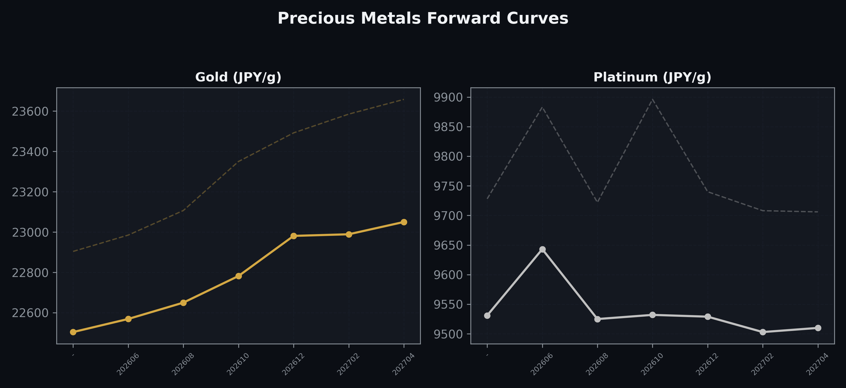
Precious Metals Forward Curves
Gold & Platinum (2026-05-28)

Slide 5
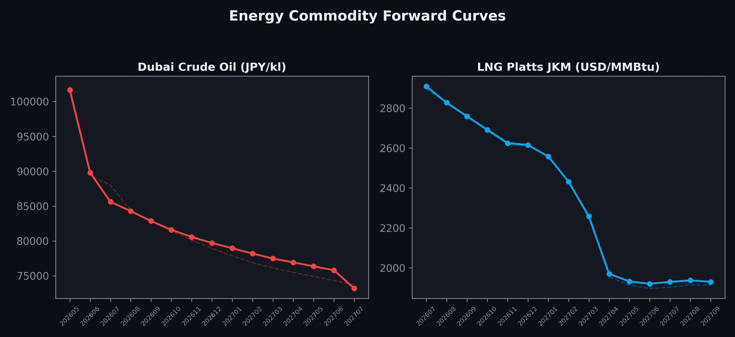
Energy Commodity Forward Curves
Dubai Crude Oil & LNG Platts JKM (2026-05-28)

Slide 6
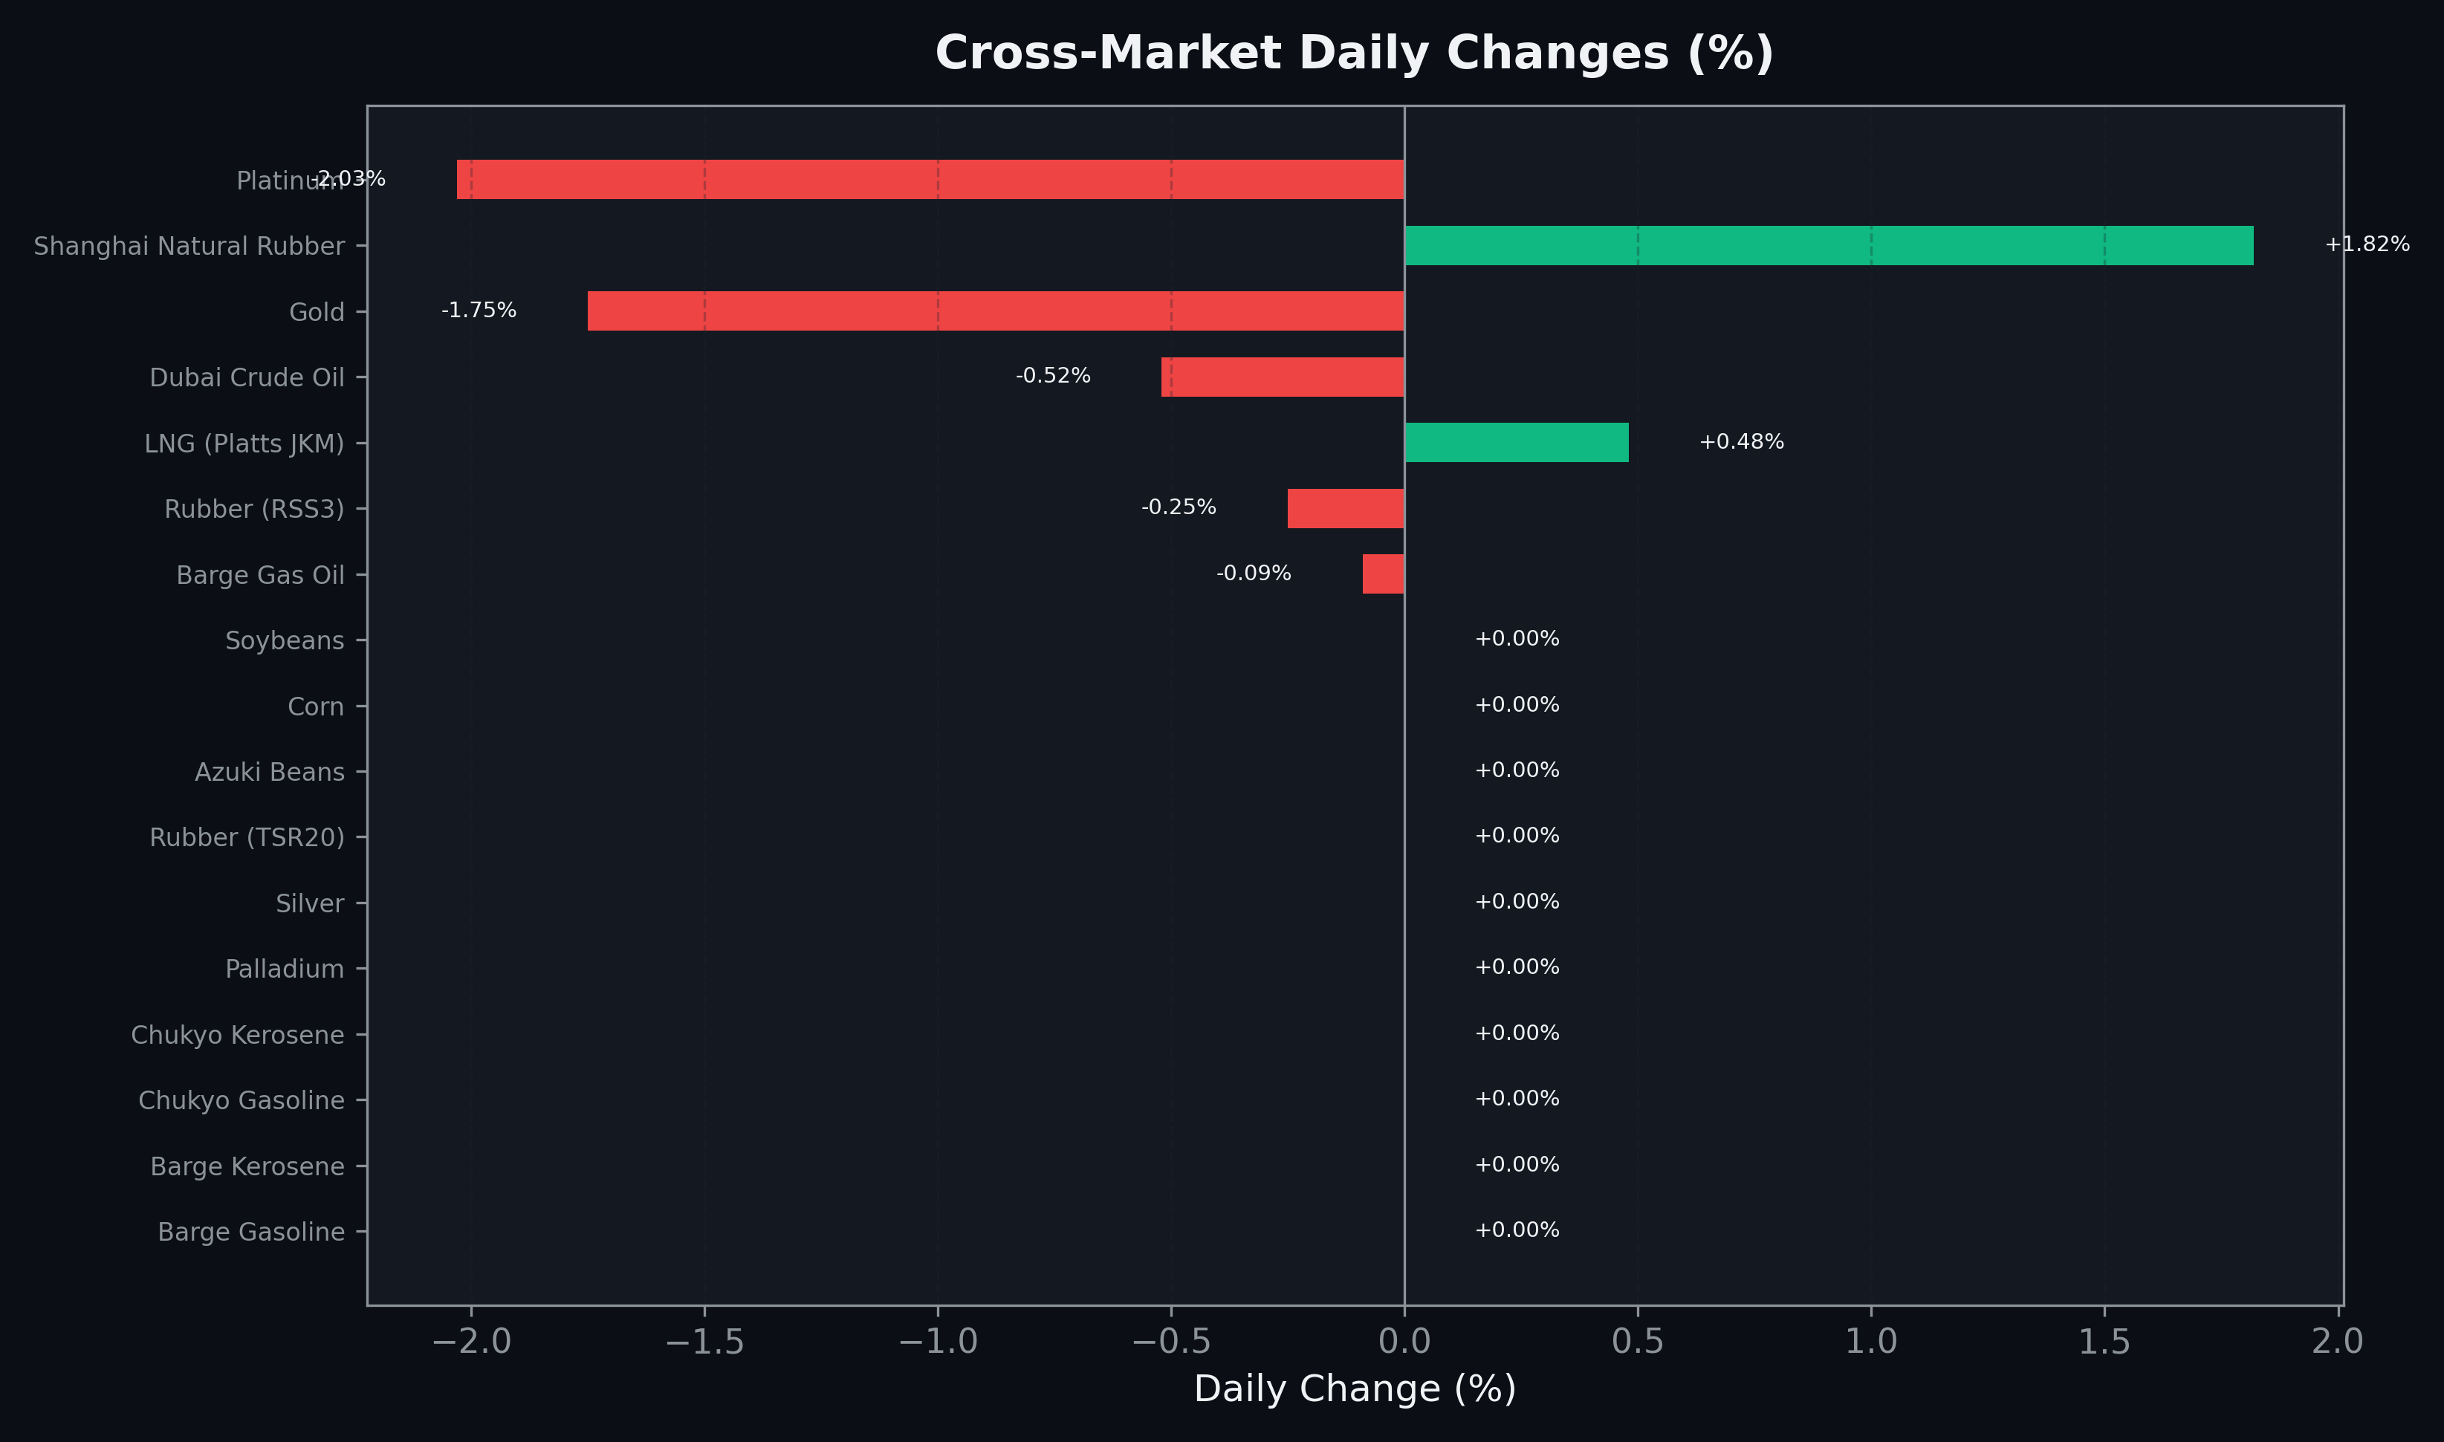
Cross-Market Daily Changes
All commodities sorted by absolute % change

Slide 7
Top Power Futures Movers
Largest absolute settlement price changes vs previous day (2026-05-28)
Instrument | Underlying | Month | Price | Prev | Change | % Chg
FUT_EEP_260730 | Power East Peak (Monthly) | 202607 | 33.05 | 29.87 | +3.18 | +10.65%
FUT_ECP_260629 | 電力(中部・日中) | 202606 | 24.18 | 22.86 | +1.32 | +5.77%
FUT_EEPW_260528 | Power East Peak (Weekly) | 20260529 | 26.41 | 25.70 | +0.71 | +2.76%
FUT_EWPW_260625 | Power West Peak (Weekly) | 20260626 | 22.70 | 21.99 | +0.71 | +3.23%
FUT_EEB_260629 | Power East Base (Monthly) | 202606 | 22.30 | 21.60 | +0.70 | +3.24%
FUT_EWPW_260618 | Power West Peak (Weekly) | 20260619 | 21.84 | 21.19 | +0.65 | +3.07%
FUT_EWP_260629 | Power West Peak (Monthly) | 202606 | 22.56 | 21.94 | +0.62 | +2.83%
FUT_EWPW_260604 | Power West Peak (Weekly) | 20260605 | 21.78 | 21.17 | +0.61 | +2.88%
FUT_EWBW_260625 | Power West Base (Weekly) | 20260626 | 18.24 | 17.67 | +0.57 | +3.23%
FUT_EWP_260929 | Power West Peak (Monthly) | 202609 | 24.77 | 25.32 | -0.55 | -2.17%
FUT_EWPW_260611 | Power West Peak (Weekly) | 20260612 | 21.37 | 20.82 | +0.55 | +2.64%
FUT_EWBW_260618 | Power West Base (Weekly) | 20260619 | 17.97 | 17.44 | +0.53 | +3.04%
FUT_EWB_260929 | Power West Base (Monthly) | 202609 | 18.72 | 19.24 | -0.52 | -2.70%
FUT_EEB_270428 | Power East Base (Monthly) | 202704 | 15.16 | 15.66 | -0.50 | -3.19%
FUT_EEBW_260611 | Power East Base (Weekly) | 20260612 | 22.00 | 21.51 | +0.49 | +2.28%

