Slide 1
Daily Market Report
Trade Date: 2026-05-20
JPX Derivative & Commodity Analytics
DataServer In-House

Slide 2
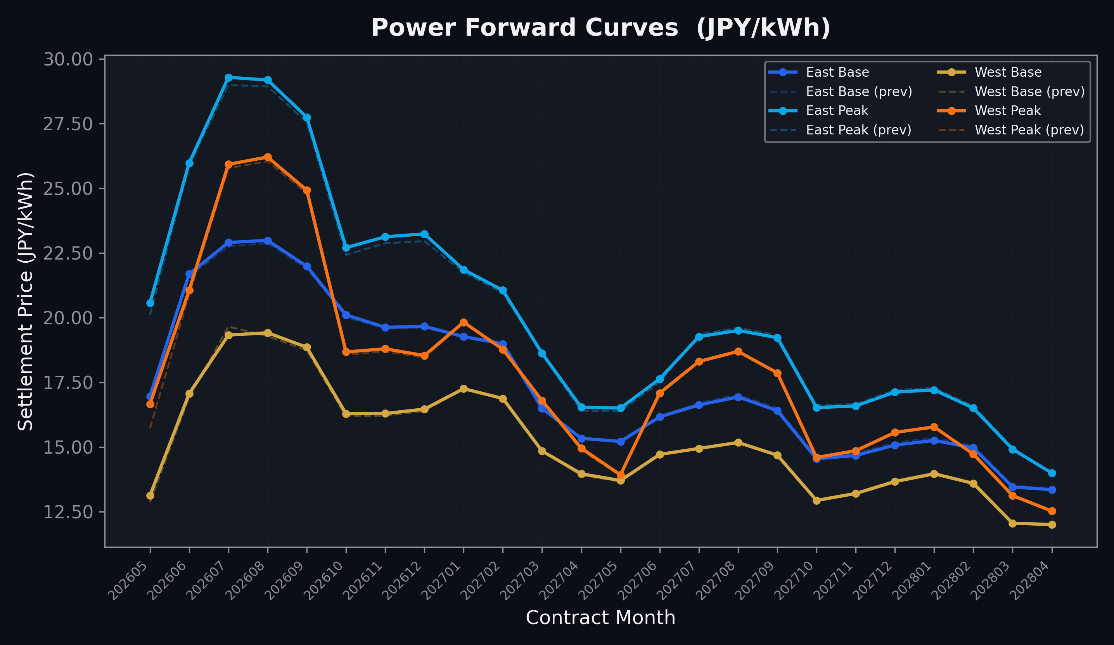
Power Forward Curves
East/West Base & Peak monthly contracts (2026-05-20)

Slide 3
Commodity Snapshot
Front-month settlement prices as of 2026-05-20
Category | Asset | Contract | Settlement | Unit | Change | % Chg
Energy | Barge Gas Oil | 202606 | 109,700.00 | JPY/kl | -200.00 | -0.18%
Energy | Barge Gasoline | 202606 | 100,000.00 | JPY/kl | +0.00 | +0.00%
Energy | Barge Kerosene | 202606 | 105,000.00 | JPY/kl | +0.00 | +0.00%
Energy | Chukyo Gasoline | 202606 | 100,000.00 | JPY/kl | +0.00 | +0.00%
Energy | Chukyo Kerosene | 202606 | 105,000.00 | JPY/kl | +0.00 | +0.00%
Energy | Dubai Crude Oil | 202605 | 104,730.00 | JPY/kl | -260.00 | -0.25%
Energy | LNG (Platts JKM) | 202607 | 3,131.00 | USD/MMBtu | +117.00 | +3.88%
Metals | Gold | - | 22,690.00 | JPY/g | -464.00 | -2.00%
Metals | Palladium | 202606 | 7,000.00 | JPY/g | -200.00 | -2.78%
Metals | Platinum | - | 9,657.00 | JPY/g | -212.00 | -2.15%
Metals | Silver | 202606 | 390.00 | JPY/10g | -5.00 | -1.27%
Industrial | Rubber (RSS3) | 202605 | 397.00 | JPY/kg | -6.50 | -1.61%
Industrial | Rubber (TSR20) | 202606 | 350.00 | JPY/kg | +0.00 | +0.00%
Industrial | Shanghai Natural Rubber | 202609 | 17,730.00 | JPY/kg | -165.00 | -0.92%
Agriculture | Azuki Beans | 202605 | 12,300.00 | JPY/bag | +0.00 | +0.00%
Agriculture | Corn | 202607 | 39,000.00 | JPY/t | +0.00 | +0.00%
Agriculture | Soybeans | 202606 | 64,000.00 | JPY/t | +0.00 | +0.00%

Slide 4
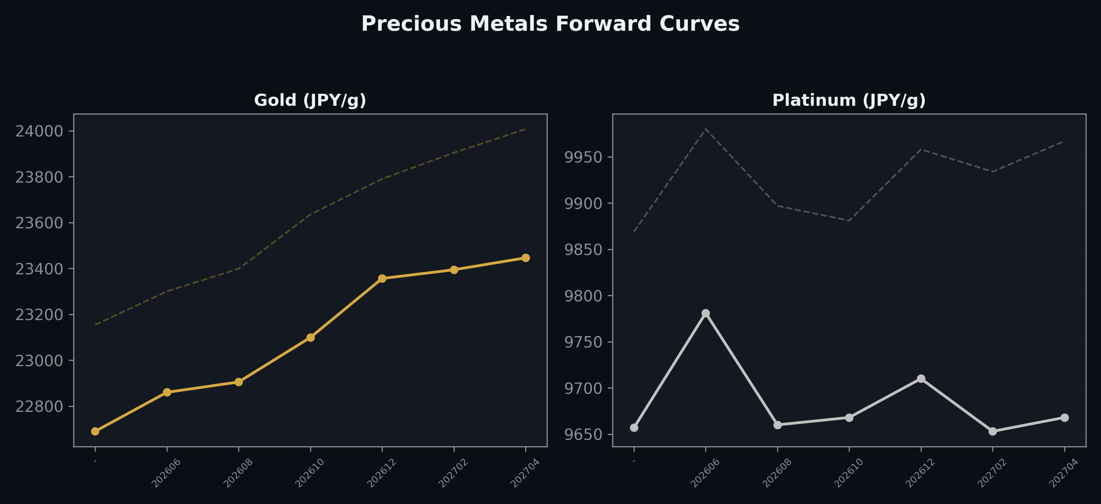
Precious Metals Forward Curves
Gold & Platinum (2026-05-20)

Slide 5
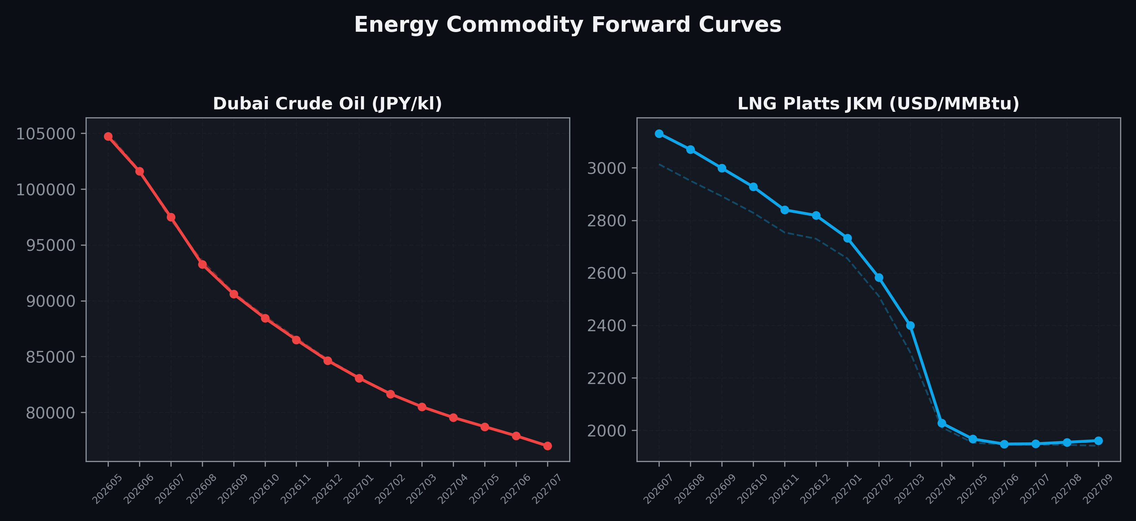
Energy Commodity Forward Curves
Dubai Crude Oil & LNG Platts JKM (2026-05-20)

Slide 6
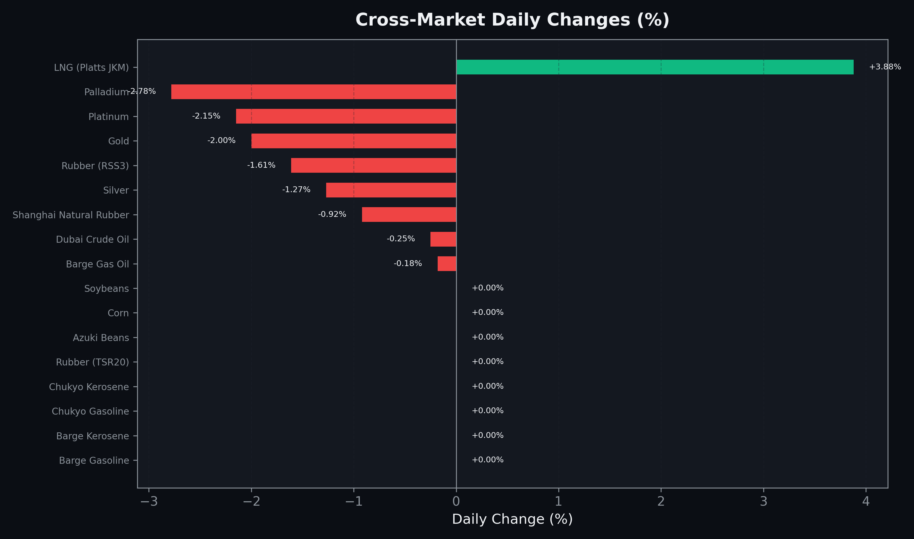
Cross-Market Daily Changes
All commodities sorted by absolute % change

Slide 7
Top Power Futures Movers
Largest absolute settlement price changes vs previous day (2026-05-20)
Instrument | Underlying | Month | Price | Prev | Change | % Chg
FUT_EWPW_260521 | Power West Peak (Weekly) | 20260522 | 21.81 | 18.39 | +3.42 | +18.60%
FUT_EEPW_260521 | Power East Peak (Weekly) | 20260522 | 23.52 | 21.32 | +2.20 | +10.32%
FUT_EWBW_260521 | Power West Base (Weekly) | 20260522 | 15.94 | 14.62 | +1.32 | +9.03%
FUT_EEBW_260528 | Power East Base (Weekly) | 20260529 | 19.50 | 18.52 | +0.98 | +5.29%
FUT_EWP_260528 | Power West Peak (Monthly) | 202605 | 16.66 | 15.72 | +0.94 | +5.98%
FUT_ECP_260528 | 電力(中部・日中) | 202605 | 18.20 | 17.42 | +0.78 | +4.48%
FUT_EWPW_260528 | Power West Peak (Weekly) | 20260529 | 14.05 | 13.28 | +0.77 | +5.80%
FUT_EWBW_260528 | Power West Base (Weekly) | 20260529 | 14.74 | 14.10 | +0.64 | +4.54%
FUT_EEBW_260521 | Power East Base (Weekly) | 20260522 | 18.44 | 17.83 | +0.61 | +3.42%
FUT_EEP_260528 | Power East Peak (Monthly) | 202605 | 20.56 | 20.10 | +0.46 | +2.29%
FUT_EWBW_260604 | Power West Base (Weekly) | 20260605 | 16.93 | 16.55 | +0.38 | +2.30%
FUT_EEPW_260528 | Power East Peak (Weekly) | 20260529 | 20.41 | 20.07 | +0.34 | +1.69%
FUT_EWB_260730 | Power West Base (Monthly) | 202607 | 19.32 | 19.65 | -0.33 | -1.68%
FUT_EEP_260730 | Power East Peak (Monthly) | 202607 | 29.28 | 28.98 | +0.30 | +1.04%
FUT_EEP_261029 | Power East Peak (Monthly) | 202610 | 22.70 | 22.42 | +0.28 | +1.25%

