Slide 1
Daily Market Report
Trade Date: 2026-06-05
JPX Derivative & Commodity Analytics
DataServer In-House

Slide 2
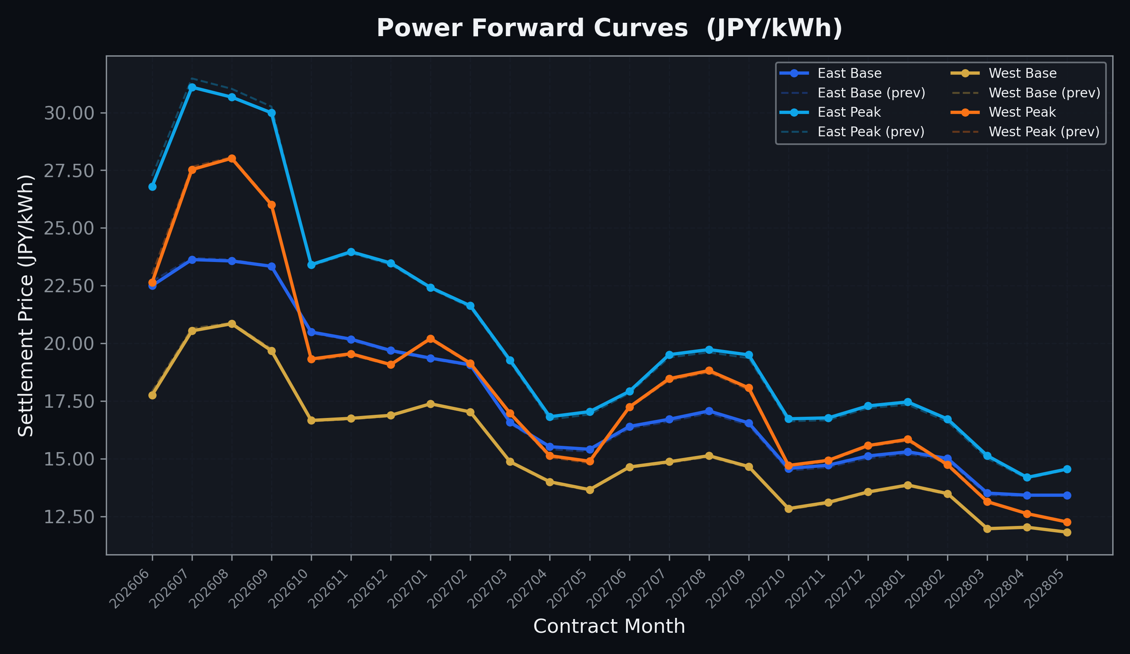
Power Forward Curves
East/West Base & Peak monthly contracts (2026-06-05)

Slide 3
Commodity Snapshot
Front-month settlement prices as of 2026-06-05
Category | Asset | Contract | Settlement | Unit | Change | % Chg
Energy | Barge Gas Oil | 202607 | 107,200.00 | JPY/kl | -800.00 | -0.74%
Energy | Barge Gasoline | 202607 | 100,000.00 | JPY/kl | +0.00 | +0.00%
Energy | Barge Kerosene | 202607 | 110,000.00 | JPY/kl | +0.00 | +0.00%
Energy | Chukyo Gasoline | 202607 | 95,000.00 | JPY/kl | +0.00 | +0.00%
Energy | Chukyo Kerosene | 202607 | 105,000.00 | JPY/kl | +0.00 | +0.00%
Energy | Dubai Crude Oil | 202606 | 93,600.00 | JPY/kl | -2540.00 | -2.64%
Energy | LNG (Platts JKM) | 202607 | 3,005.00 | USD/MMBtu | +6.00 | +0.20%
Metals | Gold | - | 22,825.00 | JPY/g | -94.00 | -0.41%
Metals | Palladium | 202606 | 6,800.00 | JPY/g | -200.00 | -2.86%
Metals | Platinum | - | 9,630.00 | JPY/g | +12.00 | +0.12%
Metals | Silver | 202606 | 379.00 | JPY/10g | -11.00 | -2.82%
Industrial | Rubber (RSS3) | 202606 | 416.20 | JPY/kg | +1.20 | +0.29%
Industrial | Rubber (TSR20) | 202607 | 365.00 | JPY/kg | +0.00 | +0.00%
Industrial | Shanghai Natural Rubber | 202609 | 17,650.00 | JPY/kg | -330.00 | -1.84%
Agriculture | Azuki Beans | 202606 | 12,300.00 | JPY/bag | +0.00 | +0.00%
Agriculture | Corn | 202607 | 39,000.00 | JPY/t | +0.00 | +0.00%
Agriculture | Soybeans | 202606 | 64,000.00 | JPY/t | +0.00 | +0.00%

Slide 4
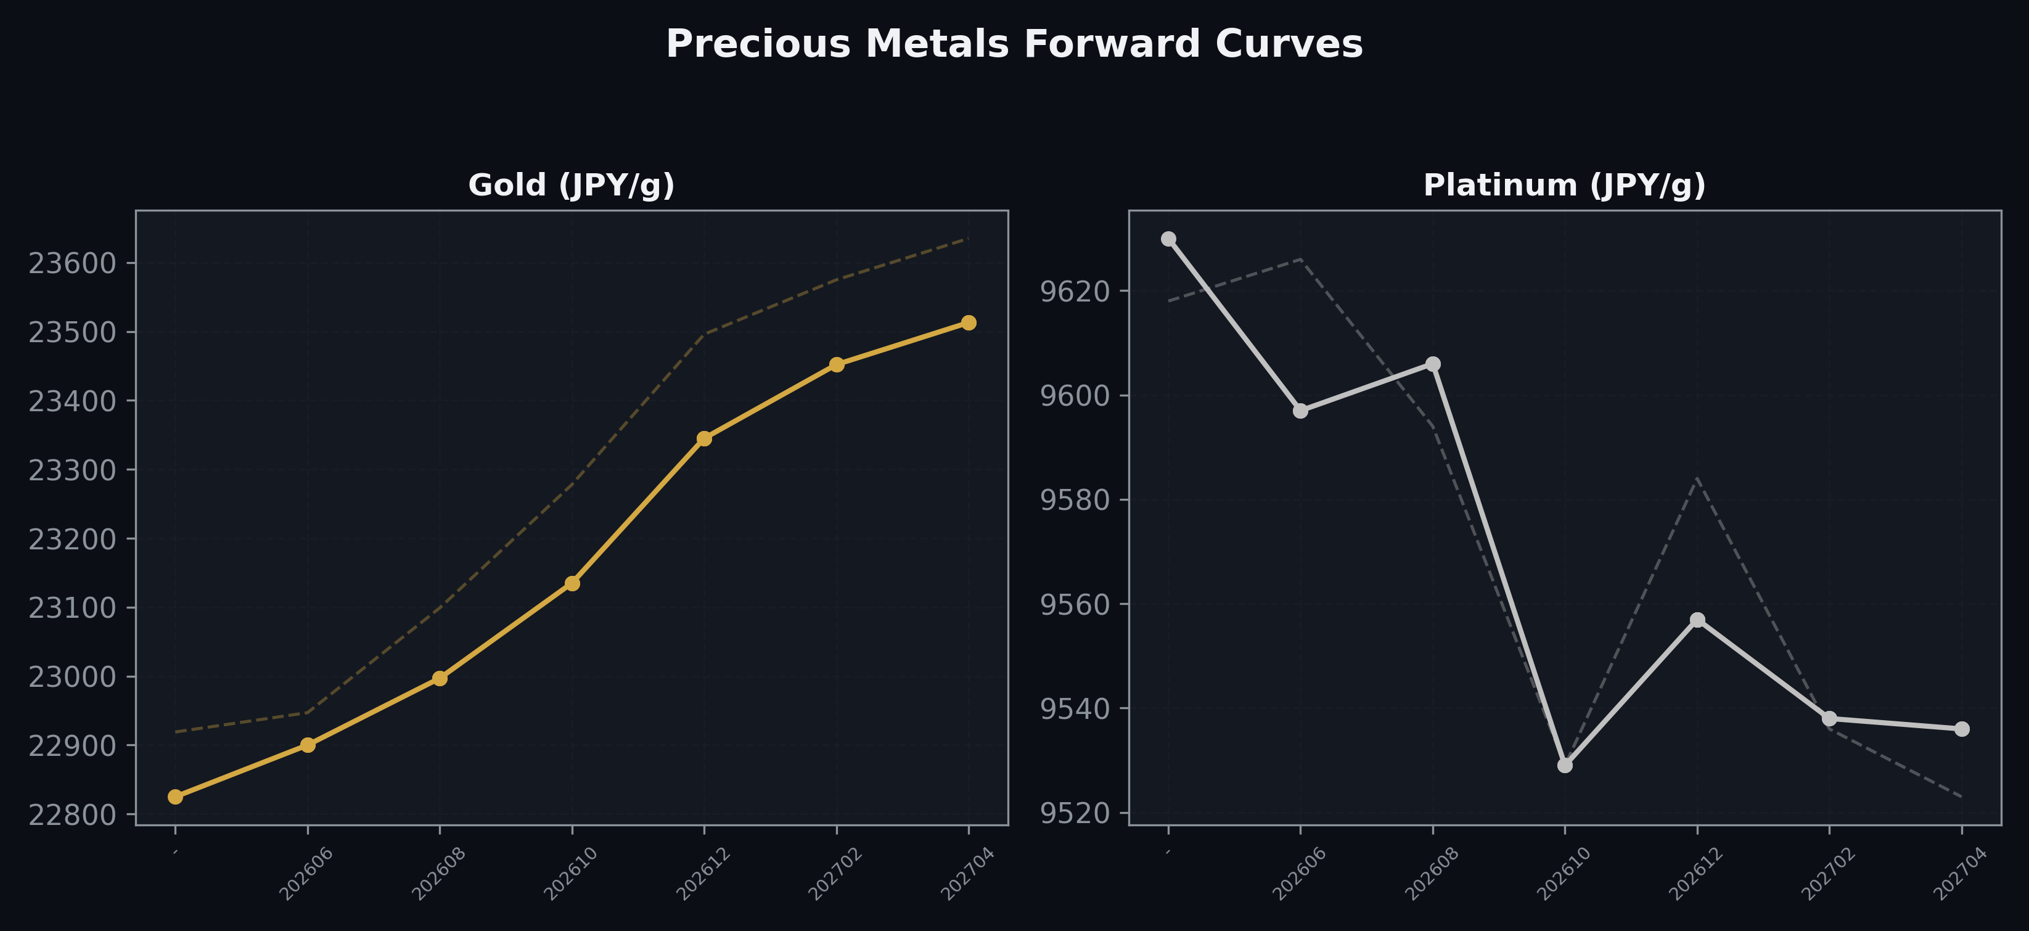
Precious Metals Forward Curves
Gold & Platinum (2026-06-05)

Slide 5
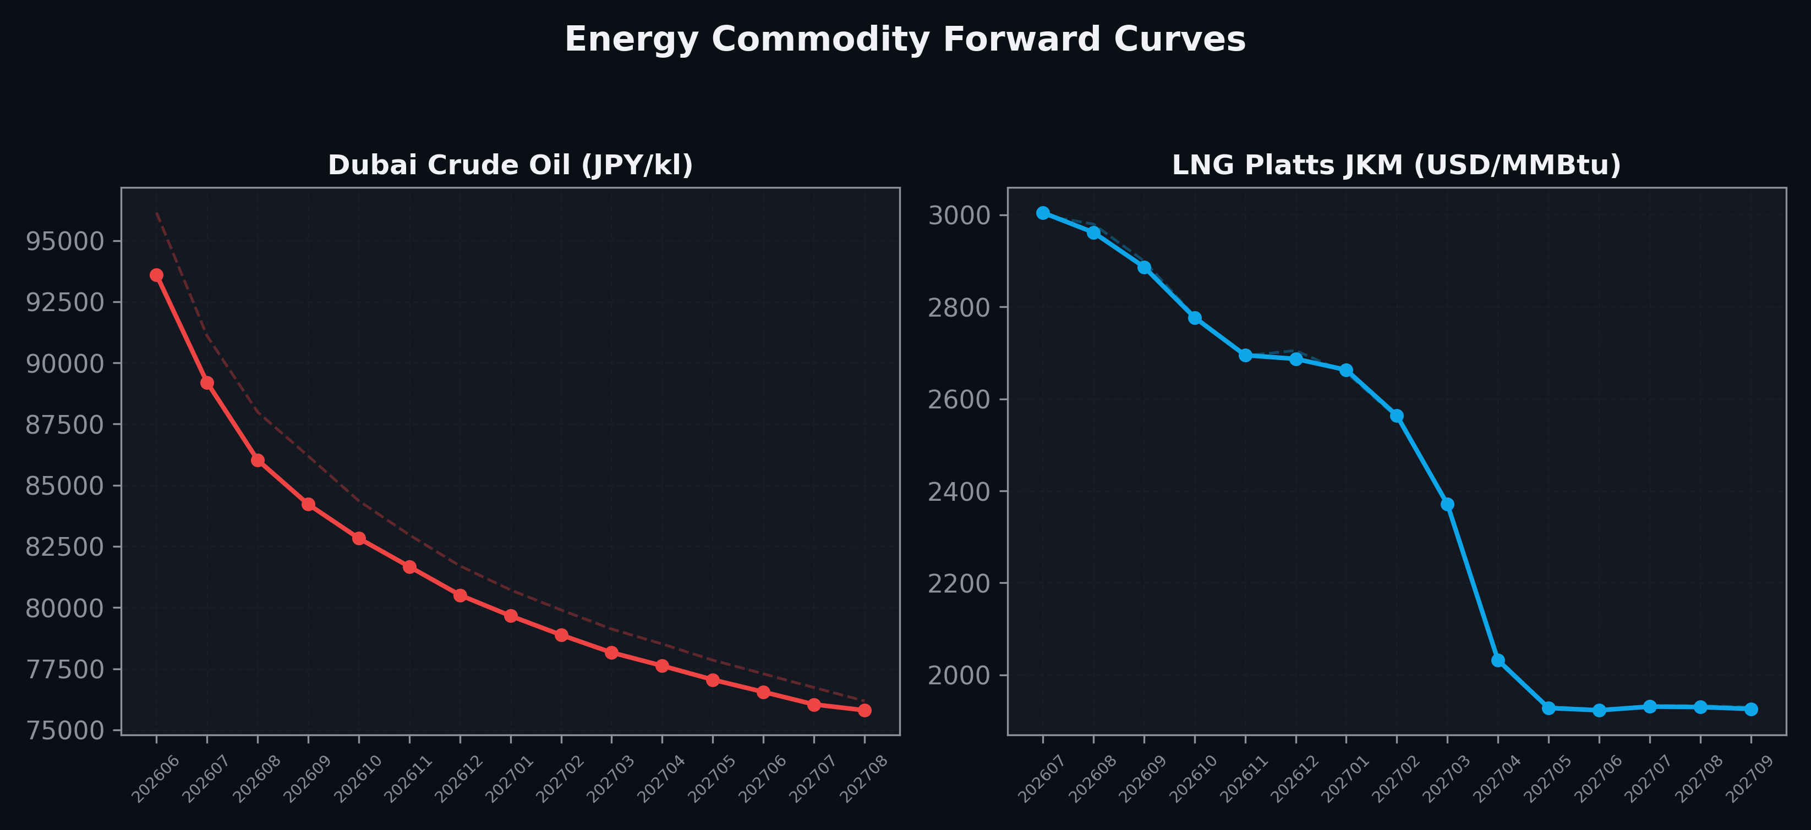
Energy Commodity Forward Curves
Dubai Crude Oil & LNG Platts JKM (2026-06-05)

Slide 6
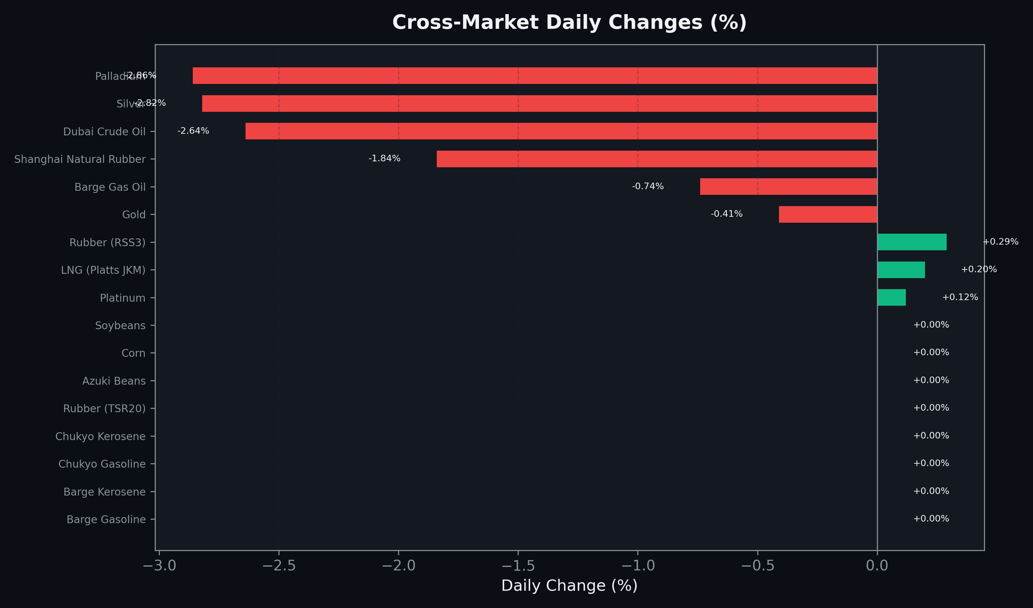
Cross-Market Daily Changes
All commodities sorted by absolute % change

Slide 7
Top Power Futures Movers
Largest absolute settlement price changes vs previous day (2026-06-05)
Instrument | Underlying | Month | Price | Prev | Change | % Chg
FUT_EEP_260629 | Power East Peak (Monthly) | 202606 | 26.80 | 27.25 | -0.45 | -1.65%
FUT_EEP_260730 | Power East Peak (Monthly) | 202607 | 31.10 | 31.48 | -0.38 | -1.21%
FUT_EEP_260828 | Power East Peak (Monthly) | 202608 | 30.67 | 31.03 | -0.36 | -1.16%
FUT_EWP_260629 | Power West Peak (Monthly) | 202606 | 22.64 | 23.00 | -0.36 | -1.57%
FUT_ECP_260629 | 電力(中部・日中) | 202606 | 24.56 | 24.88 | -0.32 | -1.29%
FUT_EEP_260929 | Power East Peak (Monthly) | 202609 | 29.99 | 30.26 | -0.27 | -0.89%
FUT_EWPW_260611 | Power West Peak (Weekly) | 20260612 | 22.04 | 22.31 | -0.27 | -1.21%
FUT_EEPW_260611 | Power East Peak (Weekly) | 20260612 | 26.14 | 26.39 | -0.25 | -0.95%
FUT_EEBW_260611 | Power East Base (Weekly) | 20260612 | 22.93 | 23.16 | -0.23 | -0.99%
FUT_EEBW_260625 | Power East Base (Weekly) | 20260626 | 22.75 | 22.97 | -0.22 | -0.96%
FUT_EWBW_260618 | Power West Base (Weekly) | 20260619 | 18.02 | 18.23 | -0.21 | -1.15%
FUT_EEPW_260618 | Power East Peak (Weekly) | 20260619 | 25.76 | 25.96 | -0.20 | -0.77%
FUT_EEPW_260702 | Power East Peak (Weekly) | 20260703 | 27.55 | 27.75 | -0.20 | -0.72%
FUT_EWBW_260625 | Power West Base (Weekly) | 20260626 | 17.77 | 17.97 | -0.20 | -1.11%
FUT_EEB_260629 | Power East Base (Monthly) | 202606 | 22.50 | 22.69 | -0.19 | -0.84%

