Slide 1
Daily Market Report
Trade Date: 2026-05-01
JPX Derivative & Commodity Analytics
DataServer In-House

Slide 2
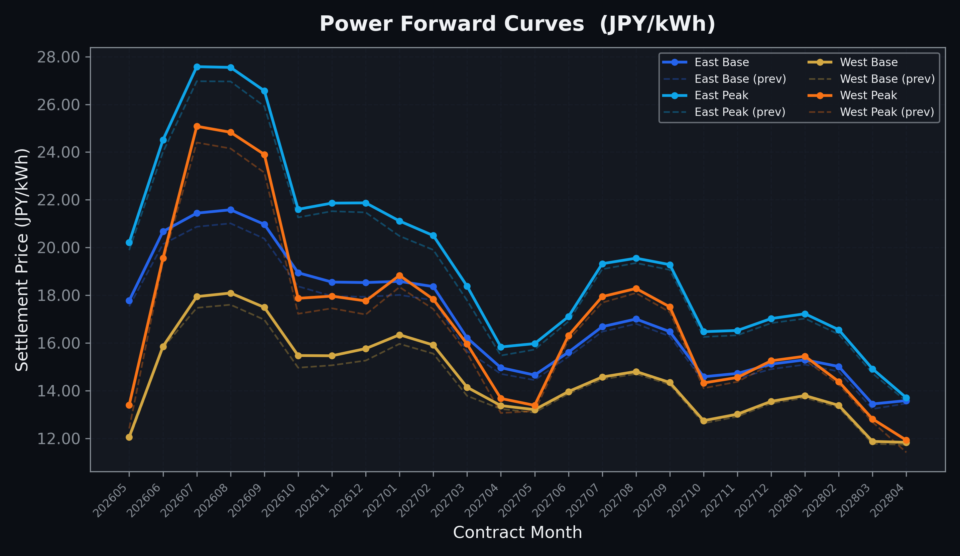
Power Forward Curves
East/West Base & Peak monthly contracts (2026-05-01)

Slide 3
Commodity Snapshot
Front-month settlement prices as of 2026-05-01
Category | Asset | Contract | Settlement | Unit | Change | % Chg
Energy | Barge Gas Oil | 202606 | 112,300.00 | JPY/kl | -700.00 | -0.62%
Energy | Barge Gasoline | 202606 | 100,000.00 | JPY/kl | +0.00 | +0.00%
Energy | Barge Kerosene | 202606 | 105,000.00 | JPY/kl | +0.00 | +0.00%
Energy | Chukyo Gasoline | 202606 | 100,000.00 | JPY/kl | +0.00 | +0.00%
Energy | Chukyo Kerosene | 202606 | 105,000.00 | JPY/kl | +0.00 | +0.00%
Energy | Dubai Crude Oil | 202605 | 102,920.00 | JPY/kl | -3100.00 | -2.92%
Energy | LNG (Platts JKM) | 202606 | 2,763.00 | USD/MMBtu | -66.00 | -2.33%
Metals | Gold | - | 23,167.00 | JPY/g | -267.00 | -1.14%
Metals | Palladium | 202606 | 7,600.00 | JPY/g | +0.00 | +0.00%
Metals | Platinum | - | 9,801.00 | JPY/g | +55.00 | +0.56%
Metals | Silver | 202606 | 380.00 | JPY/10g | +0.00 | +0.00%
Industrial | Rubber (RSS3) | 202605 | 396.00 | JPY/kg | -0.10 | -0.03%
Industrial | Rubber (TSR20) | 202606 | 330.00 | JPY/kg | +0.00 | +0.00%
Industrial | Shanghai Natural Rubber | 202605 | 17,425.00 | JPY/kg | +565.00 | +3.35%
Agriculture | Azuki Beans | 202605 | 12,300.00 | JPY/bag | +0.00 | +0.00%
Agriculture | Corn | 202607 | 39,000.00 | JPY/t | +0.00 | +0.00%
Agriculture | Soybeans | 202606 | 64,000.00 | JPY/t | +0.00 | +0.00%

Slide 4
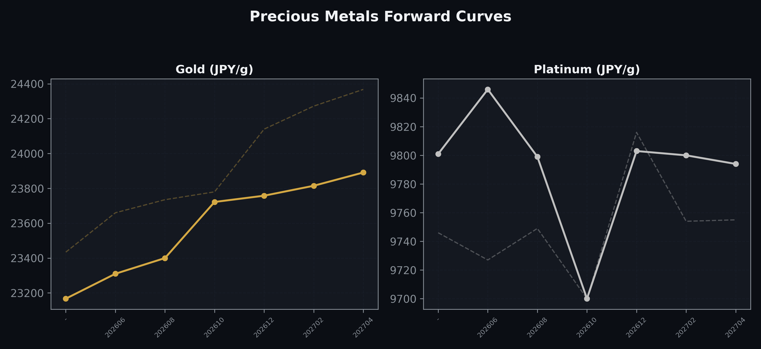
Precious Metals Forward Curves
Gold & Platinum (2026-05-01)

Slide 5
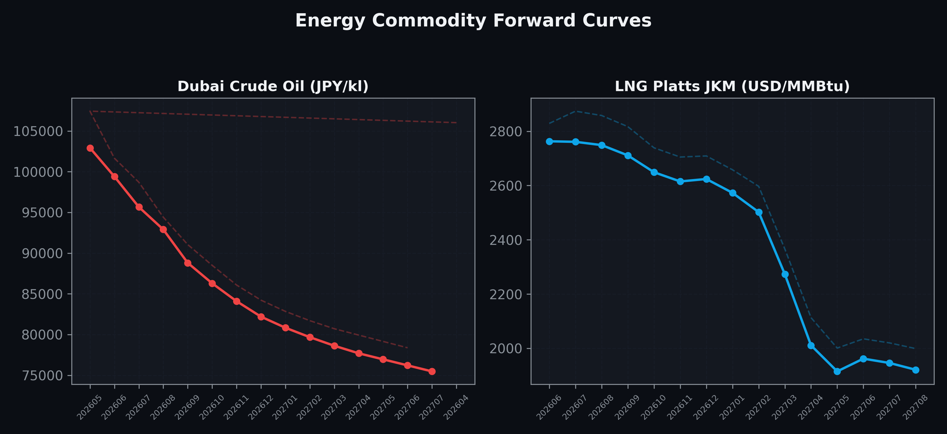
Energy Commodity Forward Curves
Dubai Crude Oil & LNG Platts JKM (2026-05-01)

Slide 6
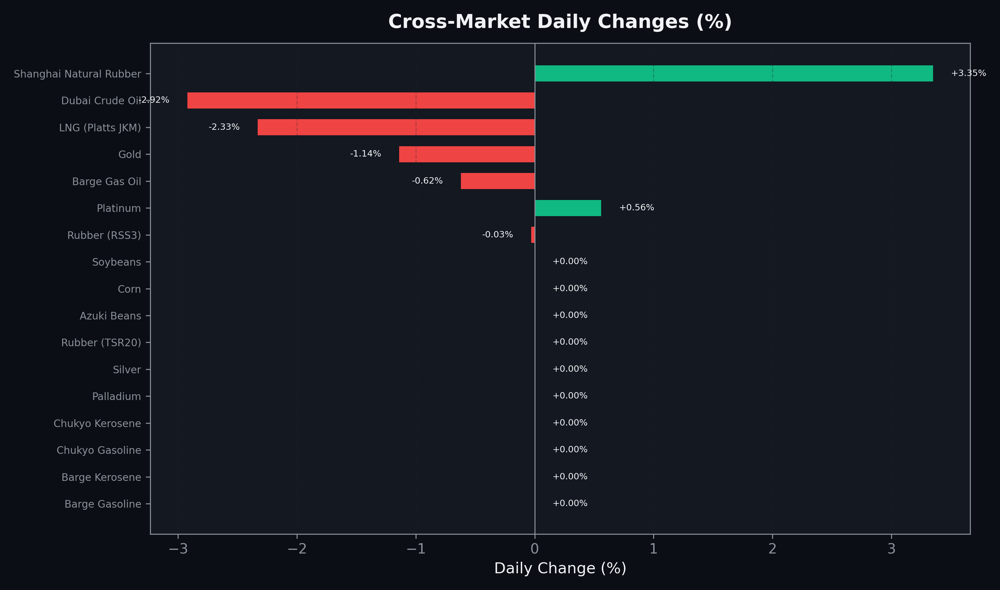
Cross-Market Daily Changes
All commodities sorted by absolute % change

Slide 7
Top Power Futures Movers
Largest absolute settlement price changes vs previous day (2026-05-01)
Instrument | Underlying | Month | Price | Prev | Change | % Chg
FUT_EWP_260528 | Power West Peak (Monthly) | 202605 | 13.39 | 12.41 | +0.98 | +7.90%
FUT_EWP_260929 | Power West Peak (Monthly) | 202609 | 23.90 | 23.14 | +0.76 | +3.28%
FUT_EWP_260730 | Power West Peak (Monthly) | 202607 | 25.08 | 24.40 | +0.68 | +2.79%
FUT_EWP_260828 | Power West Peak (Monthly) | 202608 | 24.83 | 24.15 | +0.68 | +2.82%
FUT_EWPW_260521 | Power West Peak (Weekly) | 20260522 | 11.69 | 11.01 | +0.68 | +6.18%
FUT_ECP_260929 | 電力(中部・日中) | 202609 | 25.69 | 25.04 | +0.65 | +2.60%
FUT_EEP_260929 | Power East Peak (Monthly) | 202609 | 26.57 | 25.92 | +0.65 | +2.51%
FUT_EWP_261029 | Power West Peak (Monthly) | 202610 | 17.87 | 17.22 | +0.65 | +3.77%
FUT_EWPW_260528 | Power West Peak (Weekly) | 20260529 | 12.48 | 11.83 | +0.65 | +5.49%
FUT_EEP_270128 | Power East Peak (Monthly) | 202701 | 21.11 | 20.48 | +0.63 | +3.08%
FUT_EEPW_260604 | Power East Peak (Weekly) | 20260605 | 21.76 | 21.13 | +0.63 | +2.98%
FUT_ECB_261230 | 電力(中部・ベース) | 202612 | 17.43 | 16.82 | +0.61 | +3.63%
FUT_EEP_260730 | Power East Peak (Monthly) | 202607 | 27.58 | 26.97 | +0.61 | +2.26%
FUT_EWP_270428 | Power West Peak (Monthly) | 202704 | 13.67 | 13.06 | +0.61 | +4.67%
FUT_EEB_260929 | Power East Base (Monthly) | 202609 | 20.97 | 20.37 | +0.60 | +2.95%

