Slide 1
Daily Market Report
Trade Date: 2026-06-04
JPX Derivative & Commodity Analytics
DataServer In-House

Slide 2
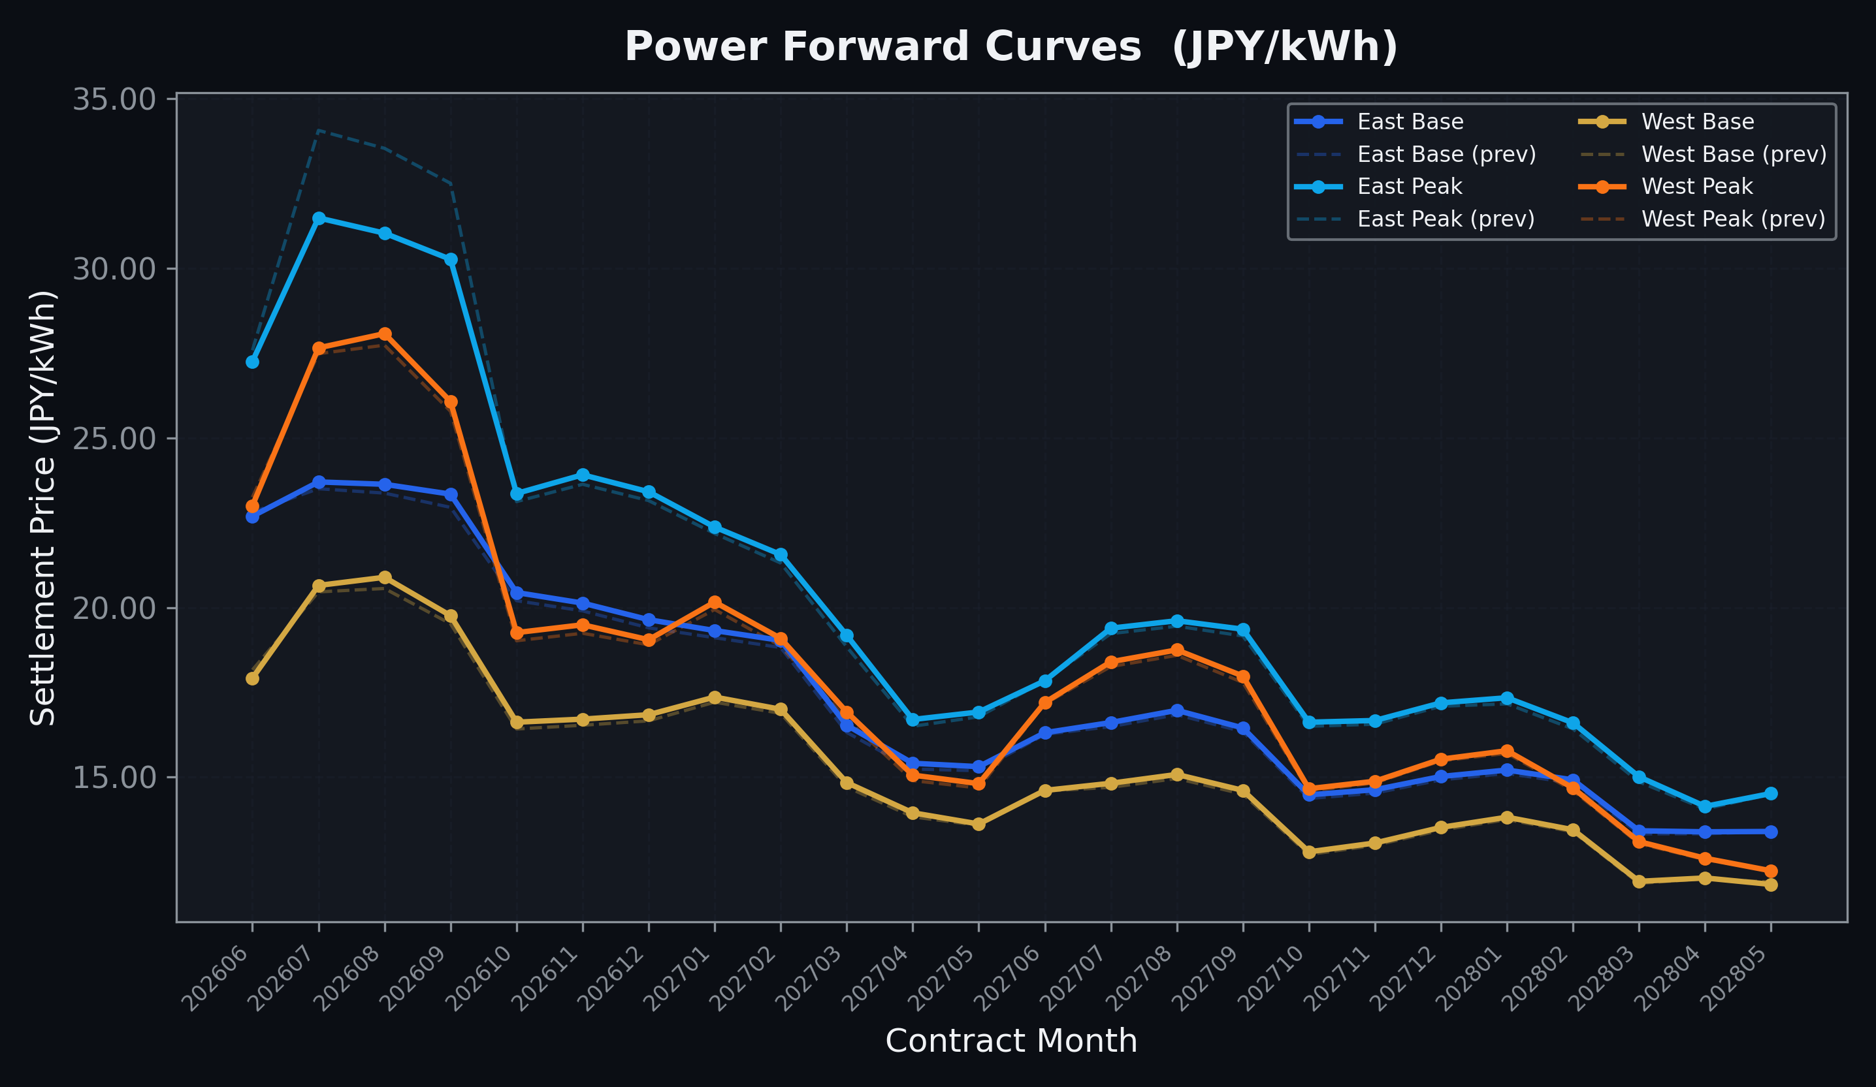
Power Forward Curves
East/West Base & Peak monthly contracts (2026-06-04)

Slide 3
Commodity Snapshot
Front-month settlement prices as of 2026-06-04
Category | Asset | Contract | Settlement | Unit | Change | % Chg
Energy | Barge Gas Oil | 202607 | 108,000.00 | JPY/kl | -400.00 | -0.37%
Energy | Barge Gasoline | 202607 | 100,000.00 | JPY/kl | +0.00 | +0.00%
Energy | Barge Kerosene | 202607 | 110,000.00 | JPY/kl | +0.00 | +0.00%
Energy | Chukyo Gasoline | 202607 | 95,000.00 | JPY/kl | +0.00 | +0.00%
Energy | Chukyo Kerosene | 202607 | 105,000.00 | JPY/kl | +0.00 | +0.00%
Energy | Dubai Crude Oil | 202606 | 96,140.00 | JPY/kl | +1650.00 | +1.75%
Energy | LNG (Platts JKM) | 202607 | 2,999.00 | USD/MMBtu | +29.00 | +0.98%
Metals | Gold | - | 22,919.00 | JPY/g | +15.00 | +0.07%
Metals | Palladium | 202606 | 7,000.00 | JPY/g | +0.00 | +0.00%
Metals | Platinum | - | 9,618.00 | JPY/g | -253.00 | -2.56%
Metals | Silver | 202606 | 390.00 | JPY/10g | +0.00 | +0.00%
Industrial | Rubber (RSS3) | 202606 | 415.00 | JPY/kg | -8.80 | -2.08%
Industrial | Rubber (TSR20) | 202607 | 365.00 | JPY/kg | +0.00 | +0.00%
Industrial | Shanghai Natural Rubber | 202609 | 17,980.00 | JPY/kg | -340.00 | -1.86%
Agriculture | Azuki Beans | 202606 | 12,300.00 | JPY/bag | +0.00 | +0.00%
Agriculture | Corn | 202607 | 39,000.00 | JPY/t | +0.00 | +0.00%
Agriculture | Soybeans | 202606 | 64,000.00 | JPY/t | +0.00 | +0.00%

Slide 4
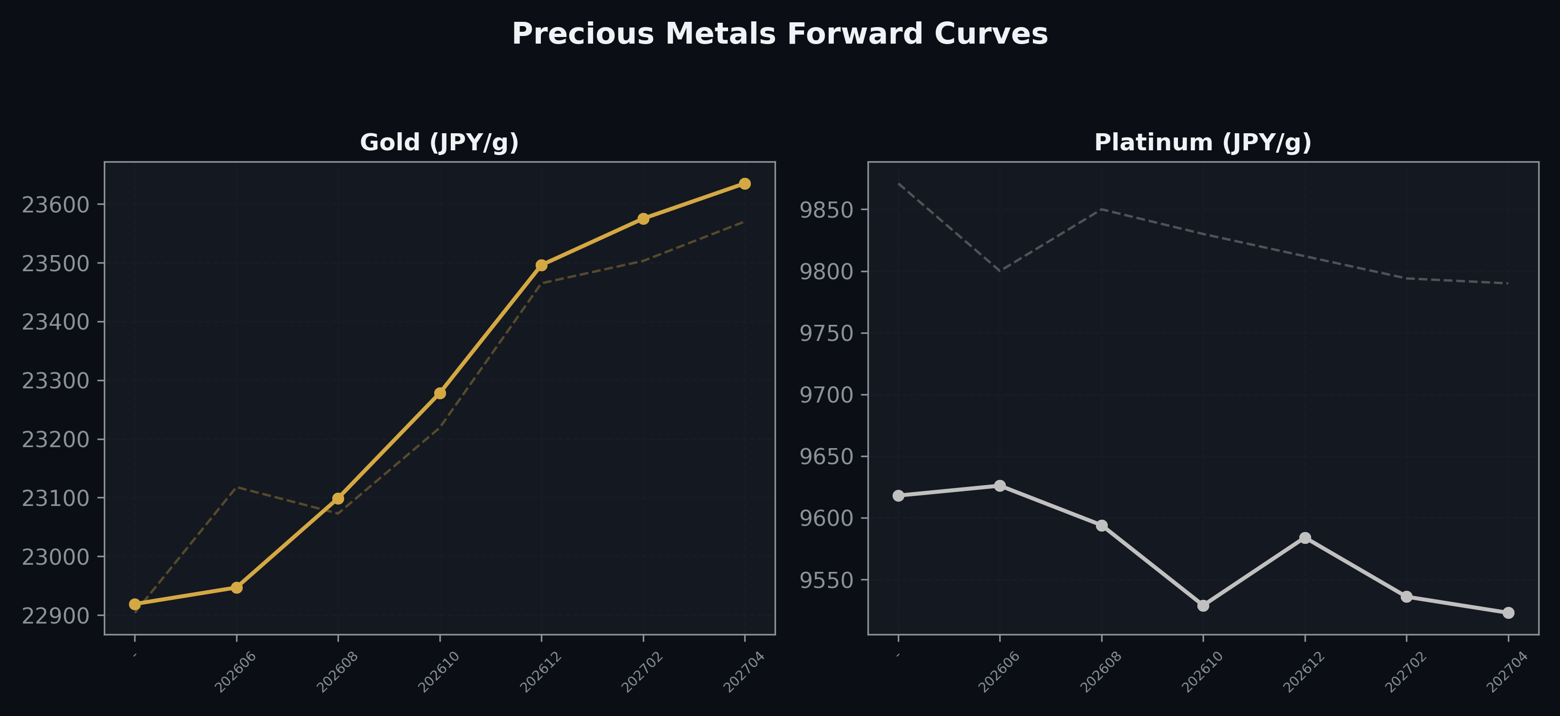
Precious Metals Forward Curves
Gold & Platinum (2026-06-04)

Slide 5
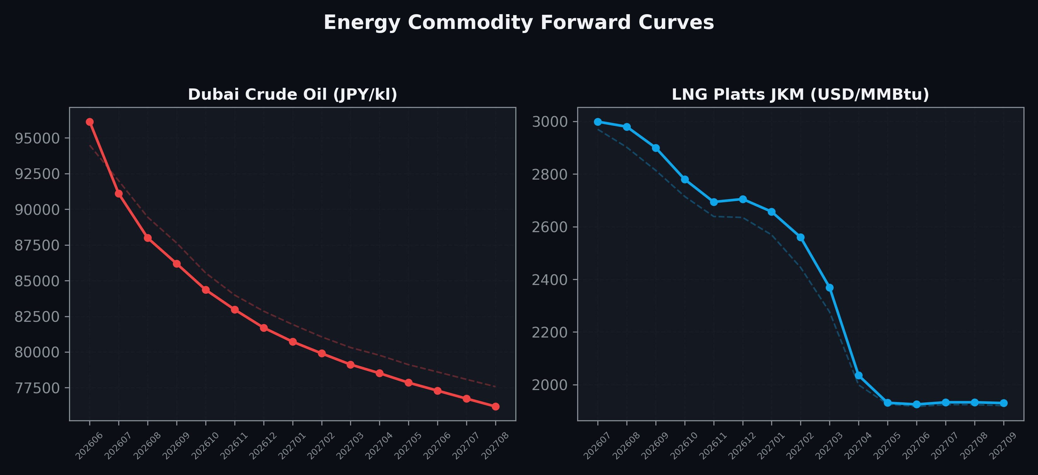
Energy Commodity Forward Curves
Dubai Crude Oil & LNG Platts JKM (2026-06-04)

Slide 6
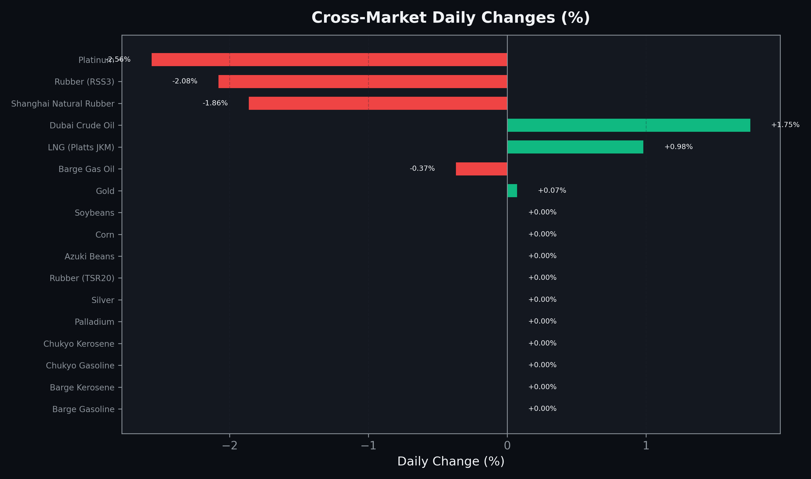
Cross-Market Daily Changes
All commodities sorted by absolute % change

Slide 7
Top Power Futures Movers
Largest absolute settlement price changes vs previous day (2026-06-04)
Instrument | Underlying | Month | Price | Prev | Change | % Chg
FUT_EEP_260730 | Power East Peak (Monthly) | 202607 | 31.48 | 34.06 | -2.58 | -7.57%
FUT_EEP_260828 | Power East Peak (Monthly) | 202608 | 31.03 | 33.53 | -2.50 | -7.46%
FUT_EEP_260929 | Power East Peak (Monthly) | 202609 | 30.26 | 32.50 | -2.24 | -6.89%
FUT_EEPW_260604 | Power East Peak (Weekly) | 20260605 | 26.48 | 27.73 | -1.25 | -4.51%
FUT_ECP_260929 | 電力(中部・日中) | 202609 | 28.54 | 27.79 | +0.75 | +2.70%
FUT_EWPW_260604 | Power West Peak (Weekly) | 20260605 | 21.94 | 22.68 | -0.74 | -3.26%
FUT_ECP_260828 | 電力(中部・日中) | 202608 | 28.81 | 28.33 | +0.48 | +1.69%
FUT_ECB_260929 | 電力(中部・ベース) | 202609 | 22.38 | 21.98 | +0.40 | +1.82%
FUT_EWBW_260625 | Power West Base (Weekly) | 20260626 | 17.97 | 18.37 | -0.40 | -2.18%
FUT_EEB_260929 | Power East Base (Monthly) | 202609 | 23.34 | 22.95 | +0.39 | +1.70%
FUT_EWPW_260702 | Power West Peak (Weekly) | 20260703 | 24.87 | 24.49 | +0.38 | +1.55%
FUT_ECB_270226 | 電力(中部・ベース) | 202702 | 18.22 | 17.85 | +0.37 | +2.07%
FUT_EEP_270330 | Power East Peak (Monthly) | 202703 | 19.18 | 18.84 | +0.34 | +1.80%
FUT_EWP_260828 | Power West Peak (Monthly) | 202608 | 28.07 | 27.73 | +0.34 | +1.23%
FUT_EEP_260629 | Power East Peak (Monthly) | 202606 | 27.25 | 27.58 | -0.33 | -1.20%

