Slide 1
Daily Market Report
Trade Date: 2026-04-15
JPX Derivative & Commodity Analytics
DataServer In-House

Slide 2
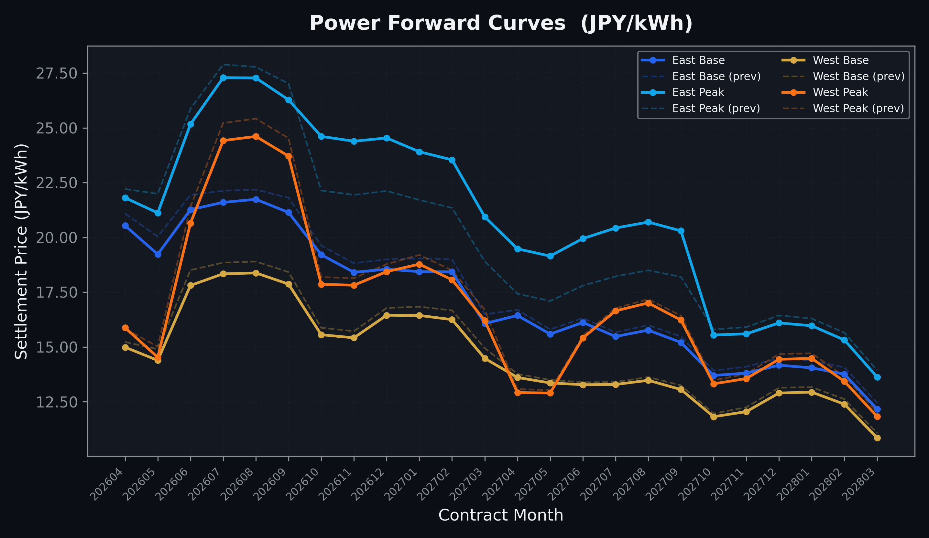
Power Forward Curves
East/West Base & Peak monthly contracts (2026-04-15)

Slide 3
Commodity Snapshot
Front-month settlement prices as of 2026-04-15
Category | Asset | Contract | Settlement | Unit | Change | % Chg
Energy | Barge Gas Oil | 202605 | 114,600.00 | JPY/kl | +500.00 | +0.44%
Energy | Barge Gasoline | 202605 | 110,000.00 | JPY/kl | -5000.00 | -4.35%
Energy | Barge Kerosene | 202605 | 105,000.00 | JPY/kl | +0.00 | +0.00%
Energy | Chukyo Gasoline | 202605 | 105,000.00 | JPY/kl | -5000.00 | -4.55%
Energy | Chukyo Kerosene | 202605 | 105,000.00 | JPY/kl | +0.00 | +0.00%
Energy | Dubai Crude Oil | 202604 | 104,040.00 | JPY/kl | -1440.00 | -1.37%
Energy | LNG (Platts JKM) | 202605 | 3,087.00 | USD/MMBtu | +0.00 | +0.00%
Metals | Gold | - | 24,540.00 | JPY/g | +50.00 | +0.20%
Metals | Palladium | 202604 | 8,000.00 | JPY/g | +200.00 | +2.56%
Metals | Platinum | - | 10,728.00 | JPY/g | +183.00 | +1.74%
Metals | Silver | 202604 | 390.00 | JPY/10g | +8.00 | +2.09%
Industrial | Rubber (RSS3) | 202604 | 377.00 | JPY/kg | +0.00 | +0.00%
Industrial | Rubber (TSR20) | 202605 | 325.00 | JPY/kg | +5.00 | +1.56%
Industrial | Shanghai Natural Rubber | 202605 | 16,680.00 | JPY/kg | +65.00 | +0.39%
Agriculture | Azuki Beans | 202604 | 12,300.00 | JPY/bag | +0.00 | +0.00%
Agriculture | Corn | 202605 | 39,000.00 | JPY/t | +0.00 | +0.00%
Agriculture | Soybeans | 202604 | 64,000.00 | JPY/t | +0.00 | +0.00%

Slide 4
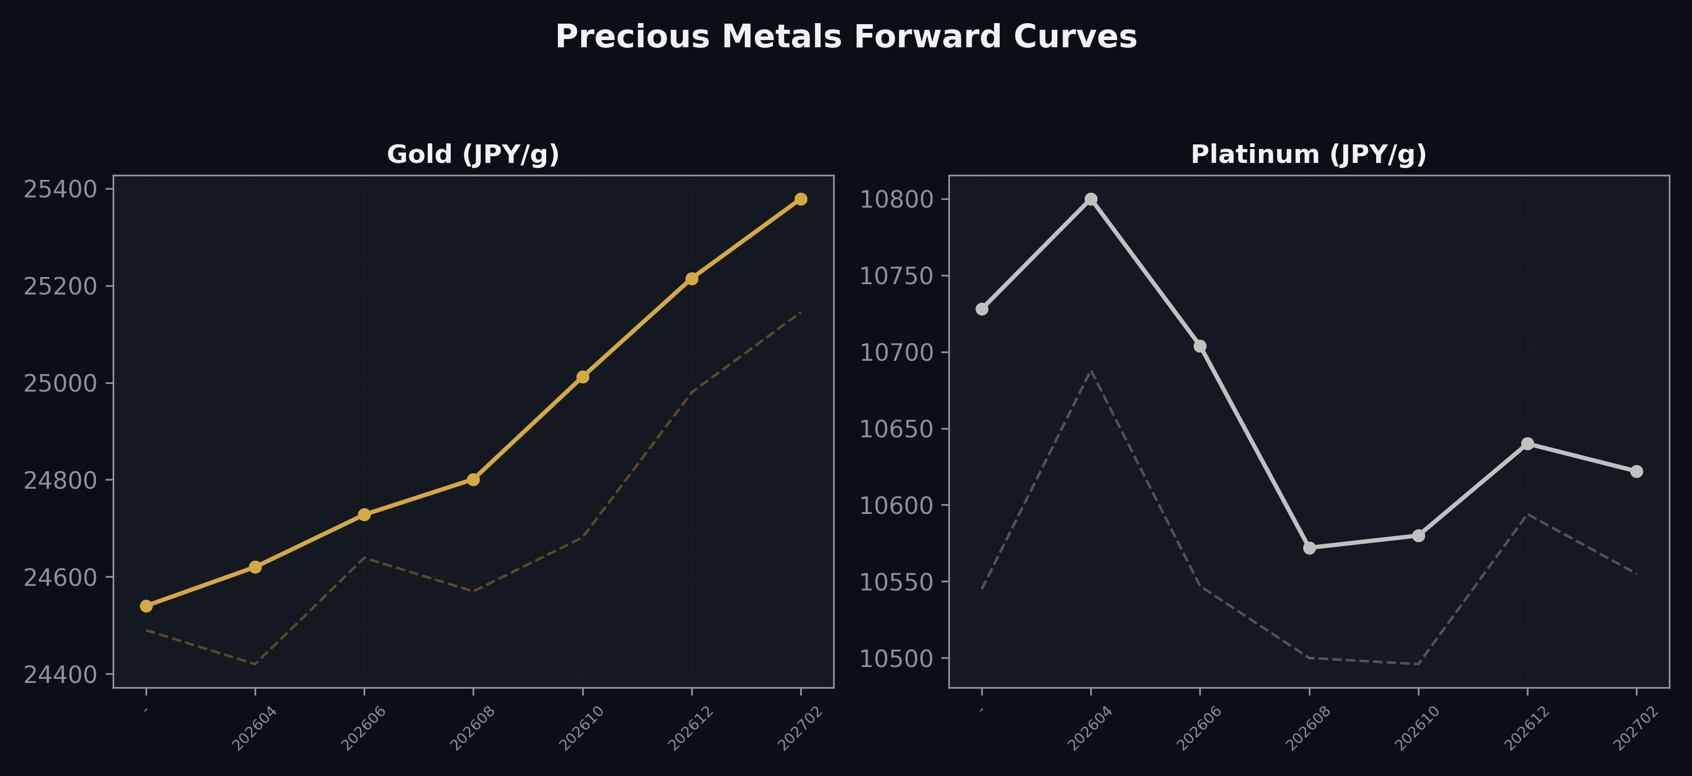
Precious Metals Forward Curves
Gold & Platinum (2026-04-15)

Slide 5
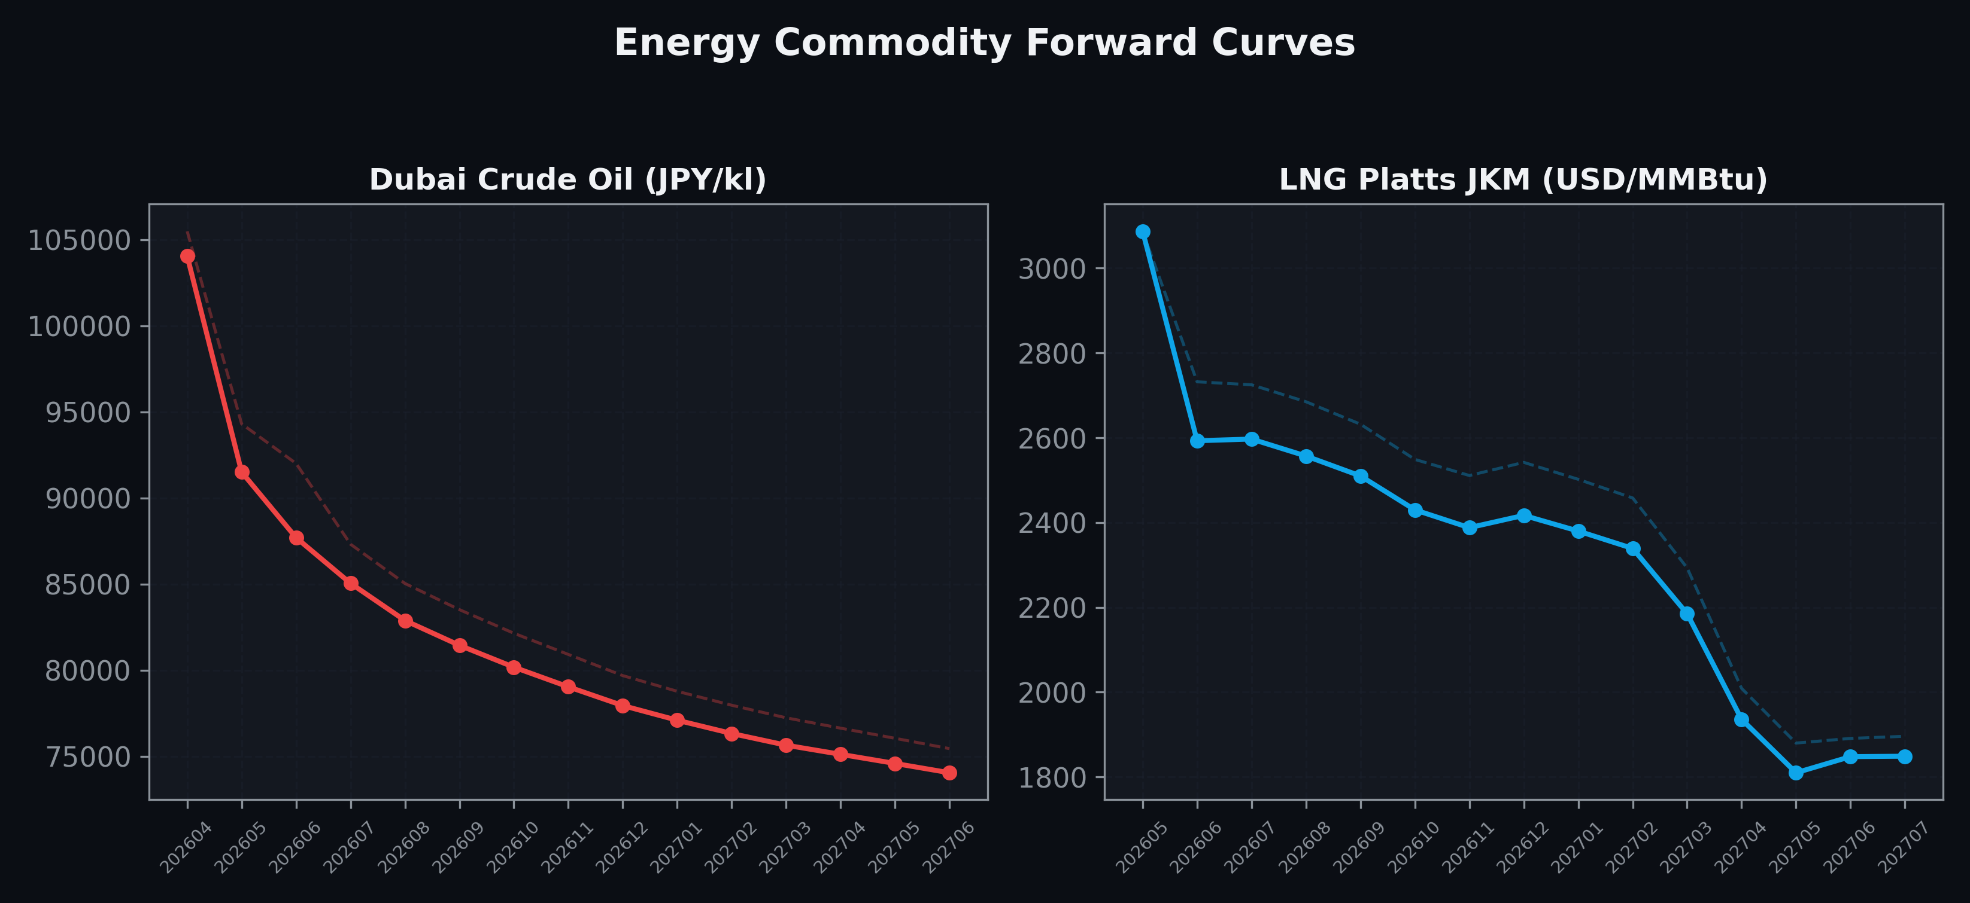
Energy Commodity Forward Curves
Dubai Crude Oil & LNG Platts JKM (2026-04-15)

Slide 6
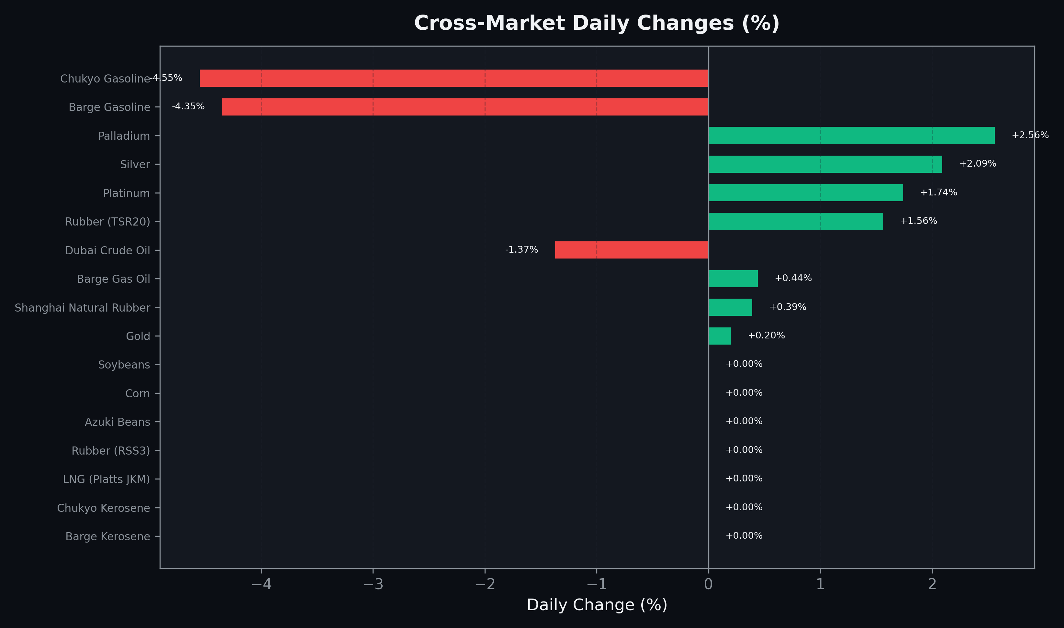
Cross-Market Daily Changes
All commodities sorted by absolute % change

Slide 7
Top Power Futures Movers
Largest absolute settlement price changes vs previous day (2026-04-15)
Instrument | Underlying | Month | Price | Prev | Change | % Chg
FUT_EEP_261029 | Power East Peak (Monthly) | 202610 | 24.61 | 22.14 | +2.47 | +11.16%
FUT_EEP_261127 | Power East Peak (Monthly) | 202611 | 24.39 | 21.94 | +2.45 | +11.17%
FUT_EEP_261228 | Power East Peak (Monthly) | 202612 | 24.54 | 22.12 | +2.42 | +10.94%
FUT_EEP_270729 | Power East Peak (Monthly) | 202707 | 20.43 | 18.22 | +2.21 | +12.13%
FUT_EEP_270128 | Power East Peak (Monthly) | 202701 | 23.91 | 21.71 | +2.20 | +10.13%
FUT_EEP_270830 | Power East Peak (Monthly) | 202708 | 20.70 | 18.50 | +2.20 | +11.89%
FUT_EEP_270225 | Power East Peak (Monthly) | 202702 | 23.54 | 21.35 | +2.19 | +10.26%
FUT_EEP_270629 | Power East Peak (Monthly) | 202706 | 19.95 | 17.80 | +2.15 | +12.08%
FUT_EEP_270929 | Power East Peak (Monthly) | 202709 | 20.30 | 18.20 | +2.10 | +11.54%
FUT_EEP_270428 | Power East Peak (Monthly) | 202704 | 19.48 | 17.43 | +2.05 | +11.76%
FUT_EEP_270528 | Power East Peak (Monthly) | 202705 | 19.15 | 17.10 | +2.05 | +11.99%
FUT_EEP_270330 | Power East Peak (Monthly) | 202703 | 20.94 | 18.91 | +2.03 | +10.74%
FUT_EWPW_260416 | Power West Peak (Weekly) | 20260417 | 14.88 | 15.92 | -1.04 | -6.53%
FUT_EEPY_270326 | Power East Peak (Yearly) | 202704 | 17.70 | 16.78 | +0.92 | +5.48%
FUT_EEPW_260514 | Power East Peak (Weekly) | 20260515 | 21.00 | 21.92 | -0.92 | -4.20%

