Slide 1
Daily Market Report
Trade Date: 2026-04-14
JPX Derivative & Commodity Analytics
DataServer In-House

Slide 2
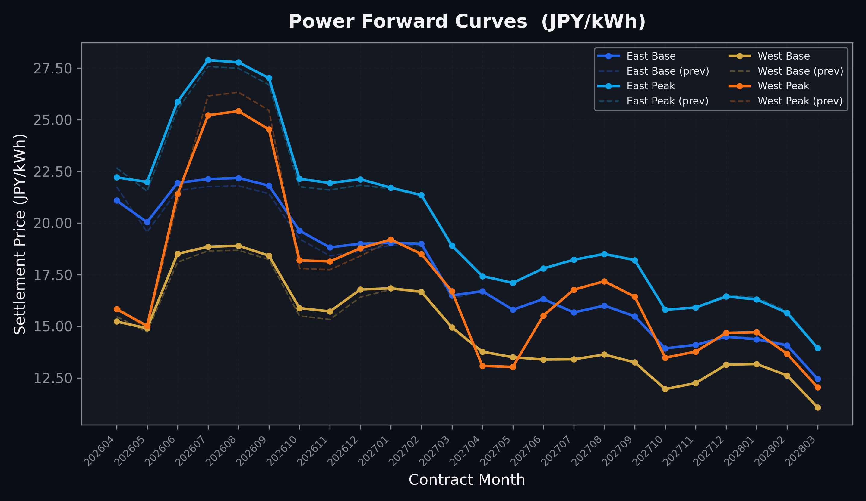
Power Forward Curves
East/West Base & Peak monthly contracts (2026-04-14)

Slide 3
Commodity Snapshot
Front-month settlement prices as of 2026-04-14
Category | Asset | Contract | Settlement | Unit | Change | % Chg
Energy | Barge Gas Oil | 202605 | 114,100.00 | JPY/kl | -200.00 | -0.17%
Energy | Barge Gasoline | 202605 | 115,000.00 | JPY/kl | +0.00 | +0.00%
Energy | Barge Kerosene | 202605 | 105,000.00 | JPY/kl | +0.00 | +0.00%
Energy | Chukyo Gasoline | 202605 | 110,000.00 | JPY/kl | +0.00 | +0.00%
Energy | Chukyo Kerosene | 202605 | 105,000.00 | JPY/kl | +0.00 | +0.00%
Energy | Dubai Crude Oil | 202604 | 105,480.00 | JPY/kl | +4730.00 | +4.69%
Energy | LNG (Platts JKM) | 202605 | 3,087.00 | USD/MMBtu | +243.00 | +8.54%
Metals | Gold | - | 24,490.00 | JPY/g | +315.00 | +1.30%
Metals | Palladium | 202604 | 7,800.00 | JPY/g | +0.00 | +0.00%
Metals | Platinum | - | 10,545.00 | JPY/g | +174.00 | +1.68%
Metals | Silver | 202604 | 382.00 | JPY/10g | +17.00 | +4.66%
Industrial | Rubber (RSS3) | 202604 | 377.00 | JPY/kg | +0.00 | +0.00%
Industrial | Rubber (TSR20) | 202605 | 320.00 | JPY/kg | +0.00 | +0.00%
Industrial | Shanghai Natural Rubber | 202605 | 16,615.00 | JPY/kg | -50.00 | -0.30%
Agriculture | Azuki Beans | 202604 | 12,300.00 | JPY/bag | +0.00 | +0.00%
Agriculture | Corn | 202605 | 39,000.00 | JPY/t | +0.00 | +0.00%
Agriculture | Soybeans | 202604 | 64,000.00 | JPY/t | +0.00 | +0.00%

Slide 4
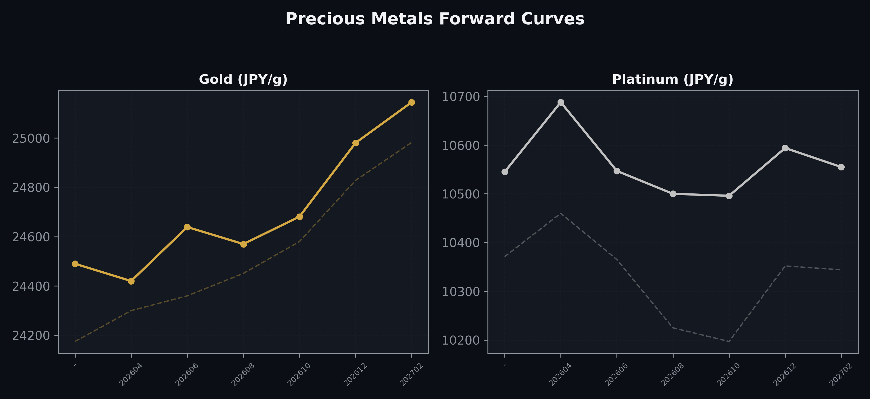
Precious Metals Forward Curves
Gold & Platinum (2026-04-14)

Slide 5
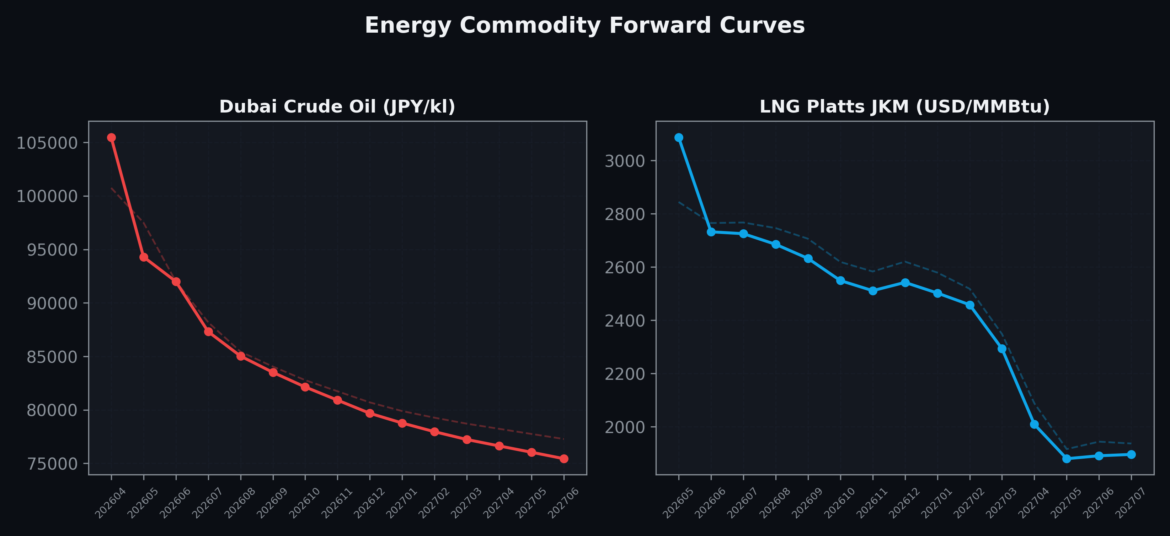
Energy Commodity Forward Curves
Dubai Crude Oil & LNG Platts JKM (2026-04-14)

Slide 6
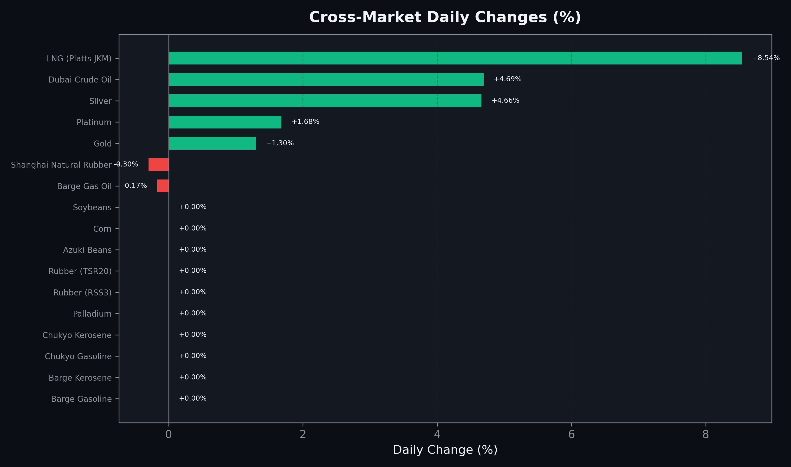
Cross-Market Daily Changes
All commodities sorted by absolute % change

Slide 7
Top Power Futures Movers
Largest absolute settlement price changes vs previous day (2026-04-14)
Instrument | Underlying | Month | Price | Prev | Change | % Chg
FUT_ECP_260929 | 電力(中部・日中) | 202609 | 26.51 | 28.19 | -1.68 | -5.96%
FUT_ECP_260828 | 電力(中部・日中) | 202608 | 26.61 | 28.26 | -1.65 | -5.84%
FUT_ECP_260730 | 電力(中部・日中) | 202607 | 26.37 | 28.00 | -1.63 | -5.82%
FUT_ECB_260929 | 電力(中部・ベース) | 202609 | 20.60 | 22.00 | -1.40 | -6.36%
FUT_ECB_260730 | 電力(中部・ベース) | 202607 | 20.91 | 22.29 | -1.38 | -6.19%
FUT_ECB_260828 | 電力(中部・ベース) | 202608 | 20.92 | 22.30 | -1.38 | -6.19%
FUT_EEPW_260423 | Power East Peak (Weekly) | 20260424 | 22.15 | 23.32 | -1.17 | -5.02%
FUT_EWPW_260416 | Power West Peak (Weekly) | 20260417 | 15.92 | 14.85 | +1.07 | +7.21%
FUT_EEBW_260423 | Power East Base (Weekly) | 20260424 | 21.05 | 22.00 | -0.95 | -4.32%
FUT_EWP_260730 | Power West Peak (Monthly) | 202607 | 25.22 | 26.15 | -0.93 | -3.56%
FUT_EWP_260929 | Power West Peak (Monthly) | 202609 | 24.53 | 25.46 | -0.93 | -3.65%
FUT_EWP_260828 | Power West Peak (Monthly) | 202608 | 25.42 | 26.33 | -0.91 | -3.46%
FUT_EEBW_260416 | Power East Base (Weekly) | 20260417 | 18.46 | 19.15 | -0.69 | -3.60%
FUT_EEB_260428 | Power East Base (Monthly) | 202604 | 21.09 | 21.76 | -0.67 | -3.08%
FUT_EEBW_260514 | Power East Base (Weekly) | 20260515 | 20.40 | 19.75 | +0.65 | +3.29%

