Slide 1
Daily Market Report
Trade Date: 2026-05-08
JPX Derivative & Commodity Analytics
DataServer In-House

Slide 2
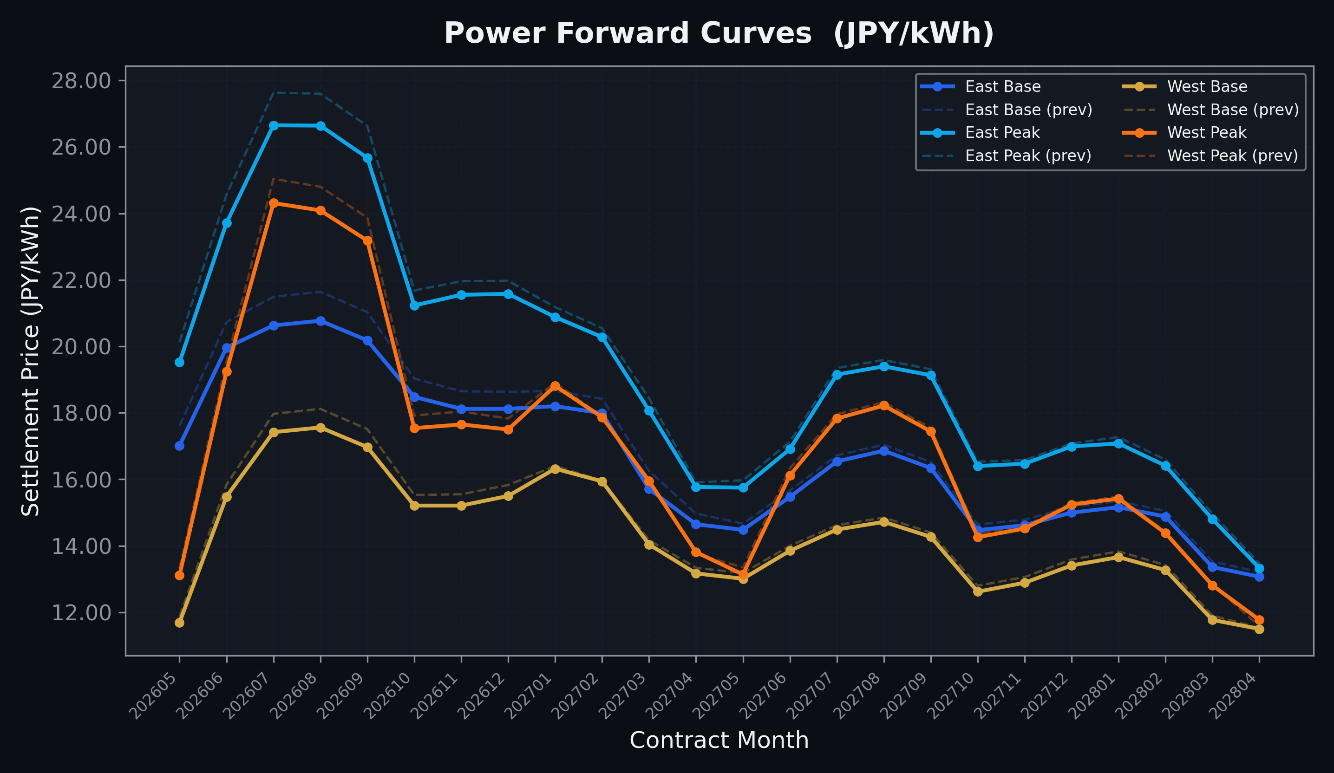
Power Forward Curves
East/West Base & Peak monthly contracts (2026-05-08)

Slide 3
Commodity Snapshot
Front-month settlement prices as of 2026-05-08
Category | Asset | Contract | Settlement | Unit | Change | % Chg
Energy | Barge Gas Oil | 202606 | 111,700.00 | JPY/kl | +0.00 | +0.00%
Energy | Barge Gasoline | 202606 | 100,000.00 | JPY/kl | +0.00 | +0.00%
Energy | Barge Kerosene | 202606 | 105,000.00 | JPY/kl | +0.00 | +0.00%
Energy | Chukyo Gasoline | 202606 | 100,000.00 | JPY/kl | +0.00 | +0.00%
Energy | Chukyo Kerosene | 202606 | 105,000.00 | JPY/kl | +0.00 | +0.00%
Energy | Dubai Crude Oil | 202605 | 95,530.00 | JPY/kl | -6470.00 | -6.34%
Energy | LNG (Platts JKM) | 202606 | 2,706.00 | USD/MMBtu | +19.00 | +0.71%
Metals | Gold | - | 23,754.00 | JPY/g | +418.00 | +1.79%
Metals | Palladium | 202606 | 7,600.00 | JPY/g | +0.00 | +0.00%
Metals | Platinum | - | 10,327.00 | JPY/g | +88.00 | +0.86%
Metals | Silver | 202606 | 390.00 | JPY/10g | +10.00 | +2.63%
Industrial | Rubber (RSS3) | 202605 | 403.70 | JPY/kg | +0.90 | +0.22%
Industrial | Rubber (TSR20) | 202606 | 340.00 | JPY/kg | +0.00 | +0.00%
Industrial | Shanghai Natural Rubber | 202605 | 17,855.00 | JPY/kg | -15.00 | -0.08%
Agriculture | Azuki Beans | 202605 | 12,300.00 | JPY/bag | +0.00 | +0.00%
Agriculture | Corn | 202607 | 39,000.00 | JPY/t | +0.00 | +0.00%
Agriculture | Soybeans | 202606 | 64,000.00 | JPY/t | +0.00 | +0.00%

Slide 4
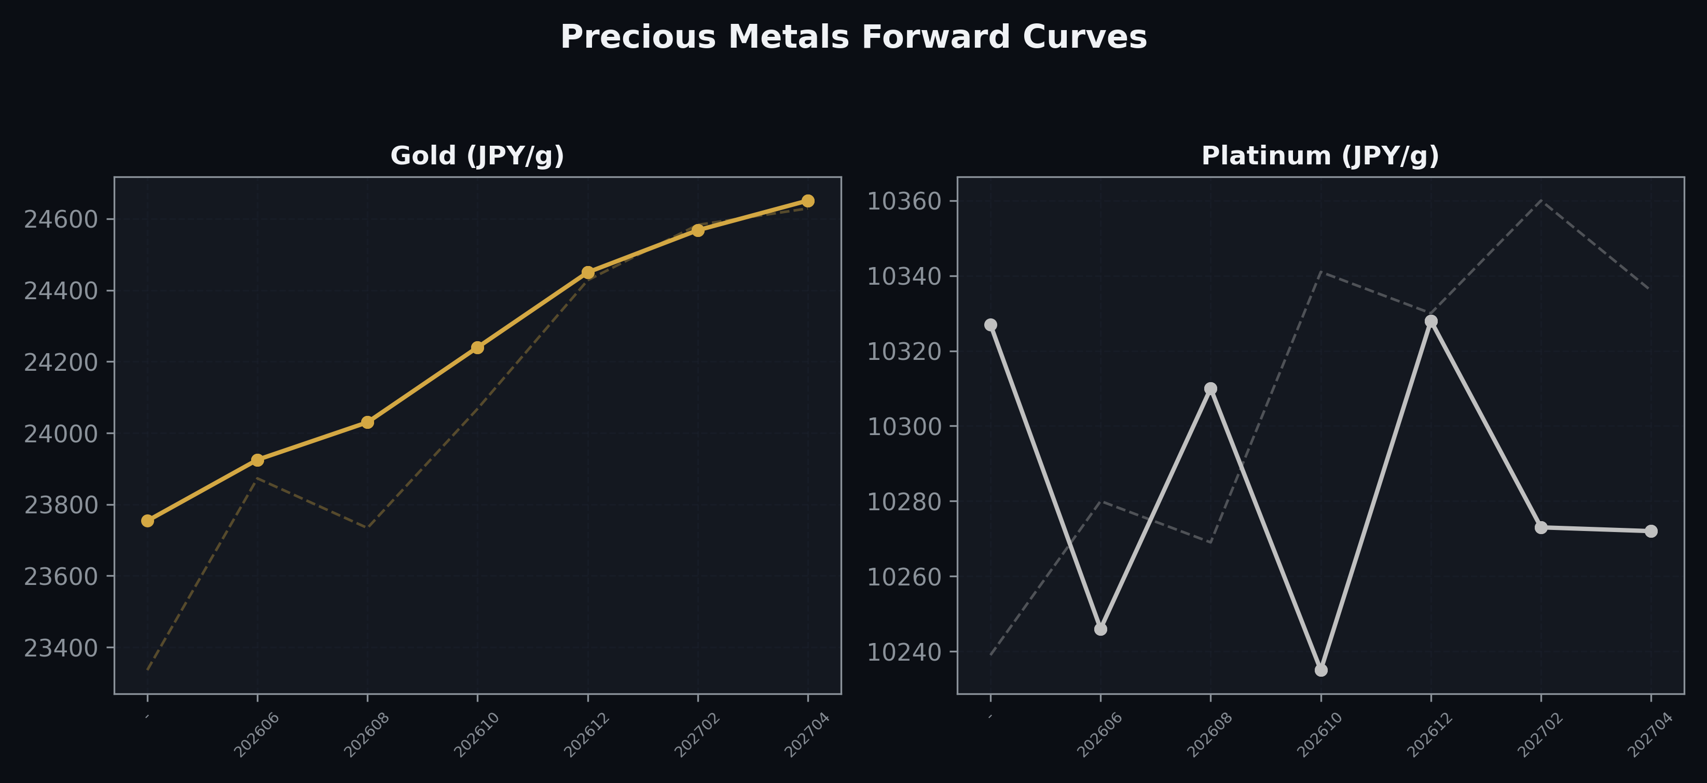
Precious Metals Forward Curves
Gold & Platinum (2026-05-08)

Slide 5
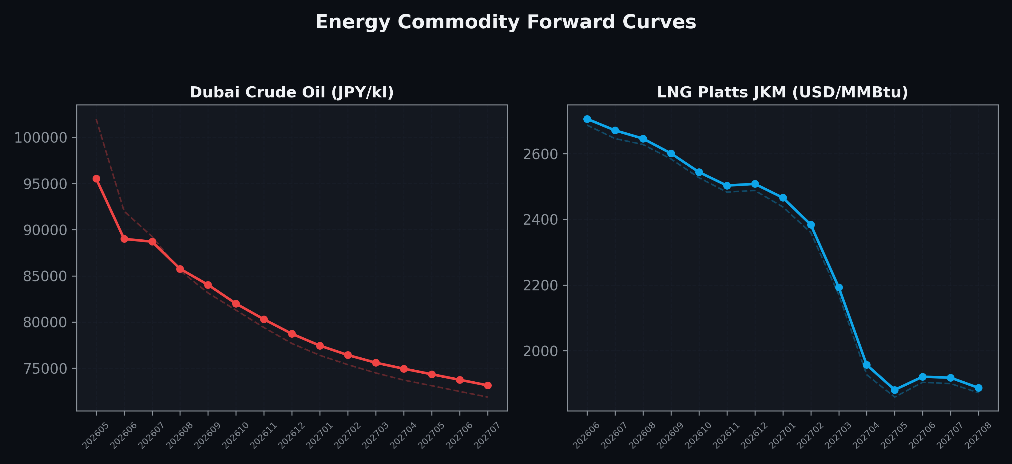
Energy Commodity Forward Curves
Dubai Crude Oil & LNG Platts JKM (2026-05-08)

Slide 6
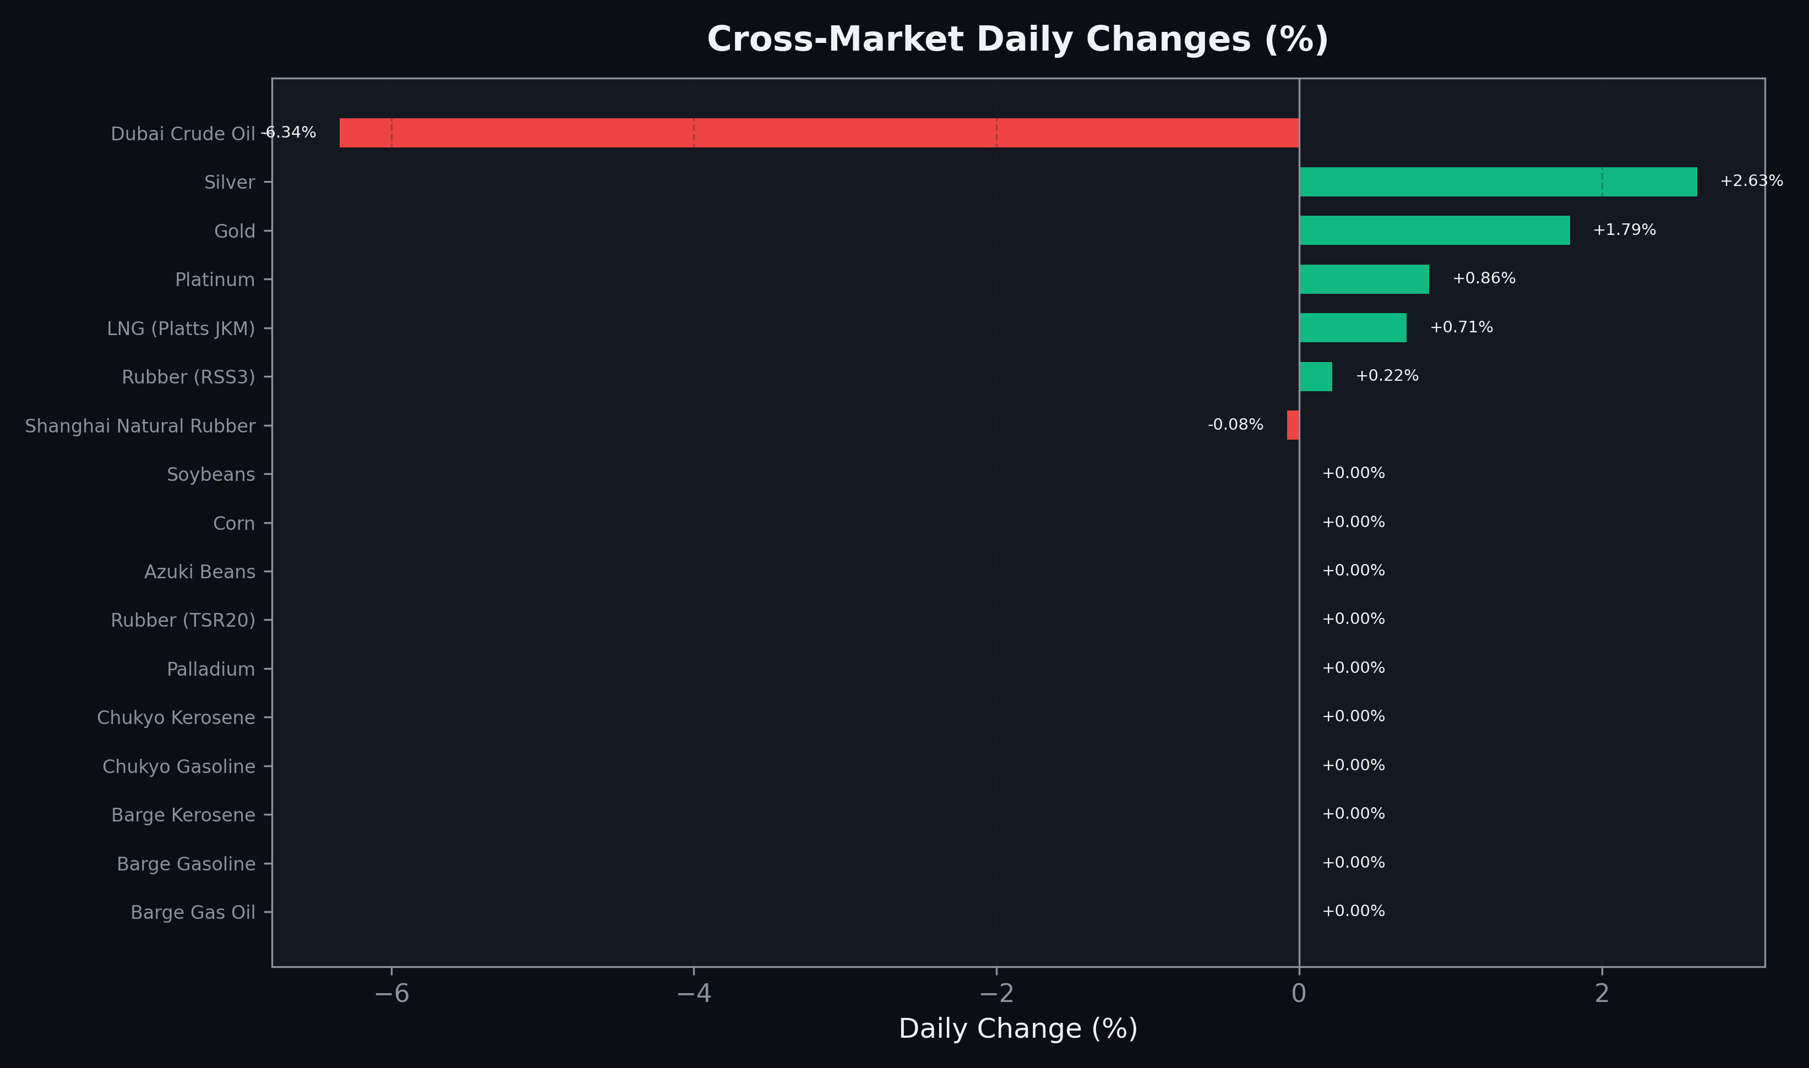
Cross-Market Daily Changes
All commodities sorted by absolute % change

Slide 7
Top Power Futures Movers
Largest absolute settlement price changes vs previous day (2026-05-08)
Instrument | Underlying | Month | Price | Prev | Change | % Chg
FUT_ECP_260929 | 電力(中部・日中) | 202609 | 24.28 | 25.62 | -1.34 | -5.23%
FUT_ECP_260828 | 電力(中部・日中) | 202608 | 24.67 | 25.99 | -1.32 | -5.08%
FUT_ECB_260929 | 電力(中部・ベース) | 202609 | 18.71 | 19.86 | -1.15 | -5.79%
FUT_ECP_260730 | 電力(中部・日中) | 202607 | 24.59 | 25.67 | -1.08 | -4.21%
FUT_ECB_260828 | 電力(中部・ベース) | 202608 | 19.30 | 20.32 | -1.02 | -5.02%
FUT_ECB_260730 | 電力(中部・ベース) | 202607 | 19.09 | 20.07 | -0.98 | -4.88%
FUT_EEP_260730 | Power East Peak (Monthly) | 202607 | 26.65 | 27.63 | -0.98 | -3.55%
FUT_EEP_260828 | Power East Peak (Monthly) | 202608 | 26.64 | 27.60 | -0.96 | -3.48%
FUT_EEP_260929 | Power East Peak (Monthly) | 202609 | 25.67 | 26.63 | -0.96 | -3.60%
FUT_EEPW_260528 | Power East Peak (Weekly) | 20260529 | 19.99 | 20.94 | -0.95 | -4.54%
FUT_EEPW_260604 | Power East Peak (Weekly) | 20260605 | 22.07 | 23.02 | -0.95 | -4.13%
FUT_EEPW_260521 | Power East Peak (Weekly) | 20260522 | 18.85 | 19.78 | -0.93 | -4.70%
FUT_EEB_260828 | Power East Base (Monthly) | 202608 | 20.77 | 21.64 | -0.87 | -4.02%
FUT_EEB_260730 | Power East Base (Monthly) | 202607 | 20.63 | 21.49 | -0.86 | -4.00%
FUT_EEB_260929 | Power East Base (Monthly) | 202609 | 20.18 | 21.03 | -0.85 | -4.04%

